Slide 1
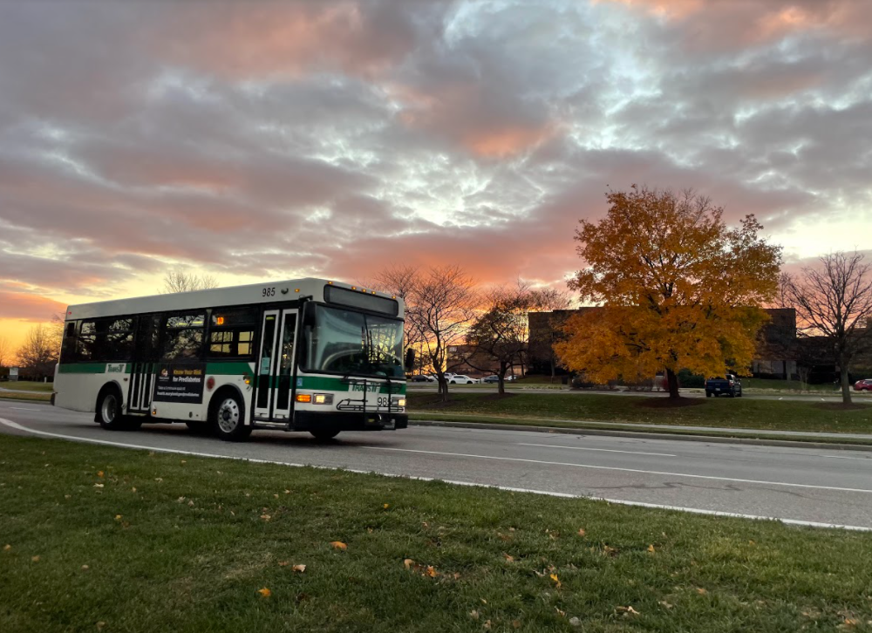
Fare-Free for Frederick

Slide 2
Who We Are
A dedicated team of award-winning professionals
Thoughtful public servants
Committed to our community

Slide 3
Driving principles
Deliver Reliable and Convenient Service
Building a Safe and Resilient Transit Environment
Re-Envisioning the Customer Experience
Invest in Our People and Our Community

Slide 4
BEFORE WE GET STARTED – a little mythbusting!

Slide 5
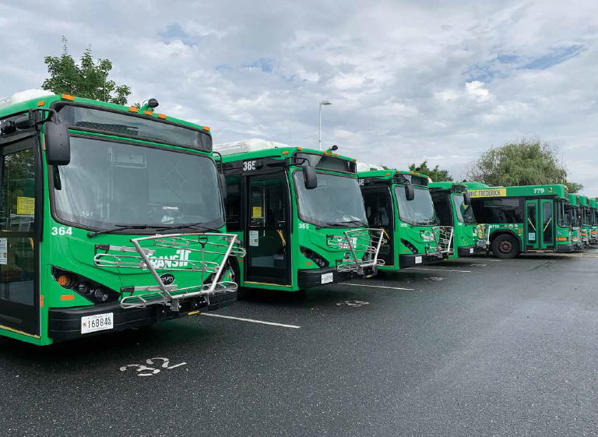
MYTH #1: Going zero-fare or fare-free will tank our budget

Slide 6
FALSE!
Thanks to the availability of federal funding, this is not an immediate issue in the short term, but could become one in the long term.

Slide 7
MYTH #2: Going fare-free is too tough to figure out

Slide 8
FALSE!
There are a lot of moving pieces, including administrative and operational, but it can be done with limited disruption.

Slide 9
MYTH #3: Customers won’t understand what fare-free means

Slide 10
SOMEWHAT TRUE! Customers understood, but often had questions about when fares would return.

Slide 11
MYTH #4: Fare-free operations will result in nondestination or problematic riders

Slide 12
FALSE! Every system has unique challenges, including challenging riders, but going fare-free (in our experience) did not exacerbate these issues.

Slide 13
MYTH #5: This won’t help ridership and is a gimmick

Slide 14
FALSE! Our ridership has continued to rebound from pandemic lows, increasing 130,000+ from FY21 to FY22.

Slide 15
Now that that’s out of the way!

Slide 16
Why did we choose to go fare-free?

Slide 17
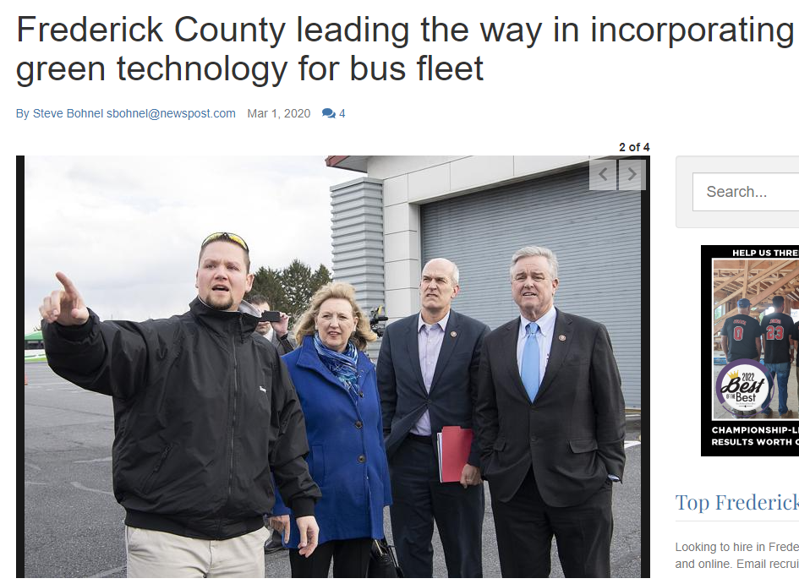
Why did we choose to go fare-free?

Slide 18
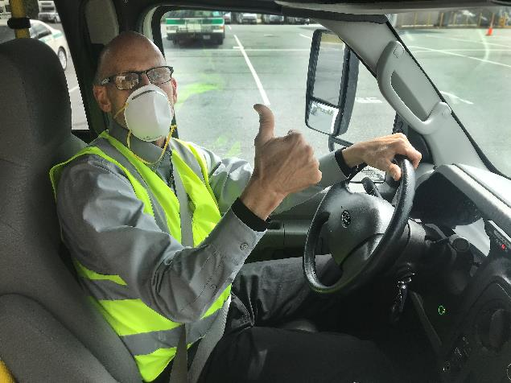
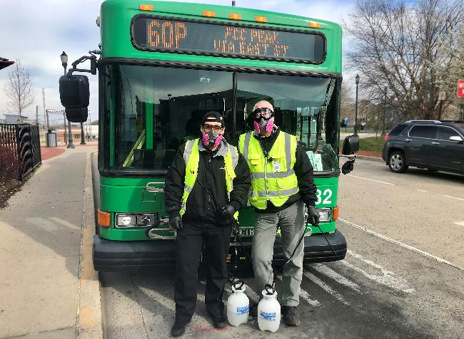
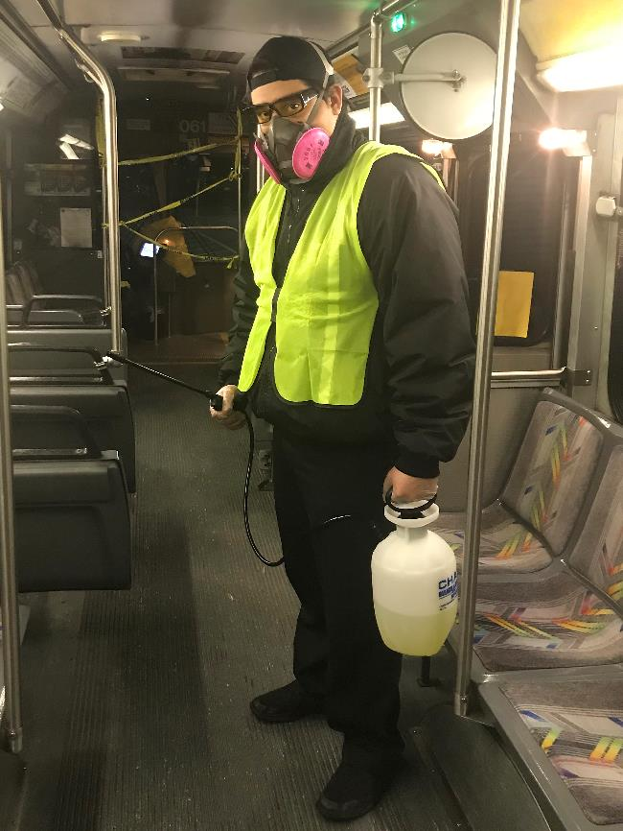
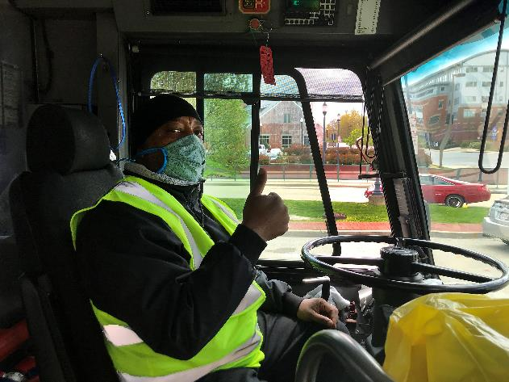
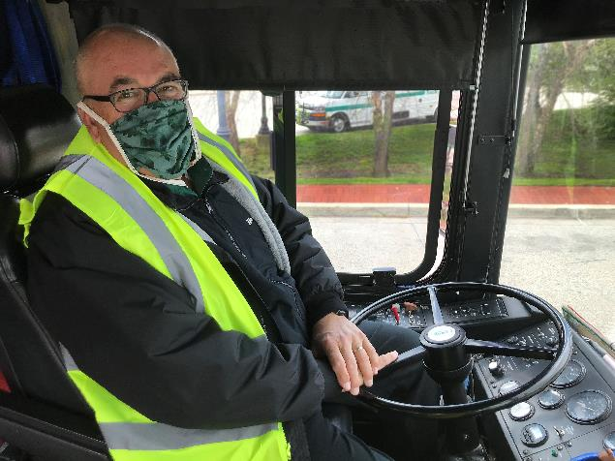

Slide 19
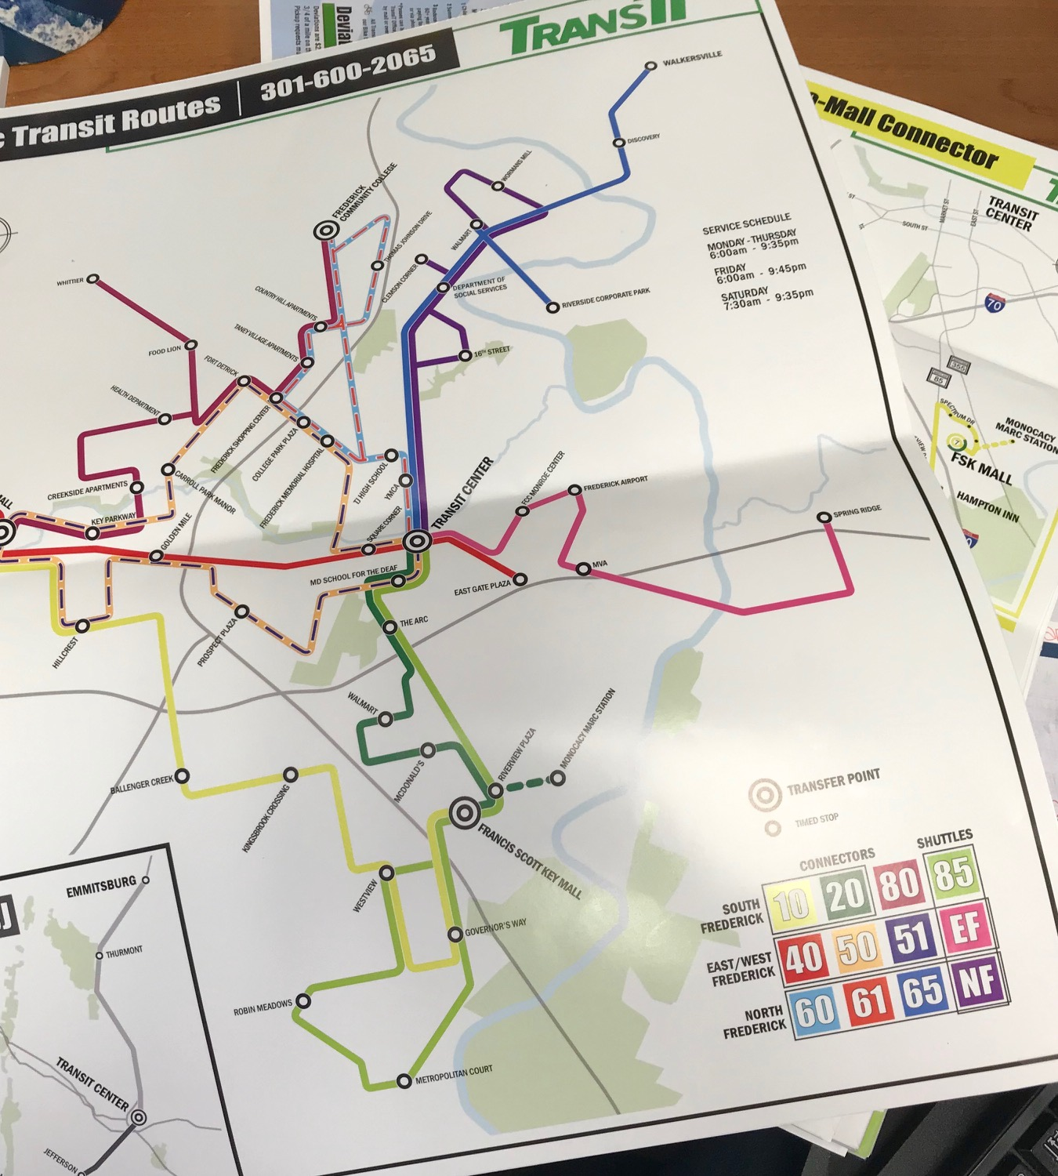

Slide 20
Policy Implications
Transit has numerous policies around fares:
-Onboard
-In the office
-Portals and ticket purchases

Slide 21
Budget Implications
There’s a lot to consider!
-Farebox recovery
-County and State funding
-Grant requests
-Long-term sustainability

Slide 22
Staff Feedback
Staff feedback has been generally positive, but mixed:
-No longer have to manage and deposit cash, coins, and digital funds
-Less energy-intensive means more time saved
-Concerns about communicating correct information to passengers

Slide 23
Conflict Reduction
Conflicts have nearly disappeared since introduction
-Transfers and fare evasion were responsible for almost all driver and passenger conflict

Slide 24
Public Perception
Transit was often seen as the option of last resort
-Fare-free operations have encouraged riders to Try Transit
-Businesses, public schools, and organizations advertise free transit on our behalf
-Transit has become easier for short-distance trips (hop on, hop off)

Slide 25
What’s next?
1040 Rocky Springs Rd, Frederick, MD 21702
FrederickCountyMD.gov/TransIT
301-600-2065 | transit@FrederickCountyMD.gov

Slide 26
Thank you! Please be in touch!
1040 Rocky Springs Rd, Frederick, MD 21702
FrederickCountyMD.gov/TransIT
301-600-2065 | transit@FrederickCountyMD.gov

