Slide 1

Small Grant Procurement
Scan Diagnostic Tool
September 22, 2022
Presented by Reanna Miller, Director of Day and Vocational Services
W

Slide 2

Guidance

Slide 3
What is needed:
Letter of Intent/Concurrence
ICE Form with justification/specification
Three Quotes
Spreadsheet for Rationale
SAM.gov Vendor Exclusion
5310 Complaint Form
5310 Complaint Procedures
Agency Procurement and Purchasing Policy
Agency Code of Ethics

Slide 4
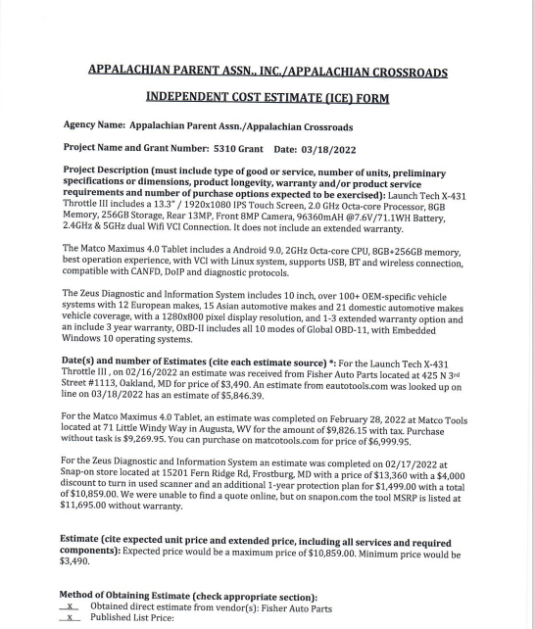
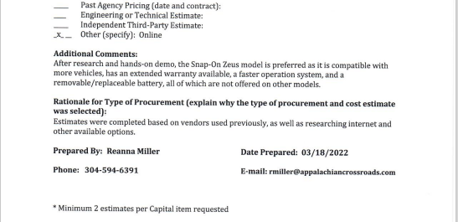
ICE Form

Slide 5
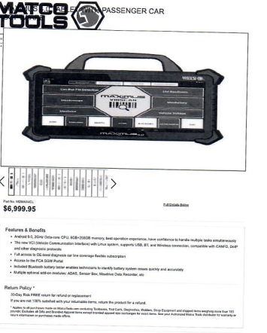
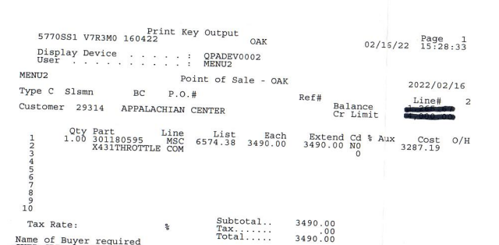
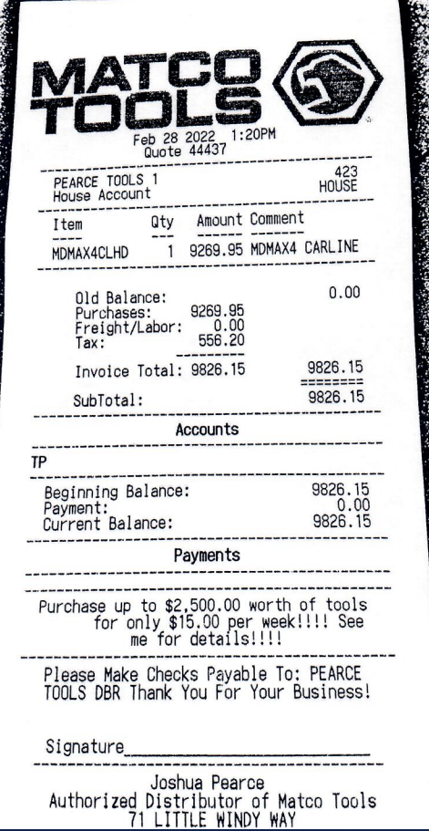
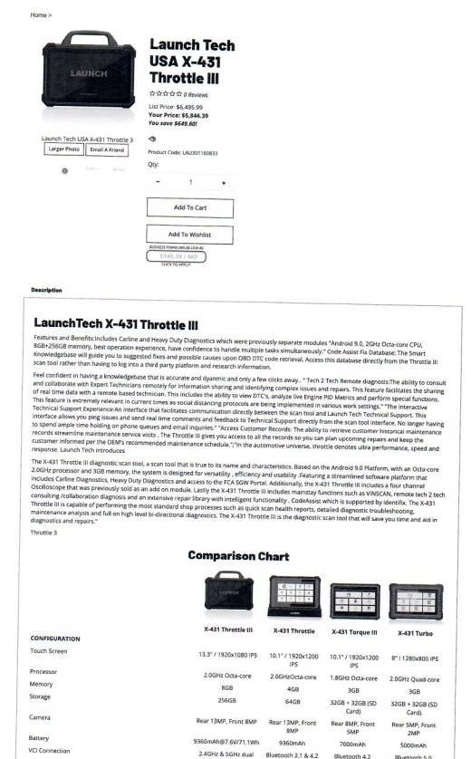
Quotes

Slide 6
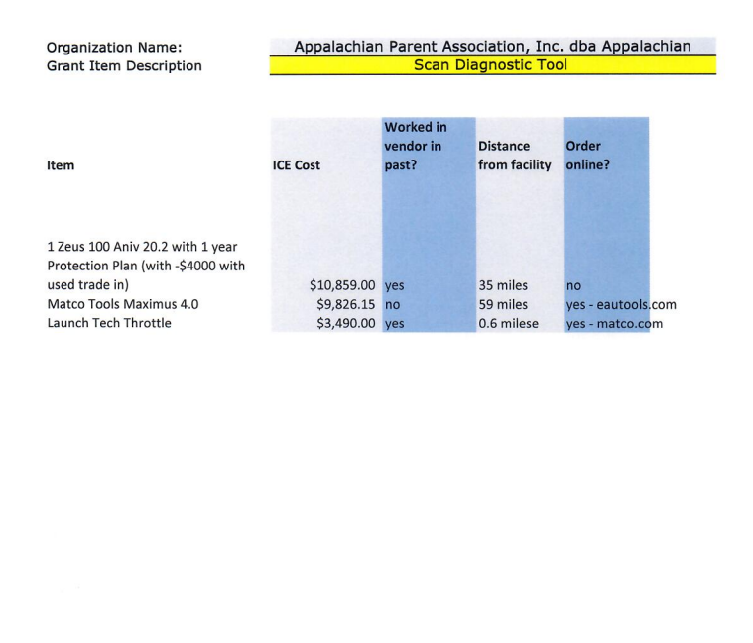
Spreadsheet – Rationale

Slide 7
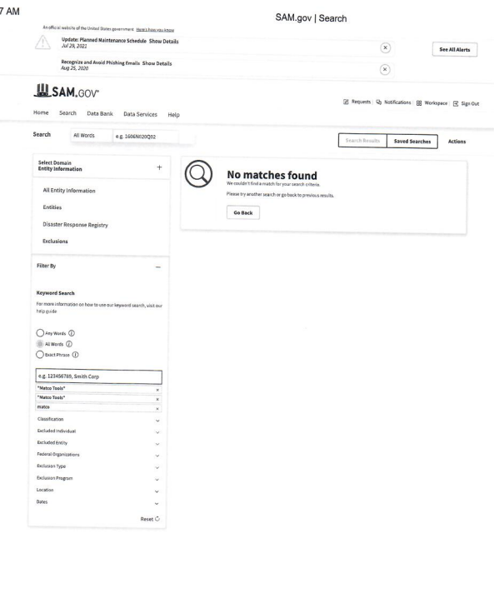
SAM.gov Vendor Exclusion

Slide 8
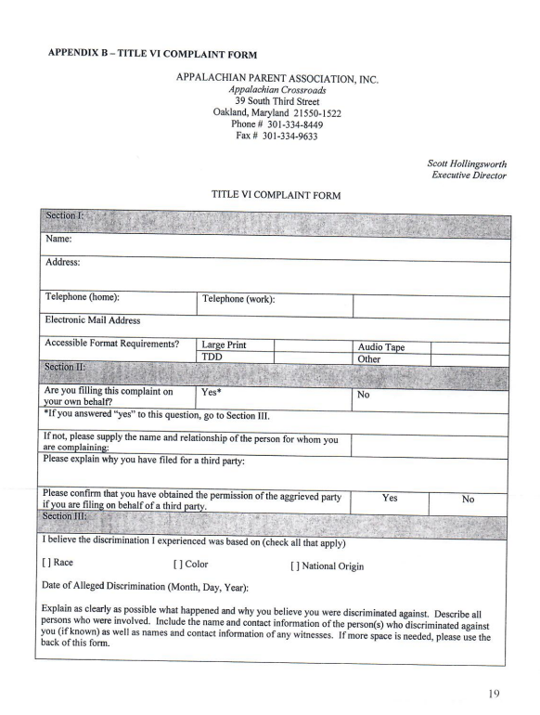
Complaint Form

Slide 9
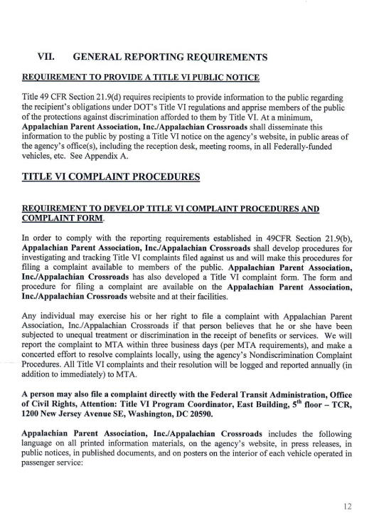
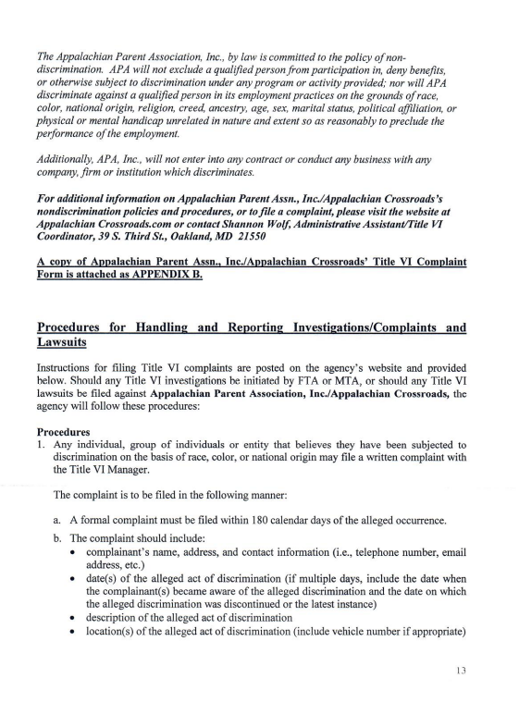
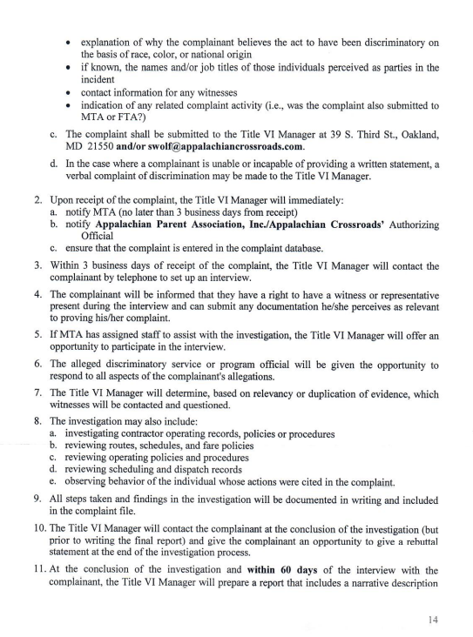
Complaint Procedures

Slide 10
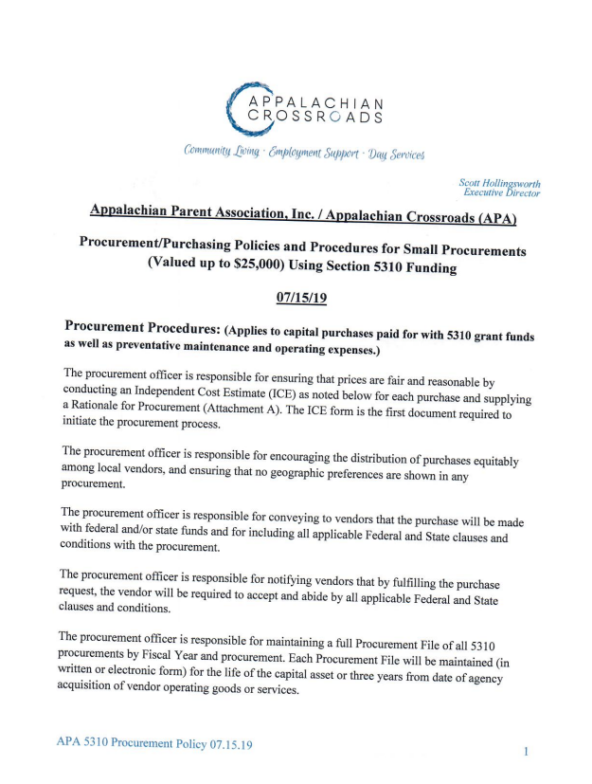
Procurement and Purchasing Policy

Slide 11
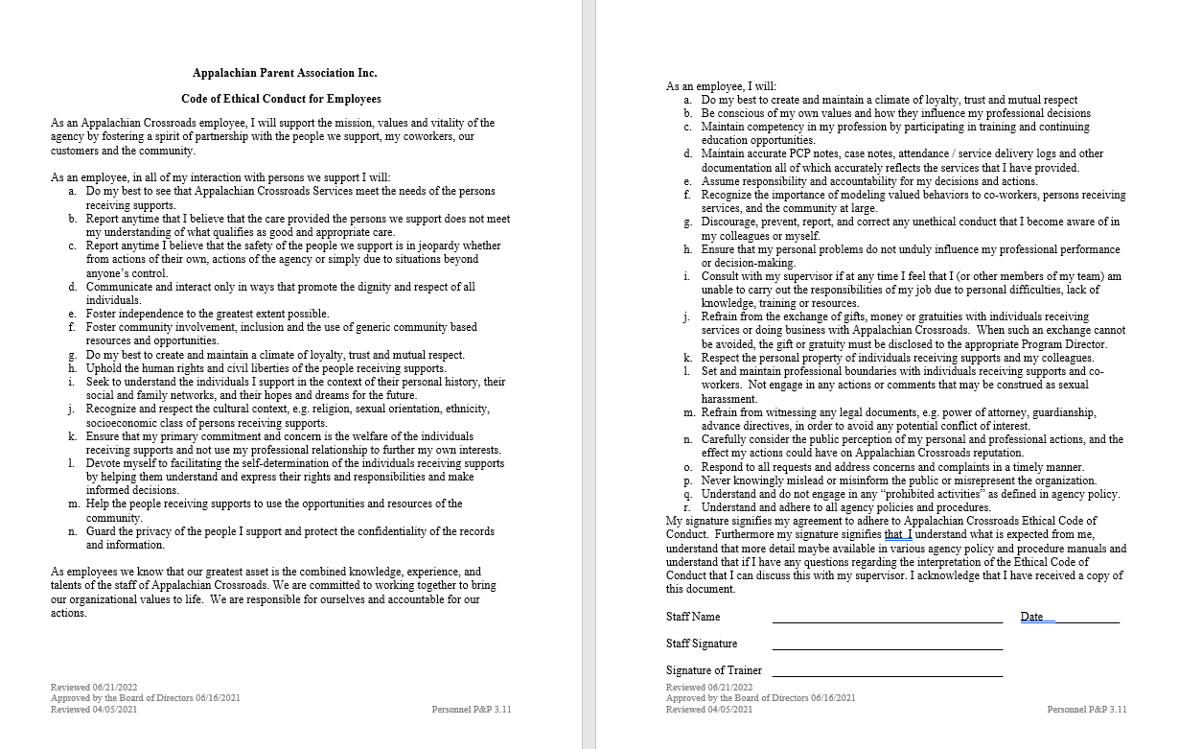
Code of Ethics

Slide 12
Conclusion
Questions and Comments

