Slide 1
Conflict De-Escalation

Slide 2
Training Objectives
Define key terms
Understand how triggers impact and escalate situations
Promote key communication practices to foster a healthy customer-focused exchange
Process responses to challenging situations through peer discussion
Discuss the importance of Response vs. Reaction

Slide 3
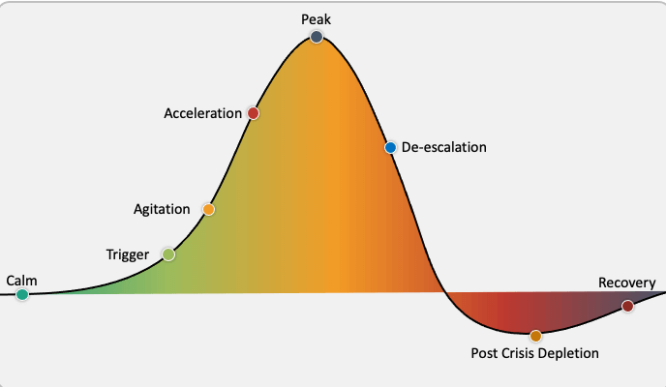
Understanding Key Terms:
Conflict:
A serious disagreement or argument, typically a protracted one.
Escalation:
To increase the intensity or seriousness of something
De-Escalation:
To decrease the size, scope, or intensity. To reduce, lessen in magnitude.
Source: Confident Counselors
Notes:
A phase of physical exhaustion and/or confusion. Not all students go through this phase, especially if the crisis episode was short and low to moderate. Some students return to their specific level of baseline.
It’s important to be able to verbalize definitions clearly and set the understanding of what is happening with an individual or individuals and the overall goal to effectively manage that situation.
Facilitator to share: “De-escalation provides the best results when implemented EARLY in the escalation phase, ideally, we try to practice prevention and avoid triggers. The higher the intensity, the more challenging to de-escalate.”
https://www.google.com/url?sa=i&url=https%3A%2F%2Fconfidentcounselors.com%2F2018%2F01%2F11%2Fde-escalation-strategies%2F&psig=AOvVaw2uoRz0O0YSWEujDmQYZEc5&ust=1610746871428000&source=images&cd=vfe&ved=0CA0QjhxqFwoTCNj8leuxnO4CFQAAAAAdAAAAABAU

Slide 4
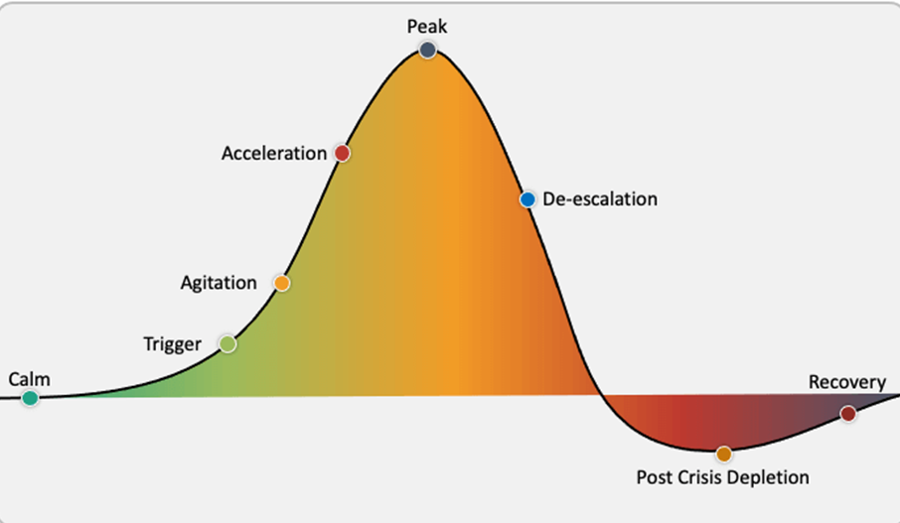
What is a trigger?
Notes:
“What is a trigger?”
After a few responses from the audience, click on the screen.
Next slide appears with cycle and definition.

Slide 5
What is a trigger?
Cycle of Anger
Triggering Event
Negative Thoughts
Emotional Response
Physical Symptoms
Behavioral Response
A trigger is something that sets off a memory tape or flashback transporting the person back to the event of his/her original distress.
Notes:
Triggers are very personal; different things trigger different people.
A person’s triggers are activated through one or more of the five senses: sight, sound, touch, smell and taste. We all have them.
Discussion
Have you ever been somewhere and had a strong smell of buttery popcorn? Just a smell – do you have an automatic response? Mouth water? Maybe feel a bit hungry? What is it? What did you think about? Where did that smell take you? This, for many, would be a positive trigger.
There are some who do not like buttery popcorn and that automatic response may be negative. This is one way to describe triggers/responses and automation.
Emotional triggers such as shame, depression, inadequacy, fear, irritation, loneliness, hate, guilt or anxiety can come about quickly (automatically), just like the popcorn smell/response.
It’s, important for all of us to understand our own triggers. From an employee standpoint this can show up how?
Listen for:
Withdrawing
Passive aggressive behavior
Inability to communicate face to face
Gossiping
Criticism
Uncertainty of how to approach someone
Sarcasm
“please share a few examples of triggers you may have or have encountered in others(without names).”
If needed to share: Example: Calling a phone company to get information regarding your bill. You are placed on hold for several minutes and then the phone disconnects? Trigger anyone? We all have triggers.

Slide 6
Exercise
What are common triggers for passengers?
What are common triggers for employees?

Slide 7
Emotional Charge: Aggression
Why?
What’s happening when a person shows signs of escalation?
What are visual signs?
Rapid Breathing
Wide Eyes
Rapidly Shifting Mood
Restlessness
Response to feeling threatened, scared, or hurt
Displaced anger
Anger is a feeling or response to a perceived negative situation
Contributors can be: frustration and fear
Notes:
To discuss these techniques, first we need to learn and address the WHY?
* what’s happening when a person is showing signs of escalating
* why is the person escalating?
Discussion – facilitator ask: “Why do people escalate?”
What could be contributing to aggression/anger?
Have participants list some of the events that may contribute to the aggression. Capture on 3M or chat box or note pad online
Listen for:
Family issues
Physical pain
Personal unresolved issues
Interpersonal conflict
Irrational thoughts/behaviors
Personality
Loss
Facilitator ask: How can we see the escalation? What are visual signs?
Rapid breathing
Wide eyed
Rapidly shifting mood
Staring into eyes in a challenging way
Frustrated or angry facial expressions
Restlessness, inability to sit still
Running hands through hair, tapping fingers, banging on walls
Facilitator ask: Do you feel yourself ‘escalating a bit or getting anxious’ thinking about situations and answering these questions? One key is to realize how you are impacted by these situations as well.

Slide 8
Understanding De-escalation
Communication Is Key
Stay calm
Listen
Manage your response
Set limits
Handle challenging questions
Prevent a physical confrontation
Communication Barriers
Pre-judging
Not listening
Criticizing
Name calling
Engaging in power struggles
Ordering
Threatening
Minimizing
Arguing
Notes:
Communication is key and de-escalation techniques should be viewed from the individual, team and organizational level. It goes beyond the individual level.
Supporting one another through effective communication practices is critical. Remember effective communication starts with Listening for verbal cues, looking for visual and nonverbal cues, as well as what's in writing (texts, slac, emails).
This applies to both internal and external customers.

Slide 9
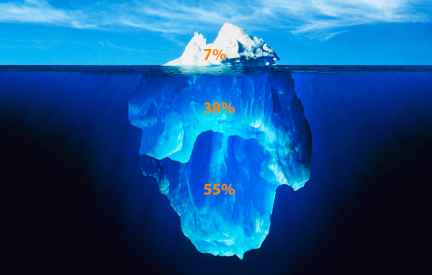
7 - 38 - 55 Rule of Communication
Notes:
7-38-55 rule of negotiation and communication
Share with the group that this is a guide of %’s on “how we may most likely hear or receive information.”
One of these #’s represent tone of voice,
one represents body language,
and one represents words.
Can you share which you think is which and Why?

Slide 10
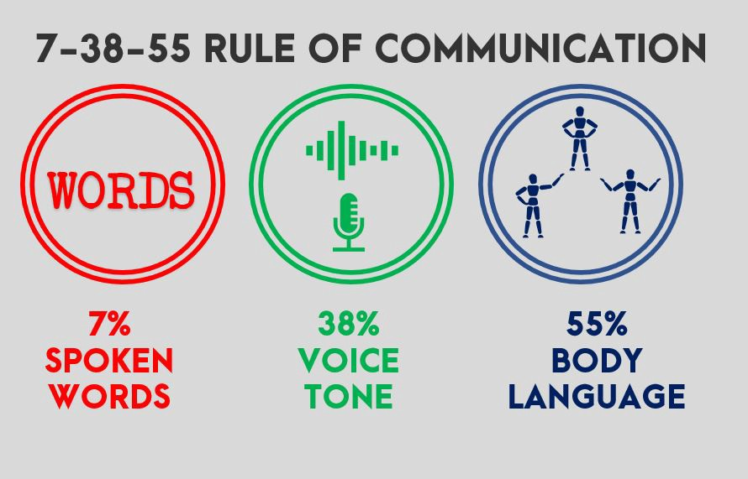
It’s Not Only What You Say, It’s How You Say it
How you frame and deliver your message means more than the words you choose.
Notes:
The rule states that 55 percent of meaning is communicated through body language, 38 percent through tone of voice, and 7 percent spoken word.
Onsite event: Look around the room right now – what do you see? What are the non-verbals?
Online event: Look at those cameras, – what do you see? What are the non-verbals? If folk don't have their cameras on – now is a great time to do so. We are missing all of your body language.
Body language is so strong - It’s not what you Say, It’s How you say it.
And only 7% are the actual words you are using – important, but tone of voice and body language are focal points.
All three categories on this slide impact overall health and can impact the health of your organization as you impart de-escalation techniques.
Facilitator Asks: If 7% comes from actual words – do you need to re-think how effective emails, texts are? How about phone calls? If its’ important face to face (either in person or through technology) with Body Language, Tone, and Words may be the most successful opportunity.
All three categories on this slide impact overall health and can impact the health of your organization as you impart de-escalation techniques.
https://www.masterclass.com/articles/how-to-use-the-7-38-55-rule-to-negotiate-effectively#what-is-the-73855-rule
https://www.eiagroup.com/communication-formula/
Data from Dr. Mehrabian study (1967)
Van Vliet, V. (2012). Communication Model by Albert Mehrabian. Retrieved February 2016 from ToolsHero: http://www.toolshero.com/communication-management/communication-model-mehrabian/

Slide 11
De-Escalation
1. Move to a private area.
2. Be empathetic and nonjudgmental.
“Focus on understanding the person’s feelings. Whether or not you think those feelings are justified, they’re real to the other person.” 3. Respect personal space.
“If possible, stand 1.5 to three feet away from the person . . . “ 4. Keep your tone and body language neutral.
5. Avoid over-reacting.
“Remain calm, rational, and professional.”
6. Focus on the thoughts behind the feelings.
7. Ignore challenging questions.
8. Set boundaries.
9. Choose boundaries wisely.
10. Allow silence.
11. Allow time for decisions.

Slide 12
Exercise
Work with 2 or 3 around you
Identify areas that may cause passenger frustrations
Identify ways to reduce these frustrations
are they reactions or responses?

Slide 13
Reaction:
Louder, defensive
Emotions increase (e.g., yelling, crying, agitation)
Pacing, not settled
Response:
Hi Sam. My name is Kelly and I’m here to help.
Tell me more so I can better understand what we can do to help you right now.
I can’t understand what you need when you are shouting, but I do want to hear you out.
That sounds like…or I imagine that is very difficult…
Notes:
What do you notice about the Response side? What stands out to you?
Listen for here to help, “we”, l care and want to her you, this sounds like, I can see, or I can imagine”
Appropriate de-escalation interventions seek to understand the individual, his or her unique circumstances and how that individual’s personal preferences and goals can be maximally incorporated in the crisis response.
Let’s practice more in the next discussion section.

Slide 14
Exercise
A proactive approach focuses on eliminating problems before they have a chance to appear, and a reactive approach is based on responding to events after they have happened.
Work with the 2 or 3 around you - think of your local rules:
Detail out 3 items/areas of concern or potential concern in your local policy, problem passengers, or work areas.
Create 2 solutions to proactively respond.

Slide 15
Proactive Versus Reactive Techniques
Remain calm -- Listen – really listen!
Validate!
Remove onlookers -- or relocate to a safer place.
Be sensitive to non-verbal clues or threats.
Bring in another trained colleague to assist whenever possible.
Do not tell someone how they feel.
It’s okay to set boundaries.
Utilize a calm, even, and confident tone.
Notes:
Trainer Notes:
Whenever organizations can have a proactive plan versus a reactive plan – the outcomes are generally better.
Imagine you are in a situation where a Customer is very frustrated with you, their annoyance level is increasing, and the volume of their voice is getting louder. Have participants take a few seconds to read the bulleted points and ask:
What on this list resonates?
What has worked that someone can share an example of?
What didn’t work despite efforts?

Slide 16
De-escalation Techniques
Do:
Ensure safety first: Evaluate exits, potential hazards, points of entry
Avoid the hold button, when possible
Offer options/choices and follow up
Repeat information for clarity and understanding
Show value to the person through listening and empathize
Seek support from others where needed
Don’t:
Engage in a power struggle
Become rigid in your process or protocols
Raise your voice, cuss, intimidate or
give ultimatums
Tell the person you know how they
feel
Make promises you can’t keep
Take the situation personal
Notes:
If you have time, have a different person read each of the D0’s and Don’ts outload.
Interesting note – did their tone or body language change as they read them?
Special note: if you are in person with de-escalation:
Ensure a safe (personal space) distance is maintained
Adopt an open body posture

Slide 17
Know Your Resources
Safety First:
Organizational and Departmental Processes/Protocols
Your Leadership Team/Supervisor/Peer Support
911/Police
Security
Human Resources
Employee Assistance Program (EAP)
Notes:
An escalated situation is not easy. Remember to lean on team members/leadership for support/feedback.

Slide 18
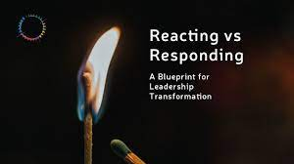
Organizational Strategies
Provide education around conflict, escalation, and de-escalation
Be available/make time to discuss triggers – specifically to areas, routes and changes made on employees' behalf
Practice responses – set 10-15 minutes aside and review regularly
Designate “regular time” to discuss passenger frustration and employee frustration – walk away with solutions
Work to find proactive solutions to situations you believe will arise

Slide 19
Questions ?
Thank you !

