Slide 1
FY2023 5310 Briefing Responsibilities and Obligations
September 22, 2022
Presented by:
Nancy Huggins, MDOT MTA OLTS
Designed for 5310 recipients’ new staff
or a refresher for current staff

Slide 2
Housekeeping Notes
WiFi Information –
Network: CBBC
Password: beachclub
Please Silent Phones
Restrooms
Notes:
Provide the WiFi info
Handouts will be uploaded to ProjectWise in the Reference Section in the appropriate folder.

Slide 3
FY2023 5310 Briefing
Responsibilities and Obligations
Procurement of goods and services
ProjectWise Refresher – although new for some

Slide 4
Agenda for this Afternoon We will review the following:
Terminology
5310 description
Fiscal Year
5310 Manual
Funding types
Requests for Payment
Payment Process
Quarterly Reports
Title VI
ProjectWise

Slide 5
Terminology
FTA: Federal Transit Administration
MDOT: Maryland Department of Transportation
MTA: Maryland Transit Administration
OLTS: Office of Local Transit Support
Section 5310: Enhanced Mobility of Seniors & Individuals with Disabilities
MM: Mobility Management
PM: Preventive Maintenance
Match: Federal and/or Local share required for grant
FY: Fiscal year
RFP: Request for Payment
Notes:
(please note: for FY22/23 NO Local Match is required!)

Slide 6
Responsibilities and Obligations
What is 5310 again?
MDOT MTA 5310 Program
The program purpose is to improve mobility for seniors and individuals with disabilities by removing barriers to transportation service and expanding mobility options.
FTA 5310 Circular: FTA C9070.1G

Slide 7
Responsibilities and Obligations
What is fiscal year?
Fiscal year is the year used for taxing or accounting purposes
MDOT MTA follows the fiscal year of July 1 to June 30
Your agency’s fiscal year may follow the calendar year of January 1 to December 30
The FTA follows the Federal fiscal year of October 1 to September 30
Notes:
The fiscal year is the year used for taxing or accounting purposes
How many organizations go by January to December?
MDOT MTA follows the fiscal year of July 1 to June 30 – that is why your grants began with a July 1 date.

Slide 8
Responsibilities and Obligations
5310 Manual
Let’s take a look at the 5310 Manual which is your ‘bible’ for this grant. Well at least the table of contents.
It can be found on the TAM website under Resources/Office of Local Transit Support
Recommend downloading PDF to your desktop
Notes:
The fiscal year is the year used for taxing or accounting purposes
How many organizations go by January to December?
MDOT MTA follows the fiscal year of July 1 to June 30 – that is why your grants began with a July 1 date.

Slide 9
Difference between Capital and Operating Expenses
Capital Grant 80% Federal/20% Local Match
Expenses mostly associated with tangible items (except MM):
Equipment (Vehicles)
Equipment (non-vehicles e.g. computers)
Preventive Maintenance
Other items such as PPE
Mobility Management
Operating Grant
50% Federal/50% Local Match
Expenses used for operating the vehicle including
Driver Salaries
Dispatch Salaries
Fuel & Oil
Vehicle Insurance
Etc. (look at your budget from grant application)
Please note - for the FY2022/2023 5310 grant cycle, no local match is required.


Slide 10
Request for Payment
There are two types of Request for Payment Forms – one for Capital and one for Operating
Depending on the type of grant(s) you have, the request for payment form was attached to the grant agreement
Important information that should be on your request for payment form:
Grantee Name
Federal ID Number
(Grant) Project Number
Address

Slide 11
How to Complete the Request for Payment Form
To begin – you need to have added and copied each expense you have spent in the quarter that you are requesting payment for.
You will use the allowable paid expenses to show the amount you are requesting.
You need to use the correct request for payment form.
You will need to use the correct project number for the grant your agency received.
FY2022 Operating = FY22-O5310
FY2022 Capital = FY22-C5310
After completing the Request for Payment, sign it and upload it to ProjectWise with copy of back-up documentation (budget, receipts, etc. for each invoice for operating or capital)

Slide 12
Request for Payment - Capital
Important information that should be on your Capital Request for Payment form:
Capital Program Outlays
Financing of Net Project Cost
Federal Share
Local Share
Local Overmatch
Requested Payment
Name, Signature, Title, Date

Slide 13
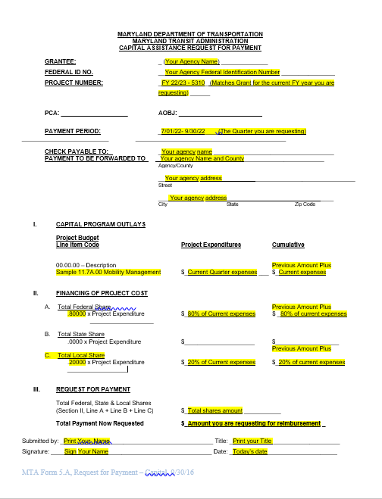
Capital Request for Payment Form

Slide 14
Request for Payment - Operating
Important information that should be on your Operating Request for Payment form:
Revenue and Expense Summary
Financing of Net Project Cost
Federal Share
Local Share
Local Overmatch
Requested Payment
Name, Signature, Title, Date

Slide 15
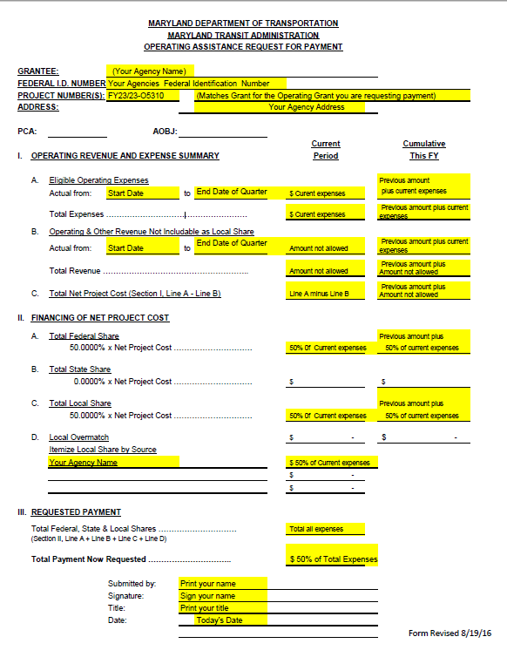
Operating Request for Payment Form

Slide 16
Required Back Up Documentation with Requests for Payment
Operating
Salary information or each person being requested reimbursement for (payroll record sufficient)
Fuel/Oil receipts
Etc. follow your application budget
Capital
Receipts for items purchased (e.g. computers, PPE, etc.)
Receipts for preventive maintenance, supplies
Note: PM is for 5310 vehicles only
If appropriate, the compliance letter from MDOT MTA
Quarterly Reports
Each quarters you will prepare your quarterly report and submit it to your program manager

Slide 17
Payment Process
Submit quarterly request for payment and back up documentation no later than 30 days after the close of the quarter.
Quarters for Fiscal Year are:
Q1 is July 1 to September 30
Q2 is October 1 to December 31
Q3 is January 1 to March 31
Q4 is April 1 to June 30
Program Manager will review and get back with questions and/or issues – do not hear anything assume all is well
After program manager reviews and approves, request goes through two more checks within OLTS

Slide 18
Payment Process - Continued
The approved Request for Payment is submitted to MDOT MTA Capital Programming for final review/approval
Then it is submitted to Finance for Payment
Typically the payment is done electronically from MDOT MTA to your agency
The entire process takes approximately 30 days after program final invoice is approval by MDOT MTA OLTS
Please remember that during the month of July there may be a delay due to the end of the year processes.

Slide 19
Quarterly Reports Must be completed if you have current 5310 vehicles regardless if you have a current operating or capital grant or not.
Section 5310 Quarterly Reports are due no later than 30 days after the end of the quarter.
These reports provide the 5310 Program Manager with information regarding the use of your 5310 vehicles for each quarter.
The Program Manager tracks the ridership for each quarter/year.
Title VI Reports are due no later than 30 days after the end of the quarter.
The 5310 Program Manager tracks the report information and stores the reports in ProjectWise should the FTA wish to review.
Should a report come in with a violation, then it is reported to the MDOT MTA Office of Compliance and agency should follow up with Program Manager
Quarterly Reports are due no later
than 30 days after the Quarter

Slide 20
Quarterly Reports
Page One
Page Two
Quarterly Reports are due no later
than 30 days after the Quarter

Slide 21
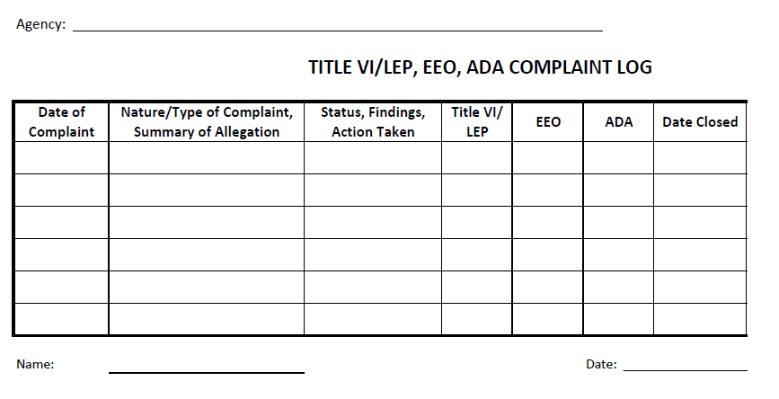
Title VI
Title VI Plans
2021-2023 Plans – still under review and you will be notified as the process moves forward.
Agencies new to 5310 or those agencies that did not submit one yet will need to complete a Title VI Plan - the 5310 Manager will be in touch with you.
Title VI Reports are due when you submit your quarterly report
Sample Title VI Report

Slide 22
Very Brief Look At ProjectWise
ProjectWise is a data collection tool that is used by MDOT MTA.
ProjectWise is a Windows application, like Microsoft Word or Excel.
The program needs to be installed on your computer by the person who has the local administrator privilege. If you have a computer where you have installed any window applications, you should be able to install ProjectWise. You may need your agency’s IT support staff to help.
Please contact Nancy Huggins, nhuggins@mdot.maryland.gov, if you need the ProjectWise installation instruction document.
You also need to log into ProjectWise with the username and password created for you. We have created the user accounts for the Non-Profit (5310) and Senior Ride recipients. If you need the username and password, Nancy Huggins has that information.

Slide 23
Some examples of the accounts are shown in the following screenshot:
The prefix of the username is either 5310 or SR based on the type of funding you manage. If you receive both 5310 and Senior Ride funding, your username with start 5310.

Slide 24
Logging into ProjectWise
Let’s take a quick look at Project Wise!
Works just like you are in your computer files system.
There are folders to store documents
You can click, move and drop from your computer into ProjectWise.
The only thing asked it if you drop a report/request for payment into ProjectWise that you let the program manager know via email.
If you need the ProjectWise installation instructions and workbook, send Nancy Huggins an email request.
Notes:
Raise you hand if you would like a formal training class on ProjectWise

Slide 25
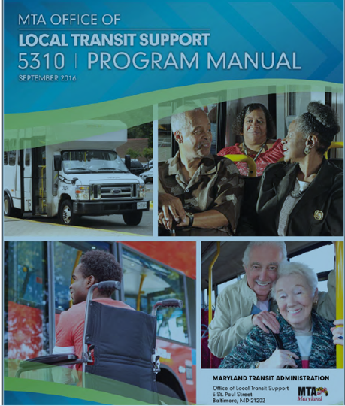
This concludes this Brief Overview of the 5310 Program

Slide 26
General Questions???
? ? ?

Slide 27
Need additional assistance? Nancy Huggins 5310 Program Manager MDOT MTA OLTS nhuggins@mdot.Maryland.gov 410-767-8356

