Slide 1
FY2023 5310 Briefing
FY2024/FY2025 5310
Enhanced Mobility for Seniors and
Individuals with Disabilities
September 22, 2022
Presented by:
Nancy Huggins, MDOT MTA OLTS
Notes:
Introduce self, if needed

Slide 2
Housekeeping Notes
WiFi Information:
  Network: CBBC
  Password: beachclub
Please Silent Phones
Restrooms
Notes:
Provide the WiFi info
Where are restrooms

Slide 3
WELCOME
Agenda for this Morning
Introductions
Terminology
Hints for Grant Writing
5310 Grant Review – Part I, Part II and Part III
Notes:
Have participants introduce themselves by name, agency and area (either county or region)

Slide 4
Terminology
FTA: Federal Transit Administration
MDOT: Maryland Department of Transportation
MTA: Maryland Transit Administration
OLTS: Office of Local Transit Support
Section 5310: Enhanced Mobility of Seniors & Individuals with Disabilities
MM: Mobility Management
PM: Preventive Maintenance
Match: Federal and/or Local share required for grant
FY: Fiscal year
RFP: Request for Payment
Notes:
(please note: for FY22/23 NO Local Match is required!)

Slide 5
10 Tips for Grant Writing
Reference in ProjectWise:
01-OLTS-SR-5310-References\Grant Writing Information*
Ensure Eligibility
Is grant opportunity aligned with your mission
Read and follow the instructions
Do not miss any deadlines
Use your time wisely
Be concise and accurate with information
Create the budget
Plan for cash match
Use the checklist provided
Have someone read grant application to make sure it is understandable
*ProjectWise Grant Writing Information also has a 2019 presentation on 5310 grant writing, you may wish to review
Notes:
Besides a general Grant Writing Tips document, you also may want to review on ProjectWise Grant Writing Information the 2019 presentation on 5310 grant writing

Slide 6
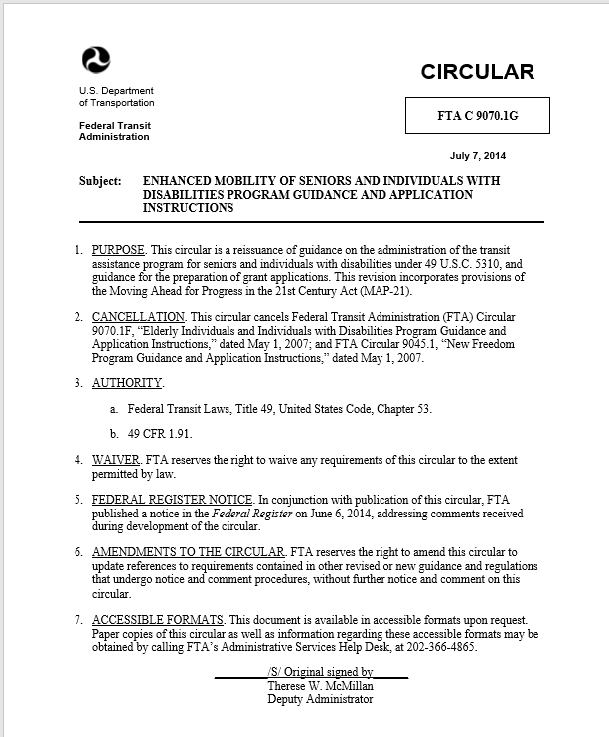
What is 5310?
A Federal Program – Section 5310
Enhanced Mobility for Seniors and Individuals with Disabilities
MDOT MTA 5310 Program
The program purpose is to improve mobility for seniors and individuals with disabilities by removing barriers to transportation service and expanding mobility options.
FTA 5310 Circular: FTA C9070.1G

Slide 7
NOW, Lets look at the
5310 Grant Application
    The application can be found on the TAM website:
      https://www.taminc.org/5310-grant
    First Deadline is October 28, 2022
    Second Deadline is November 28, 2022
    Final Submission Deadline:
      The 5310 Human Services Grant application Parts II and Part III plus corresponding documentation will be submitted electronically via the MDOT MTA Grant Application Portal (https://mtaolts.ecopwise.com) no later than January 20, 2023 at 4:00 pm.
    Calling up the application on the TAM website.
Notes:
Before we start:
The application can be found on the TAM website in three parts – Part I, Part II and Part III
Note the deadlines

Slide 8
Buses/Vans
Bus/Van Order Forms and Floor Plans can be found on the TAM website https://www.taminc.org/5310-grant
If you have questions about bus or van configurations, please contact either Jason Kepple, MDOT MTA OLTS Bus/Van expert at jkepple@mdot.maryland.gov or the vehicle manufacturer.

Slide 9
General Questions on the
5310 Grant Application?
? ? ?

Slide 10
Need additional assistance?
Nancy Huggins, 5310 Program Manager, MDOT MTA OLTS nhuggins@mdot.Maryland.gov
Jason Kepple, 5310 bus/van information, MDOT MTA OLTS jkepple@mdot.Maryland.gov

