Slide 1
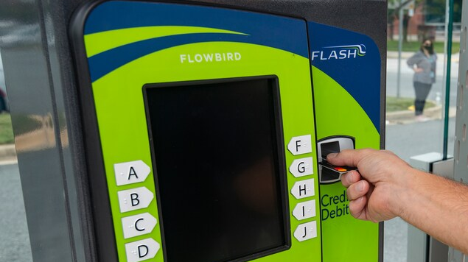


MCDOT Fare Study
September 21, 2022

Slide 2
Definition of Alternatives
Fare Alternative | Definition
A | Zero-fare for all riders (all day, every day)
B | Zero-fare for all riders (weekends & holidays)
C | Extend reduced fare to all riders (reduced from $2.00 to $1.00)
D | Means-tested fare policy (50 percent discount for users under 200 percent Federal poverty level)
Note: Each alternative includes zero-fare for seniors and youth, all day, every day.

Slide 3
Fare Study Elements
The case for zero and reduced fares was explored through:
  Socioeconomic comparisons between the County’s population and Ride On customers
  The fare policies of peer agencies in relation to their operational and financial statistics
Fare alternatives were measured against:
  Equity
  Fiscal Impact
  Ridership Impact
  Customer Experience
  Transit Operations and Performance
  Fare Program Administration, Collection, and Enforcement
  Climate and Sustainability
ANALYSIS
CONSIDERATIONS
Local and Regional Implementation Factors
Peer Agency Experiences and Precedents for Zero and Reduced Fare Programs
Pre- and Post-COVID Impacts on Transit in Montgomery County

Slide 4
Ride On vs County-Wide Income Distribution
For a household of two adults and one child in Montgomery County (county average household size is 2.8) a combined income of $69,826 is required to sustain financial independence
(Source: MIT Living Wage Calculator)
Median = $35,000
Median = $108,000

Slide 5
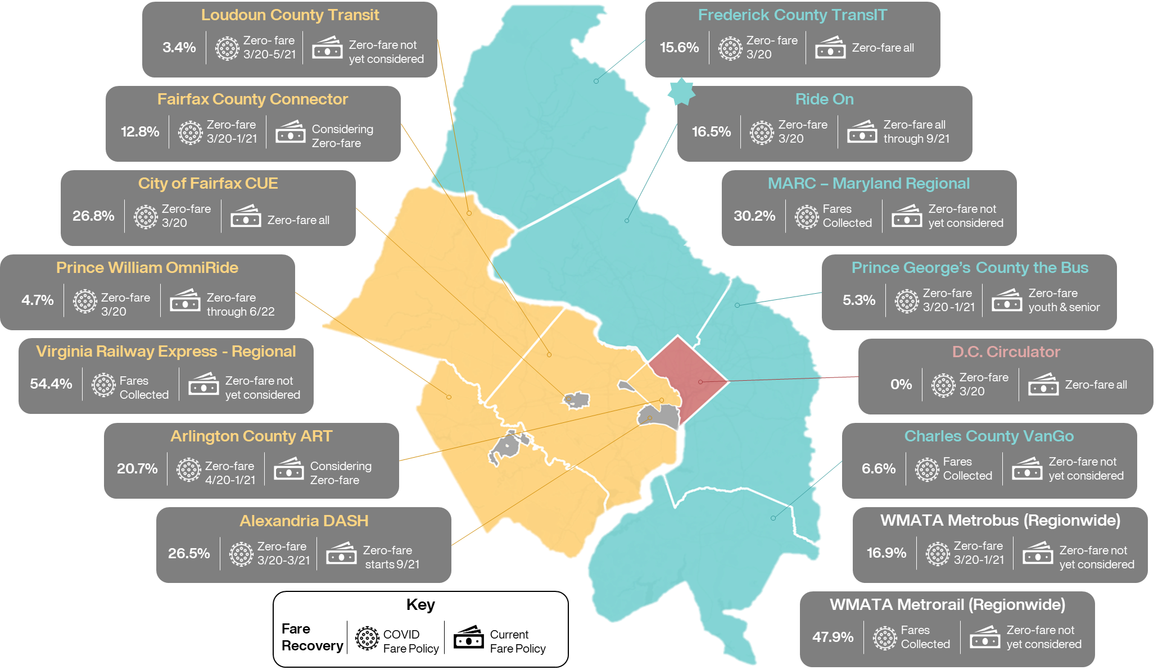
Washington Region Fare Policy
Notes:
This is a comparison of transit agencies in the region and their fare policies

Slide 6
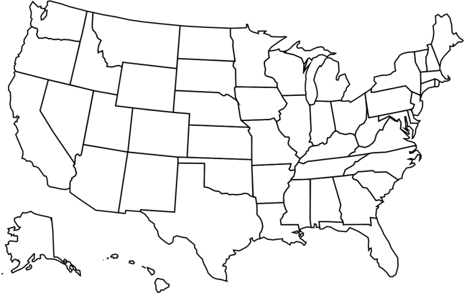









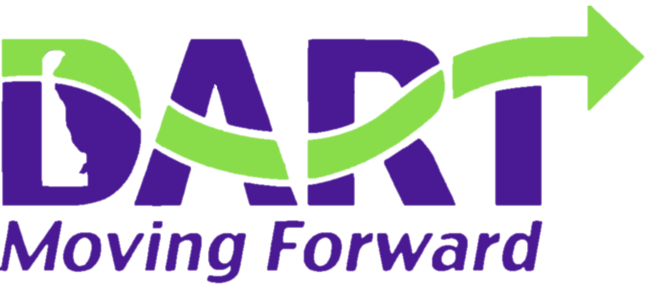












Ride On Operational Peers
Ride On peer agencies were determined by analysis of key operating and financial metrics for their bus networks, including:
  Bus fleet size
  Annual boardings
  Average bus occupancy
  Fare recovery
  Fare revenue per
  passenger-mile
Notes:
This is a comparison of 22 agencies with similar in fleet size, boardings, passenger miles and fare recovery impacts

Slide 7
Ride On Operational Peers
Ride On peer agencies were determined by analysis of key operating and financial metrics for their bus networks, including:
  Bus fleet size
  Annual boardings
  Average bus occupancy
  Fare recovery
  Fare revenue per
  passenger-mile
UTA
Salt Lake City, UT
Income-based discount
Initiated June 2021
RTD
Denver, CO
Income-based discount
Initiated July 2019
KCATA
Kansas City, MO
Zero-fare for all
Pilot initiated Mach 2020
Committed thru 2023
SamTrans
San Mateo, CA
Income-based discount
Initiated January 2021
Of these 22 agencies:
  Three (3) have implemented an income-based fare discount
  One (1) has implemented zero-fare for all riders
  One (1) is in the process of implementing zero-fare for all riders
ABQ Ride
Albuquerque, NM
Zero-fare for all
Pilot pending city approval
Proposed commitment thru June 2022

Slide 8
Income & Cost of Living Among Peers
SamTrans (San Mateo, CA)
Median Household Income
(County Population)
Income-Based Discount
Agencies serving populations with lower income or higher cost of living may feel more pressure to explore zero-fare policies, while agencies serving populations with higher incomes may feel a need to look at more targeted means-tested policies to provide relief to lower-income customers while maintaining fare revenues from more affluent riders.
Zero-fare (implemented)
Zero-fare (pending)
Ride On (Montgomery, MD)
Agency | County | Median Income | Income for Financial Independence¹ | Cost-Burdened Households | Fare Policy
SamTrans | San Mateo, CA | $122,641 | $102,860 | 36.3% | Income-based discount
Ride On | Montgomery, MD | $108,820 | $69,826 | 32.1% | TBD
UTA | Salt Lake, UT | $74,865 | $61,116 | 27.3% | Income-based discount
RTD | Denver, CO | $68,592 | $67,923 | 34.6% | Income-based discount
KCATA | Jackson, MO | $55,134 | $60,447 | 29.0% | Zero-fare (implemented)
ABQ Ride | Bernalillo, NM | $53,329 | $58,605 | 32.2% | Zero-fare (pending)
¹For a family of two adults and one child
UTA (Salt Lake, UT)
RTD (Denver, CO)
KCATA (Jackson, MO)
ABQ Ride (Bernalillo, NM)
Notes:
Interestingly, the agencies and governments serving populations with higher incomes may be more financially capable of sustainably implementing zero-fare policies. In relation to these peers, Ride On is once again more closely aligned with agencies that have implemented means-tested policies.

Slide 9
Comparison of Alternatives
Goal | Measure | Alternative A Zero-Fare All | Alternative B Zero-Fare Weekend | Alternative C Half-Fare All | Alternative D Half-Fare Means-Tested
Equity | Magnitude of benefit to lower-income riders | High | Marginal | Moderate | Moderate
 | Increased annual boardings from riders without vehicle access | 1.52M | 0.34M | 0.75M | 0.81M
Fiscal Impact | Increase in total $NOS from baseline (with WMATA reimbursement) | $20.5M ($35.9M) | $3.1M ($6.1M) | $11.1M ($18.3M) | $11.3M ($16.2M)
 | Incremental $NOS per capita (with WMATA reimbursement) | $19.52 ($34.17) | $2.97 ($5.83) | $10.70 ($17.46) | $10.65 ($16.40)
Ridership | Increase in annual passenger-miles over baseline | 15.1% | 2.4% | 7.1% | 4.2%
Transit Operations | Productivity (passenger-miles per revenue vehicle-hour) | 80.6 | 72.3 | 74.8 | 73.1
Customer Experience | Average operating speed (mph) | 16.9 | 16.7 | 16.6 | 16.6
Climate & Sustainability | Reduction in highway vehicle-miles traveled (VMT) | 6.98M | 0.79M | 3.39M | 2.02M
Fare Program Administration | Range and cost | Many aspects simplified | Minimal change | Minimal change | Added complexity and cost

Slide 10
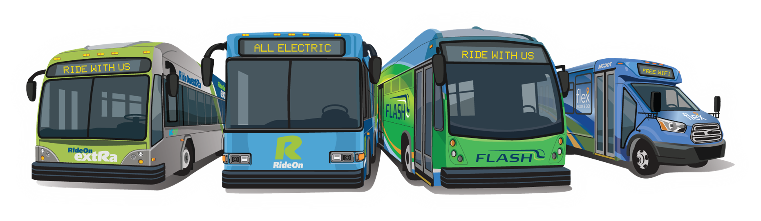
Fare Collection Resumes
Fare Collection Resumes on all services (Ride On, Ride On extRa, Flex and Flash) on August 1, 2022.
  Fare collection had been suspended for 28 months.
New reduced fare is $1 (previously was $2).
Monthly passes are now $22.50 (previously were $45).
Fares are still free for seniors (65+), persons with disabilities and youth under 19.

Slide 11
Comparison of Alternatives

