Slide 1
LOTS Program Manual
LOTS Manual Updates
September 22, 2022

Slide 2
Annual TAM Conference 2022
Introduction to LOTS Manual Updates
Meet the Office of Local Transit Support
Quick Reference Guide
Key Area(s) updated
  1 – Introduction
  3 – Financial Management
  5 - Procurement
  8 – Human Resources
  11 – Safety Security Risk Management

Slide 3
Key Area(s) Updates
    1 – Introduction
      Added Relief funding:
        CARES, CRRSAA, ARPA
          Eligible operating (Capital in some cases) expenses on or after January 20, 2020.

Slide 4
Chapter 3 – Financial Management
Accounting System and Financial Record Keeping
Accounting Practices
  Allocate costs to specific grants
    Remember period of performance dates (Relief Funds)
  Accurate and Timely invoicing and reporting
    Timely reporting can extend how often we visit for a Comprehensive Review

Slide 5
Chapter 4 – Procurement & Contracting
Contracts that make use of Federal and State funds must:
follow locally established procedures
not award to fraudulent, debarred, or technically unqualified vendors
be cost-efficient and price-consistent
provide fair opportunity
not discriminate
make preference for materials manufactured in the U.S.
ensure contractors comply with Federal and State requirements
MTA Concurrence
solicitation documents
recommendation for the award of local contracts and purchase orders valued more than:
  $1,000 if capital grant funds are involved, or
  $3,500 if operating grant funds are involved

Slide 6
Chapter 4, Procurement & Contracting, continued
Prior to the Award of any Procurement Contract, you must Perform the following:
Awards to Responsible Contractors
Cost or Price Analysis for Every Procurement Action
Fair and reasonable price analysis
  Evaluate Options Quantities
  Evaluate Optional Equipment
  Evaluate Offers
  Exercise Options
  Change Orders and/or Contract Modifications
Notes:
DBE Procurement Requirements
Project Specific Goals for All Procurements over $25,000
All LOTS must establish individual DBE subcontracting project goals for procurements over $25,000. This goal must be approved by the MTA Office of Equal Opportunity Compliance Programs (OEOCP). A contract clause must require prime contractors to pay subcontractors for satisfactory performance of their contracts no later than 30 days from each payment they receive. For procurements of $50,000 or more, DBE project goals must be approved by the MTA OEOCP and MTA’s Procurement Review Group.
Transit Vehicle Manufacturer (TVM) Certification
LOTS must require that each Transit Vehicle Manufacturer (TVM), as a condition of bidding on their transit vehicle procurements, certify that it has complied with the DBE requirements of 49 CFR 26.49. Only those TVMs listed on FTA's DBE-compliant certified list of transit vehicle manufacturers are eligible to bid. Further, LOTS are required to submit to MTA, within 30 days of making an award, the name of the successful bidder and the total dollar value of the contract. MTA will submit these reports on behalf of the LOTS to the FTA.
Prior to the Award of any Procurement Contract, you must Perform the following:
Awards to Responsible Contractors
LOTS may make awards only to responsible contractors possessing the ability to perform successfully under the terms and conditions of a proposed procurement. The LOTS must get concurrence from MTA before awarding any contract or procurement. MTA requires that the subrecipient check the Excluded Parties List System (EPLS) maintained by the GSA’s System for Award Management (SAM) before awarding a third party contract. A screen print of the EPLS search results must be placed in the procurement file.
Cost or Price Analysis for Every Procurement Action
LOTS must perform a fair and reasonable price analysis in connection with every procurement action.
Evaluating Options Quantities - the value of all options needs to be considered at the time of award.
Evaluating Optional Equipment – the value of all required or allied equipment must be considered.
Evaluating Offers - a fair price/cost analysis must be conducted immediately prior to award.
Exercising Options - a fair price/cost analysis must be conducted prior to exercising options.
Change Orders and/or Contract Modifications - a price/cost analysis must be conducted prior to making any changes to the contract.

Slide 7
Chapter 8 – Human Resources
Drug and Alcohol Program & Testing Requirements
Drug and alcohol use in the workplace
  Update policies to address changes.
Education and training program
  60 minutes training on drug program.
Testing program
  50% of workforce to be randomly tested.
  Across ALL service hours and days.
Administrative procedures
  Review and update procedures annually.
Notes:
General Personnel Policies and Procedures
The MTA strongly recommends that each LOTS system develop personnel policies and procedures contained in a manual to help maintain consistency in management. Even LOTS that are part of a county or city government are encouraged to develop a manual to address personnel policies that are specific to the Transportation Department. Personnel policies and procedures that a LOTS will have to develop, maintain, and document include:
Job Descriptions and Employment Conditions
Hiring and Training practices (important to meet ADA, EEO and Drug & Alcohol requirements)
Leave Policies and Pay Plans
Performance Evaluations and Disciplinary Plans/Guides
Discrimination, Harassment and ADA Reasonable Accommodation Policies
Employee Grievance and Work Rights (Union) Procedures
Personnel Record Keeping Practices (important to meet Federal and State requirements)
Drug and Alcohol Program & Testing Requirements
All LOTS, and their contractors, that receive FTA public transportation funds (including Sections 5307, 5309/5339, and 5311) are required to have, implement, and maintain substance abuse programs and procedures. LOTS employees who perform safety-sensitive duties (drivers, supervisors and mechanics) are required to be tested for drug and alcohol use under a number of situations. Major required elements of the Drug and Alcohol Program include:
A written policy statement on prohibited drug and alcohol use in the workplace including consequences.
A documented employee and supervisor education and training program (at least 60 minutes annually).
A drug and alcohol testing program for prohibited substances for employees and applicants for safety sensitive positions to include provisions for: pre-employment, random, reasonable suspicion, post accident, return to work, and follow-up testing.
Referral of employees who have violated the drug and alcohol regulations to a Substance Abuse Professional.
Administrative procedures for recordkeeping, reporting, releasing information, and certifying compliance.

Slide 8
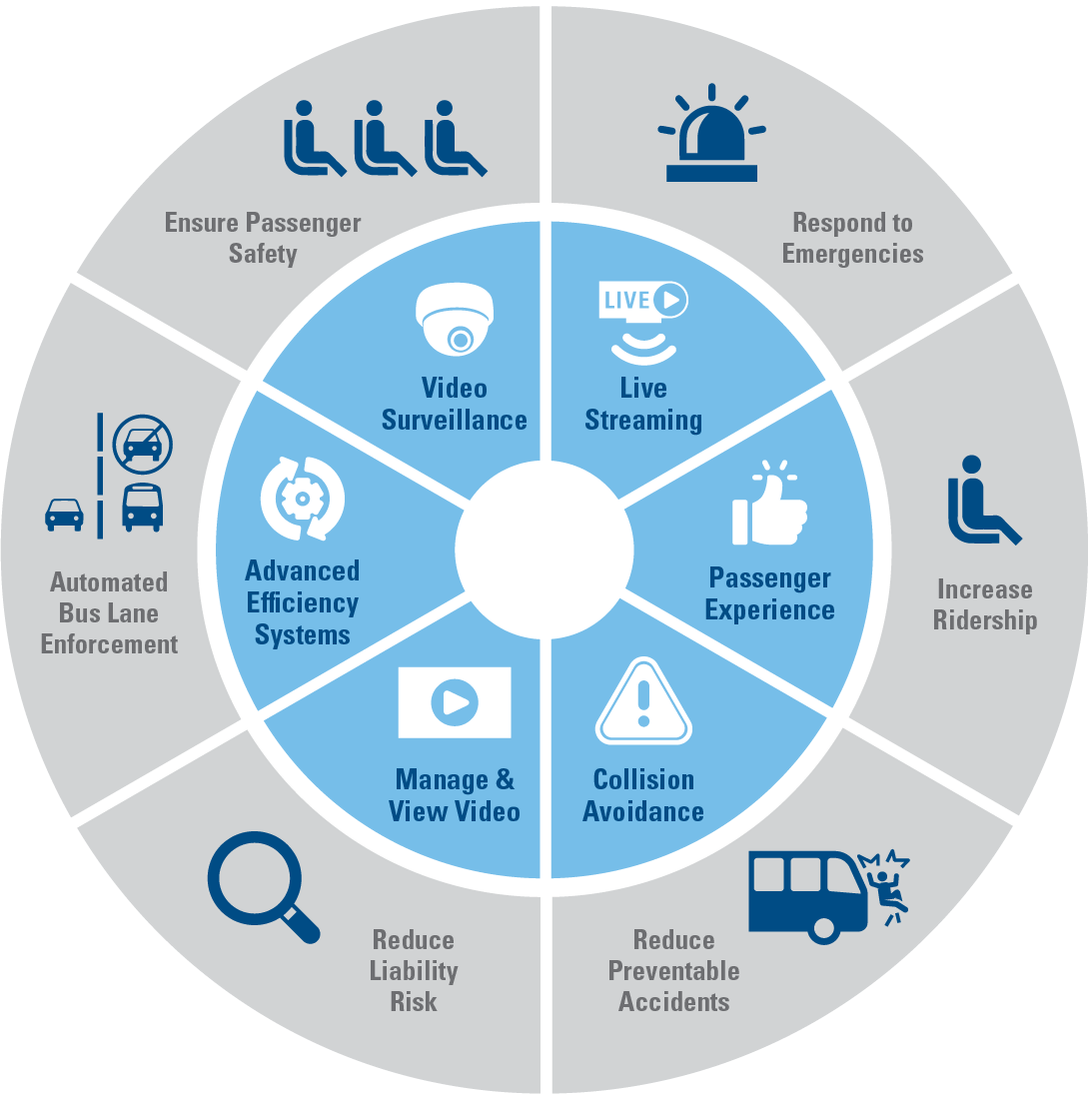
Chapter 1 – Safety and Security Management
Agency Safety Plans
  All LOTS must have an approved updated SMS plan with annual goals.
Review and update annually
  Leadership/Executive Level Staff
  Fleet data
  Risk Assessments
Attend all trainings
  Lots of changes are coming.
Notes:
Charter Requirements
LOTS are prohibited from providing charter services except under certain specific conditions. The following types of service are exempt from charter service rules:
Transit systems transporting transit employees and government representatives within the service area for monitoring purposes.
Emergency response and preparedness planning and operations.
Recipients in non-urban areas transporting employees for training to destinations outside the service area.
The FTA Charter Service rules also allow some charters to be operated under the exceptions rule (the most notable being the Governmental Officials exception). These exceptions require substantial documentation to use.
LOTS are required to provide a quarterly Charter report to the MTA, and must report even if they did not engage in charter activities.
School Bus Service
School bus operations are defined in the FTA regulations as transportation by bus exclusively for school students, personnel and equipment in school bus type vehicles.
The prohibition against school bus service applies to both home-to-school transportation and transportation for school-sponsored activities or trips.
The FTA considers Head Start to be a social service program rather than a school program, and as such the prohibition against providing school bus service does not apply to transporting children who are participating in Head Start programs.
LOTS may not use grant program funds or equipment to engage in school bus service of any kind. Call your MTA Regional Planner if you have any questions. but you may not transport children to school services or functions without prior written MTA approval.

