Slide 1
Federal Transit Administration
Bringing a Federal Voice
to the TAM General Meeting
Transportation Association of Maryland
2022 Annual Conference
September 21, 2022
9:15 am – 10:00 am

Slide 2
FTA Leadership
FTA Administrator Nuria Fernandez

Slide 3
TAM Board Roundtable - Targeted Topics
Discretionary Funding Opportunities
Supply Chain Issues
Challenges of Workforce Development
Regulatory Changes Affecting Rural Communities
Non-Emergency Medical Transportation Trips
Human-Service and Transportation Provider Collaboration

Slide 4
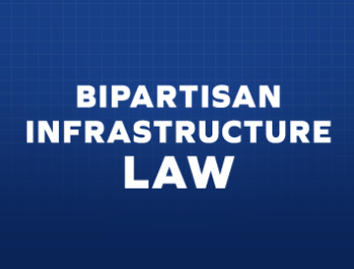
Agenda
USDOT Strategic Goals
Bipartisan Infrastructure Law (BIL)
BIL Implementation – FTA Priorities
Discretionary Funding Opportunities
Targeted Topics
Resources for Rural/ Small-Urban Transit Providers

Slide 5
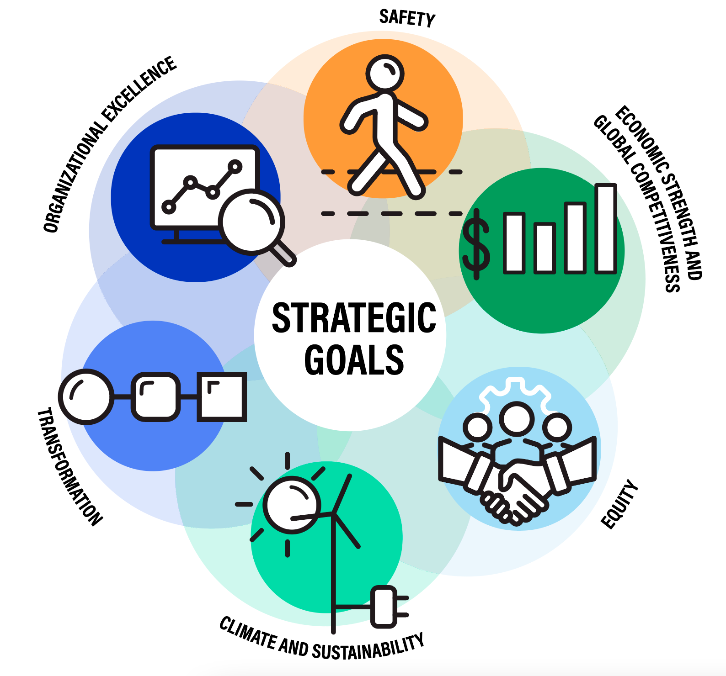
USDOT Strategic Goals

Slide 6
Bipartisan Infrastructure Law (BIL)
Significant Funding Increases
New and increased funding for State of Good Repair, Low or No Emission, and CIG Grants
New Grant Programs
Continues existing structure for FTA programs focused on urban, rural, and targeted populations
Ferry Service for Rural Communities
All Station Accessibility Program
Electric or Low-Emitting Ferry Pilot Program
Up to $108 billion for public transit over five years
Rail Vehicle Replacement Program

Slide 7
BIL – Increased Funding for Transit
An additional $45 billion authorized over 5 years

Slide 8
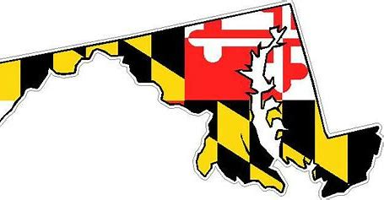
BIL – Increased Funding for Transit - Maryland
MARYLAND – Section 5310 + Section 5311
Section 5310
FAST Act (FY 2021) BIL (FY 2022)
$4,584,255 $5,662,928 (11% increase)
Section 5311
FAST Act (FY 2021) BIL (FY 2022)
$7,226,203 $8,934,355 (11% increase)

Slide 9
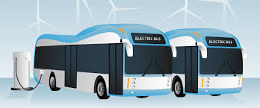
BIL: Investing in Rural Transit Systems
Formula Grants for Rural Areas (Section 5311) - $875 million (FY 2022)
Bus and Bus Facilities (Competitive) Program – $550 million (FY 2022) – sets aside 15% of funds for rural communities
Electric Vehicle Charging
Network

Slide 10
BIL: Investing in Rural Transit Systems

Slide 11
Bipartisan Infrastructure Law - FTA Priorities:
Safety
Modernization
Climate
Equity
FTA Bipartisan Infrastructure Law Priorities

Slide 12
FTA Priorities (BIL) – Workforce and Rider Safety
Strategies
Our Priorities
Provide additional training to transit agency staff
Ensure the safety of the transit rider
Ensure the safety of the transit workforce
Ensure the safety of the general public
Collect data on safety incidents and operator assaults
Promote continued adoption of safety management systems
Enhance oversight of safety requirements and regulations

Slide 13
FTA Priorities (BIL) – Modernizing Transit Infrastructure
Strategies
Our Priorities
Ensure the availability of modern, safe, and efficient transit infrastructure
Reduce the backlog of transit modernization investments
Provide funding to repair and replace aged and outdated transit infrastructure
Promote equitable and climate friendly transit investments
Incorporate new technologies
Build and expand transit to serve growing communities and those without adequate mobility options

Slide 14
FTA Priorities (BIL) – Addressing the Climate Crisis
Strategies
Our Priorities
Focus discretionary investments on projects that address the climate crisis
Reduce carbon emissions from transit vehicles, infrastructure and construction
Increase the resilience of transit systems to climate and extreme weather hazards
Support the adoption of American-made low and zero-emission vehicle technologies
Technical assistance to support adoption of zero-emission vehicles
Research and innovation investments
Join FTA's Sustainable Transit for a Healthy Planet Challenge

Slide 15
FTA Priorities (BIL) – Addressing the Climate Crisis
Sustainable Transit for a Healthy Planet Challenge
www.transit.dot.gov/climate-challenge

Slide 16
FTA Priorities (BIL) – Addressing the Climate Crisis
Sustainable Transit for a Healthy Planet Challenge
Existing Signatories in the Mid-Atlantic Region
Anne Arundel County Office of Transportation
Crawford Area Transportation Authority
Delaware Transit Corporation
Erie Metropolitan Transit Authority (EMTA)
Jaunt, Inc.
Maryland Department of Transportation - Maryland Transit Administration (MDOT MTA)
Montgomery County Department of Transportation (MCDOT)
New Jersey Transit
Petersburg Area Transit
Radford Transit
Southeastern Pennsylvania Transportation Agency (SEPTA)
Suburban Transit Network, Inc.
Washington Metropolitan Area Transit Authority

Slide 17
FTA Priorities (BIL) – Improving Equity in Transit
Strategies
Our Priorities
Support underserved, overburdened, and disadvantaged communities by:
Expand access and opportunity to underserved, overburdened, and disadvantaged communities
Incorporate equity in transportation planning and funding decisions
Increase social and economic opportunity through investments in equitable transit projects
Justice40: Ensure that no less than 40% of the benefits of FTA investments reach underserved, overburdened, and disadvantaged communities
Ensuring that planning organizations responsible for planning hear from these communities
Focusing discretionary investments on projects that promote equity
Directing technical assistance
Collecting data on the effects of transit service that can address historic inequities
Supporting minority and women-owned businesses

Slide 18
Upcoming FTA Discretionary Funding Opportunities
Coming Soon
Areas of Persistent Poverty Grant Program (early Fall 2022)
Mobility, Access & Transportation Insecurity: Creating Links to Opportunity Research and Demonstration Program (closes 10/11/2022)
USDOT’s Thriving Communities Initiative (late Fall 2022)

Slide 19
TAM Board Roundtable - Targeted Topics:

Slide 20
Targeted Topics: Supply Chain Issues
Presidential Executive Order – encourages agencies to work together to improve supply chain weaknesses.
Supply Chain Task Force – works with partners across the supply chain to make a meaningful impact.

Slide 21
Targeted Topics: Workforce Development Challenges
Transit Workforce Center (TWC) Initiatives:
American Transit Training and Apprenticeship Innovators Network, or ATTAIN
ZEB Workforce Transition Initiative

Slide 22
Targeted Topics: Regulatory Changes for Rural Areas
FTA Funding Programs -- Sections 5310 + Sections 5311
No Ongoing Regulatory Changes – However….
BIL added 3% of Section 5311 funding for the Appalachian Development Public Transportation Assistance Program.
Possible Changes for Associated Circulars in Future

Slide 23
Targeted Topics: Non-Emergency Medical Transportation (NEMT) Trips
Are Non-Emergency Medical Transportation Trips Reported to FTA’s National Transit Database (NTD)?
No…However…
Trips that Partner b/w Qualified Human Services Orgs (QHSO) + Transit Agencies (and Attempt to “Share Rides” Either with Clients of other QHSOs or General Public) ARE Reported to NTD.

Slide 24
Targeted Topics: Collaboration b/w Human-Service Providers + Transportation Providers
FTA Created Coordinating Council on Access and Mobility (CCAM)
Works to improve coordination between transit and non-emergency medical transportation services
To better meet customer and community needs

Slide 25
Targeted Topics: Collaboration b/w Human-Service Providers and Transportation Providers – Best Practices
LTD’s RideSource – Coordinates Transportation Services Directly with Social Workers + Local Coordinated Care Organizations
MO Rural Health Association’s HealthTran Program – NEMT in 10 Rural Counties. Supported via Health-Care Provider Subscriptions

Slide 26
Resources for Rural/ Small-Urban Transit Providers
NADTC: Promotes availability and accessibility of transportation options for older adults, people with disabilities, and caregivers.
Contacts: Carrie Diamond and Virginia Dize, nadtc.org
N-CATT: Helps small-urban, rural, and tribal transit operators understand / apply technological tools available to them.
Contact: Andrew Carpenter, n-catt.org
NRTAP: Addresses training and technical assistance needs of rural and tribal transit agencies and supports state RTAPs.
Contact: Robin Phillips, nationalrtap.org

Slide 27
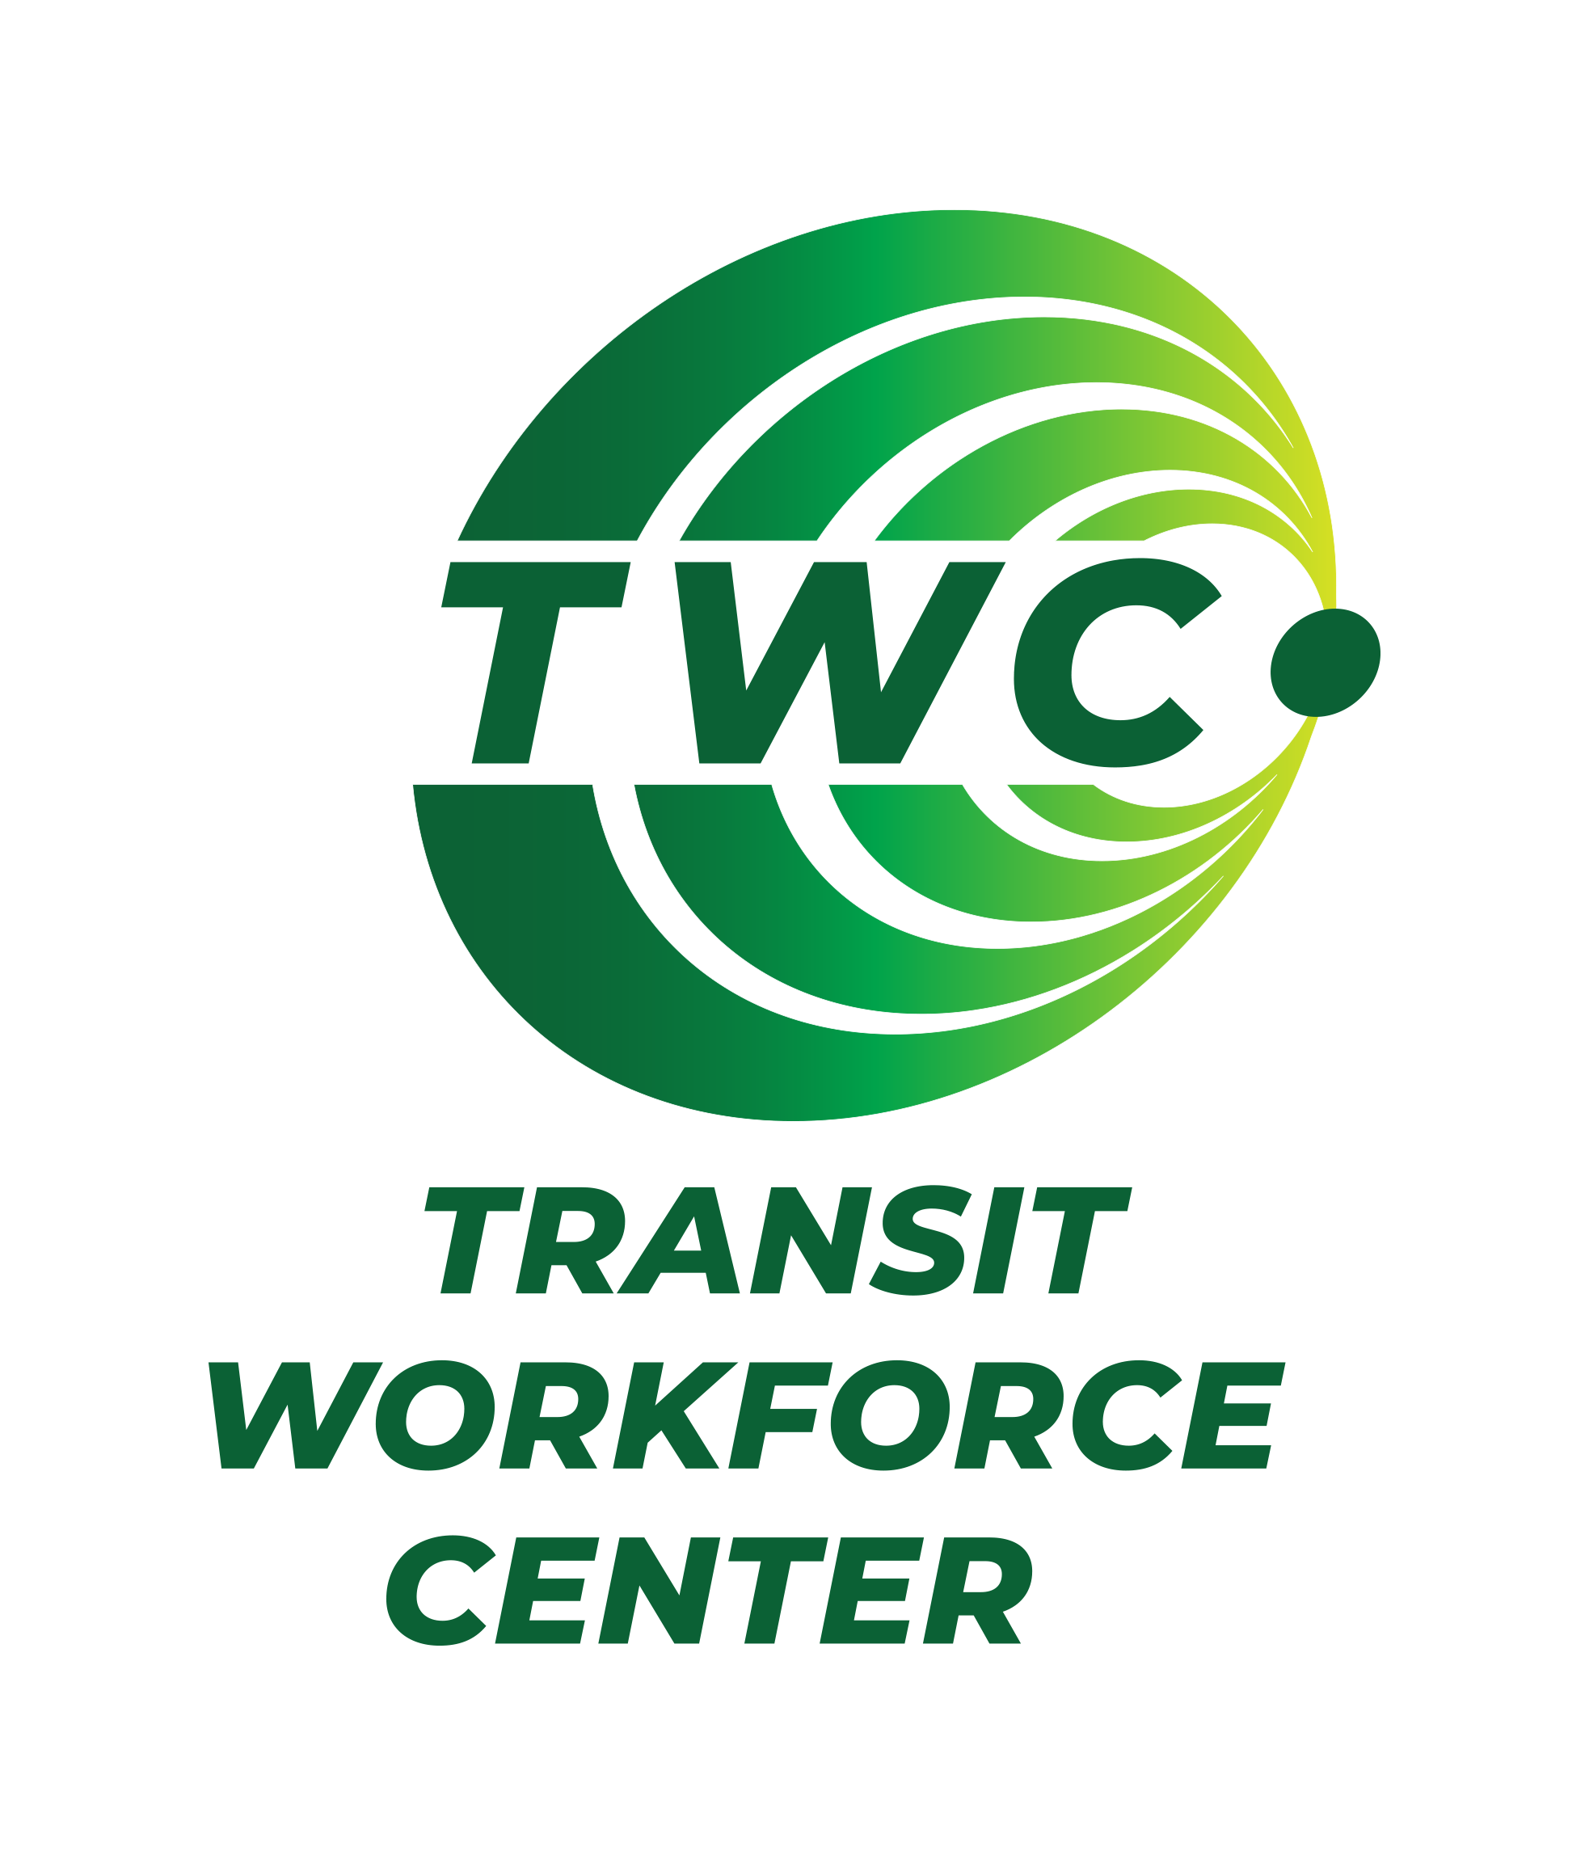
Resources for Rural/ Small-Urban Transit Providers
NCMM: Promotes customer-centered mobility strategies that advance good health, economic vitality, self-sufficiency, and community.
Contact: Amy Conrick, nc4mm.org
SUMC: Works to achieve equitable, affordable, and environmentally sound mobility through the efficient sharing of transportation assets.
Contact: Albert Benedict, sharedusemobilitycenter.org
TWC: Helps urban, suburban, tribal, and rural public transportation entities recruit, hire, train, and retain a diverse workforce.
Contact: Jack Clark, transitworkforce.org

Slide 28
