Slide 1
Thriving, Not Surviving Chaos:
5 Steps to mastering your time and beating burnout!
ROBERT HEATH, SR. | PRINCIPAL CONSULTANT
THE LEGACY LEADERSHIP CONSULTING GROUP

Slide 2



Slide 3
The Average Manager, Supervisor, Executive, or CEO works 72 Hours Per Week

Slide 4

Overwhelm, Decision Fatigue, & Burnout

Slide 5

How would it feel if You could wake up every morning excited about Your day instead of drained because you knew that it was filled with things that Energized you and moved You closer to your goals?
What would it be like if You didn’t have to empty your cup to fill the cups of others?
What would it be like to feel professionally and personally fulfilled, successful, rested, happy, and balanced…every day?

Slide 6


Time

Slide 7

Who Controls your Time?
Customers
Subordinates
Family and Friends
Superiors

Slide 8
Who Controls your Time?
YOU

Slide 9
3 Transitions of Leadership
Being Led → Leading Oneself
Emerging Leaders
2. Leading Oneself → Leading Others
Developing Leaders
3. Leading Others → Creating Leaders
Experienced Leaders
= Thriving In Chaos TM
= Delegation Mastery TM
= Legacy Leadership TM

Slide 10

Traditional Leadership Pipeline

Slide 11
Being the Leader is a Different Experience
Follower:
Course is set for you
Success is specifically defined for you
Limited responsibility
Your results largely in your control
Leader:
You must determine the Course
Success is loosely defined and you must fill in the blanks
Ultimate responsibility for success or failure
Your results feel largely dependent on others

Slide 12





Slide 13
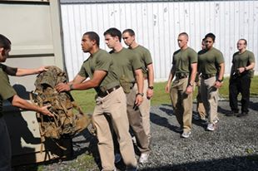


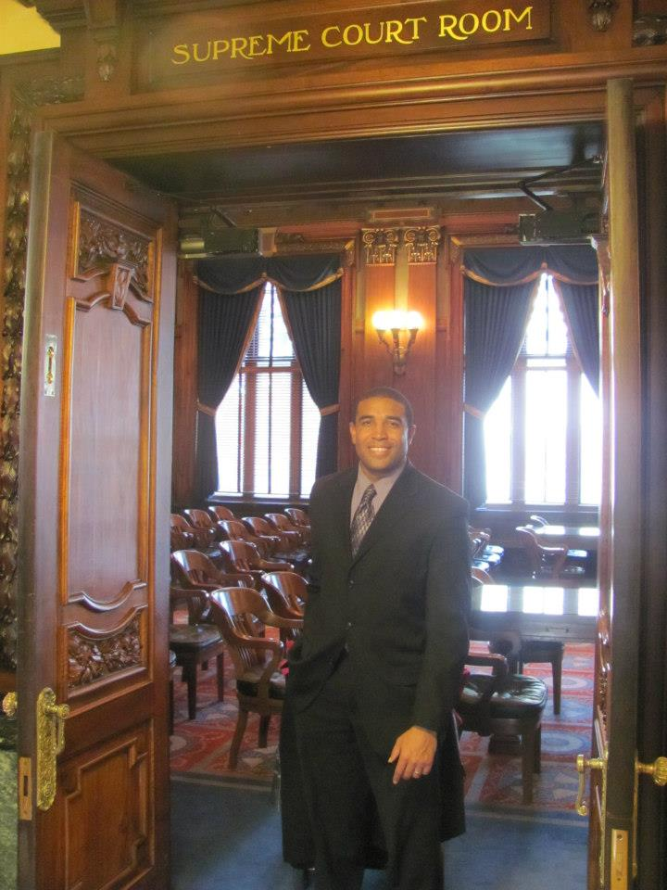



Slide 14










Slide 15
Time Management vs. Time Ownership
Time Management: Tactics
Priorities are set by others
You must make decisions based on the needs of others
You generally don’t have enough time to complete everything that you want to complete
You are normally not a priority

Slide 16
Time Management vs. Time Ownership
Time Management: Tactics
Priorities are set by others
You must make decisions based on the needs of others
You generally don’t have enough time to complete everything that you want to complete
You are normally not a priority
Time Ownership: Strategy
You set the priorities
You schedule those priorities
Everything else fits in around those priorities
There is always more than enough time to get the priorities done
You are always a priority

Slide 17
How would it feel if You could wake up every morning excited about Your day instead of drained because you knew that it was filled with things that Energized you and moved You closer to your goals?
What would it be like if You didn’t have to empty your cup to fill the cups of others?
What would it be like to feel professionally and personally fulfilled, successful, rested, happy, and balanced…every day?

Slide 18
How Do You Fill Your Time?

Slide 19

Burnout Leadership Model

Slide 20

Thriving leadership model aka the “abundance” model

Slide 21

5 Steps to Mastering your Time and beating burnout
Define Success
Set and Align Priorities
Schedule Priorities
Handling Interruptions aka Setting and Enforcing Boundaries
Sustaining the Transformation

Slide 22

Define Success

Slide 23


Slide 24
It’s Easier When you Know Where you are going!

Slide 25
5 Steps to Mastering your Time
Define Success
Set and Align Priorities
Schedule Priorities
Handling Interruptions aka Setting and Enforcing Boundaries
Sustaining the Transformation

Slide 26
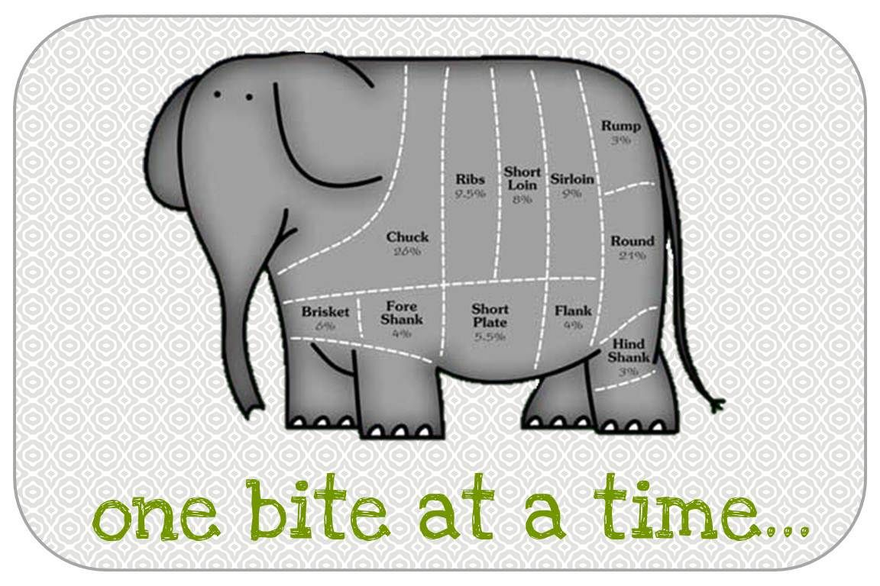

Slide 27
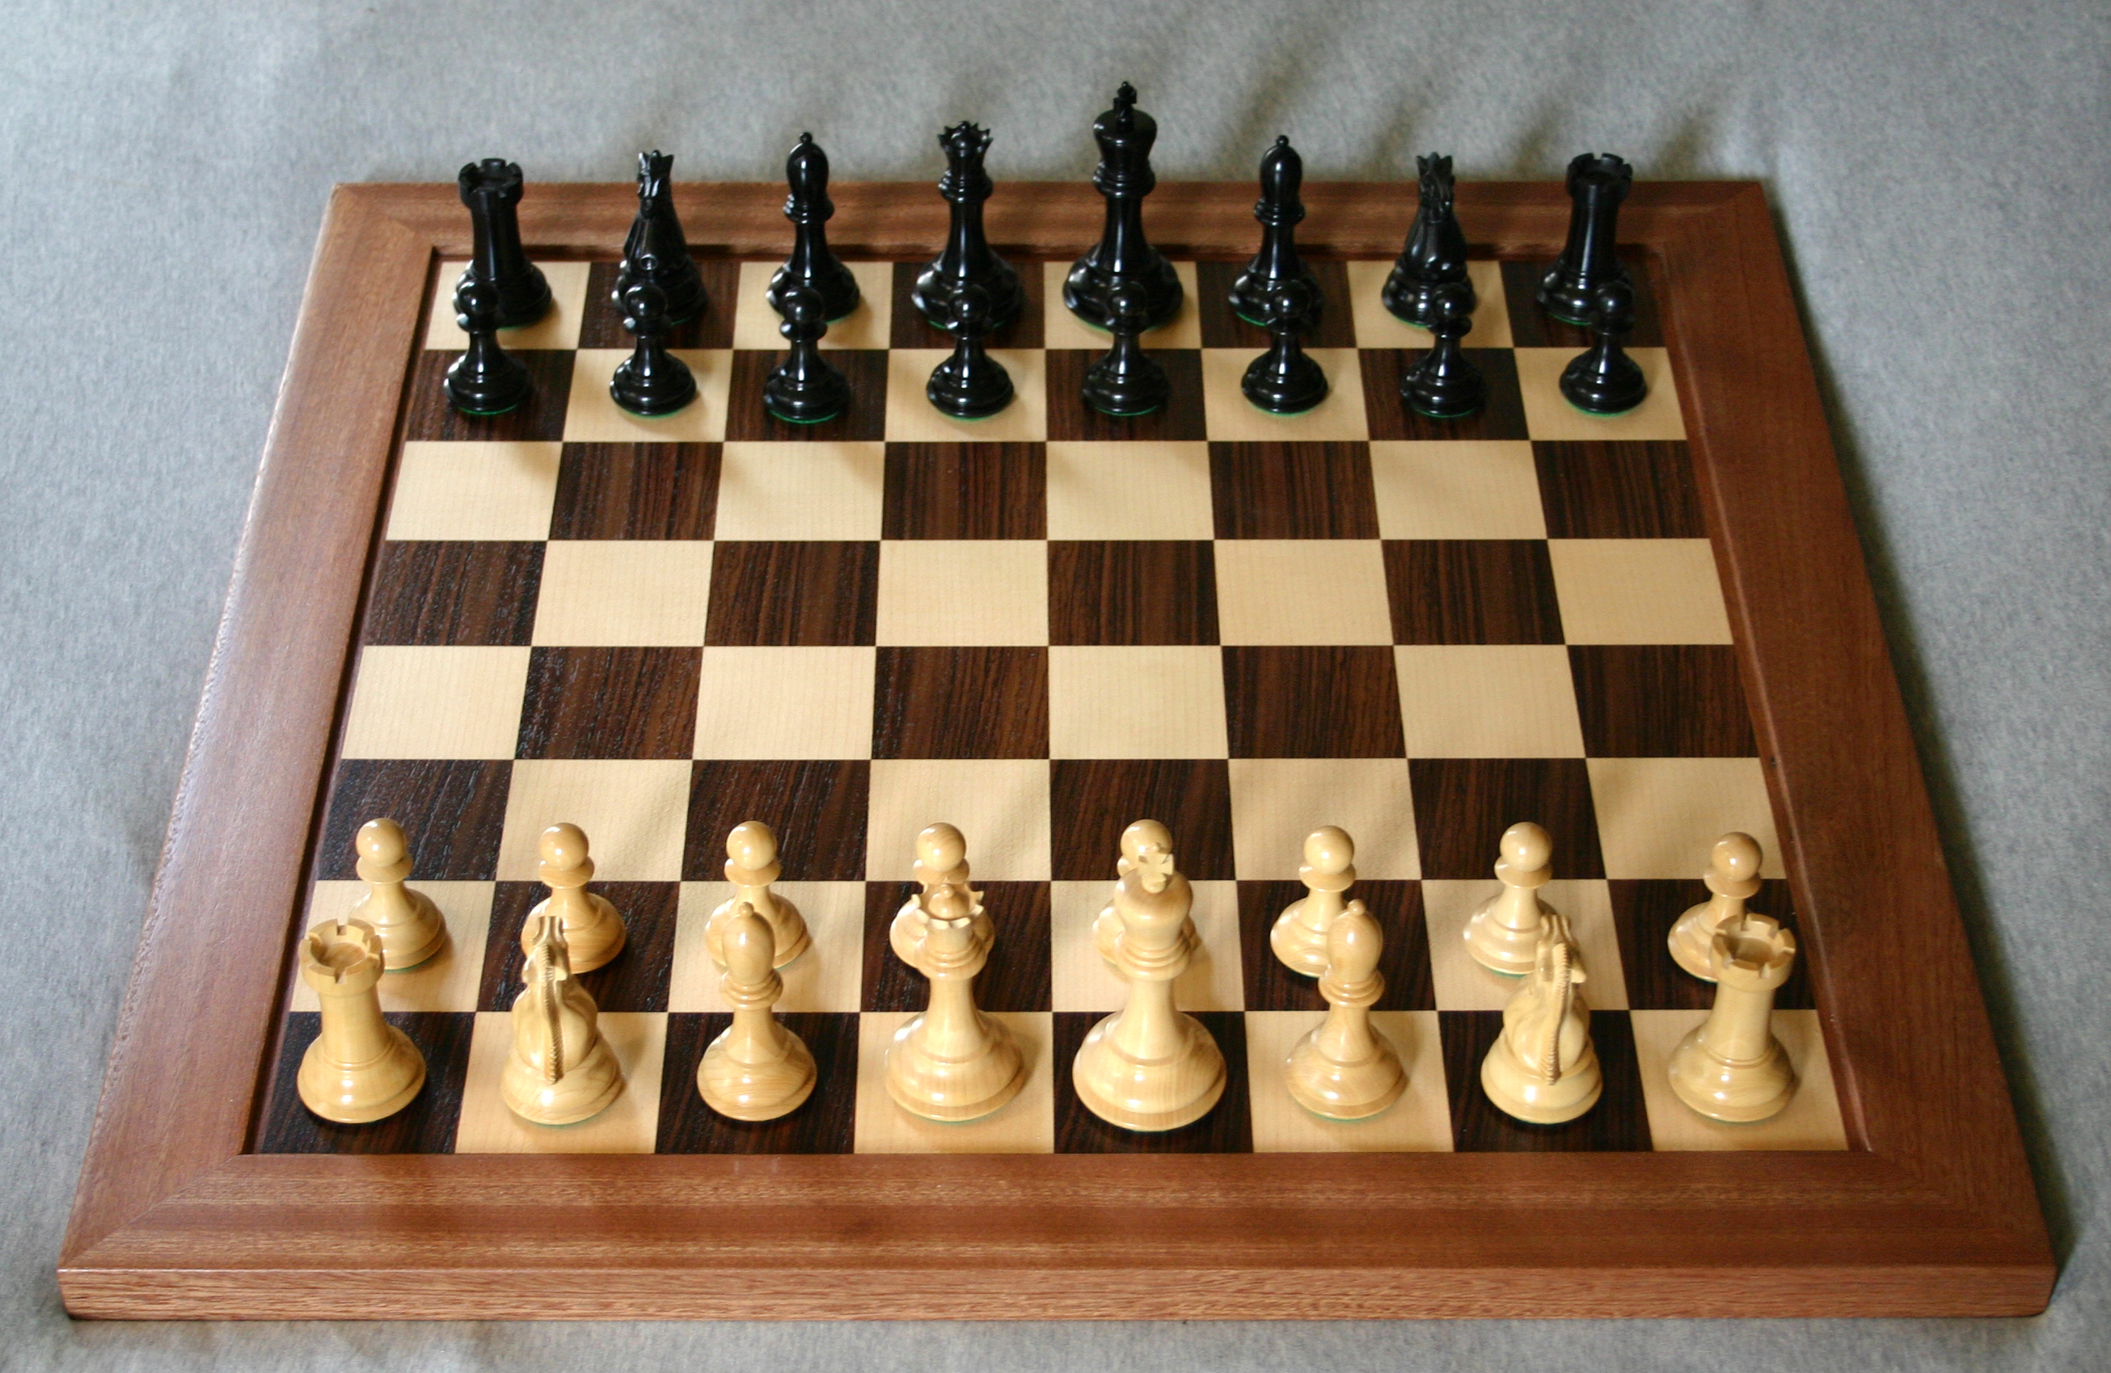

Slide 28
5 Steps to Mastering your Time
Define Success
Set and Align Priorities
Schedule Priorities
Handling Interruptions aka Setting and Enforcing Boundaries
Sustaining the Transformation

Slide 29
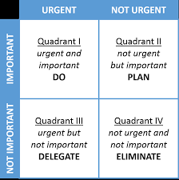
Importance Versus Urgency

Slide 30
5 Steps to Mastering your Time
Define Success
Set and Align Priorities
Schedule Priorities
Handling Interruptions aka Setting and Enforcing Boundaries
Sustaining the Transformation

Slide 31
Creating A System for Decision making
Delegate
Automate
Eliminate
Distinguish
Deliberate
Decide

Slide 32
GROUP DISCUSSION-Setting and Enforcing Boundaries
Scenario 1
Scenario 2
You work at a Manufacturer as a Supervisor. One of your team leads received a call from a supervisor from another plant in your company telling them that they needed to get something down there by Close of Business today. Your Team Lead already has 2 VIP jobs that have to get done today and your schedule is full for the rest of the day. You have no one that you can spare to get this job done. This decision is within your discretion, however, it is frowned upon to refuse these types of tasks by your Manufacturing Manager unless you have a “very good” reason. What do you do?
You’re working on a major project, and you’ve blocked out a few hours to really knock it out. But just as you’re getting into the zone, your boss stops by to drop off some paperwork. Then your co-worker comes over to chat about next week’s meeting. What do you do?

Slide 33
5 Steps to Mastering your Time
Define Success
Set and Align Priorities
Schedule Priorities
Handling Interruptions aka Setting and Enforcing Boundaries
Sustaining the Transformation

Slide 34
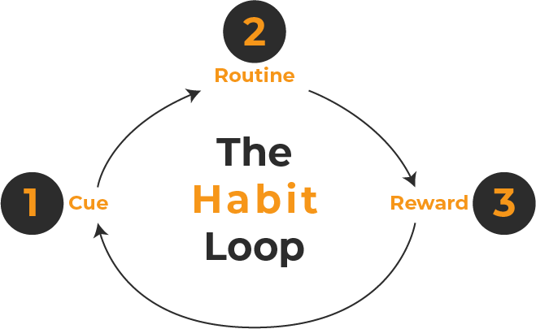

Slide 35

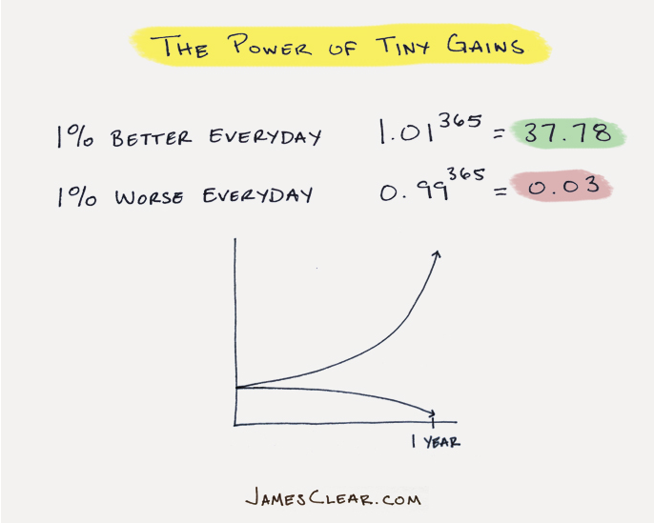
Tips for Building new Habits
Make it so easy you can't say no.
Utilize the power of Tiny Gains
When you slip, get back on track quickly.
  AKA Never Miss Twice
Be patient. Stick to a pace you can sustain

Slide 36

Momentum and the Domino Effect
Because of momentum a domino can knock over another domino which is 1 and ½ times its size.
In just13 dominoes you can go from moving something 1mm x 5mm, weighing less than a gram to moving something weighing over 100lbs which is over 1m tall.

Slide 37
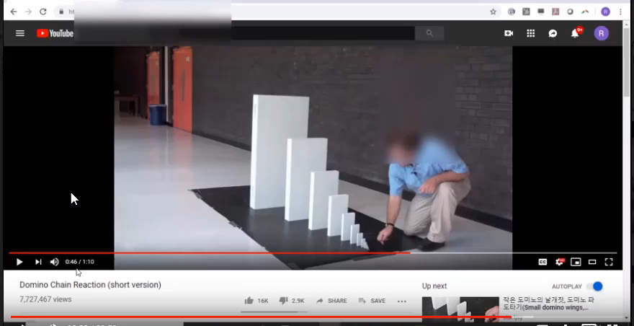
Momentum

Slide 38


Slide 39
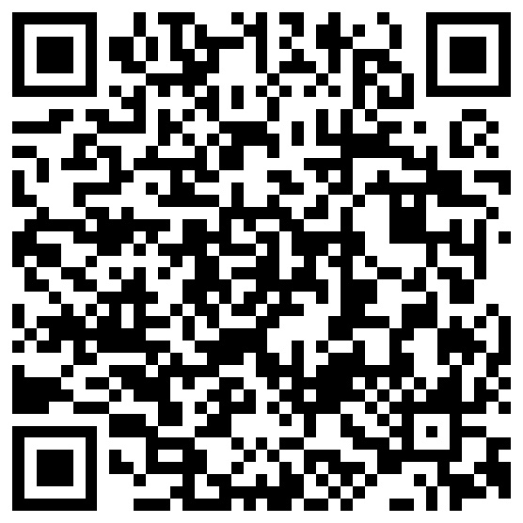
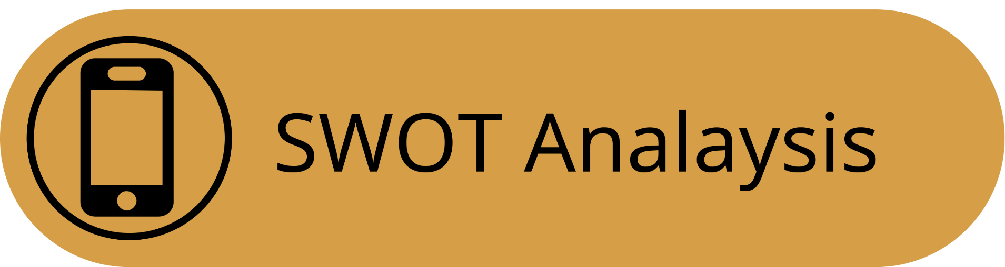
Next Steps
Define success and Alignment
1. download the swot analysis
2. take your strengths assessment
3. complete the analysis

Slide 40

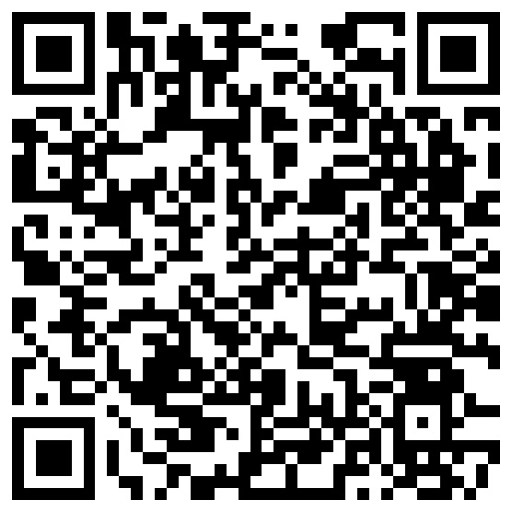
Scan to Get the Book!!!
Email Us:
Support@
legacyleadershipmastery.com

Slide 41

QUESTIONS?

