Slide 1
ZEV Study – Now What?
How to Develop a Zero Emission Transition Plan
2023 TAM Annual Conference
September 21, 2023

Slide 2
Outline
1
WSP Overview
2
Zero Emission Transition Plan Overview
3
FTA Funding Programs
4
Sample ZET Plan
5
References
6
Q & A

Slide 3
About WSP
Planning, Design, & Engineering
Operation & Management
Strategic Consulting & Road-mapping
Facility Planning & Design
TCO & Financial Analysis
Construction Management
Energy Resiliency
Fleet Electrification
Sustainable Buildings
Operations Considerations
Battery Life Cycle
Automation
Onsite Renewables
Workforce Considerations

Slide 4
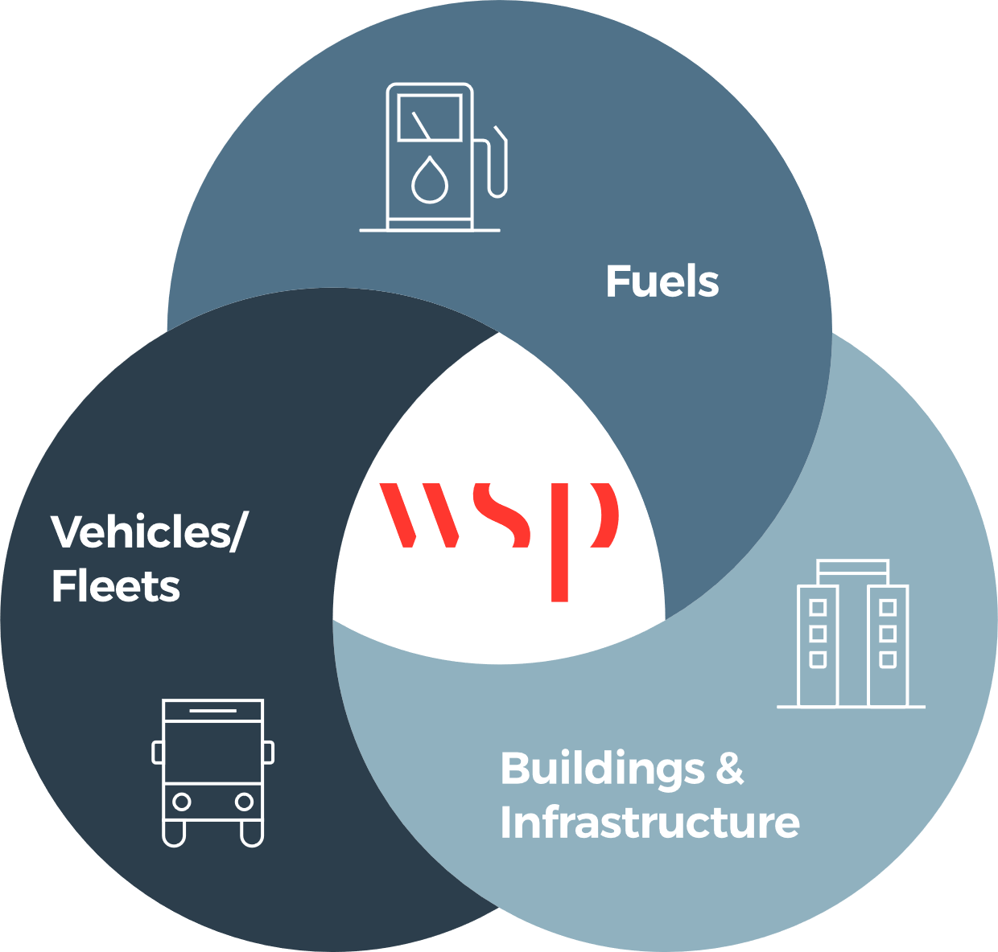
Center for Clean Transportation
Electricity
Hydrogen
Renewables
Renewable Natural Gas
Renewable Diesel
Biodiesel
Green Methanol
EMERGING TRENDS
Liquid hydrogen carriers
Fire safety protocols
On-road
Transit
School Bus
Services
Delivery
Freight
Active transport
Marine
Ferries
Excursion
Water Taxi
Off-Shore Vessels
Shore to ship power
Rail
Passenger
Freight
Support Equipment
Aviation
GSE
Aircraft
Nonroad
Construction
Agriculture
Mining
EMERGING TRENDS
Vehicle automation
New battery technologies
Battery end-of-life management
Production/Generation
Storage
Transport
Fueling/Charging
Resiliency
Connectivity
Automated Management
EMERGING TRENDS
V2G/V2H/V2I
Software Development
Grid Scale Storage

Slide 5
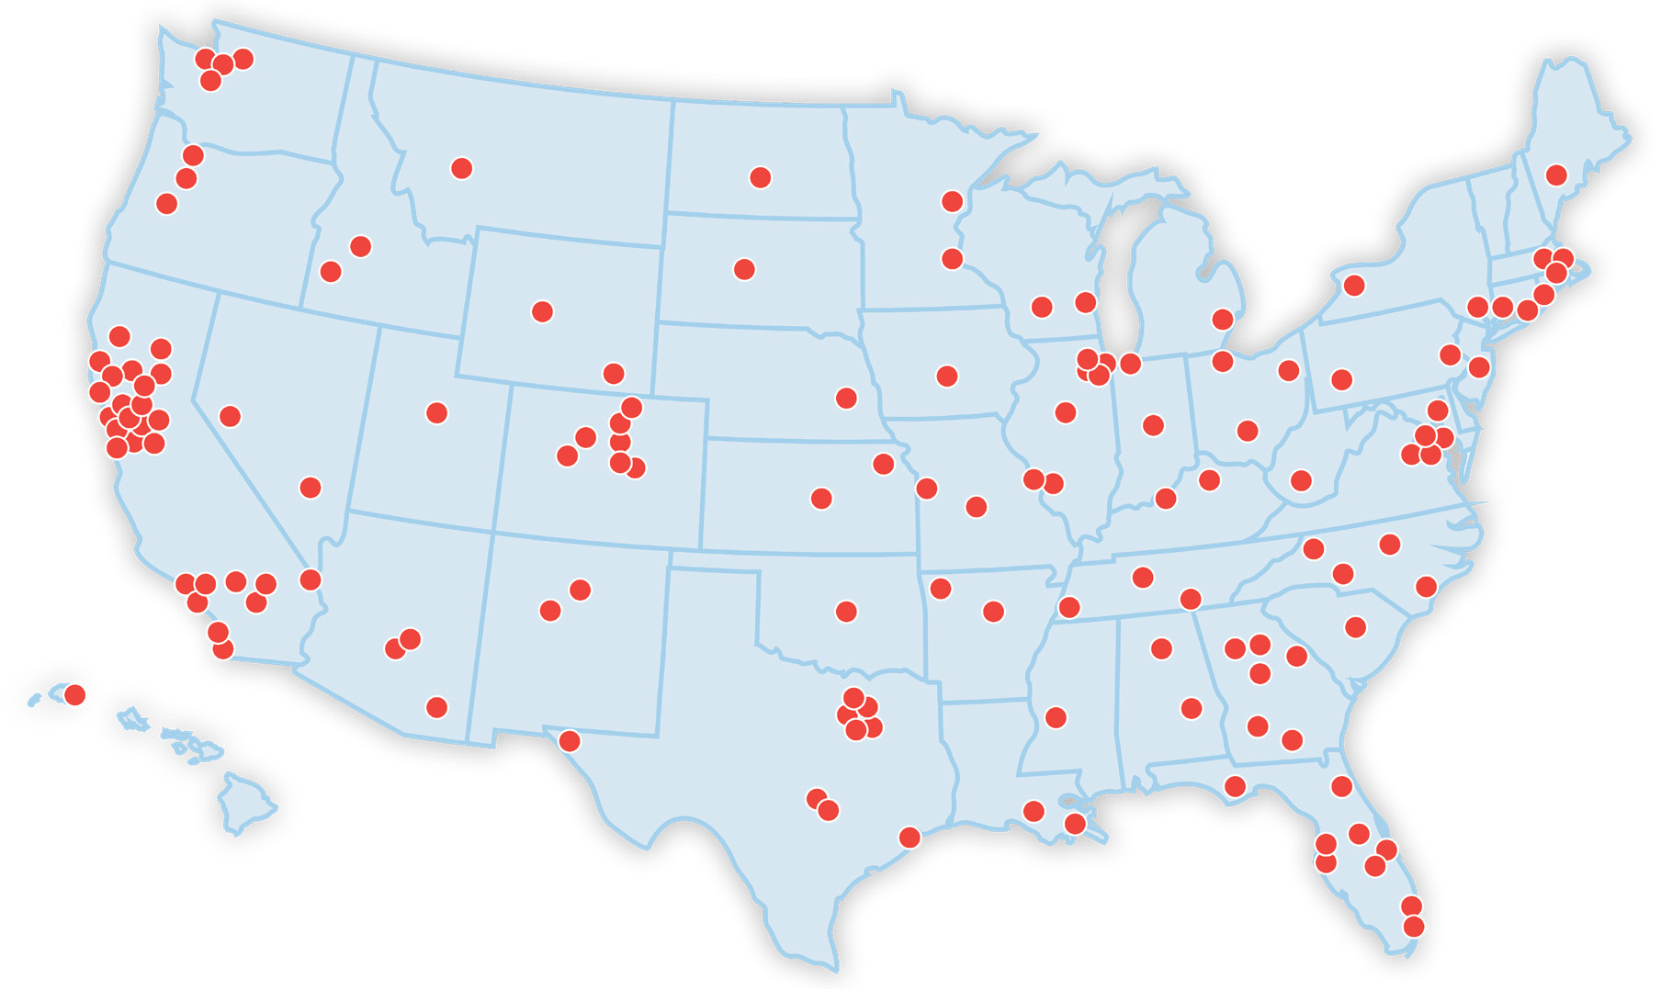
WSP National ZEB Experience
ZEB Contracts with
19/25
Top Transit Fleets in USA
Writing
130+
ZE Plans and Projects
Planning and designing
800+
ZE facility projects
Working with a total of
17,000+
North American vehicles

Slide 7
Why do you Need a Zero-Emission Transition Plan?
If you apply for FTA funding for a zero-emission vehicle project, you need a Zero-Emission Transition (ZET) Plan
FTA defines the elements to include in a ZET Plan
You need a ZET Plan if you apply through either of the following grant programs:
What are the elements of a ZET Plan?
Low or No Emission Vehicle Program (“Low-No”)
Buses and Bus Facilities Program (BBF)
Notes:
Plans do not need to be extensive. Agencies have flexibility in meeting FTA requirements
FTA states that “Applicants are encouraged to develop a plan that meets their needs while also ensuring that the required content is included”
Agencies do not need to prepare a new document if they already have a plan that addresses the requirements

Slide 8
FTA Zero Emission Plan Requirements
1. Fleet
2. Finance
3. Regulations
4. Facilities
5. Utilities
6. Workforce

Slide 9
1. Fleet
Requirement
Demonstrate a long-term fleet management plan with a strategy for how the applicant intends to use the current request for resources and future acquisitions.
What is FTA Looking For?
Describe a long-term fleet management plan and how it aligns with zero-emission transition
Describe a procurement plan to transition the fleet to zero emission

Slide 10
2. Finance
Requirement
Demonstrate a long-term finance management plan with a strategy for how the applicant intends to use the current request for resources and future acquisitions.
What is FTA Looking For?
Overview of current funding sources and levels
Identify efforts to secure additional funding sources for sustainable zero-emission operations and maintenance

Slide 11
3. Regulations
Requirement
Consider policy and legislation impacting relevant technologies.
What is FTA Looking For?
Discuss current and proposed National, State, and Local legislation and policy that could impact your transition plan
Discuss any agency-specific plans or policies related to the zero-emission transition

Slide 12
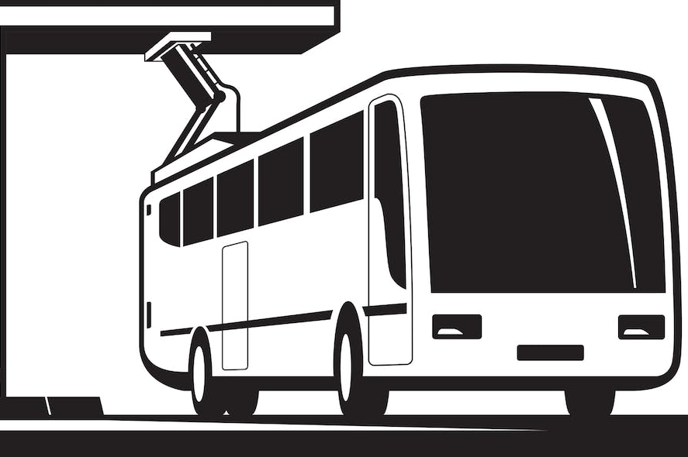
4. Facilities
Requirement
Include an evaluation of existing and future facilities and their relationship to the technology transition.
What is FTA Looking For?
Capital inventory of all existing and future facilities, including current and/or potential zero emission infrastructure
Analysis of existing infrastructure and the ability to integrate zero emissions infrastructure

Slide 13
5. Utilities
Requirement
Describe the partnership of the applicant with the utility or alternative fuel provider.
What is FTA Looking For?
Demonstrate that you worked with the local utility to document the relationship, costs, and risks associated with the delivery of energy/alternative fuel.
This can be shown through a letter of support from the utility, existing or pending contracts, or documentation of conversations with the utility.

Slide 14
6. Workforce
Requirement
Examine the impact of the transition on the applicant's current workforce by identifying skill gaps, training needs, and retraining needs of the existing workers of the applicant to operate and maintain zero-emission vehicles and related infrastructure and avoid displacement of the existing workforce.
What is FTA Looking For?
Use the FTA Workforce Evaluation Tool (not required)
Describe operations and maintenance training plans
Show coordination with existing employee representation and members
Plan for workforce reskilling and retention
Describe apprenticeship and other programs

Slide 15
When to Update Your ZE Transition Plan
ZET Plans should be up-to-date when agencies apply for Low-No or BBF grants
Your ZET Plan does not need to be updated unless you are applying for one of these grant programs. The Plan can be updated through addendum attachments.
Regularly updating the ZET Plan is a good way to stay attentive to industry shifts and track ZEV project successes
Reasons for ZET Plan Updates
Evolving Technology
Regulation Changes
Requirements Changes
Funding Advantage/Changes
Stakeholder Engagement

Slide 16
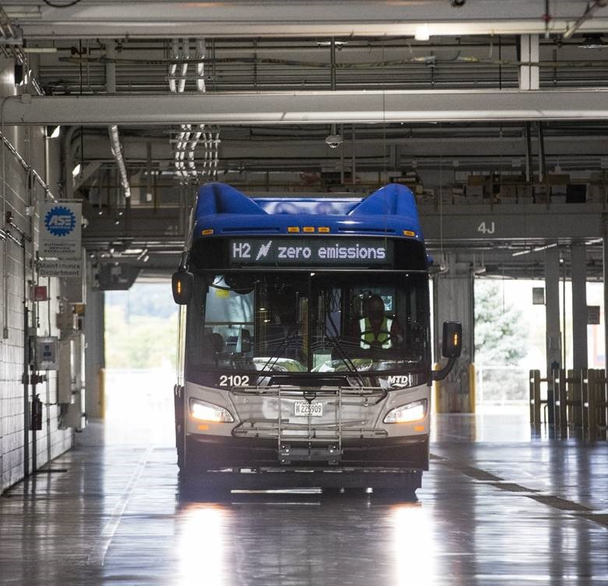
FTA Zero-Emission Funding Programs
How can FTA fund your zero-emission projects?
Low-No: Supports transition of the nation’s transit fleet to the lowest polluting and most energy efficient transit vehicles.
Available Funds: $1.2 Billion
Buses and Bus Facilities: Funds to replace, rehabilitate, and purchase buses and related equipment and to construct bus-related facilities
Available Funds: $469 Million
Notes:
Please note if submitting to both programs, a separate application package must be submitted to each opportunity ID

Slide 17
Matching Funds
Federal share of the cost is not to exceed:
85% of bus lease/purchase cost
90% of equipment and facilities net project cost
Applicants must identify these specific activities in their application to receive this increased federal share
Agencies must cover the rest of the cost.
Notes:
“All eligible expenses under the Low-No Program are attributable to compliance with the Clean Air Act and/or the Americans with Disabilities Act. Therefore, the Federal share of the cost of leasing or purchasing a transit bus is not to exceed 85 percent of the total transit bus cost. The federal share in the cost of leasing or acquiring low- or no-emission bus-related equipment and facilities is 90 percent of the net project cost. Applicants must identify these specific activities in their application in order to receive this increased federal share.” - FTA

Slide 18
FTA Zero-Emission Funding Programs
One Notice of Funding Opportunity (NOFO) for both programs
Applicants can apply for one or both programs
Last application period was January 27 - April 13, 2023
130 projects were awarded in 2023
Funds remain available for obligation for four fiscal years. This includes the fiscal year in which the amount is made available or appropriated plus three additional years.
FTA received 475 eligible project proposals totaling approximately $8.7B in requests.
Notes:
Please note if submitting to both programs, a separate application package must be submitted to each opportunity ID

Slide 19
Low-No Program: Eligible Activities
Activity | Low-No | BBF
Purchase/lease low/no- emission buses | ✓
Acquire low/no- emission buses with leased power source | ✓
Construct or lease facilities and equipment | ✓
Intelligent tech/software for low/no- emission buses | ✓
New public transit facilities | ✓
Upgrade existing transit facilities | ✓
Workforce Training | ✓ | ✓
Purchase low/no- emission buses, vans, and equipment |  | ✓
Replace buses and related equipment |  | ✓
Rehabilitate buses, vans, and related equipment |  | ✓
Intelligent tech/software for low/no- emission buses |  | ✓
Construct bus related facilities |  | ✓

Slide 20
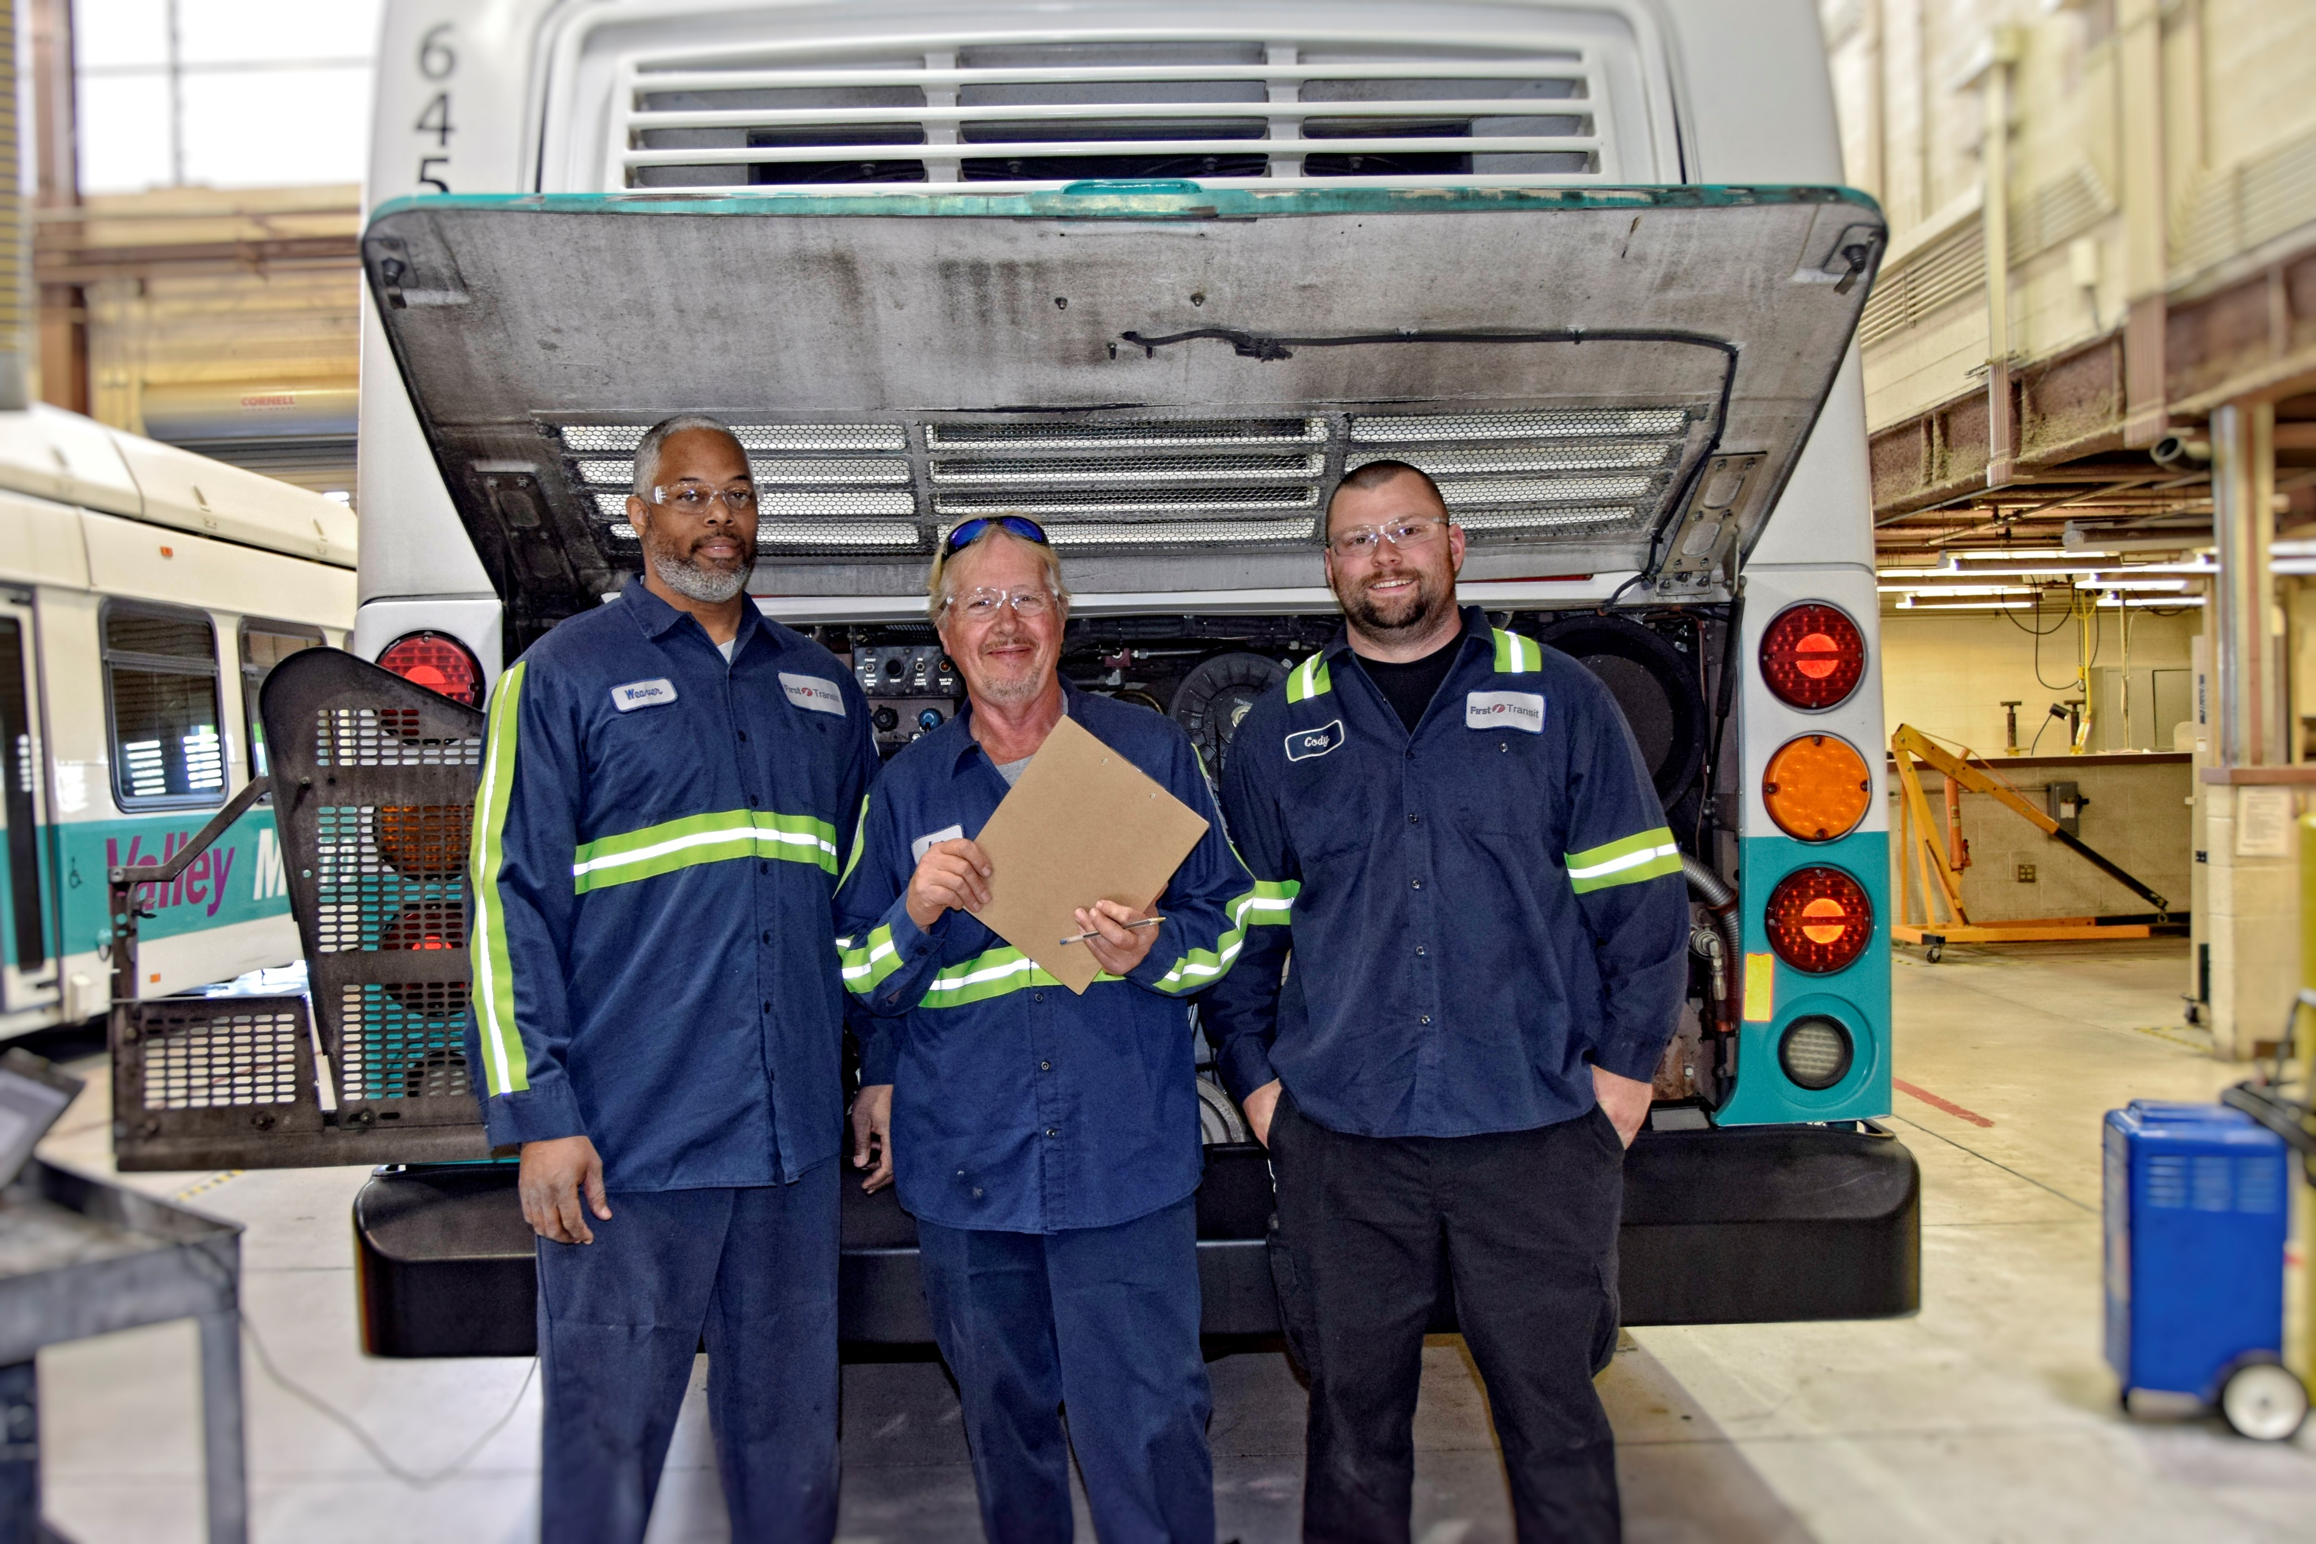
Workforce Training
0.5% of a request may be for workforce development training and an additional 0.5% may be for training at the National Transit Institute (NTI).
Any ZEV project must spend 5% of the award on workforce development and training according to the ZET Plan
FTA likes to see applications that include:
Apprenticeships for skilling current and entry-level staff
Partnerships with workforce development programs
Supportive services (childcare, tools, attire, etc.)
Workforce input on fleet transition plan
Apprenticeships for skilling current and entry-level staff
Promoting underrepresented groups

Slide 21
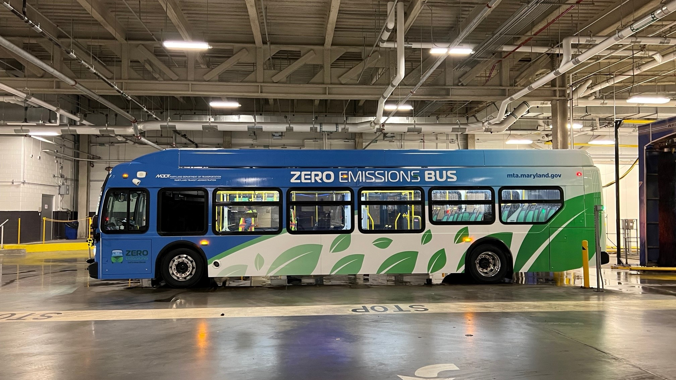
Sample Study: Maryland Transit Administration
Notes:
Largest Mtro in Pheonix Arizona, fixed bus route, low no application

Slide 22
MDOT MTA’s ZE Transition
In 2019 MDOT MTA committed to transitioning 50% of Core Bus fleet to ZEBs by 2030
Only ZEBs will be procured after 2023
MDOT MTA is in its third phase of ZE transition planning:
Phase I – analyzed baseline conditions and developed four scenarios
Phase II – recommended two final alternatives: full conversion of one bus facility and 50% conversion of another
Phase III – testing and implementation
Notes:
WSP’s in-house modeling tool, Lightning Bolt, analyzes several factors that may impact the performance of a BEB, including specific operating conditions of an agency,

Slide 23
Case Study: Fleet
Vehicle Delivery Schedule to 2030
Vehicle Procurement Schedule
Vehicle Costs
Operational Costs
Phased procurement / Pilot Testing
Notes:
WSP’s in-house modeling tool, Lightning Bolt, analyzes several factors that may impact the performance of a BEB, including specific operating conditions of an agency,

Slide 24
Case Study: Regulations
Yearly Legislative Report requires MDOT MTA to provide updates on transition plan progress
2016 Maryland Greenhouse Gas Reduction Act Reauthorization set 40% reduction target for statewide emissions by 2030 from 2006 levels
Maryland Department of Energy proposed the Greenhouse Gas Reduction Act Plan (GGRA) in 2019 to meet this target
2022 Zero-Emissions Bus Transition Act dictates that no additional orders for ICEBs be made after FY 2022

Slide 25
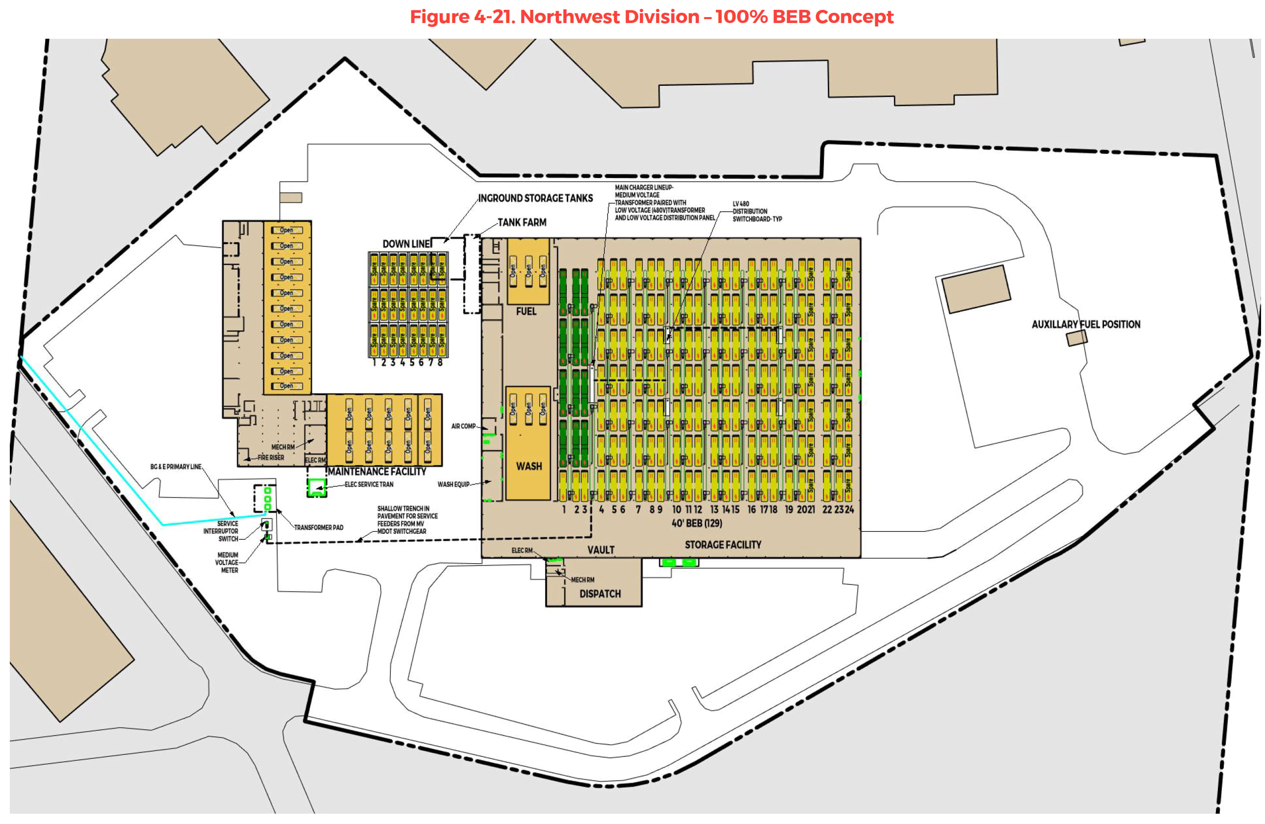
Case Study: Facilities
Northwest Division – 100% BEB Concept
Facility existing conditions
Facility power needs
Full and partial BEB conversion concepts
FCEB concept for Northwest
Types of EVSE
Proposed facility phasing

Slide 26
Case Study: Utilities
Coordinated with BGE
Analyzed existing power facilities and BGE service
Identified service upgrades needed to convert each facility
Discussed resiliency strategies such as microgrids and charge management
Microgrid Layout

Slide 27
Case Study: Workforce
Developed comprehensive Workforce Development Plan including:
Job classifications impacted by the transition
Types of training each classification needs to receive
Required training modules by job classification
Implementation strategy for training deployment
Training delivery schedule based on fleet and infrastructure arrival time
MDOT MTA is developing a registered apprenticeship program in partnership with labor union

Slide 28
References
FTA Zero-Emission Fleet Transition Plan: https://www.transit.dot.gov/funding/grants/zero-emission-fleet-transition-plan
Low or No Emission Vehicle Program: https://www.transit.dot.gov/lowno
Grants for Buses and Bus Facilities Program: https://www.transit.dot.gov/bus-program
FY23 FTA Bus and Low- and No-Emission Grant Awards: https://www.transit.dot.gov/funding/grants/fy23-fta-bus-and-low-and-no-emission-grant-awards
MDOT MTA’s Zero Emission Bus Transition: https://zeb.mta.maryland.gov/

Slide 29
Thank You!
C O N T A C T D E T A I L S
Chris Wenz
Senior Director, Asset Management
WSP USA, Washington, DC
christopher.wenz@wsp.com
Severin Skolrud
Vice President, Transit & Rail
WSP USA, Washington, DC
severin.skolrud@wsp.com

Slide 30
Questions?

Slide 31
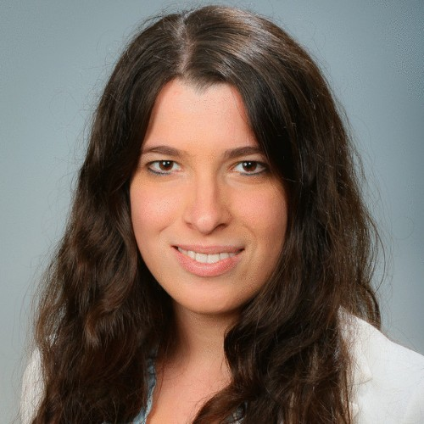
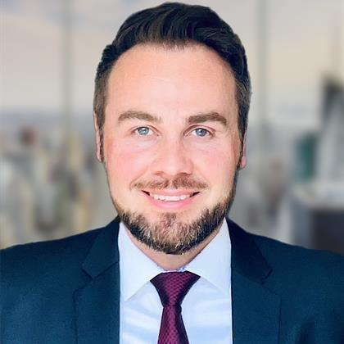
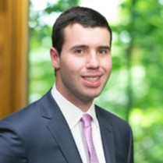
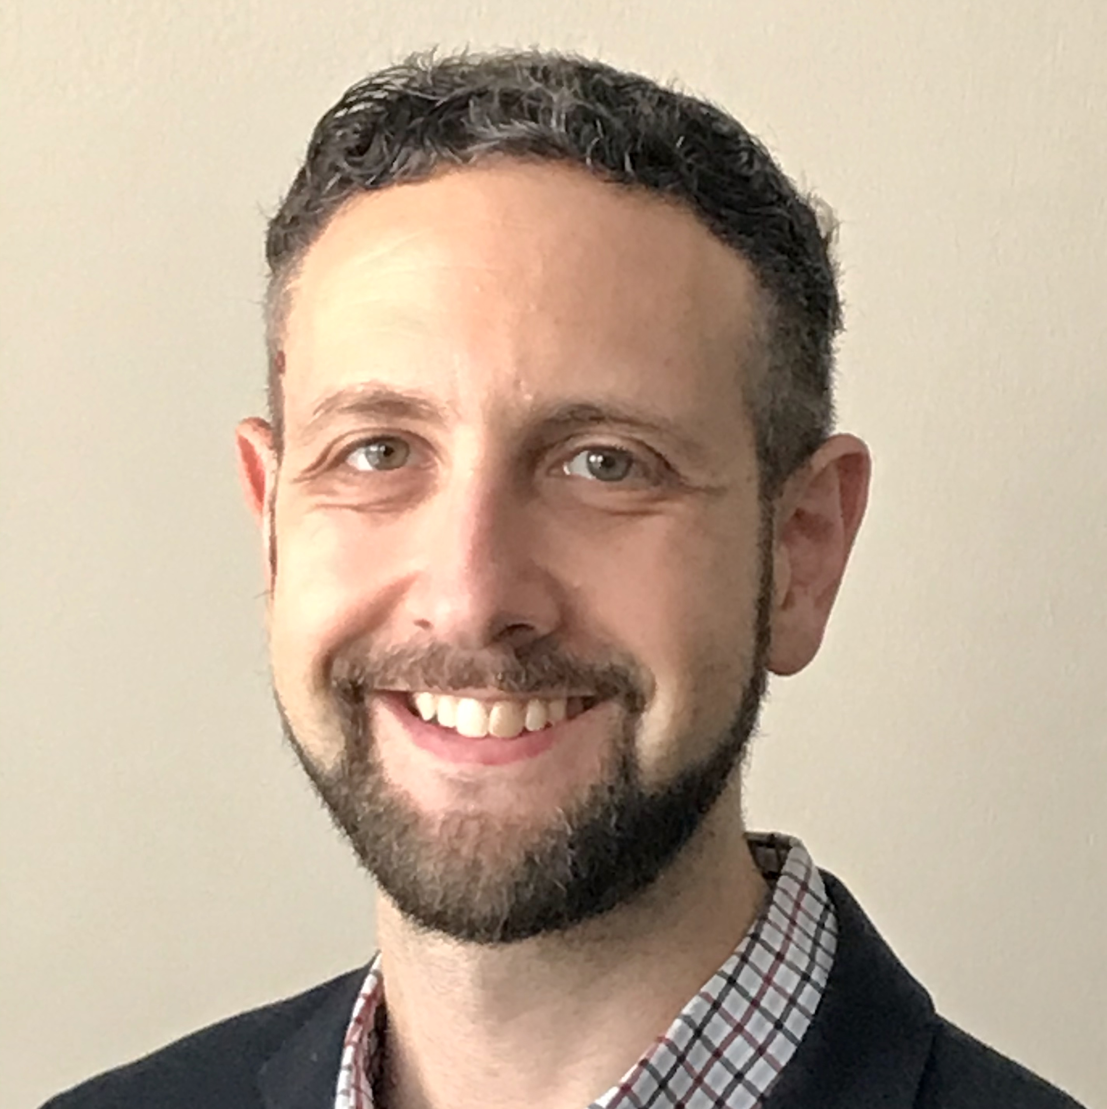
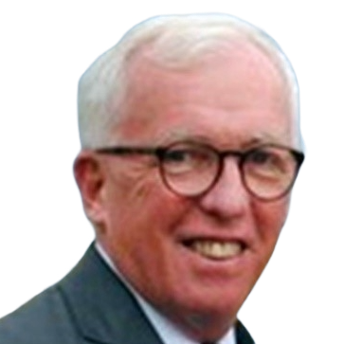
Zero Emissions Team
Emerging Tech Department (DC, Maryland, Virginia)
Michelle Bisceglia
Transit Analyst
Zero-Emissions Transition Planning
Transit Analysis and Data Analytics
Mike Butler
Program Lead - Zero Emissions Mobility
Zero-Emission Program Management
Transit Planning & Engineering
Zachary R. Falk
Emerging Tech Project Manager
Zero-Emissions and Bus Fleet Planning
Microtransit and Transportation Policy
Harsheeta Gupta
Emerging Tech Consultant
Transit Analysis and Management
Customer experience
Auden Kaehler
Manager for Highway/Tolling PD&F
Lifecycle Cost Modeling
Financial Analysis
David Koch
Program Lead - Zero Emissions Vehicles
ZE Transitions and Planning
Transit Planning and Operations
Severin Skolrud
Emerging Tech Dept. Lead,
National Fleet & Facilities
Zero-Emission Program Development
Bus Automation Research & Deployment
Christopher Wenz
Senior Director, Asset Management & Business Advisory
Transportation Asset Management
Zero Emission Transitions

Slide 32
Case Study: Finance
Updated lifecycle cost analysis to:
Analyze projected cost of purchasing, maintaining, and charging the fleet until full conversion
Compare projected transition costs with cost of continuing to operate diesel fleet
Results showed that full lifecycle costs of BEB is higher than continued reliance on diesel
Fueling cost savings are lower for BEBs than for diesel buses
Overall operating costs for BEBs are higher than for diesel buses
High capital costs of BEBs and infrastructure may offset fuel savings

