Slide 1
Three Types of Transit Management

Slide 2
Training Objectives
Define and make a distinction between Leaders, Managers, and Supervisors.
Explore the potential idiosyncrasies of these roles within the Transit environment.
Identify the skill sets necessary of these Transit professionals.
Share tips for nurturing the talents and skills in these roles.

Slide 3
Types of Management
Leader
Manager
Supervisor
Senior level management position
Creates the Vision and looks to the future
Focus on developing change, empowering and using influence
Use influence - evaluate risk and use potential for change and ways to be alive and competitive
Middle-level management position
Works with HR to hire new talent
Focus on processes and planning for the team’s future
Authority to promote or let employees go
Entry-level management position
Train new employees
Focus on individual performance and give feedback
Authority to recommend promotions/ dismissal

Slide 4
Leaders/Managers/Supervisors
Leaders focus on creating a vision, inspiring others, and adapting to change.
See the “forest” and how it impacts the world.
Managers often oversee an entire department or division, including not only the people but also the processes and equipment.
See the “trees” and how they live together.
Supervisors manage a team based on preexisting organizational goals and guidelines.
Work tree by tree.

Slide 5
Notes:
https://www.youtube.com/watch?v=EyI_ISMlndI

Slide 6
Identify levels
Leaders- any individual who takes full ownership of his or her actions and behaviors, and who positively influences the actions and behaviors of others
Leadership is a choice – not a position.
Managers – balance the needs of the employees, company, and customers.
Supervisors – direct line and customer service. Often the root cause area of most workplace issues/problems/accidents.
Not all are meant to do each role.

Slide 7
Exercise/Discussion
On an Index card please write down:
Does your organization have leaders?
How many and What do they do?
Does your organization have managers?
How many and What do they do?
Does your organization have supervisors?
How many and What do they do?
Notes:
On an index card

Slide 8
Leaders
Traits of effective leaders are effective communication, having a vision and ensuring it transforms, trust, being innovative, and being inspiring
Setting and persuading people to follow their clear set direction.
The process is transformational: develop a vision and find a way forward.
Skills:
Written and Verbal Communication
Develop and articulate a vision.
Establish direction.
Develop change strategies.
Focus on outward areas and risk.
Do the right things, inspire, create.
Use influence and conflict to overcome barriers.

Slide 9
Managers
Skills:
Traits of effective managers are effective communication, ability to delegate, being caring, empowering, and results-oriented
Set tasks and assign resources for employees to carry out the tasks.
Their process is transactional: meet objectives and delegate tasks.
Written and Verbal Communication
Execute plans looking for areas of improvement via detailed processes and procedures.
Focus inward on issues in the organization and process for managing change and solving problems.
Use authority, avoid conflicts, act within risks set and achieve organizational key results.

Slide 10
Supervisors
Traits of effective supervisors are effective communication, empathy, conflict resolution, leadership, and time management
Involves coaching and mentoring individuals.
Their process is transactional: to monitor, follow, carefully enforce rules, reward success, and punish failure.
Skills:
Written and Verbal Communication.
Decision-making.
Interpersonal skills.
Adaptability.
Time Management.
Conflict resolution.
Willingness to learn.

Slide 11
Exercise/Discussion
Leaders, Managers, Supervisors Exercise:
Review each area
Add in areas of opportunity in your organization
Skills Spreadsheet:
Review each area
Place a check on areas that are going well and an X on areas needing improvement
Please feel free to add appropriate areas as well
Notes:
Hand outs
<iframe width="413" height="232" src="https://www.youtube.com/embed/N7YWMUgEbiE" title="8 Minute Timer" frameborder="0" allow="accelerometer; autoplay; clipboard-write; encrypted-media; gyroscope; picture-in-picture; web-share" allowfullscreen></iframe>

Slide 12
Communication
Express oneself effectively in both individual and group settings.
Communicates plans and activities in a manner that supports strategies for employee involvement.
Creates a clear picture of what matters.
Provides timely information people need to do their jobs and to feel good about being a member of the team.
Enables the open flow of information while maintaining appropriate confidentiality.
Actively listens to others and values other’s input.
Sends clear verbal and nonverbal messages.
Expresses written ideas clearly, using good grammatical form.
Comprehends written materials with little or no help.

Slide 13
Barriers to Effective Communication
Fear of Conflict
Fear of Rejection
Low Self Esteem
Passive Aggressive
Truth
Blame
Need to be a Victim
Defensiveness
Mistrust
Selfishness
Self-Deception
Emotional Perfectionism

Slide 14
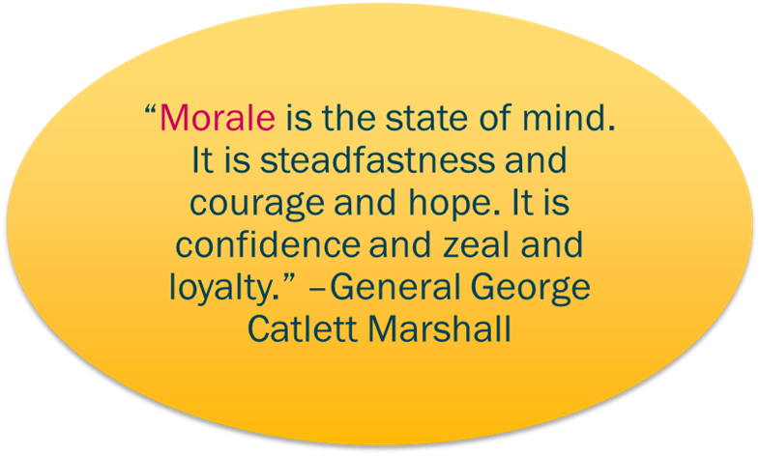
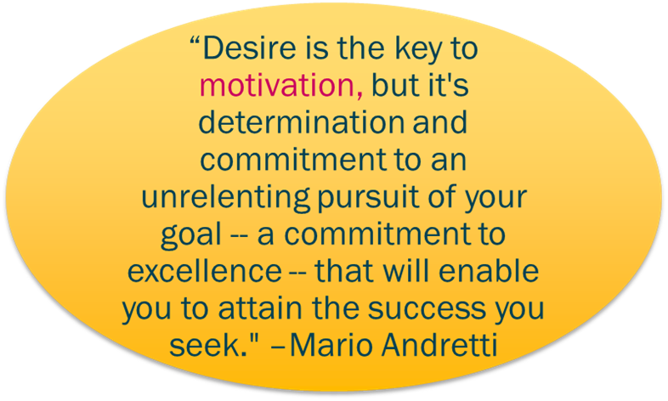
Understanding Morale and Motivation
Morale: the satisfaction derived by an individual from his job, his work group, his superior, the organization he works for, and the environment. It generally relates to the feeling of an individual’s comfort, happiness, and satisfaction; a group concept.
Motivation: internal-psychological drive of an individual that urges him/her to take action toward a specific goal; an individual concept.

Slide 15
COLLECTIVE, Complex TRAUMA
Notes:
As leaders prior to 2020 we supported employees struggling with a loved one’s substance abuse, navigating divorce or the stress of taking on caregiving for an aging parent – experiences we may or may not have gone through ourselves. What’s different now is that we’ve all experienced collective, complex traumatic experiences: the pandemic, racial reckoning, intense political division, etc. The ripple effects of this are showing up in the workplace.

Slide 16
Emotional Impact of Stress
Overwhelmed | Irritable | Angry
Anxious | Frustrated | Lonely
Grieving | Afraid | Sad
Notes:
Chronic levels of stress create a sort of tunnel vision in which our minds can only see what’s right in front of us. It also makes us more susceptible to focusing more on the negative. It heightens feels of frustration, fear, uncertainty and irritability.
As leaders its important to not just practice empathy with others, but also hold ourselves with the same care, concern and compassion. It’s been difficult for us too.

Slide 17
Components of Empathy
EMPATHY
See their reality
Appreciate them as human beings
Understand their feelings
Communicate understanding
“Empathy is not connecting to an experience; it’s connecting to the emotions that underpin the experience.”
Dr. Brene Brown, Ph.D.
Notes:
There are 4 key components of empathy. Let’s take a closer look at each.
Empathy vs. Sympathy
Empathy - how much compassion and understanding we can give to another; the ability to understand how someone feels.
Sympathy is more of a feeling of pity for another; our relief in not having the same problems.

Slide 18
Creating a Team
Uses appropriate interpersonal style to steer team members towards the goal.
Allocates decision-making and other responsibilities to the appropriate individuals.
Organizes resources to accomplish tasks with maximum efficiency.
Influences events to achieve goals beyond what was called for.
Willingly helps out where needed.

Slide 19
Wrap-up and Questions
Thank you!

