Slide 1
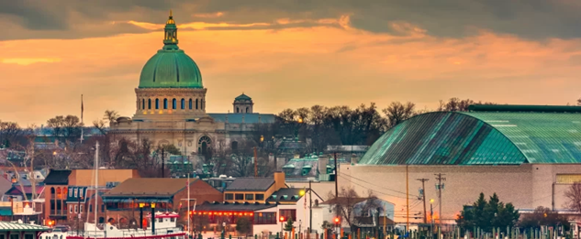
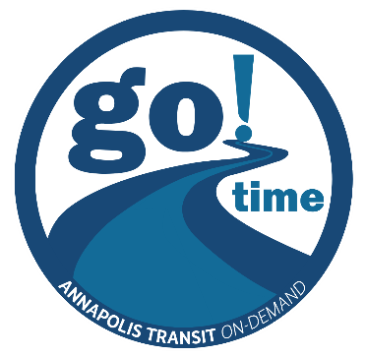
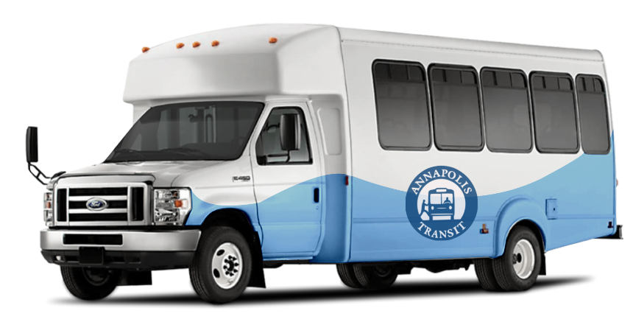
Annapolis Go Time Microtransit: Insights After a Year

Slide 2
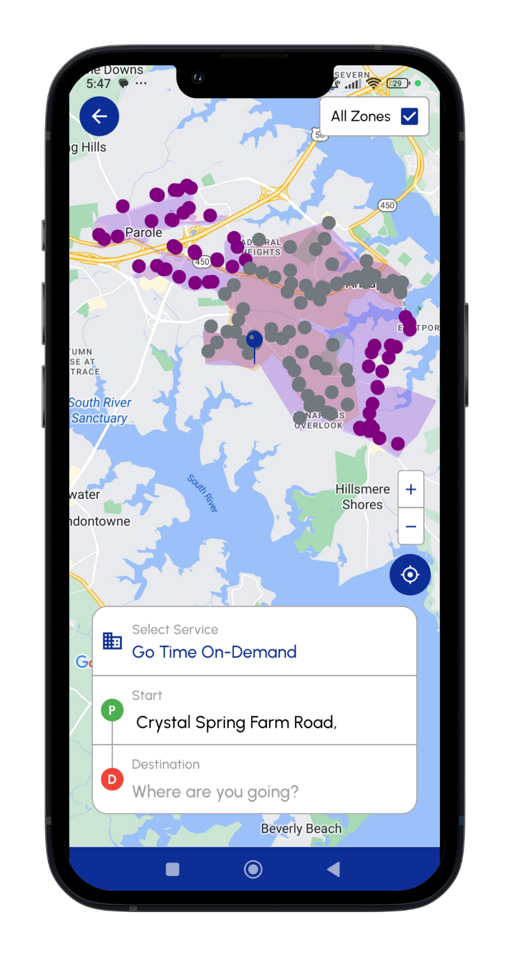
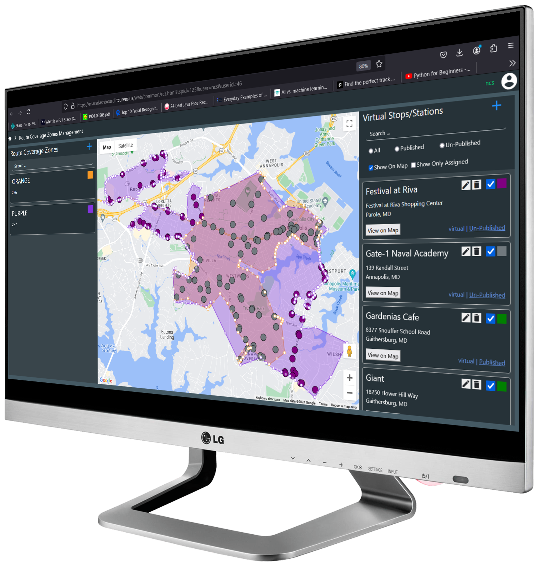

GO TIME Annapolis PiLot PROGRAM:
Program Start Date: July 15th 2024
2019 Annapolis Transit Development Plan Recommendation: Convert the lowest performing fixed route (Orange Route) to a microtransit service
Expanded the scope of the project to include the Purple routes, which are used for reduced service in the evening on weekdays and Saturday, and all-day Sunday
In January 2024, selected IT Curves to be our technology partner after competitive bidding process.

Slide 3

GO TIME Annapolis PiLot PROGRAM:
Objectives
Expand service area
Improve customer experience
Increase ridership

Slide 4
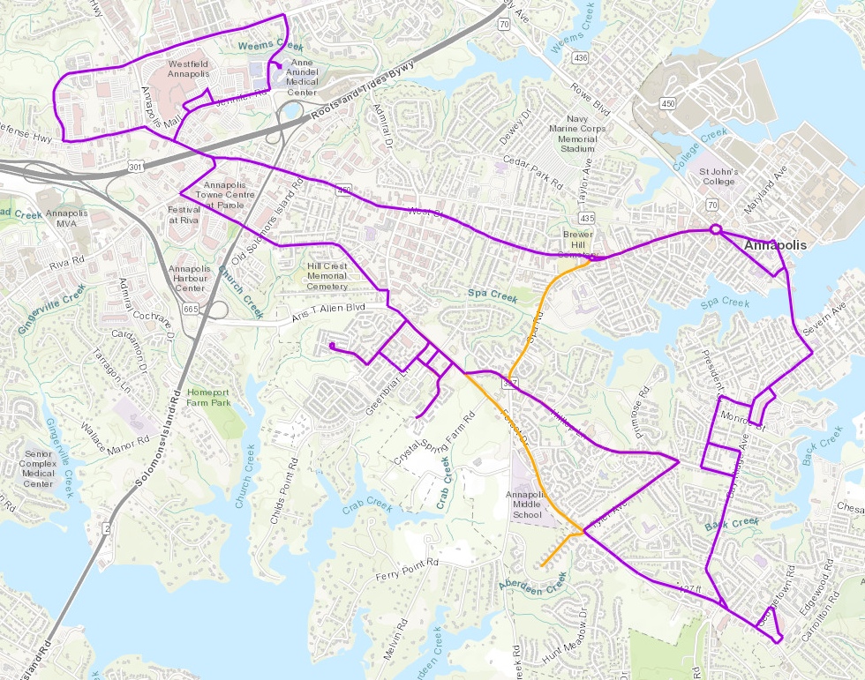
Fixed route bus service area

Slide 5
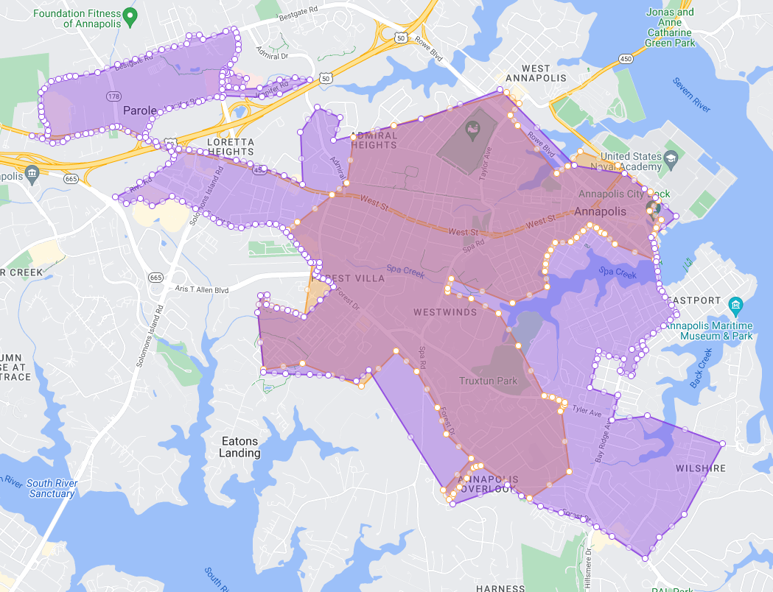
Microtransit service area

Slide 6
Two overlapping Zones:
Orange Zone:
Covers Most of the Downtown area beyond the Orange fixed route service area
75 Virtual Stops
Service Time: 5:30 AM – 7:00 PM, Mon – Fri
1 or 2 vehicles daily
Purple Zone:
Covers the entire service area
133 Virtual Stops
Service Time:
7:00 PM to 10:30 PM, Mon - Sat
7:00 AM to 8:00 PM Sunday
Up to 4 vehicles daily

Slide 7
LESSON LEARNED:
Expansive Service Zones
Large service areas stretch resources thin
Excessive wait times during:
Weekday evenings
Saturday evenings
Sunday service
Only 4 vehicles covering fixed routes in a 20 sq. mile service area

Slide 8
LESSON LEARNED:
Solution
Conduct a feasibility study to determine:
Appropriate service zones
Optimal resource allocation

Slide 9
LESSON LEARNED:
Technology
Reliable technology is essential for microtransit success
Challenges
App failures: glitches in booking and routing
Institutional challenges:
Annapolis IT department handles all city IT needs → limited staff to resolve issues quickly
Developer accounts managed by different city departments
Example: Apple developer account under City’s Office of Emergency Management (OEM)
Updating the app through OEM causes unnecessary delays

Slide 10
LESSON LEARNED:
Solutions
Technology must be user-friendly and stable
Provide seamless booking, clear ETA, and real-time vehicle tracking
Transit agency must directly control developer accounts (App Store & Google Play) to avoid update delays

Slide 11
LESSON LEARNED:
Environmental Impacts
Inefficient operations → more vehicle miles
Caused by:
Large service zones
Inefficient routing
Solutions
Optimize routing
Define appropriate service zones
Use electric vehicles to align with sustainability goals

Slide 12
Service DATA:
FY 2025
Route Name | Ridership per Vehicle Revenue Mile | Ridership per Vehicle Revenue Hour
Red | 0.40 | 4.69
Green | 0.93 | 9.01
Brown | 0.58 | 7.85
State Shuttle | 1.54 | 17.71
Go Time Microtransit | 0.26 | 3.17
FY 2024
Orange/Purple** | 0.25 | 3.51
** average

Slide 13
Service DATA:
FY 2025
Route Name | Operating Cost per Vehicle Revenue Mile | Operating Cost per Vehicle Revenue Hour | Operating Cost per Trip
Red | $10.92 | $129.14 | $27.54
Green | $12.88 | $124.94 | $13.86
Brown | $9.46 | $127.42 | $16.23
State Shuttle | $12.65 | $145.70 | $8.23
Go Time Microtransit | $10.48 | $128.43 | $40.48
FY 2024
Orange/Purple** | 9.76 | 136.60 | 38.98
** average

Slide 14
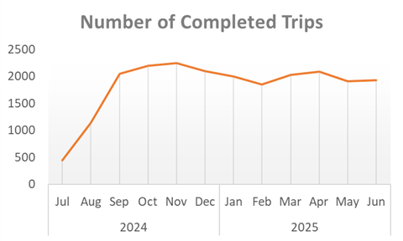
2024-2025 Growth Patterns:

Slide 15
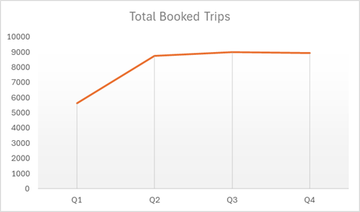
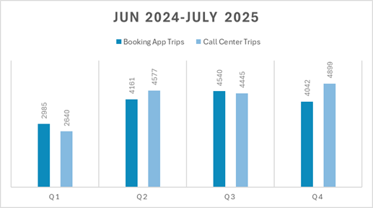
2024-2025 Growth Patterns:

Slide 16
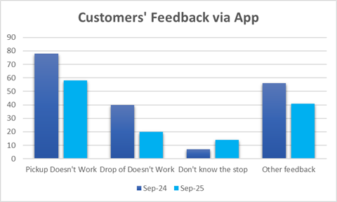
Customers’ Experience & FEEDBACK

Slide 17
CONCLUSIONS
We present our experience with the implementation of microtransit service and seek to contribute to an improved understanding of microtransit costs, advantages, and current challenges.
The lessons learned from Annapolis Go-Time microtransit experience will assist planning and transportation agencies to plan and design successful microtransit systems.

