Slide 1





ANNE ARUNDEL COUNTY
OFFICE OF TRANSPORTATION
Presented By:
SAMUEL SNEAD
WWW.AACOUNTY.ORG/TRANSIT

Slide 2
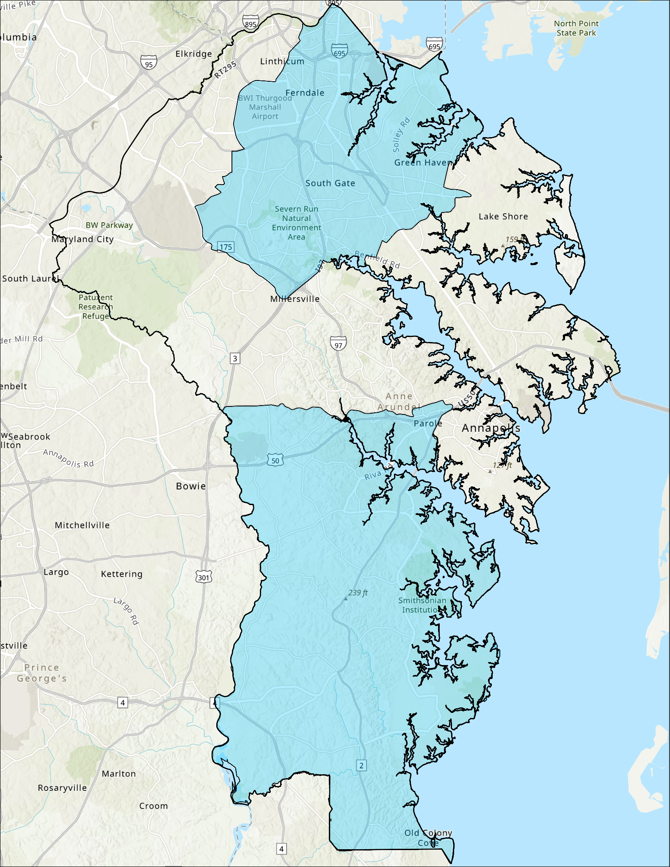
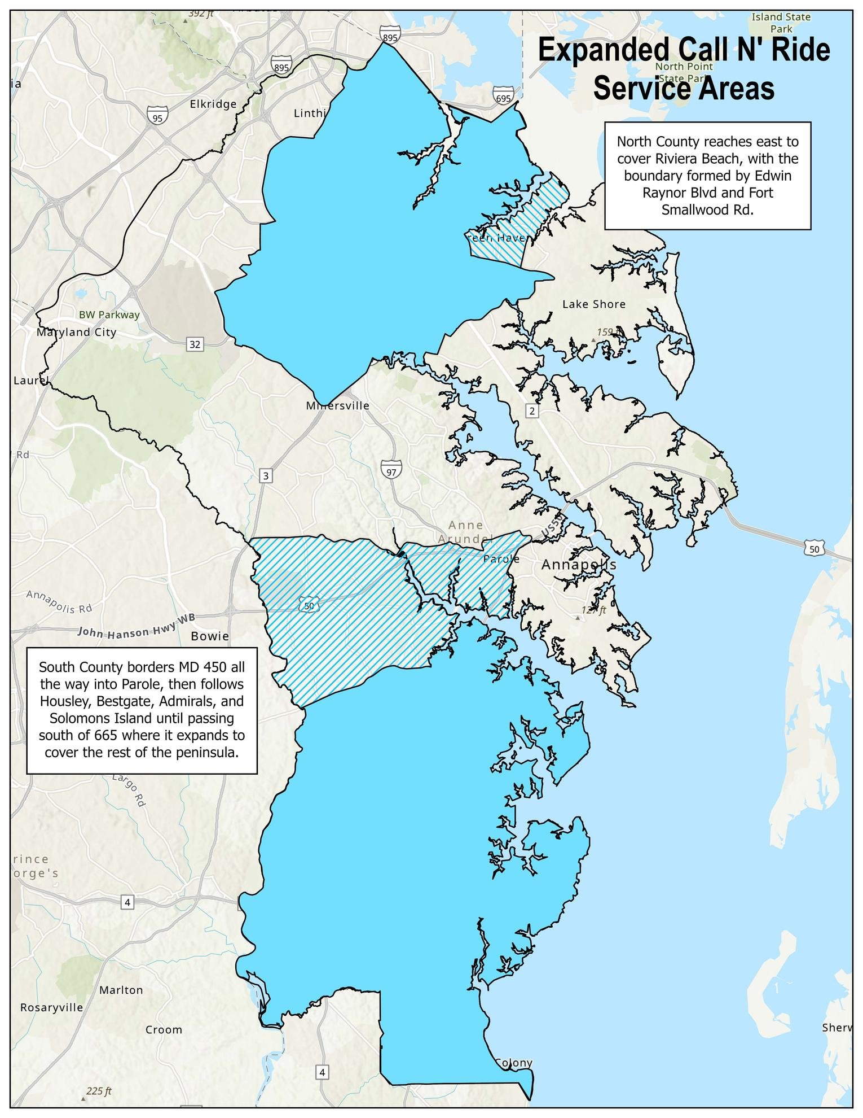
INTRODUCTION
The ultimate goal of our office is to provide transit services to every household and business in AACO. While we operate a robust fixed-route network, we realize there are many residents who are still outside that network.
Our Call N’ Ride services seek to address this gap by providing point-to-point transit for anyone in the North or South County zones. Over the past three years, we have continually worked to expand the coverage area of these zones, and our proud to say that we now have service to more than 50% of county businesses and residents

Slide 3

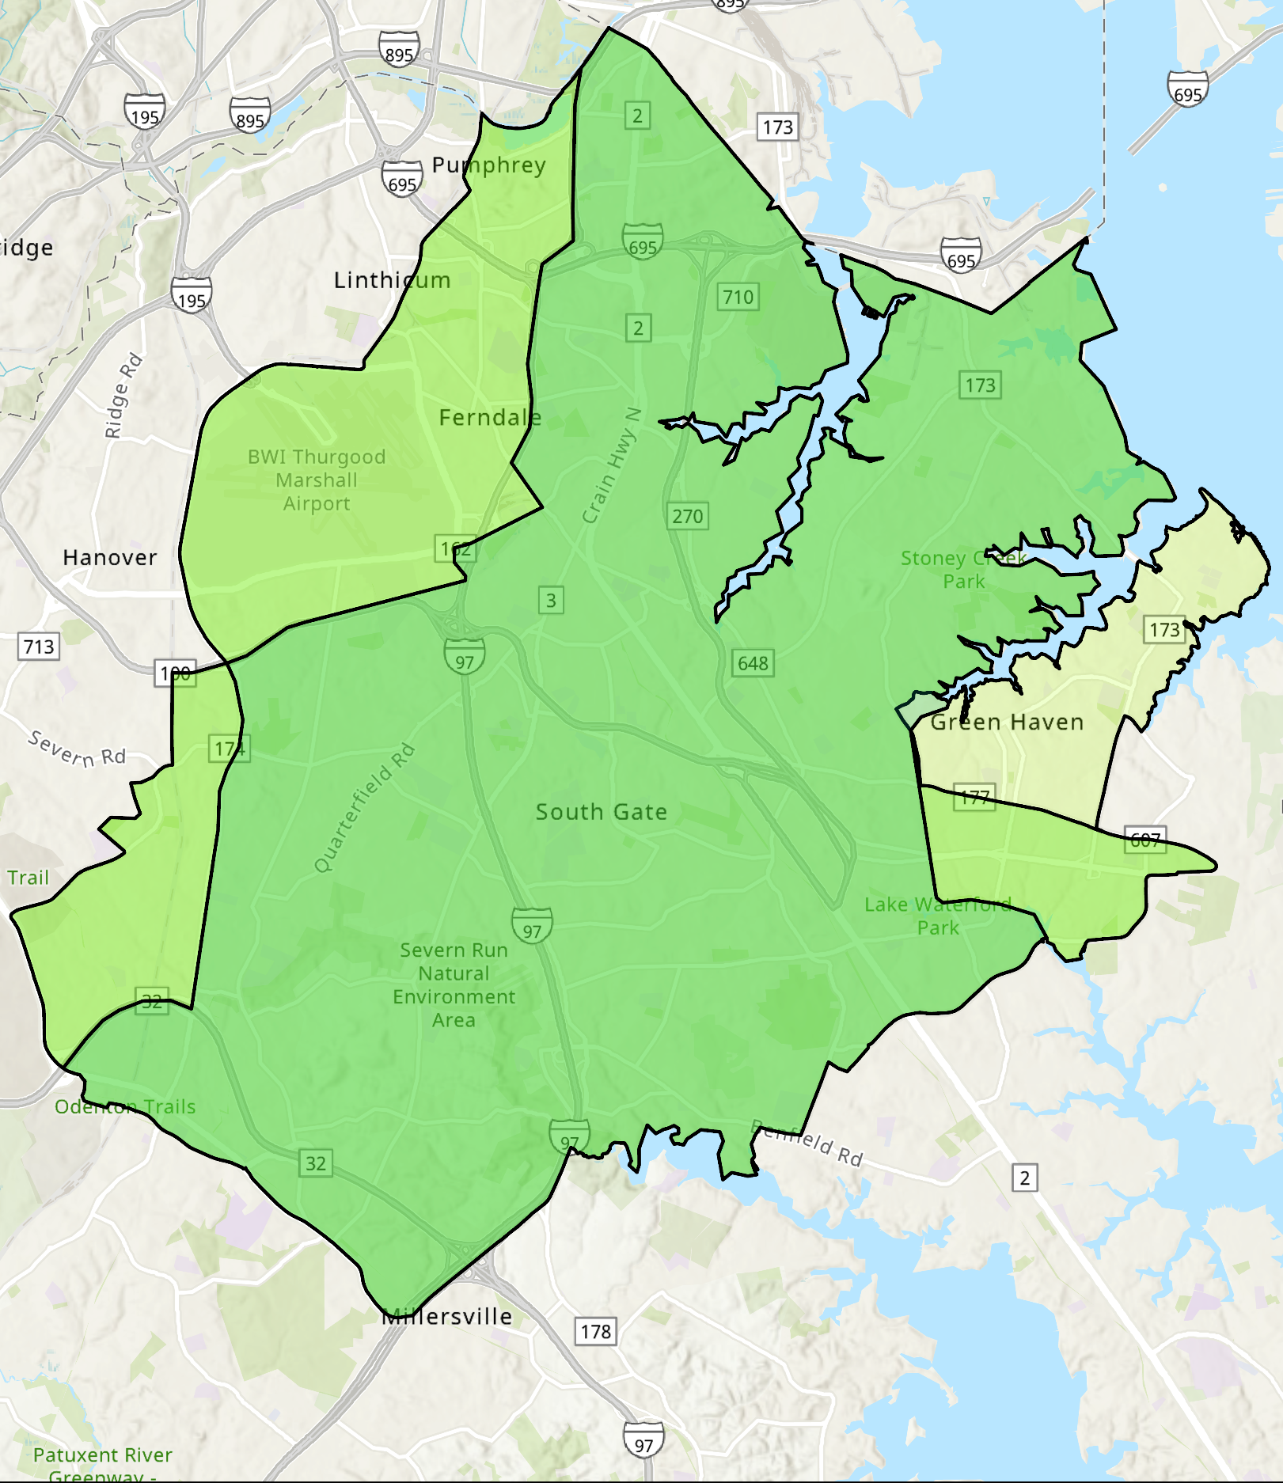

NORTH COUNTY
CALL N’ RIDE
Fastest-growing microtransit zone.
Expanded in 2023 to cover BWI, Jacobsville, and discontinued Shopper Shuttle service.
Riviera Beach peninsula added in 2025.
Pingo app now available across both zones.
2023
2025
2022
2023
2023
On-Demand services operates
*7am - 7pm
*Monday - Saturday
Population Served:
2022: 155,479
2023: 192,044
2025: 215, 159
AACO: 592,695

Slide 4
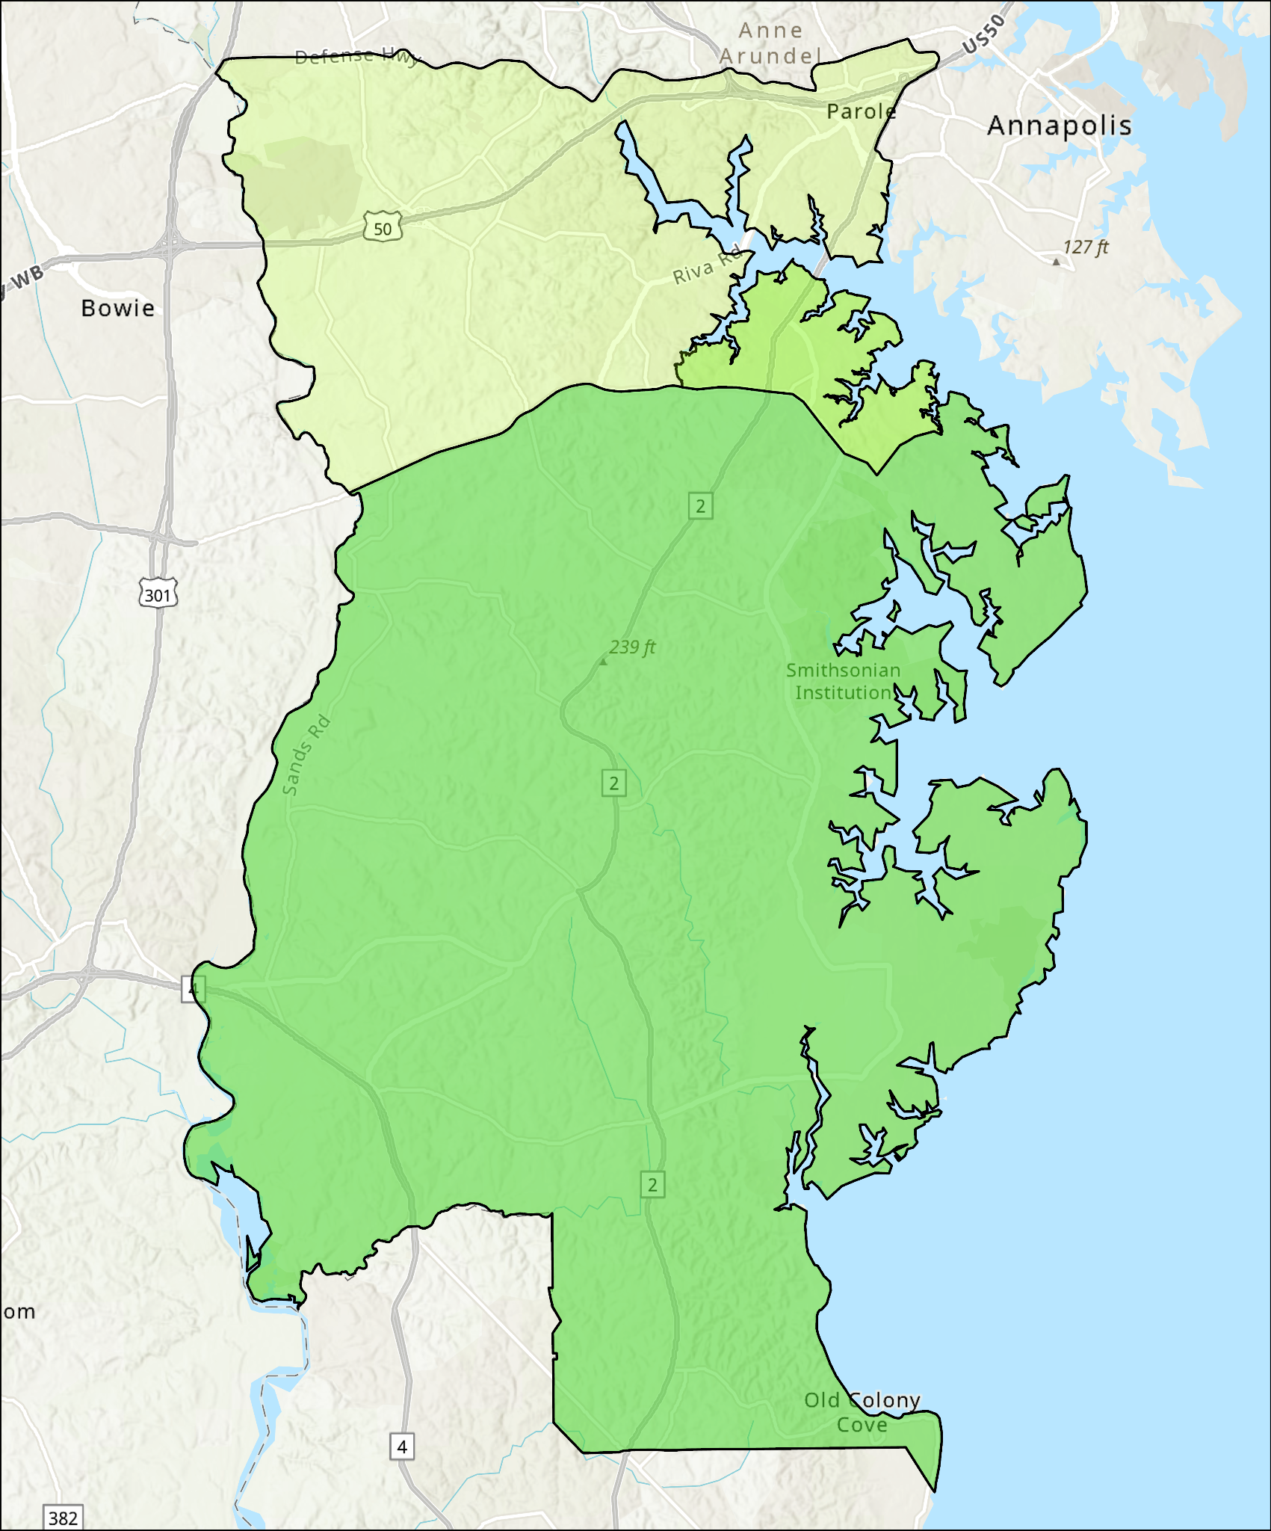
SOUTH COUNTY
CALL N’ RIDE
2025
2023
First microtransit service in AA county.
Replaced the seldom used South County Circulator.
Edgewater service added at public request in 2023.
Service extended to Crofton & Parole in 2025 as a replacement for fixed-route.
2022
On-Demand services operates
*7am - 7pm
*Monday - Friday
Population Served:
2022: 37,342
2023: 47,584
2025: 70,319
AACO: 592,695

Slide 5
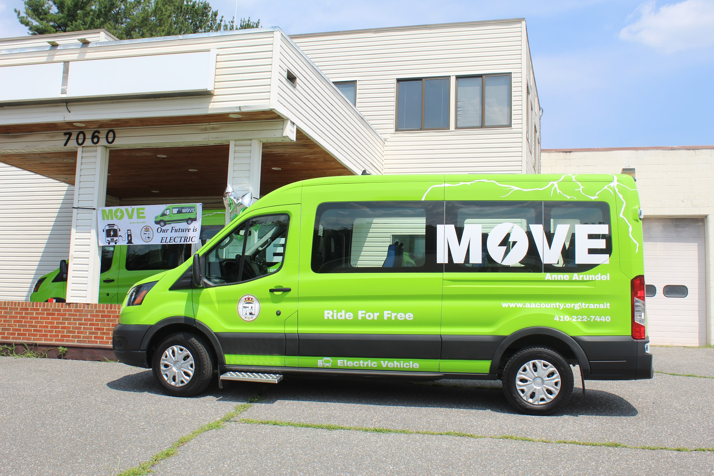
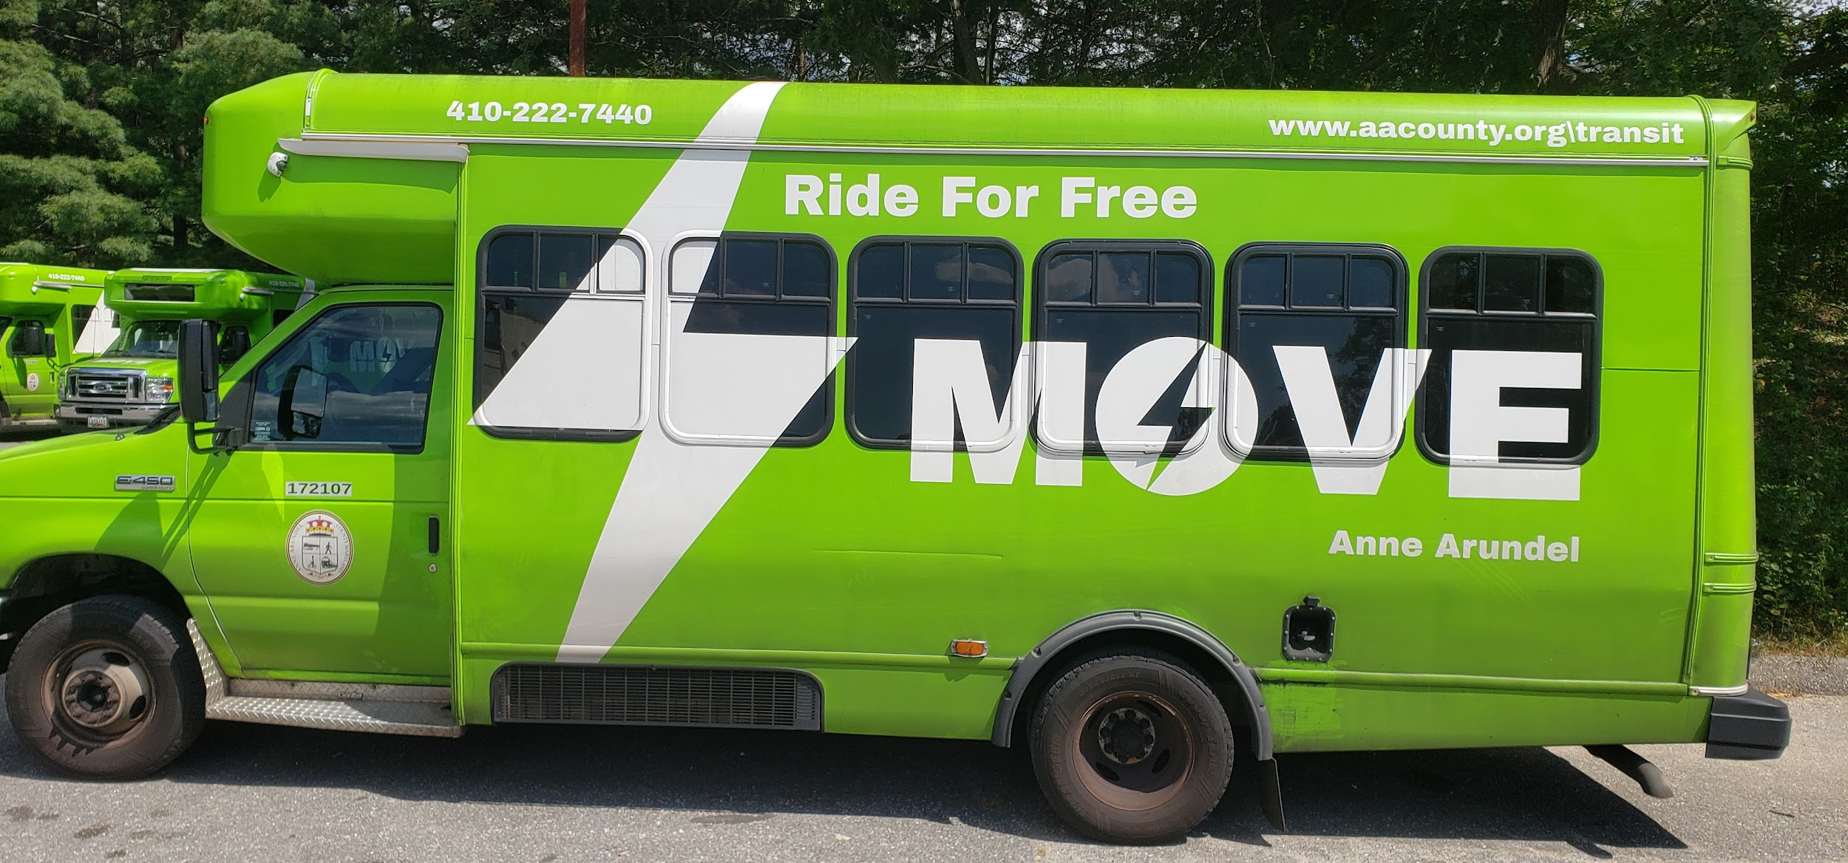
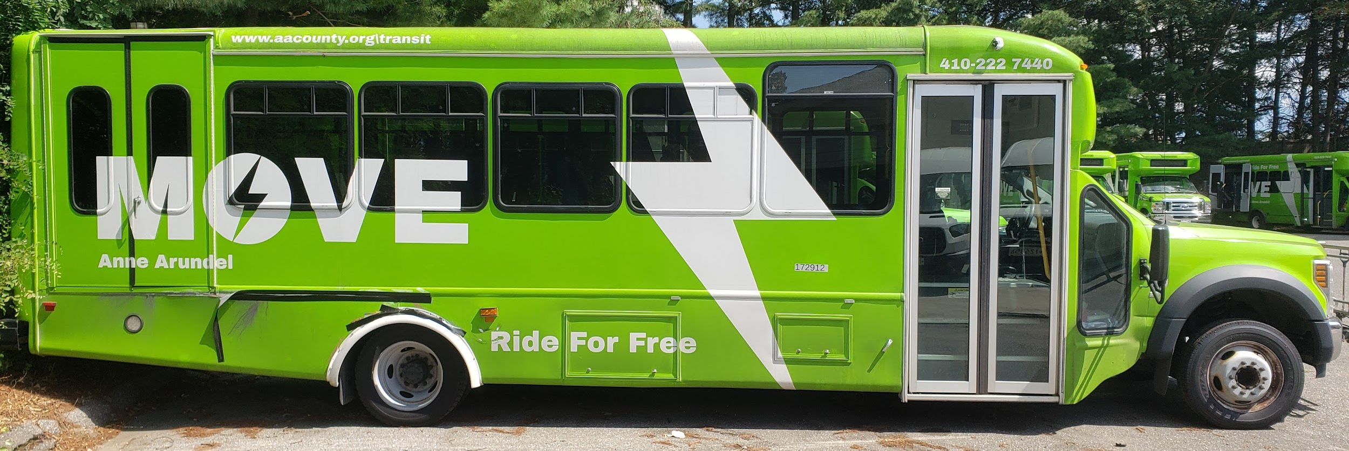
FLEET EXPANSION

Slide 6
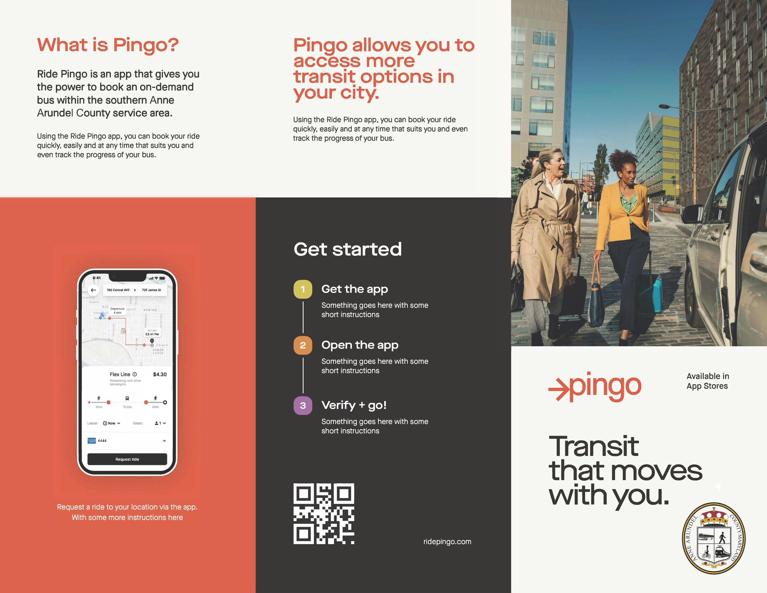
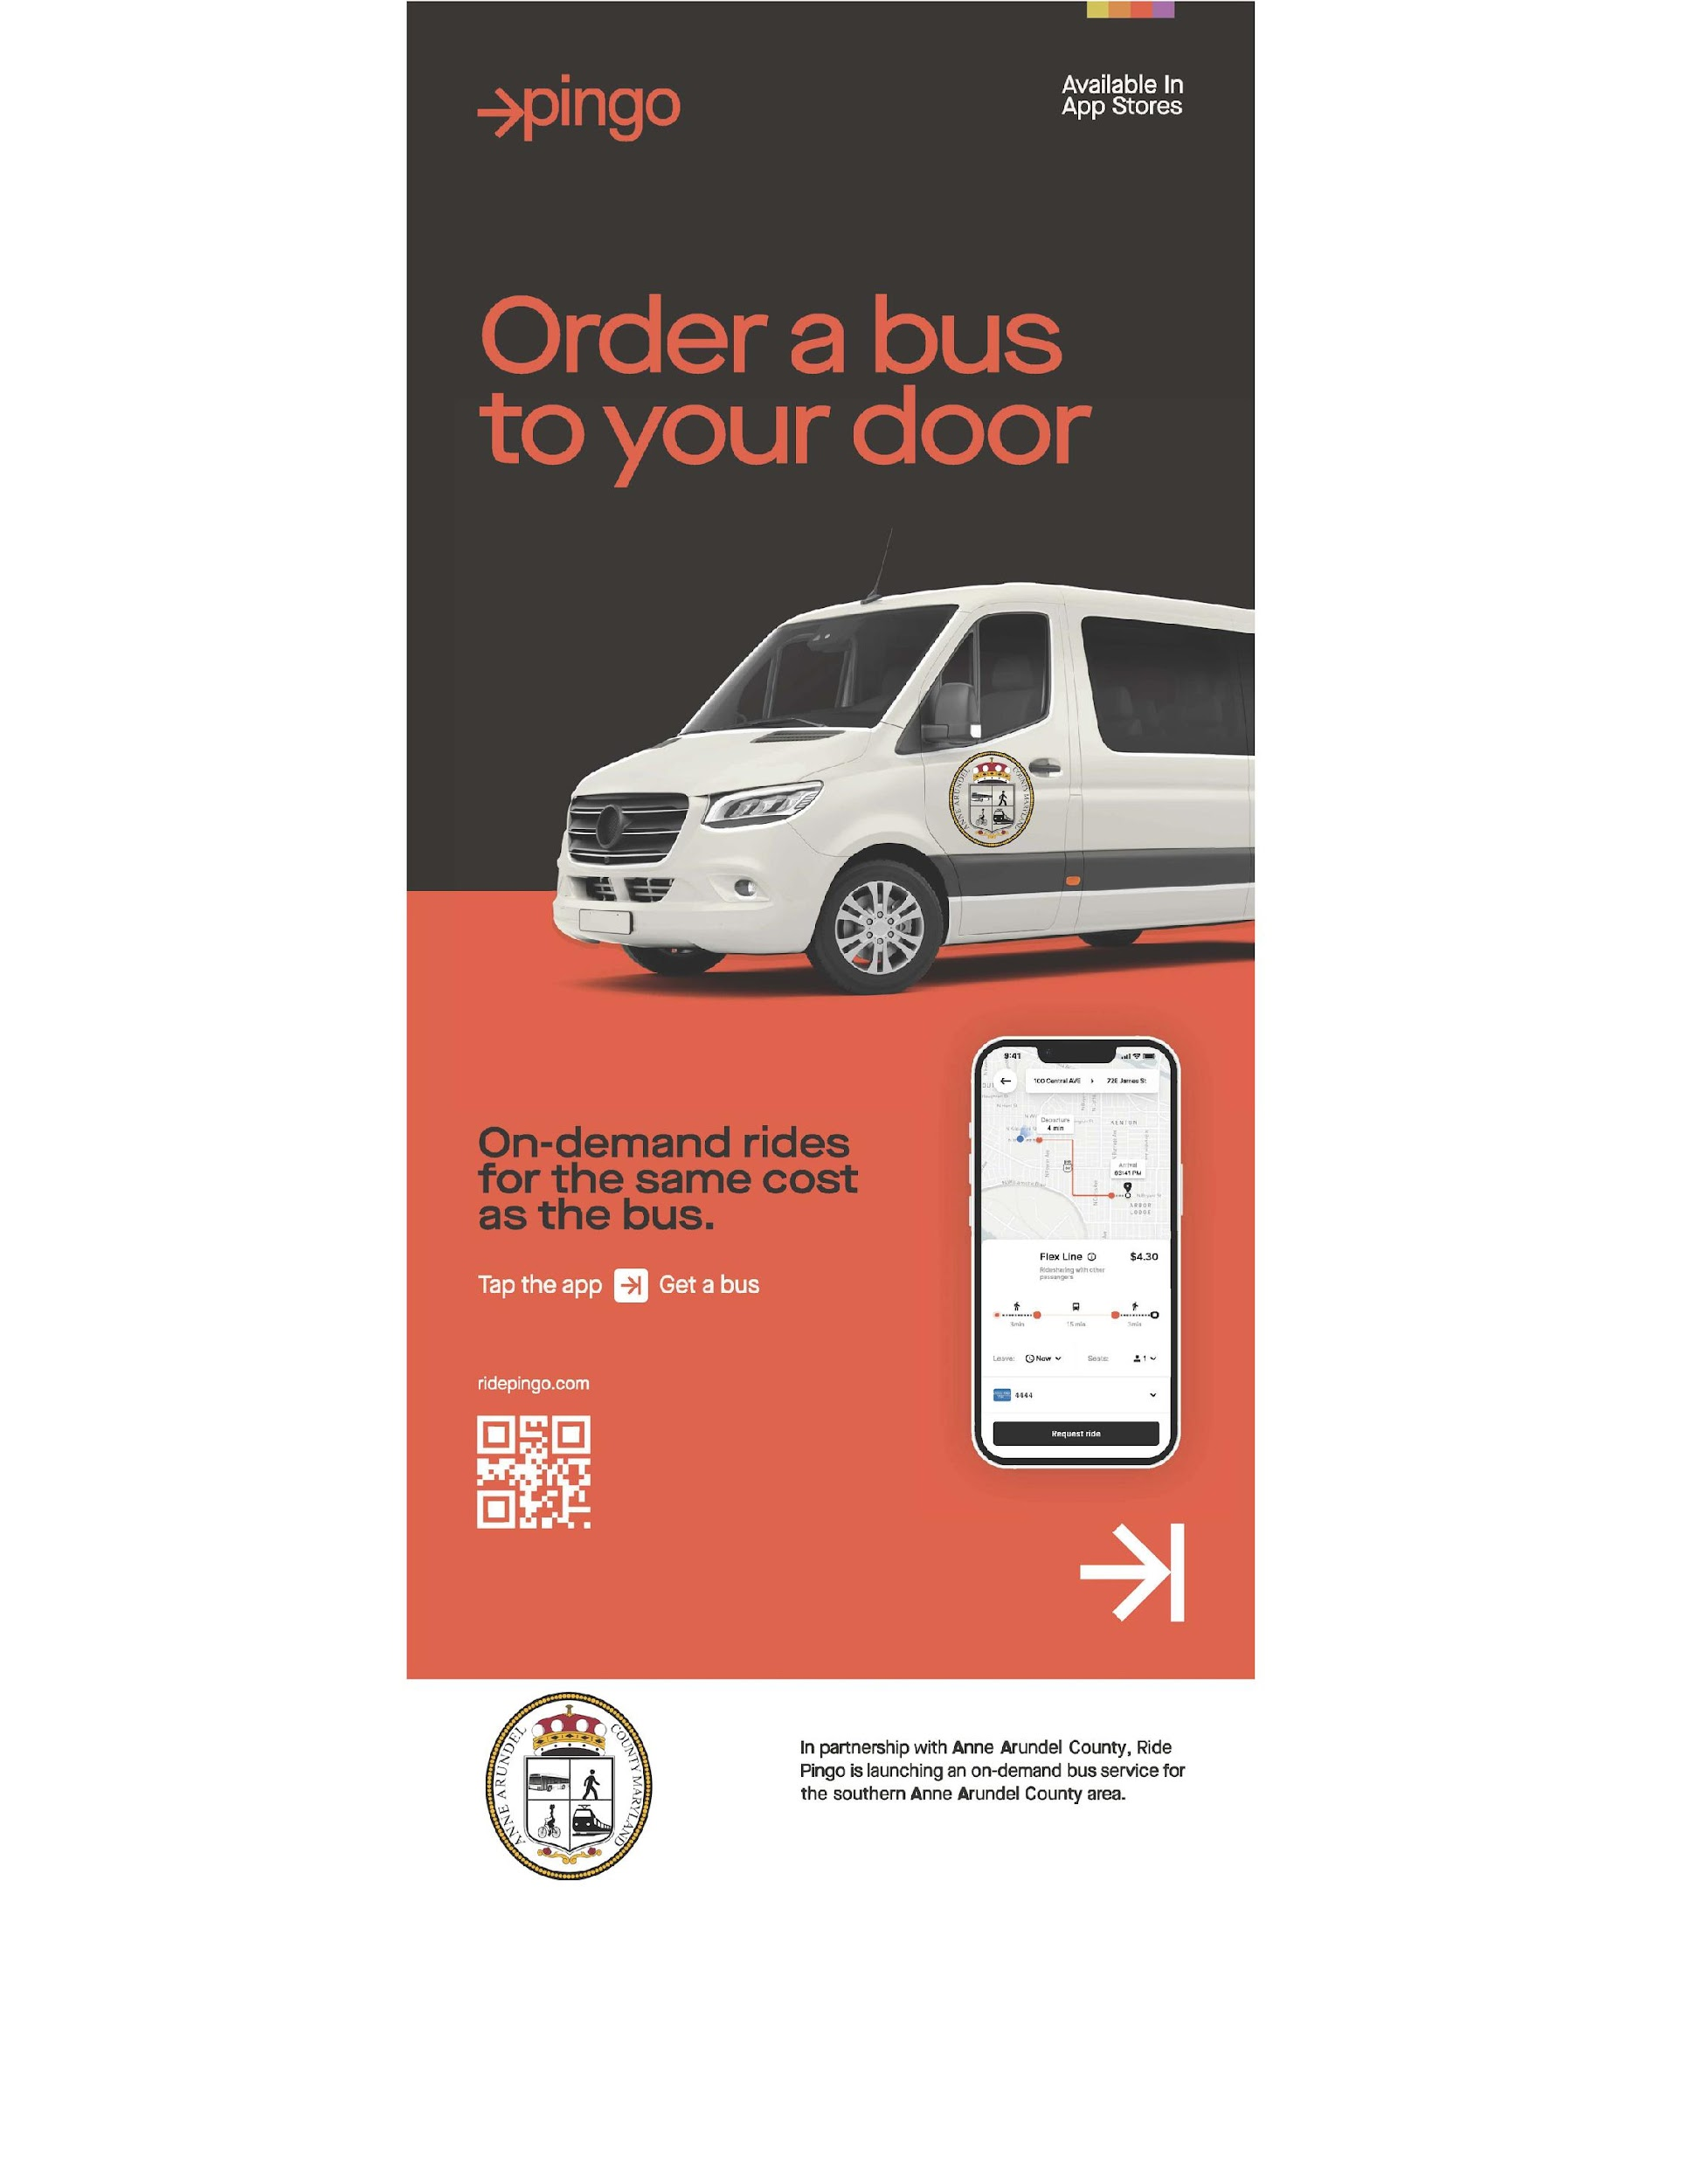

Slide 7
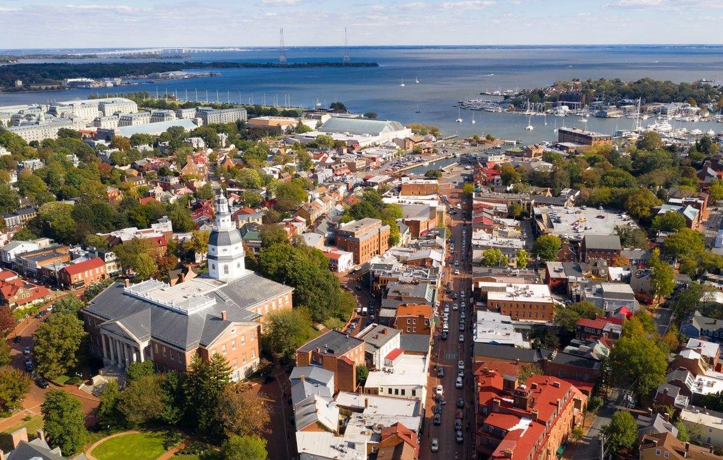



THANK YOU
CONTACT INFORMATION:
410-222-7400
transportation@aacounty.org
aacounty.org/transit
2664 Riva Road, Annapolis MD 21401

Slide 9

ON-DEMAND SERVICES
NORTH & SOUTH COUNTY CALL N’ RIDE
Requesting a ride has never been easier!
Simply call or use the free Pingo app to access our services.
Available in two distinct regions: North County and South County.
**Operating Hours**
Daily from 7 AM to 7 PM.
South County operates Monday - Friday.
North County operates Monday - Saturday.

Slide 10
HOW TO RIDE
Call (410) 222-0025 - at least two hours in advance. For pick-ups before 9 a.m., call between 5 p.m. and 7 p.m. the previous business day to schedule.
Schedule your pick up time - by providing scheduler with exact pickup address and desired time. If no one answers, please leave your name, address and phone number. The scheduler will return your call with your scheduled pick-up time and location.
Passengers can schedule your return - trip at the same time, or you may call back 2 hours before your desired return trip.
Pick up times - are estimated and may change due to unexpected traffic delays.

Slide 11
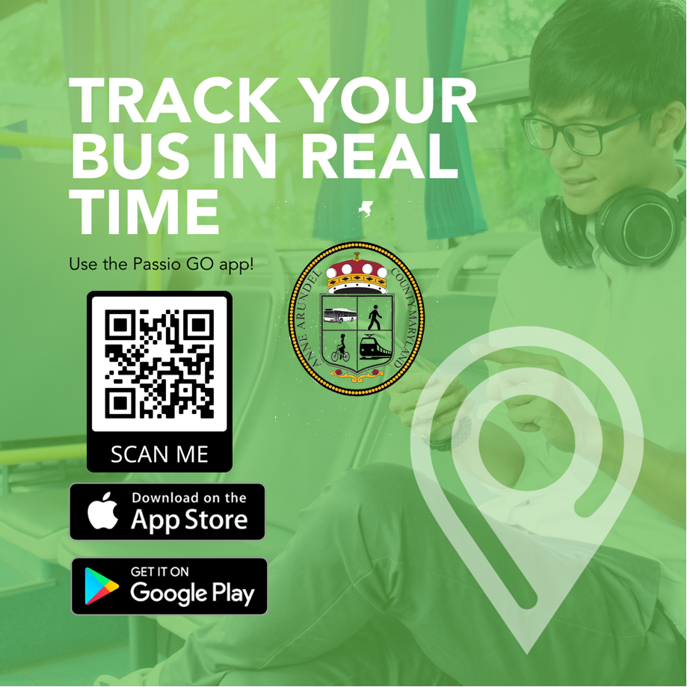


PassioGO
www.passiogo.com

