Slide 1
Driving Results: Time Management & Prioritization for Transportation Leaders
Presented by Lynn Scarbath Berger, MSW, LGSW
October 8, 2025, 1:30 PM - 5:00 PM
Beach House Ballroom
Code: B25008
Notes:
“This helps you reclaim focus, manage chaos, and lead intentionally.”

Slide 2


Ice Breaker
Introduce yourselves to those are your table.
Time management is a real struggle; it is also a leadership skill, not just personal productivity.
Talk with those are your table: list on your paper your top 5 areas where you feel you are struggling.
  Write one word on your paddle that explains your relationship with
  time: hold it up for your table and all to see.
Notes:
(~5 minutes)
https://youtu.be/sNKaXfuoB_E

Slide 3
Why This Matters
Transit Operations are demanding and reactive.
We’re often understaffed and overloaded.
Time management isn’t personal – it’s survival

Slide 4
Workshop Objectives
Identify
Identify individual primary time management challenges
Understand
Understand cost in lack of prioritization
Apply
Apply tools (Eisenhower Matrix, MITs, Time Blocking)
Reflect
Reflect on habits and leadership patterns specific to fast-paced, reactive transportation environment
Focus on
Focus on how to prioritize areas you can and cannot control
Build
Build a personal action plan to improve focus and time discipline
Notes:
(~3 min) Outline what attendees will walk away with.
Discuss the slide titled 'Workshop Objectives' and encourage participant reflection.

Slide 5

Today’s Roadmap
Welcome & Framing
Facing the Time Drain
Break #1
Time Management Tools for Focus
Break #2
Circle of Control
Leadership Habits
Action Planning
Key Commitments
Notes:
~ 3 minutes

Slide 6


Where Does Your Time Go?
Why does time slip away in transportation
What’s your biggest “time bandit”?
Why does it steal so much time?
What could you do to reduce its impact?
Write a few words on your paddle – share with your table. Partner up with someone and tell them what your time bandit is, how much time does it take in a week – what you think you can do to reduce its impact.
Notes:
~ 8 minutes
https://youtu.be/sPVjW1Mkxhw

Slide 7
Why Time Slips Away
Constant disruptions
Reactive demands
Labor shortages
Competing priorities
Notes:
Write top 3 daily time-wasters on sticky notes.

Slide 8

✍️Where Does Your Time Go? 🕓
Write your top 5 time-wasters on sticky notes .
Paste them next to others that are similar on the board.
“What takes up time but adds least value?”
Discuss shared themes.
Notes:
~ 8 minutes
https://youtu.be/NQYR55EiKvs

Slide 9

Facing the Time Drain
Email
Meetings
Staffing/schedules
Crisis
Stress and burnout
Lack of OR poor communication
Notes:
Connect time pressure with real operational consequences.
Stress and Burnout
Missed Deadlines
Safety decreases

Slide 10

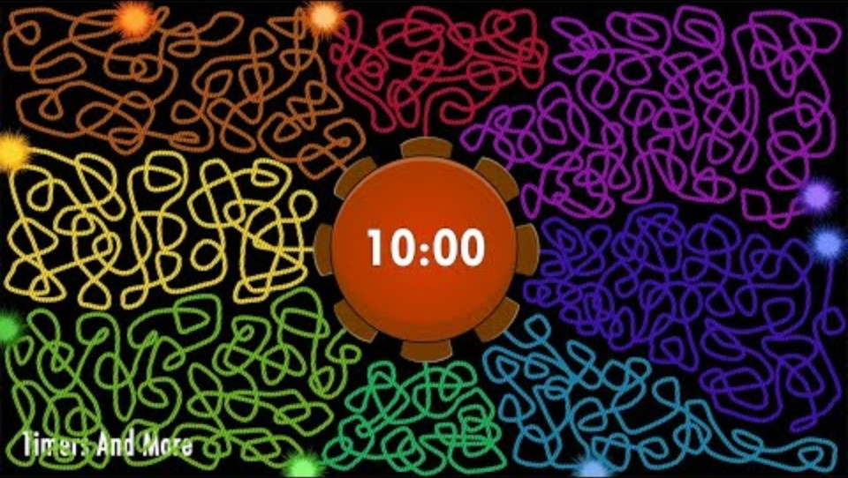
Time Audit Exercise
Reflect on last week (Monday-Friday):
List out your schedule /review your schedule on phone
  Next to each item categorize
    Strategic: High-impact, forward-looking activities that shape the future of your organization, department, or team.
    Operational/Admin : Essential day-to-day tasks that keep the organization running smoothly.
    These maintain service delivery, compliance, and internal coordination, but don’t fundamentally change direction or strategy.
    Distractions: Activities that consume time and attention but don’t contribute meaningfully to operational or strategic outcomes.
    These often feel urgent but deliver little value — and can derail focus or decision-making.
Debrief: surprises and misalignment
Notes:
(~10–15 min) Invite participants to share insights. Capture themes like “too many meetings” or “not enough coaching time.” Transition: “Now that we see where our time really goes, let’s use the Eisenhower Matrix to prioritize intentionally.”
https://www.youtube.com/watch?v=WS3r1BT7hAQ&list=PLsoISPGLorlNTbqNsYjiY5lZUKkGXaz6A

Slide 11
Time Management Tools
Eisenhower Matrix
MITs: Most Important Tasks
Time Blocking
Notes:
Facilitator Note: Discuss the slide titled 'Time Management Tools' and encourage participant reflection.

Slide 12

Break
Notes:
https://www.youtube.com/watch?v=geyBSrgLazE

Slide 13
Eisenhower Matrix
Why Use It?
Clarifies priorities – helps you separate true priorities from distractions.
Reduces stress – you spend less time in crisis mode.
Increases productivity – focus on high-impact, goal-oriented work.
Supports delegation – shows which tasks can be handed off.
Builds strategic discipline – shifts effort toward long-term growth (Quadrant II).
Notes:
~ 3 minutes

Slide 14

Eisenhower Matrix Activity
Pull out Eisenhower Matrix – worksheet.
Review your list of items done LAST week. Fill out the Matrix.
Quadrant | Description | Action
Q1 – Urgent & Important 🚨 | Crises, pressing problems, deadlines. | Do it now. Focus immediately. High impact.
Q2 – Not Urgent but Important 🌱 | Strategic planning, relationship-building, training, prevention. | Schedule it. Protect time for these. Build toward goals, or improvements.
Q3 – Urgent but Not Important 📞 | Interruptions, unimportant meetings, other people’s priorities. Feel pressing but not in alignment with priorities. | Delegate it. Reduce distractions.
Q4 – Not Urgent & Not Important 💤 | Busywork, scrolling, trivial activities. Time-wasters – don’t add value. | Eliminate it. Avoid or minimize.
Notes:
~ 12 minutes https://youtu.be/XINUz1Dq-3w
List all your tasks.
Write everything you’re working on last week.
Label each task by asking:
Is it urgent? (Needs attention soon?)
Is it important? (Contributes to goals or mission?)
Place each task into the corresponding quadrant.
Act accordingly:
Focus time on Quadrant 2—this is where proactive leadership happens.
Keep Quadrant 1 controlled but not constant.
Push back or delegate Quadrant 3.
Cut Quadrant 4.

Slide 15

Test your Knowledge
Which Quadrant would each statement be in
Bus breakdown 🚍 or safety incident requiring immediate response
Over-checking email or chatting without purpose
A last-minute meeting that doesn’t impact your area
Staff development plans or system-wide scheduling improvements
Quadrant | Example Scenario
Q1 | Bus breakdown 🚍 or safety incident requiring immediate response
Q2 | Staff development plans or system-wide scheduling improvements
Q3 | A last-minute meeting that doesn’t impact your area
Q4 | Over-checking email or chatting without purpose
Notes:
~ 6 minutes
Help you to organize in a quadrant…..but how do you block time???

Slide 16
Most Important Tasks (MIT) & Time Blocking
Identify your 3 top MITs and timeline
Link to outcomes
Block time for deep work
Use ‘No Meeting’ zones
Notes:
~ 4 minutes
Quadrants help you to organize – how do you block and prioritize???

Slide 17

Time Blocking
Make sure you Block out for Q1 and Q2
Quadrant | Focus | Example (Transit Context)
Q1 Urgent & Important | Act Immediately | Bus breakdown on route 🚍
Q2 Important, Not Urgent | Plan & Schedule | Staff development meeting 📅
Notes:
~ 2 minutes

Slide 18

Notes:
~ 4 minutes
https://youtu.be/Q4sxT5A5rLc?si=j_tEUuxLWcq4WEkV

Slide 19

MITs (Most Important Tasks) & Time-Blocking
Step 1 – Identify your top 3 MITs for this week (even with you here)
Step 2 – Design your ideal workday (not at a conference)
Step 3 – Share with a colleague at your table your thoughts
Tip: Block MITs during your highest-energy hours -protect those slots.
Time | Task / Focus Area | Priority (H/M/L)
7 – 8 AM
8 – 9 AM
9 – 10 AM
10 – 12 PM
12 – 1 PM | Lunch / Break
1 – 2 PM
2 – 3 PM
3 – 4 PM
4 – 5 PM
Notes:
Q1 and Q2
https://youtu.be/8ekL42n1_XU
Quadrant Focus
Example (Transit Context)
Q1 Urgent & Important
Act Immediately
Bus breakdown on route 🚍
Q2 Important, Not Urgent
Plan & Schedule
Staff development meeting 📅

Slide 20

Break
Notes:
https://www.youtube.com/watch?v=IQ3SaSf--8Q

Slide 21
🎯Circle we Cannot Control - Concerns to Influence
Circles I can Control
As a transit leader, you face daily challenges that can feel overwhelming — from weather delays and staffing shortages to customer demands and maintenance issues. This exercise helps you focus on what’s truly within your control, what you can influence, and what you must let go of
Things You Cannot Control. Examples: Weather, funding levels, system policies, or unexpected public events.
Things I Can Influence. Examples: Team motivation, process improvements, peer collaboration, or scheduling adjustments.
Things You Can Control. Examples: Your attitude, communication, planning, accountability, follow-up, and team support.
Notes:
~ 15 minutes

Slide 22
Can or Cannot Control
Accident or breakdown - one of your vehicles is in a collision.
How You Communicate - tone, timing, clarity of your messages
Out sick - a driver or dispatcher is out sick unexpectedly; you need to figure out who can pick up the slack.
How You Prioritize and Plan: Setting clear MITs (Most Important Tasks) each day
Reporting Season - you’re working on your national transit database, and it’s taking up so much of your time other aspects of your agency are suffering
Operational Choices Within Your Span of Control: Route assignments, shift coordination, and crew briefings
Mandatory Meetings - you’re stuck with mandatory reviews by the state, or meetings with your local elected officials, or your board of directors.
Understaffing - You’re taking on multiple roles, and you don’t have time to handle all of them.
Extreme weather - snow or storm is coming, and you need to redo or cancel service
Notes:
~ 5 minutes

Slide 23

Venn Diagram Exercise – Transit Leadership Style
Fill out your Venn Diagram
Walk though each column with a person sitting at your table.
Peer coach: offer suggestions, ideas, challenge if it is or isn’t in their control.
Notes:
~ 15 minutes
https://youtu.be/NS-_N1cBg8Y

Slide 24
Leadership Habits
⚡ “Hero Mode”
Description: Taking on every crisis or tough task personally to “save the day.”
Trap: Feels responsible and rewarding but prevents the team from learning and creates burnout.
Shift: Step back and empower others to solve problems — coach instead of rescue.
🤝 Overhelping
Description: Jumping in to fix or finish work for others instead of guiding them.
Trap: Builds dependency, not capability. You end up doing your job and theirs.
Shift: Ask coaching questions — “What’s your next step?” or “What’s your plan for this?”
🚫 Avoiding Delegation
Description: Thinking “it’s faster if I just do it myself.”
Trap: Short-term gain, long-term pain — you stay stuck in the weeds.
Shift: Delegate outcomes, not just tasks. Clarify expectations and check progress, not perfection.
🔥 Reactivity
Description: Constantly responding to issues, interruptions, and messages.
Trap: Keeps you busy but not effective. You’re running on adrenaline, not priorities.
Shift: Use daily planning and MITs (Most Important Tasks) to focus on proactive work first.
Notes:
~15 minutes
Even the most capable leaders fall into habits that feel productive in the moment but actually drain focus, energy, and team capacity. These “time traps” often come from good intentions — but they can unintentionally block others’ growth and your own effectiveness.
“Which of these patterns show up most often in your leadership? What would shift if you replaced one ‘trap’ with a stronger habit?”

Slide 25
As a leader, your value isn’t measured by how much you do — it’s measured by how well you enable others to do.
Many operational leaders struggle to transition from being the “go-to” person to being the “guide.”
Doing | Leading
Fixing problems yourself | Teaching others how to solve problems
Managing tasks | Developing people
Being busy | Being strategic
Focusing on short-term output | Building long-term capability
Reacting to issues | Anticipating and preventing issues
Controlling every detail | Empowering others to take ownership
Success = personal completion | Success = team success
Notes:
~ 3 minutes
🧭 Small Shifts That Help
Pause before acting: Ask, “Who else could handle this?”
Coach, don’t correct: Guide through questions instead of fixing.
Plan time to lead: Block time for team development, feedback, and strategic thinking.
Celebrate delegation: Recognize when others solve problems without you stepping in.

Slide 26
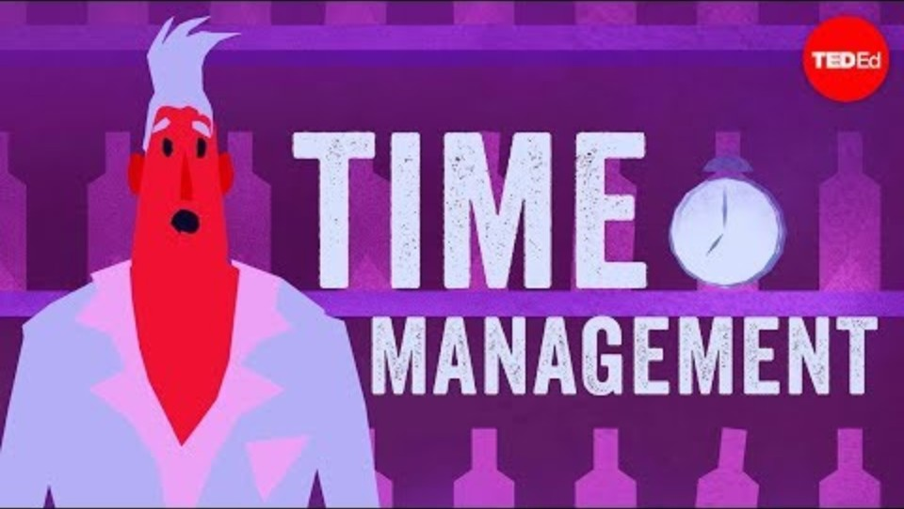
Notes:
https://youtu.be/iDbdXTMnOmE?si=0Ydo4nTYTBGB2Rqo

Slide 27


Activity:
Leading vs. Doing
Estimate your week:
Are you doing your team’s job or your own?
Are you working 'In’ vs. 'On’
  Delegation and boundary-setting
    IN the business (tactical)
    ON the business (strategic)
What’s your ideal balance?
Notes:
~ 15 minutes https://youtu.be/f4q7BqKw50c
~ Discuss the slide titled 'Leading vs. Doing' and encourage participant reflection.

Slide 28
It’s up to you! Equip yourself with proven tools to prioritize, focus, and lead effectively – delegate and reprioritize the constant demands.
Understand challenges transit professionals face with limited resources and competing priorities | Learn to apply the Eisenhower Matrix for prioritizing urgent and important tasks | Use MITs (Most Important Tasks) to focus daily efforts on what truly matters
Implement time blocking to structure your schedule for greater discipline and control | Reflect on leadership habits to distinguish between controllable and uncontrollable factors | Build personalized action plans to improve focus and discipline in a dynamic transit environment
Notes:
~ 5 minutes

Slide 29

Your Action Plan Blueprint
Reflection: Habit to break, habit to build
Action plan worksheet
  Where are you now?
    Biggest trap: habit to break
  Area more proactive – strategic about?
    Habit to build
Focus areas of change
30-day commitment (3 items)
Create an accountability partner (this can be you!)
Notes:
~ 20 minutes Action Plan Blueprint
https://www.youtube.com/watch?v=0faIt59uhus
https://youtu.be/XfHlOEJPa8o

Slide 30

Peer Coaching & Commitment
Pair up: Share challenge and plan – 5 minutes per person
Give feedback: give at least 1 tip
Optional: Follow-up email in 30 days
  Write future-self email.
  Partner write you – how’s it going?
Notes:
~ 10 minute
Facilitator Note: Discuss the slide titled 'Peer Coaching & Commitment' and encourage participant reflection.

Slide 31
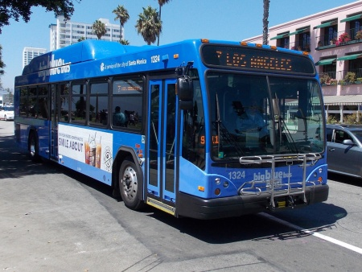
“You can’t control every route — but you can control how you lead through detours.”

Slide 32
Final Reflection
Grab those paddles:
One insight – one thing you already knew but reminded yourself, heard and want to improve or learned today
One commitment you are willing to make to you!
Thank you for participating!
Lynn Berger
lberger@strategicevolutionllc.com
Notes:
~5 minutes

