Slide 1

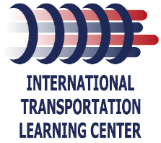



Foundational Skills Curriculum:
Filling Skills Gaps in Technical Positions
Transportation Association of Maryland
October 8, 2025
Transit Workforce Center
National Technical Assistance Center
for Transit Workforce Development
Notes:
State session purpose: explore the Foundational Skills Curriculum and how it can support agencies in recruitment, retention, and workforce development.
*at many of these conferences, there are always more folks from the operations side of the agencies in the room. Make mention that early that this is a program for mechanics. At the end of the session, we have taken some time to talk about foundational skills for operators and what that program could look like (possible future project depending on FTA funding).

Slide 2

Agenda
WHO
WHY: Why are you here? Why did we create this training?
WHAT is contained in the training?
HOW would you use it?
What’s Next
Notes:
This program is built to directly address skills gaps across transit maintenance, making it easier for agencies to onboard, train, and grow their workforce.
Industry Need
We heard consistently from agencies that new hires often lack core mechanical, electrical, or math skills.
This program is designed to close those gaps, supporting both new employees and incumbent workers who want to advance.
Engagement: “What’s the most common skill you find missing when new employees come through your doors?”
Scalable Approach
Agencies can pick and choose, whether it’s a single module to support a specific need or a full foundational curriculum.
This flexibility makes it work for both large systems and small rural agencies.
Freely Available Materials
Funded through FTA materials are freely available on TWC’s website. Agencies don’t need to “reinvent the wheel.”
Courses Included
Phase 1:
Basic Mechanical – tools, theory, hands-on basics.
Computer Basics – essential digital literacy. This course is very basic and starts with powering on your computer.
Electrical Fundamentals – safety, laws, components, diagnostics.
Shop Math – applied math problems in a maintenance context.
Possible Phase 2: Shop math, Technical Writing and Soft Skills – communication, documentation, teamwork, deescalation
This foundation isn’t just about technical training, it’s about building a pipeline that sets employees up for safety, success, and long-term career growth.

Slide 3
Goals of This Session
Describe common knowledge and skills gaps in frontline and technical transit occupations.
Explain the design and purpose of TWC’s Foundational Skills Program for bridging those gaps.
Identify core curriculum areas (basic mechanical, electrical, computer skills, and shop math) included in the program.Examine examples of courseware tools (templates, videos, on-the-job activities) that can be applied within their agencies.
Discuss their own workforce challenges and contribute ideas for additional areas of skills development.

Slide 4
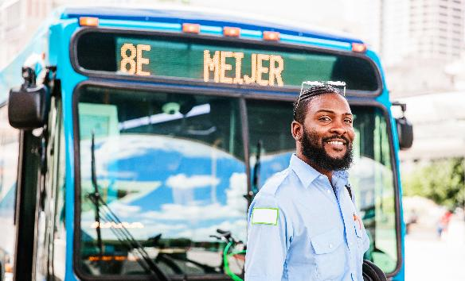
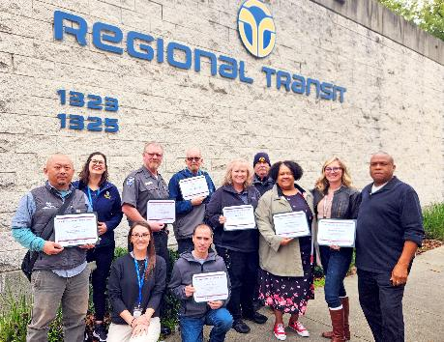
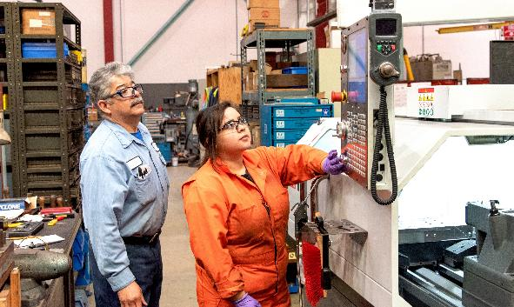
WHO: Transit Workforce Center
Operated by the International Transportation Learning Center (ITLC), the Transit Workforce Center (TWC) is the Federal Transit Administration’s national technical assistance center for transit workforce development.
TWC supports the workforce development needs of urban, suburban, tribal, and rural public transportation entities across the country.

Slide 5
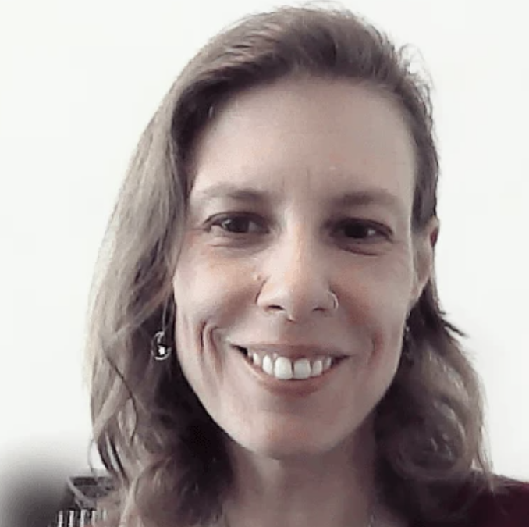
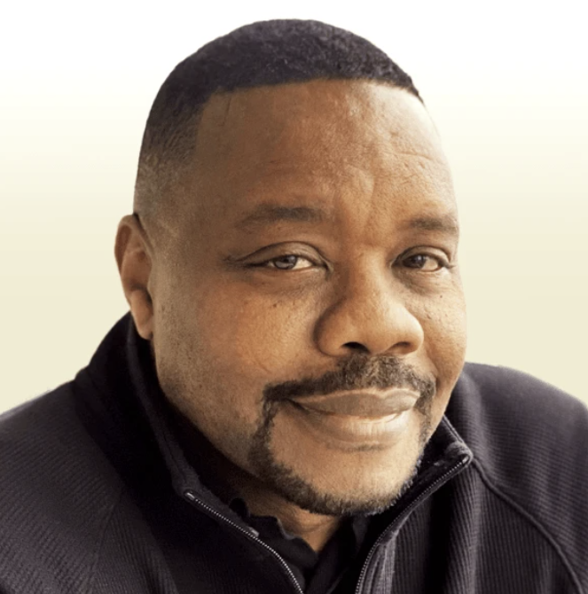
WHO: Speakers
Julie Deibel-Pundt
Program Director, Instructional Design
ITLC/TWC
Maurice Beard
Senior Workforce Development Advisor
ITLC/TWC
Notes:
If small group, do the “who” by show of hands:
Transit agency
Nonprofit
DOT
Vendor

Slide 6

WHO and WHY
Name, Organization, Title
Why did you pick this session? What spoke to you? What need do you see?
Notes:
Either individual or turn and talk – bringing back the “whys”

Slide 7
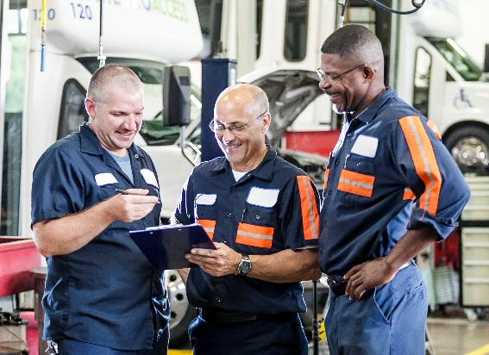
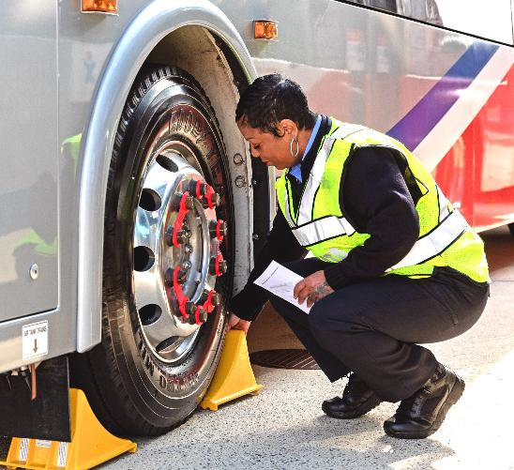
WHY Foundational Skills Matter
Help maintenance workers build the core knowledge they need to succeed
  Workforce readiness
  Safety
  Career progression
Meet industry need
Bridge the skills gaps at agencies
Notes:
This program isn’t just about filling gaps, it’s about ensuring every worker has the baseline knowledge to perform safely, confidently, and with opportunities to grow.
Helping New and Incumbent Workers
Many new hires are coming in without strong mechanical, electrical, or math foundations.
Incumbent workers may have learned on the job but need a refresher.
Engagement: Ask: “At your agency, do you find the bigger need is with brand-new hires or with supporting existing staff who want to advance?”
Safety
Foundational skills tie directly to safe practices — understanding tools, math, and electricity helps prevent accidents and injuries.
Emphasize: this is about protecting workers, equipment, and passengers.
Career Progression
With solid foundational knowledge, workers can move from entry-level positions into apprenticeship programs or advanced certifications.
This creates a pathway and career progression.
Industry Need
We heard consistently from agencies that new hires often lack core mechanical, electrical, or math skills.
This program is designed to close those gaps, supporting both new employees and incumbent workers who want to advance.
Engagement: “What’s the most common skill you find missing when new employees come through your doors?”

Slide 8
WHAT We’re Building
Flexible, scalable training for all occupations in public transportation which teach fundamentals of Mechanical, Electrical, Computer, Math, etc. Developed with industry experts and aligned to adult learning principles, the materials - ranging from PPTs to hands-on activities - will be freely available and modular, allowing agencies to choose exactly what they need.
Notes:
This program is built to directly address skills gaps across transit maintenance, making it easier for agencies to onboard, train, and grow their workforce.
Industry Need
We heard consistently from agencies that new hires often lack core mechanical, electrical, or math skills.
This program is designed to close those gaps, supporting both new employees and incumbent workers who want to advance.
Engagement: “What’s the most common skill you find missing when new employees come through your doors?”
Scalable Approach
Agencies can pick and choose, whether it’s a single module to support a specific need or a full foundational curriculum.
This flexibility makes it work for both large systems and small rural agencies.
Freely Available Materials
Funded through FTA materials are freely available on TWC’s website. Agencies don’t need to “reinvent the wheel.”
Courses Included
Phase 1:
Basic Mechanical – tools, theory, hands-on basics.
Computer Basics – essential digital literacy. This course is very basic and starts with powering on your computer.
Electrical Fundamentals – safety, laws, components, diagnostics.
Shop Math – applied math problems in a maintenance context.
Possible Phase 2: Shop math, Technical Writing and Soft Skills – communication, documentation, teamwork, deescalation
This foundation isn’t just about technical training, it’s about building a pipeline that sets employees up for safety, success, and long-term career growth.
Overview of the Program
We are developing comprehensive foundational skills training that covers four core technical areas: Mechanical, Electrical, Computers, and Math.
These are the building blocks needed for success in transit maintenance careers, and we’re designing them to be accessible to new and experienced employees.
Variety of Instructional Materials
Each topic area includes a mix of learning resources: PowerPoint presentations, hands-on activities, reference guides, videos, assessments, glossaries, and workbooks.
This variety ensures we meet different learning styles and reinforce knowledge in multiple ways.
Collaboration with SMEs
Development is done with and by industry Subject Matter Experts (SMEs).
This ensures accuracy, real-world relevance, and that the materials reflect the tools, systems, and challenges agencies face every day.
Grounded in Adult Learning Principles
The materials are designed with adult learners in mind, practical, job-relevant, and immediately applicable.
Courses encourage active participation and problem-solving.
Modular & Flexible Approach
The curriculum is modular so agencies can select only what they need.
This flexibility makes it easier to tailor the program to local priorities, budgets, and workforce needs.
Goal & Impact
Ultimately, this program supports workforce development, skill building, and career growth, while improving agency safety and performance.

Slide 9
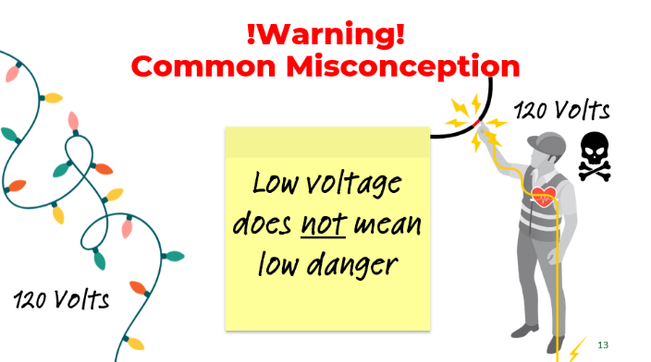
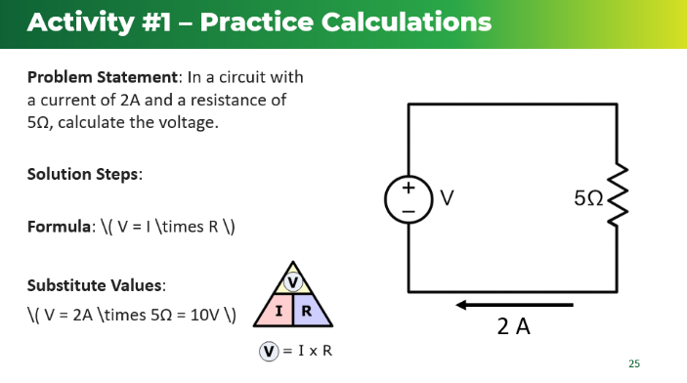
Coming in Winter 2025
WHAT: Basic Electrical
Introduction to Electricity
Basic Electrical Laws
AC and DC Electricity
Circuit Components
Magnetism and Electromagnetism
Electrical Tools
Safety and PPE
Notes:
Talk about electrical course. Show materials if attendees seem interested.

Slide 10
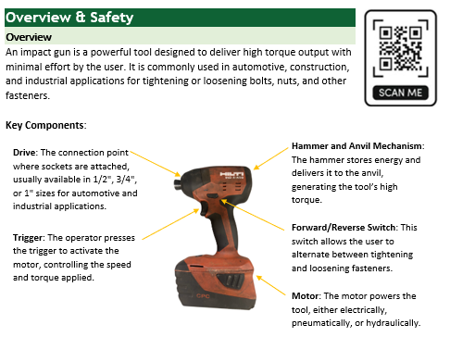

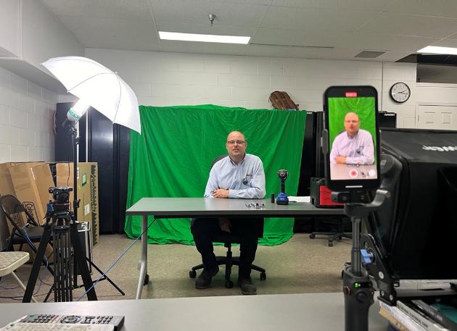

WHAT:
Basic Mechanical Course
Mechanical Theories
Fundamental Mechanical Tools
  Bite-sized training videos
  Reference documents
Suggested Hands-on Learning
  Completed with instructor or mentor
  Templates provided
Assessments and implementation plans
Coming in Winter 2025
Notes:
Talk about mechanical course. Show materials if attendees seem interested.

Slide 11
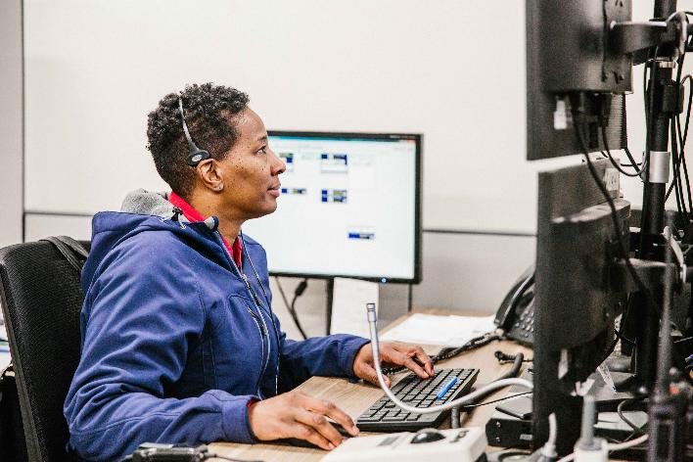
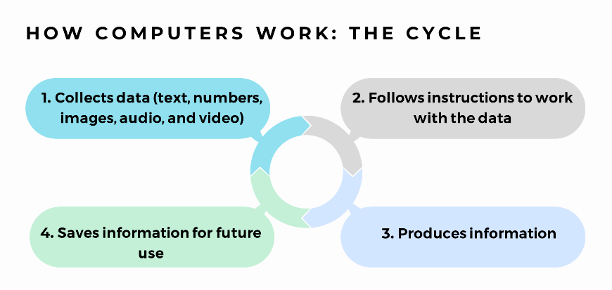
WHAT: Computer Basics
Self-led online learning modules
Scenario activities
Can be taken in any order, depending on need
Coming in Winter 2025
Notes:
Talk about computers course. Show materials if attendees seem interested.
Computers course is self-led, others are ILT.

Slide 12
HOW could your organization use this?
How could you use the Foundational Skills Curriculum?
Environment
Audience
Purpose
Do you see anything that may be a block to implementation?
Notes:
Either individual or turn and talk and share

Slide 13
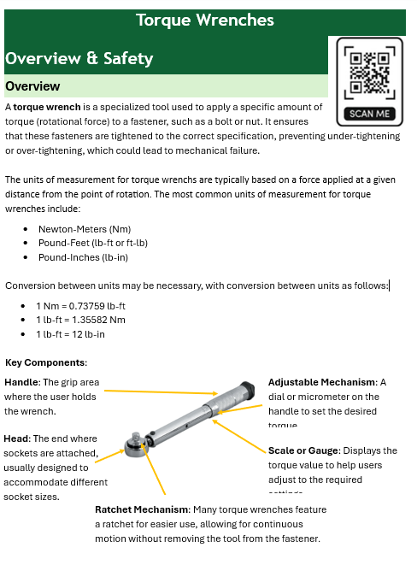
HOW To Use the Program
Modular and flexible
Support options
  Skills-gap analysis
  Train-the-Trainer
  Direct delivery
Materials available early Winter 2025
Complements apprenticeship programs
Notes:
Flexible & Modular Design
Emphasize that the program is designed to be modular and flexible.
Agencies can choose entire courses or just the specific modules they need which is perfect for customizing training to local workforce priorities.
Multiple Support Options (discuss on future slides)
Highlight that there are several ways to implement the program:
Skills-Gap Analysis – We can work with agencies to identify workforce training needs and recommend the right modules.
Train-the-Trainer – We prepare agency trainers to deliver the courses themselves, creating long-term sustainability.
Direct Delivery – ITLC/TWC can deliver the training directly to employees if agencies don’t have in-house capacity.
Ready-to-Use Materials
All course materials are packaged and ready for agencies to use right away, presentations, activities, assessments, reference guides, and more.
This saves agencies time and effort developing content from scratch.
Alignment with Apprenticeships
The program is apprenticeship-friendly and it can easily be integrated into registered apprenticeship programs as related instruction.
This supports agencies in building career pathway.
Big Picture Impact
Remind them that this is about improving skills, boosting performance, and creating a pipeline for future maintenance professionals.

Slide 14
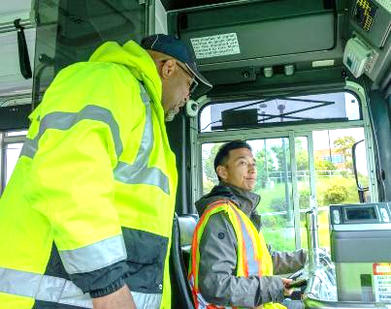
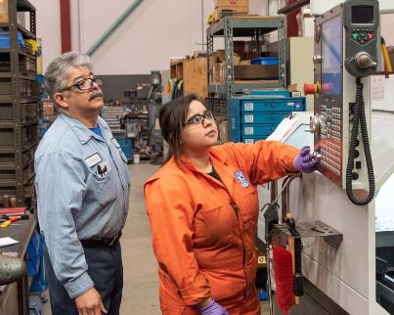
Tools & Resources to Get Started
Skills Gap Analysis
TWC funding opportunities and resource center
TWC Help Desk
Train-the-Trainer programs

Slide 15
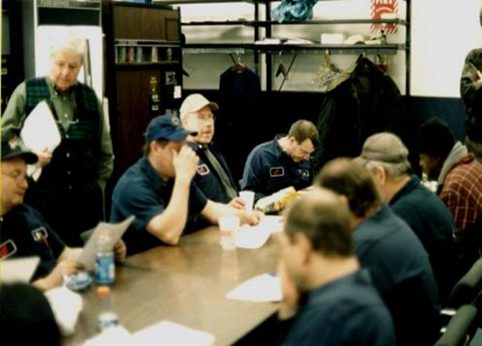
Skills Gap Analysis
Self-administrated
Anonymous
Non-threatening
Highly detailed
Accurate measure
Capacity-building

Slide 16
Sample Workforce Skill Survey
Key
0 - Unaware of this type of work 1 - Aware of this type of work 2 - Able to perform this type of work with supervision
3 - Able to perform this type of work independently 4 - Able to instruct others in this type of work.
Read and interpret multimeters
Task Statement
0 1 2 3 4 Use digital multimeter
0 1 2 3 4 Use analog multimeter
0 1 2 3 4 Understand multimeter abbreviation, symbols and terminology
0 1 2 3 4 Understand displays on multimeters, reading data
0 1 2 3 4 Measure AC voltage
0 1 2 3 4 Measure DC voltage
0 1 2 3 4 Measure resistance and continuity
0 1 2 3 4 Measure AC or DC current
0 1 2 3 4 Apply Ohm's law
0 1 2 3 4 Use data from multimeter to make diagnostic determinations

Slide 17
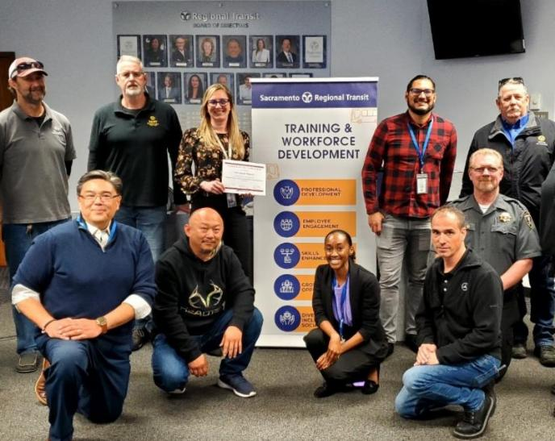
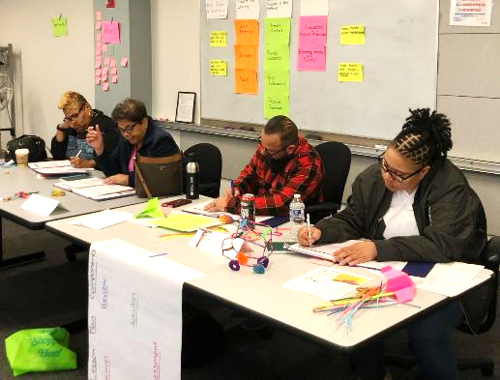
Overview of Train-the-Trainer Programs
  Adult Learners
  Facilitations Skills
  Teaching Methods
  Engaging Activities
  Lesson Planning
  Assessment & Retention
  Materials Development

Slide 18
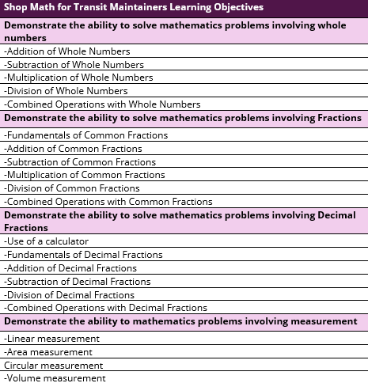
WHAT’s Next:
Shop Math
What other topic areas would fit well into a shop math course?
To be developed in 2026
Notes:
Shop Math is our next course to develop. What you see here is what our industry SMEs have identified as core needs in this area. What do you think? What else would you add? Where does your workforce struggle with math?

Slide 19
WHAT’s Next?
Current Scope:
Basic Electrical
Basic Mechanical
Computer Basics
Shop Math
Which of the remaining items would be most useful? What else?
Other Possibilities
Industry Overview
Workplace Relations
Transit Maintenance
Notes:
Either individual or turn and talk and share

Slide 20

More Than Courses: A Workforce Strategy
Recruitment and retention
Upskilling and pathways
Supporting a multigenerational workforce

Slide 21
Q
A
&
Notes:
Additional topics that would be useful?

Slide 22

Thank You!
Julie Deibel-Pundt
Program Director, Instructional Design
jdeibelpunt@transportcenter.org
Maurice Beard
Senior Workforce Development Advisor
mbeard@transportcenter.org
www.transitworkforce.org

