Slide 1

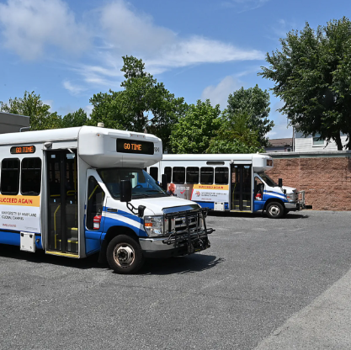
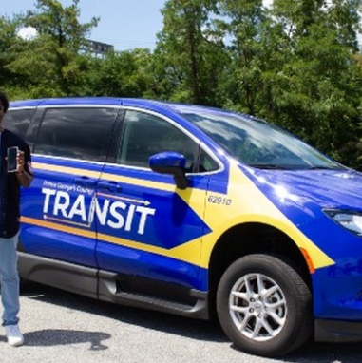
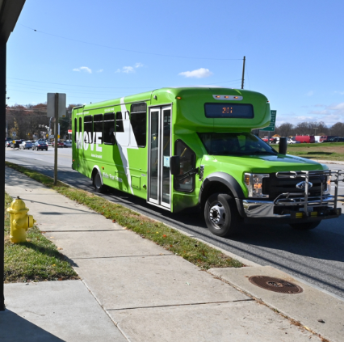
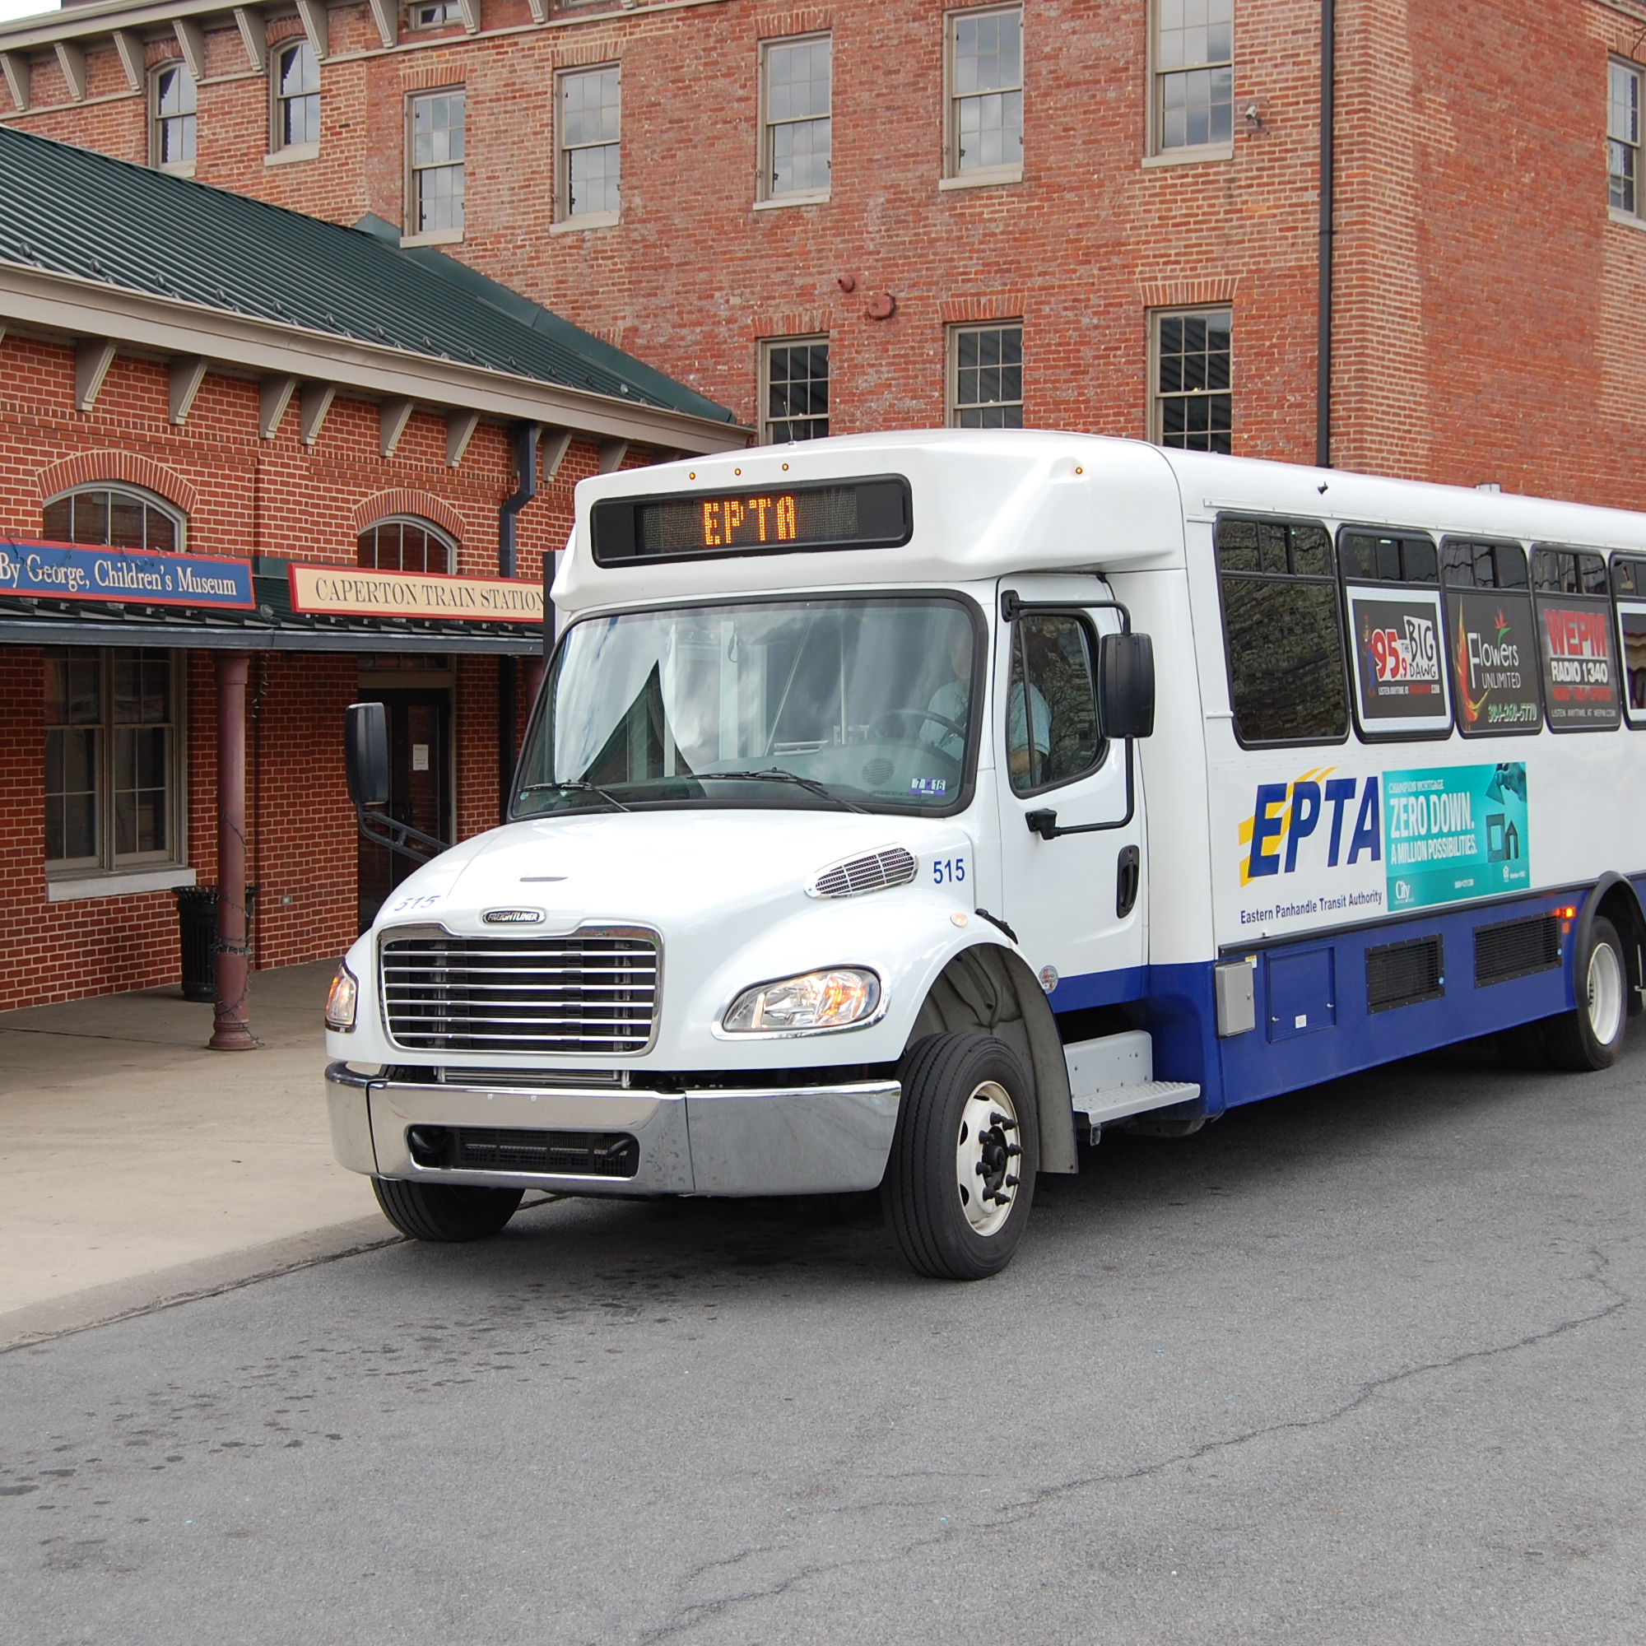
Microtransit, Macro Impact
October 8, 2025

Slide 2


Introductions
Sandy Brennan
Vice President & Senior Project Manager
sbrennan@foursquareitp.com
240.205.7469
Jessica Klion
Microtransit Practice Lead
jklion@foursquareitp.com
610.421.4174

Slide 3



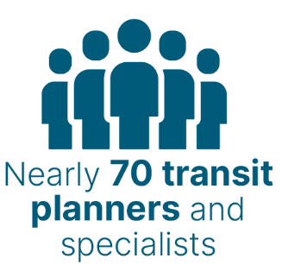




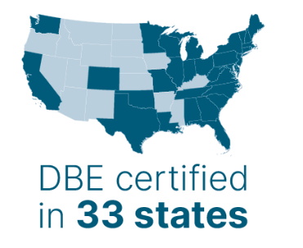
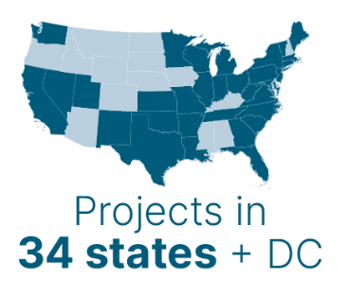





Service Area Expertise
Learn more at FoursquareITP.com
Notes:
About Foursquare ITP --- we were founded almost 20 years ago by our President and CEO L:ora Byala. We are about 75 people today, with about 70 of those folks being transit or transportation planners, analyst, coordinators. We are headquatered in DC, with offices in Philly, Boston and Atlanta. We work across the US, with an occasional candadian projects but primarily working in US.
The type of work we do ranges from transit planning and transit operations planning to active transportation so bike and pedestrian planning work, we work with DOTs, States, MPOs on more visioning transportation plans or strategic transportation plans. And we have a really strong cohort of Transportation Demand Management professionals too. SO basically covering everything that is non-SOV travel.

Slide 4
Agenda
What is Microtransit?
Planning for Success
Implementation Considerations
Conclusion & Additional Resources
Notes:
How many of you have heard about microtransit
How many of you are currently considering microtransit in your transit planning or working on microtransit projects?
What are you interested in most about microtransit

Slide 5
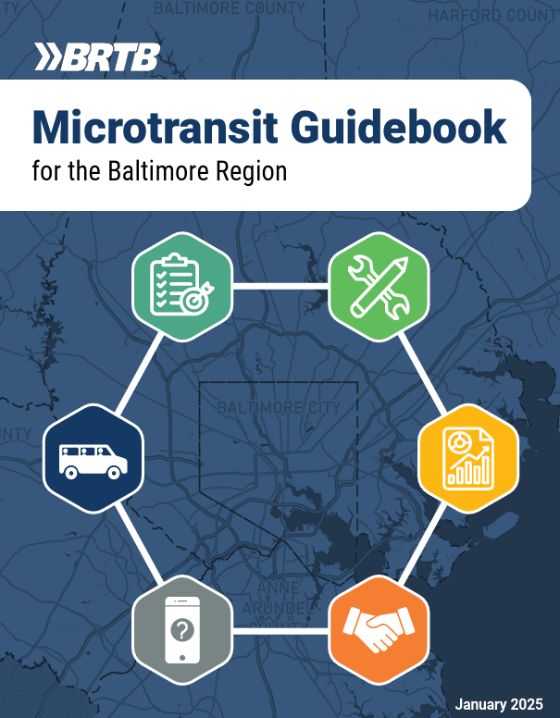
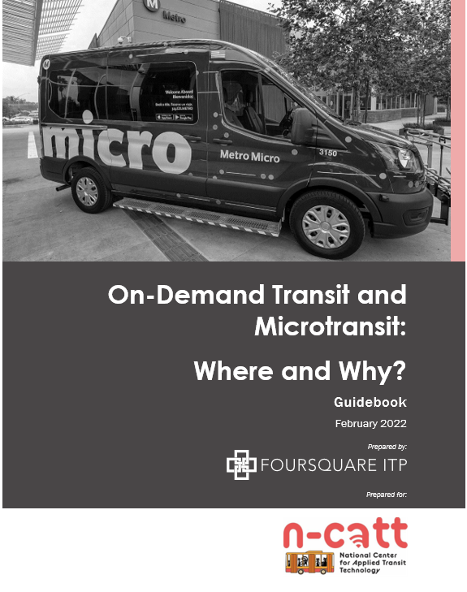
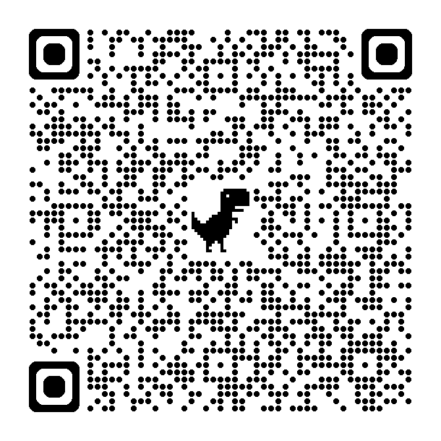
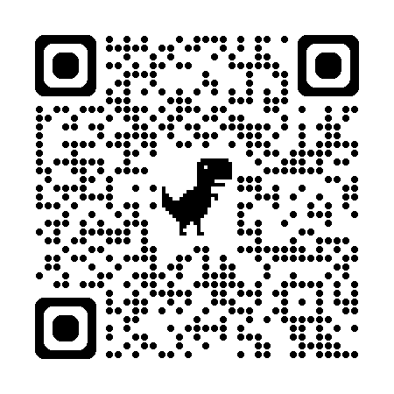

Slide 6
Overview
What is microtransit?
Notes:
Let’s begin with an introduction to microtransit.

Slide 7



Introduction
What is microtransit?
What are the key features of microtransit?
What objectives does microtransit achieve?
Dynamic transit service using technology to provide on-demand, flexible routes
Operates in specific zones
Uses app-based booking and real-time route optimization
Offers first / last mile connectivity
Close gaps in transit coverage and provide a sustainable mobility option
Notes:
Microtransit is a technology-driven, on-demand transit service that operates flexibly, unlike traditional fixed-route transit systems. It uses dynamic routing and scheduling, enabling it to adapt to real-time passenger needs.
Unlike the fixed route services, which serve a linear region, microtransit is based on the zones. Combines the convenience of ride-hailing services like Uber and Lyft with the accessibility and affordability of public transit. Riders can book trips instantly or schedule them in advance through user-friendly mobile apps, websites, or call centers. Algorithms dynamically adjust routes to pool riders going in similar directions, maximizing vehicle utilization.
Microtransit is to bridge the gap. Connects riders from their homes or workplaces to major transit hubs, such as train stations or bus terminals. Complements existing fixed-route systems, enhancing overall network accessibility.
Serves areas and populations that fixed-route systems cannot efficiently reach, such as low-density suburbs or rural regions. Promotes ride-sharing to reduce vehicle miles traveled and emissions.

Slide 8
Why are agencies choosing microtransit?
Potential Benefits for an Agency
Increase performance of existing services Reduce call center staff dependency Minimal bus stop investments Improve data collection, reporting, and analytics
COMMON USE CASES
Service expansion, either service area and/or hours expansion
Replace underperforming fixed-route service
Supplement to ADA service
Connect first mile/last mile
Potential Benefits for Customers
Enhance customer experience Improve service for transit-oriented populations Low-cost alternative to TNCs Sense of safety

Slide 9
Planning for Success
How and where will microtransit work?
Notes:
Let’s begin with an introduction to microtransit.

Slide 10
Defanging Goals: Value considerations for rural and suburban systems
Accessible
Serves underserved areas where fixed route transit is not feasible, including low-density areas and dispersed trip patterns
Flexible
Adapts to real-time demand changes to reduce underutilized bus hours
Supports varying community needs, including seasonal/shift work towns, rural job centers and recreational destinations
Sustainable
More easily enable electrification and supports regional climate goals
Equitable
Expands access for low-income communities, seniors, and person with disabilities
Shared rides reduce single occupancy vehicles
Notes:
Accessible: Microtransit operates where traditional transit struggles, such as low-density areas or late-night services.
Flexible: Its adaptability is key for regions with changing demographics or economic conditions.
Sustainable: Microtransit reduces congestion by encouraging ride-sharing and supports electrification goals. Newton, MA’s phased electrification plan is a great example of aligning microtransit with sustainability objectives.

Slide 11
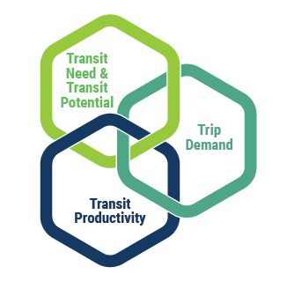
What factors influence microtransit success?
From a quantitative perspective, areas with the greatest likelihood for success with microtransit can be found by looking at data through three lenses:
Transit need and potential (microtransit suitability),
Transit productivity, and
Trip demand.

Slide 12
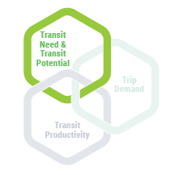
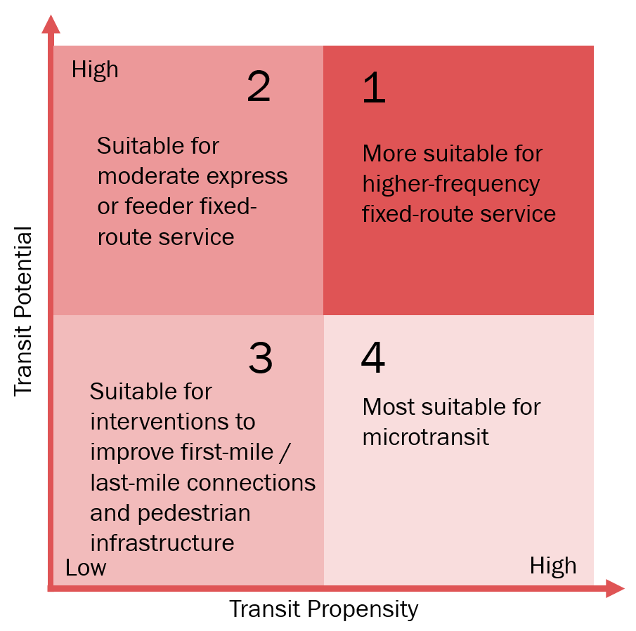
Microtransit Suitability
Using a bivariate analysis is a helpful way to visualize where microtransit could be suitable throughout a study area.
Transit potential: density of residents and jobs in an area (viability of transit service)
Transit propensity: density of specific population groups that are more likely to use public transit (need for transit)
Sweet Spot
Notes:
Transit need/propensity is compared to transit potential, allowing each area to be categorized into one of the quadrants

Slide 13
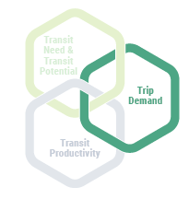
Trip Demand Analysis
A Trip taker demographics: Trips by populations that are more likely to use transit.
A Trip purpose: Trips that could be better serviced by microtransit if they have a mix of purposes such as to work, retail destinations, and medical appointments, as well as if trip origins and destinations are either unserved or underserved by existing transit service.
A trip demand analysis provides more information about the travel needs that microtransit may be able to serve and can inform identification of microtransit service area (or “zone”) boundaries
Notes:
Transit need/propensity is compared to transit potential, allowing each area to be categorized into one of the quadrants

Slide 14
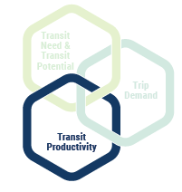
Microtransit Suitability
Using a bivariate analysis is a helpful way to visualize where microtransit could be suitable throughout a study area.
Transit potential: density of residents and jobs in an area (viability of transit service)
Transit propensity: density of specific population groups that are more likely to use public transit (need for transit)
Sweet Spot
Notes:
Transit need/propensity is compared to transit potential, allowing each area to be categorized into one of the quadrants

Slide 15
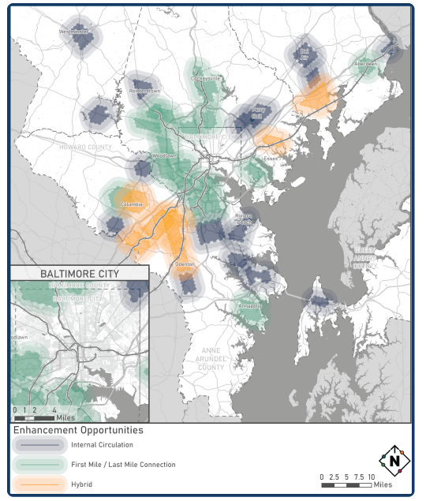
Baltimore Region Example
Areas to Integrate Microtransit into the Baltimore Region’s Fixed-Route Network

Slide 16
Implementation Considerations
How will microtransit work?
Notes:
Let’s begin with an introduction to microtransit.

Slide 17
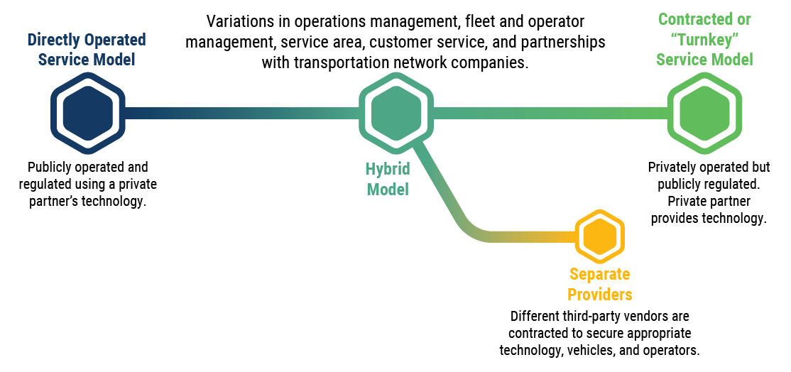
Service Model Spectrum
Notes:
A microtransit service delivery model refers to the division of responsibility in providing microtransit service between public agencies and vendors, also called mobility technology companies. There are three predominant models: the software-as-a-service (SaaS) or directly operated model, the transportation-as-a-service (TaaS) or contracted service model, and the hybrid model.

Slide 18
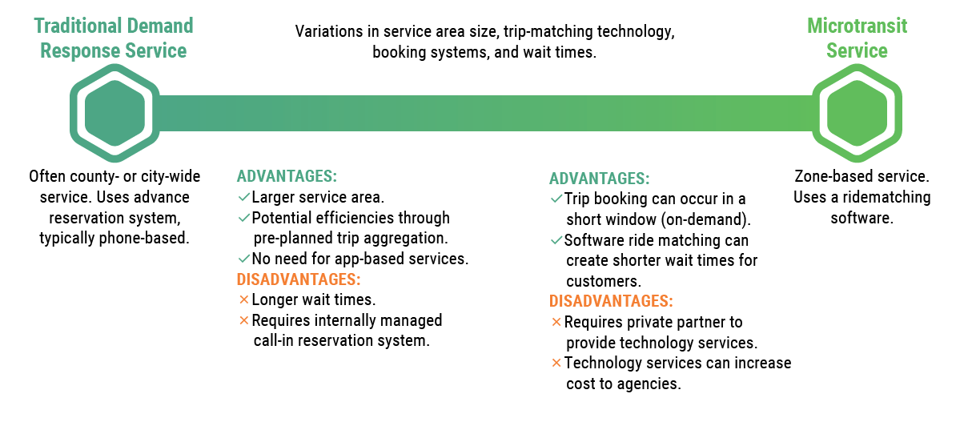
Co-mingling Consideration

Slide 19
What service delivery model makes sense for my agency?
Key Considerations:
Operational Control and Flexibility vs Risk Ownership
Ability to scale (vehicles and employees)
Technology needs
Customer service control
Booking > Matching > Dispatching > Real Time Reporting needs

Slide 20
Service Model Considerations
There is no one right way to provide microtransit service
OPERATING MODELS TO CONSIDER:
Software as a Service (SaaS)
Transportation as a Service
Curb-to-Curb
Corner-to-Corner
Geographic Service Zones
Distance-Based Pricing
No Restrictions
Designated Stops
Traditional Hours
Late Night Service
Notes:
Microtransit is still a fairly new service model and each pilot or implementation is like a laboratory of innovation and experimentation

Slide 21
Inclusivity Considerations
Considerations for fare policy design
Revenue vs. Accessibility
Premium fares vs fare-free
Employer-subsidized rides in suburban job centers
Trip purpose
Dedicate services to regional hubs like medical centers, shopping malls or airport
Community characteristics
Student, low income households & senior pass
Considerations for technology
Enhance service for non-English speakers with multilingual apps
Offer multiple booking platforms including mobile application and call center for residents with limited broadband or smartphone access

Slide 22
Implementation Challenges
OPERATOR SHORTAGES
Recruit locally, and offer competitive benefits
Several agencies using rideshare drivers
Potential to partner with local school bus drivers
TECHNOLOGY INTEGRATIONS
Choose platforms that integrate with existing systems
Standardize procurement across regions
Flex EV requirements as rural agencies may face barriers in EV charging infrastructure
FUNDING GAPS
Leverage partnerships and grants
Blend FTA 5310 & 5311, local funds, and partnerships with healthcare providers and employers

Slide 23
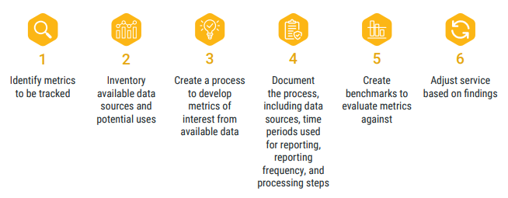
Monitoring: Establishing Performance Measures

Slide 24
Monitoring: Establishing Performance Measures
Example Performance Metrics for Microtransit Service
On-Time Performance
Average Wait Time
Cost Efficiency
Cost Effectiveness
Customer Satisfaction
Number of ADA paratransit-eligible customers using the service
Operating Effectiveness
Trip Request Status
Trip Length
Total Passenger Boardings
Total Unique Passenger Boardings
Checklist
Which objectives does each of the metrics measure? Does my organization have good data to support each of the suggested metrics? Does my organization have the capability to easily measure the metrics over potentially several service scenarios or iterations, such as through automated calculators/scripts and/or GIS-based tools? Are there duplicative metrics that seem different but are essentially measuring the same thing?
Reference: Performance Measurement and Evaluation Framework of Public Microtransit Service
Reference: TCRP Research Report 221: Redesigning Transit Networks for the New Mobility Future: Resource and Toolkit

Slide 25
Additional Resources

Slide 26
Additional Resources
N-CATT Microtransit Service Design On-Demand Course
Virtual workshops videos, instructions, reference materials, and other interactive content were converted into an on-demand course
Free enrollment!

Slide 27
Sandy Brennan
Vice President & Senior Project Manager
sbrennan@foursquareitp.com
240.205.7469
Jessica Klion
Microtransit Practice Lead
jklion@foursquareitp.com
610.421.4174
Notes:
Set up for next speakers: now you will hear real-world lessons learned from PG County, Anne Arundel, and Annapolis, and how they used microtransit to test new markets, fill service gaps, and better coordinate with their existing services.

