Slide 1

Safety Committee In Action
October 9, 2025
TAM Conference

Slide 2
Why Are We Here?
Share Cecil Transit’s experience
Encourage others
Learn from peers

Slide 3
Agenda
Regulations
Cecil Transit’s Safety Committee
Benefits
Open Discussion

Slide 4
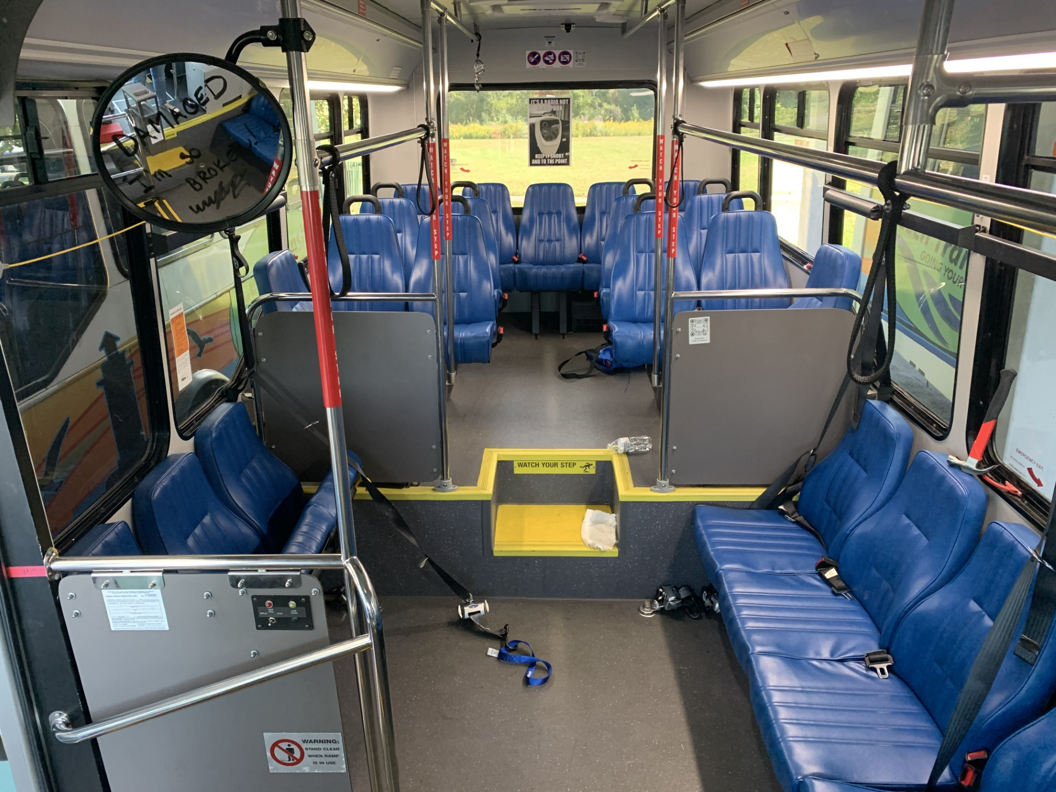
Spot the Hazard

Slide 5
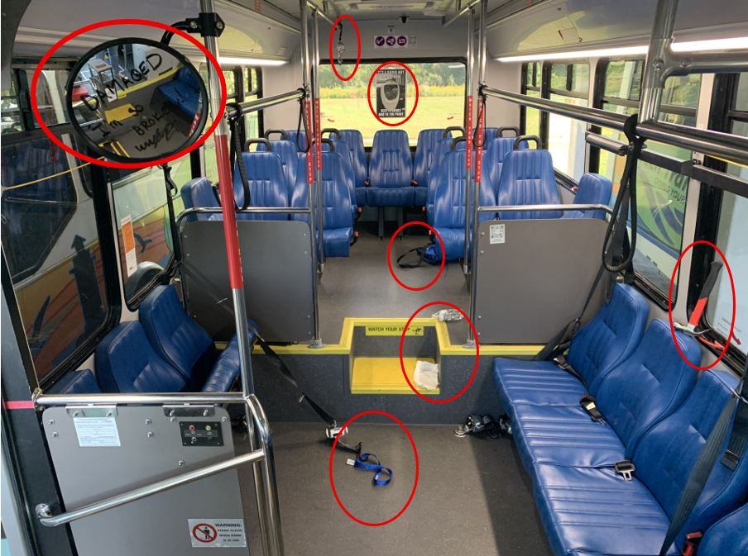
Spot the Hazard

Slide 6

Role Call
5311 Recipients Only
5307 Small UZA
5307 Large UZA
Non Profit
Other

Slide 7
SMS/PTASP Overview
2012
First required as part of MAP-21
2015
FAST Act reaffirmed the requirement and expanded oversight provisions
2018
FTA Published the final rule for the Public Transportation Agency Safety Plan (PTASP) (49 CFR Part 673)
2020
PTSAP Rule Became Effective. Agencies required to have compliant safety plans in place

Slide 8
Who must comply
5311 Recipients and 5307 Recipients in Small UZA (less than 200,000 people): Must develop a safety plan in cooperation with front line employee representation.
5307 Recipients from Large UZAs (200,000+):
Establish a safety committee comprised of 50% front line staff
Implement a risk reduction program to improve safety by reducing number and rates of accidents, injuries, and assaults
Set performance targets using a rolling 3 year average
Allocated at least .75% of 5307 funding to safety related projects
Provide de-escalation training

Slide 9
Who is Who?
Small UZAs & Rural
Allegany
Calvert
Carroll
Charles
Delmarva Community Transit
Frederick
Garrett
St. Mary’s
Shore Transit
Ocean City
Washington
Large UZAs
Annapolis
Anne Arundel
Baltimore City
Baltimore County
Cecil
Harford
Howard
Montgomery
Queen Anne’s
Prince Geoge’s

Slide 10
Why It Works?
Strengthens safety culture
Enhances data driven decision making
Promotes Continuous improvements in safety

Slide 11
Cecil Transit's Safety Committee
50/50 Frontline Workers and Management
CDL and non-CDL drivers based on seniority

Slide 12
Management Representatives
Director – Accountable Executive
Transit Chief – Safety Officer
Operations Supervisor – Lead Investigator and Meeting Facilitator
Human Resources Representative
Risk Manager

Slide 13

Responsibilities
Accident/Incident Review
Final preventability determination
Hazard report review
Risk Register
Mitigation Suggestions

Slide 14
When We Meet
Quarterly Meetings
Information Presented
Year-To-Date safety performance targets
Present accidents, incidents, and hazards from the quarter
Agree or disagree?

Slide 15
Hazard Review
Presented
Discussed
Rated
Agree or Disagree?
Mitigations
Implementation

Slide 16
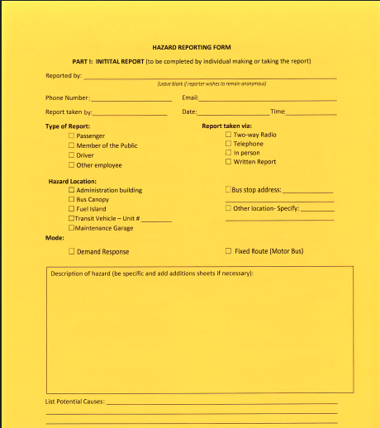
Hazard Reporting
Form

Slide 17
Investigation
Potential Causes
Operational Consequences
Safety Consequences
Suggested Mitigations
Resolution
FOLLOW THROUGH WITH REPORTER

Slide 18
Hazard Risk Indices
HAZARD RISK INDICES
PROBABILITY OF OCCURRENCE | HAZARD SEVERITY
 | 1 CATASTROPHIC | 2 CRITICAL | 3 MAJOR | 4 MINOR | 5 NEGLIGIBLE
(A) FREQUENT | ☐1 A | ☐2A | ☐3A | ☐4A | ☐5A
(B) PROBABLE | ☐1B | ☐2B | ☐3B | ☐4B | ☐5B
(C) OCCASIONAL | ☐1C | ☐2C | ☐3C | ☐4C | ☐5C
(D) REMOTE | ☐1D | ☐2D | ☐3D | ☐4D | ☐5D
(E) IMPROBABLE | ☐1E | ☐2E | ☐3E | ☐4E | ☐5E

Slide 19
Time Table
 | UNACCEPTABLE | REQUIRES TRANSIT CHIEF REVIEW / REQUIRES DIRECTOR REVIEW - Preliminary investigation within 24 hours/Final report due within 72 hours
 | UNDESIRABLE | REQUIRES TRANSIT CHIEF REVIEW – Preliminary investigation within 24 hours/Final report due within 72 hours.
 | ACCEPTABLE WITH TECHNICAL REVIEW | REQUIRES TRANSIT CHIEF REVIEW – Preliminary investigation within 48 hours/Final report due within 7 days.
 | ACCEPTABLE WITHOUT FURTHER REVIEW | REQUIRES OPERATIONS SUPERVISOR REVIEW – Final report due within 30 days.

Slide 20

Risk Register
Purpose
Tracks and Evaluates Safety Risks Over Time
Identifies Patterns and Recurring Issues for Target Mitigation

Slide 21
Example of Tracking Log
Hazard Identification |  |  |  | Safety Risk Assessment |  |  |  | Monitoring
Risk | Source | Consequences | Existing Mitigations | Safety Risk Index | Selected Mitigations | Responsible Parties | Estimated Implementation Date | Safety Performance Indicator (Effectiveness) | Safety Performance Target

Slide 22
Minor Accidents Under the Canopy
Risk: Canopy Accidents
Source: 3 Minor Accidents in 9 months
Potential Consequences: damage to equipment and/or minor injury
Existing Mitigations: red and white reflective striping on some of the poles
Rating: 4C (minor and occasional)
Mitigations: add reflective stickers to the back poles, change overhead lighting to LED, and restripe the pavement markings
Performance Indicator: No accidents involving Canopy
Performance Target: Zero accidents 6 months after the restriping

Slide 23
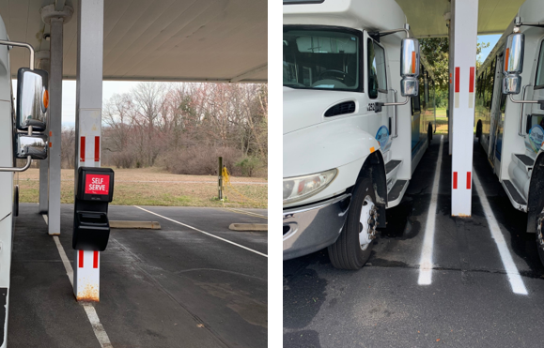
Restriping Before and After

Slide 24
Safety / Retention Bonus
$4800 annually
$1200 paid out per quarter if parameters are met
Pro rated for part-time drivers
Implemented in January 2023
Increases earning potential
Helps us met safety goals
Also tied to attendance
Notes:
Include that we did this in lieu of giving a raise and it was more agreeable with administration

Slide 25
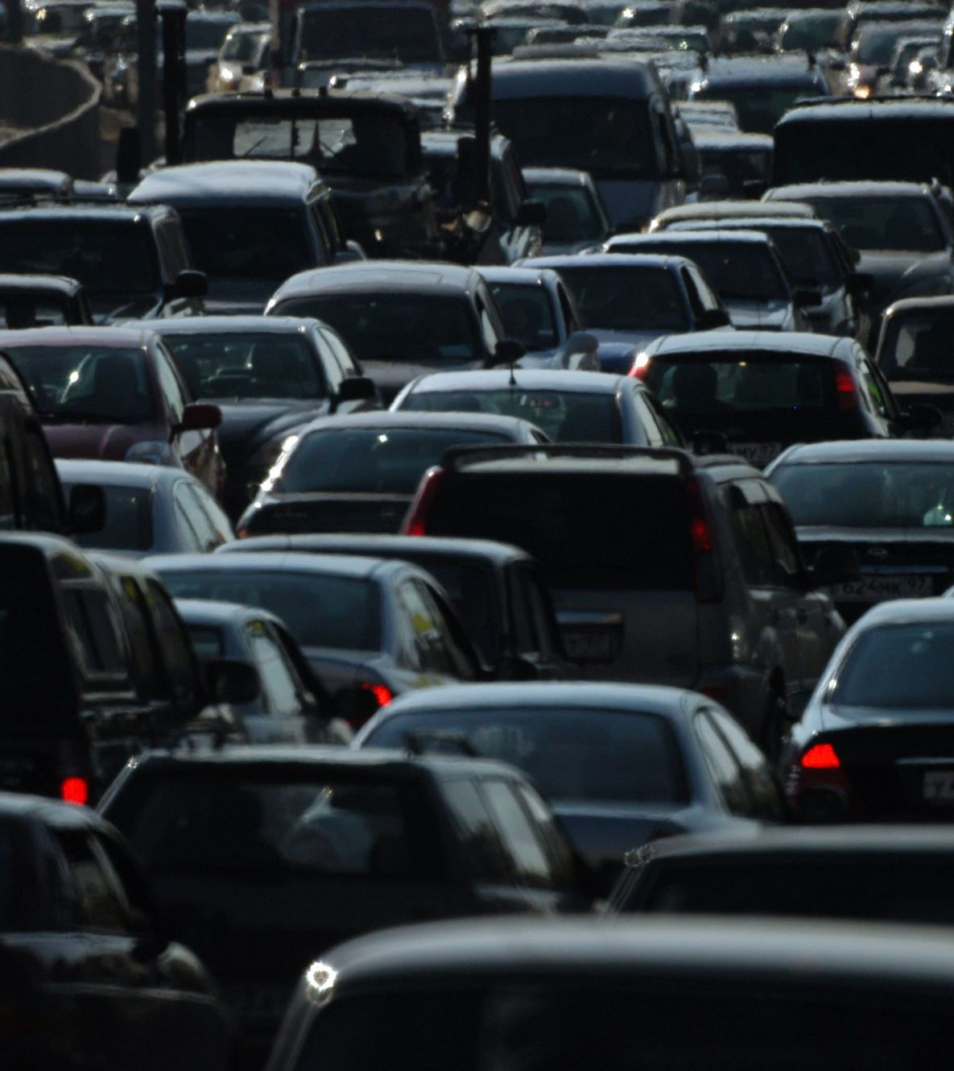
Bonus Requirements- eligibility resets each quarter
Not on probation
Hold a qualifying position that requires more than 50% of their time driving
Not on FMLA or Leave of Absence
No preventable accidents or incidents
No disciplinary actions
No unauthorized absences
Have not accumulated more than 3 unscheduled absences

Slide 26
Benefits
Stronger Safety Culture
Staff Buy In
Administrative Buy In
Safety Improvement
Reduced Minor Accidents
Reduce Safety Events
Increased Hazard Reporting

Slide 27
Safety Matters
Brenda Darr, frontline staff-
“Discussing the causes of accidents allows us to identify and address contributing factors, helping prevent similar incidents in the future and keeping drivers safer on the road.”

Slide 28
Key Takeaways
Compliance builds culture and not to just check boxes
Safety Committee gives frontline staff a voice
More Reporting = More Prevention
Tangible Results
Fewer Accidents
More Buy-in
Stronger Safety Culture

Slide 29
Open Discussion
Do you have a Safety Committee?
What works best for you?

Slide 30
Cecil Transit
Transit Chief
Suzanne Kalmbacher
skalmbacher@ccgov.org
410-996-8422
Operations Supervisor
Kimberly Stayman
kstayman@ccgov.org
410-996-8421

