Slide 1




Innovation
In Transit

Slide 2



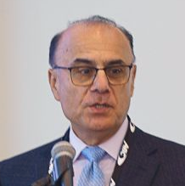
Allegany Transit TBD
Allegany HRDC TBD
Josh Thomas IT Curves
Director of Sales & Marketing
Moderator Matthew Mohebbi
IT Curves
CEO

Slide 3

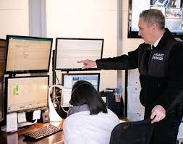

Public Transit: All About People’s Mobility
Demand
Fulfillment
Service
Make it a Conversation
Intuitive
Integrated
Interactive
Intelligent

Slide 4
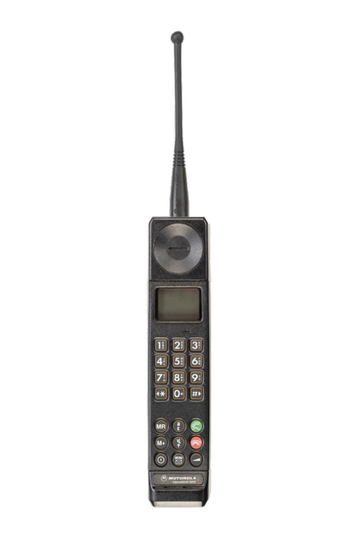

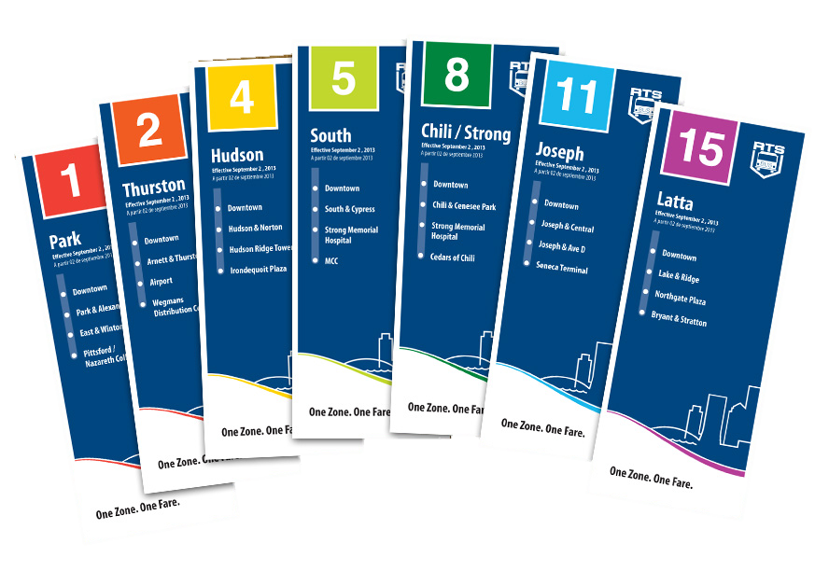
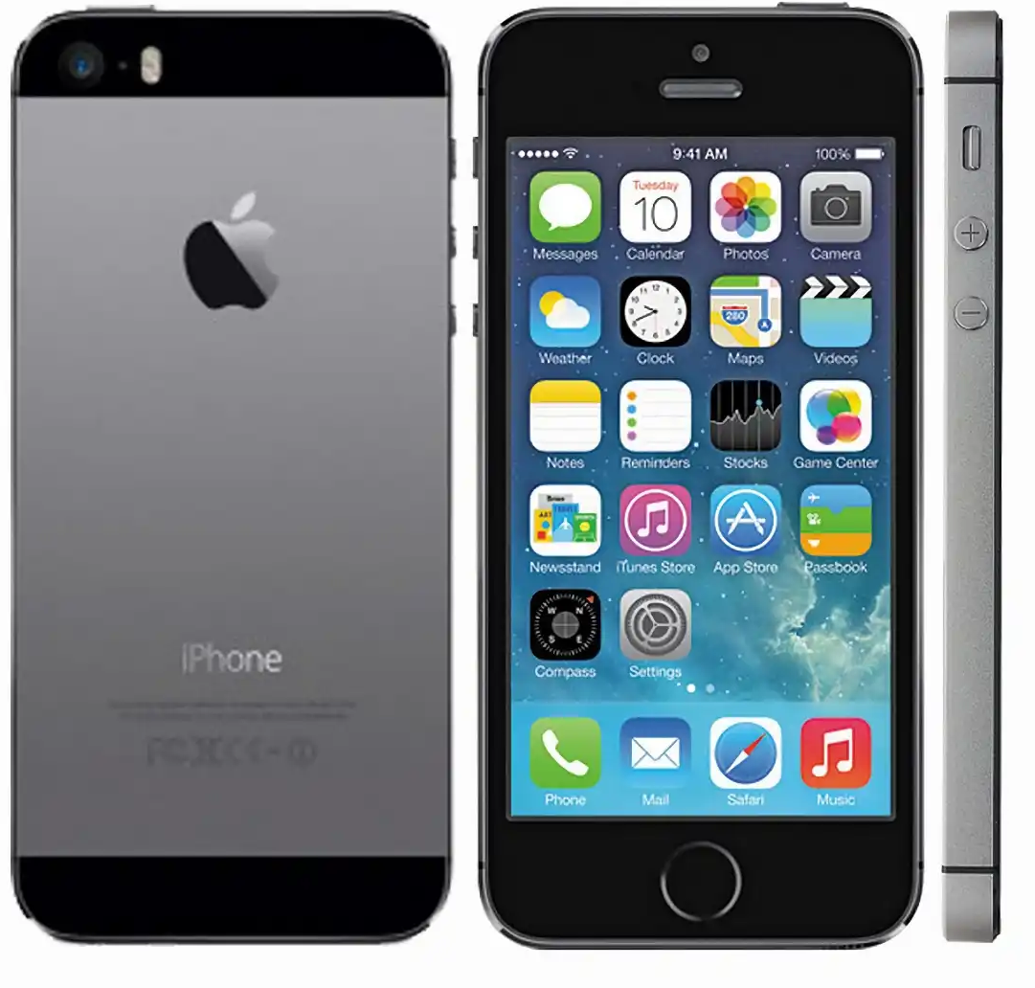

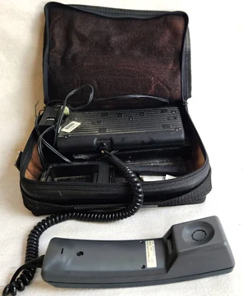
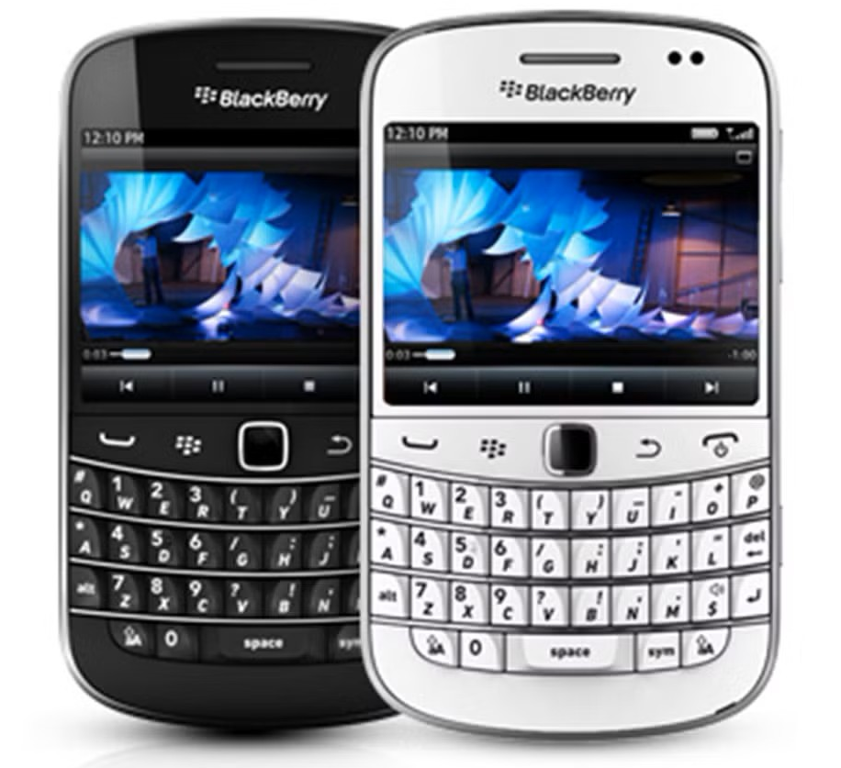
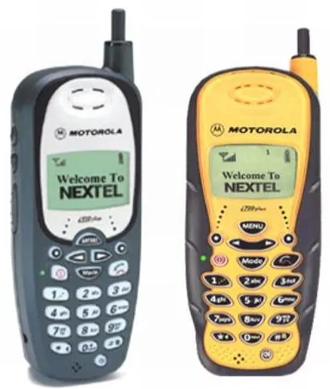
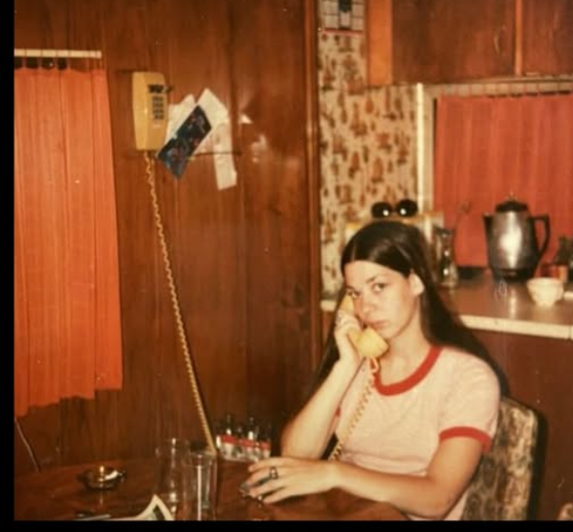
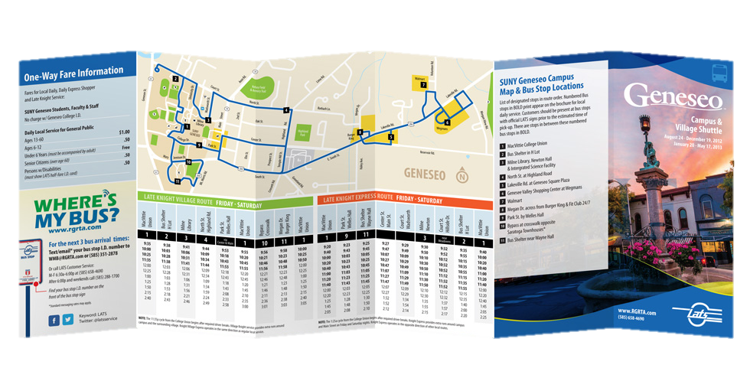
Riders Voyage
1990
Motorola Brick
19xx
Standard Phone with Long Cord
19xx
Pamphlet
& Scheduling
19xx
Hitchhiking
1985
Motorola Suitcase
2005
BlackBerry
Graphic Screens On Phones
2025+
Wearables
Intuitive, Interactive, Intelligent
2000
Nextel
GPS In Phones
2012
iPhone & Apps
A New Era

Slide 5
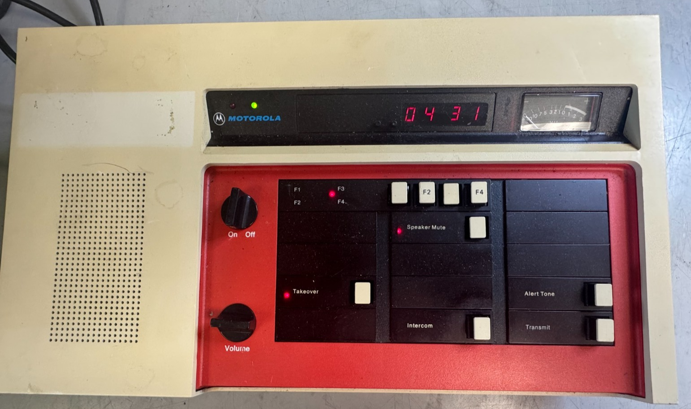
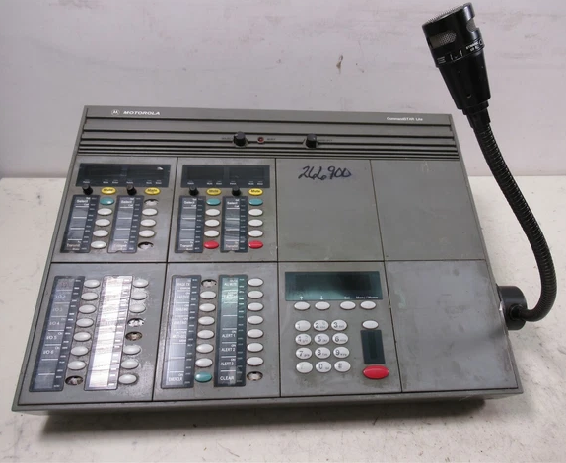
Vintage Dispatch Radios

Slide 6
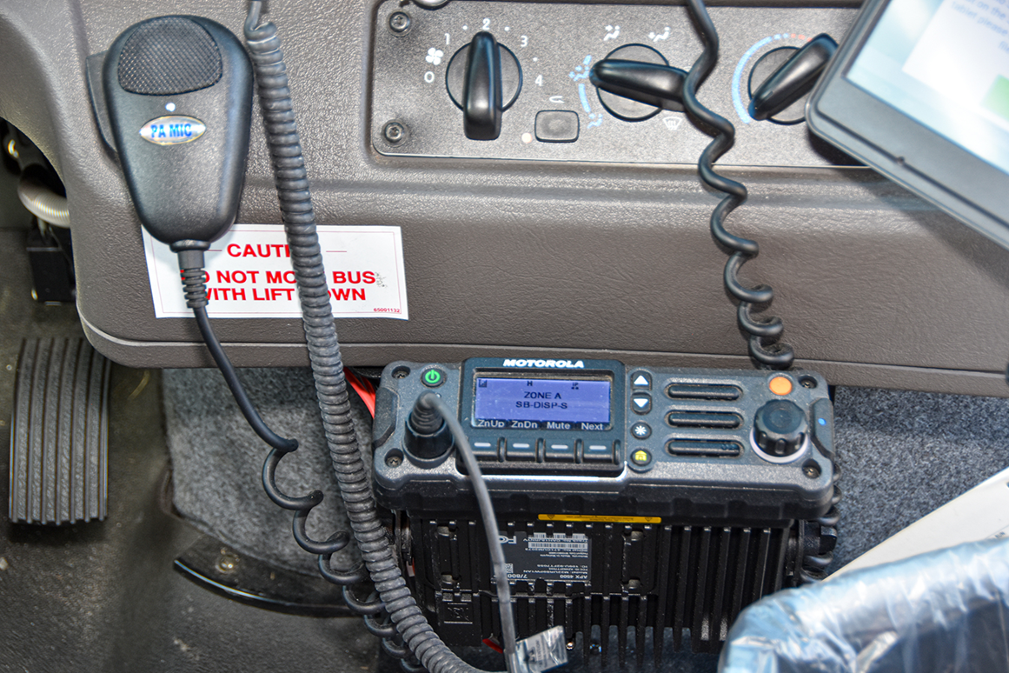
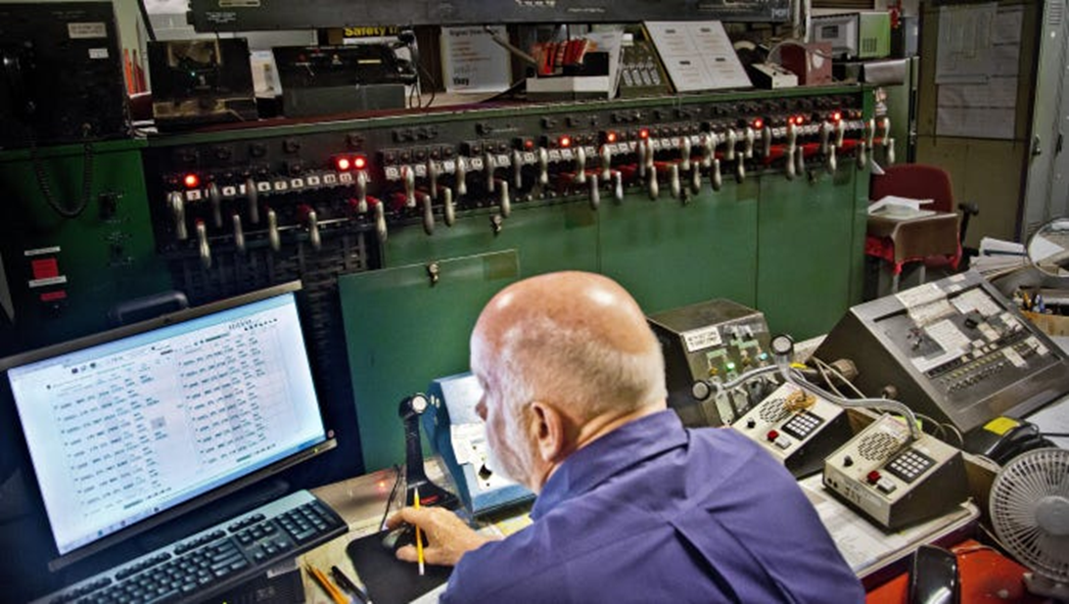
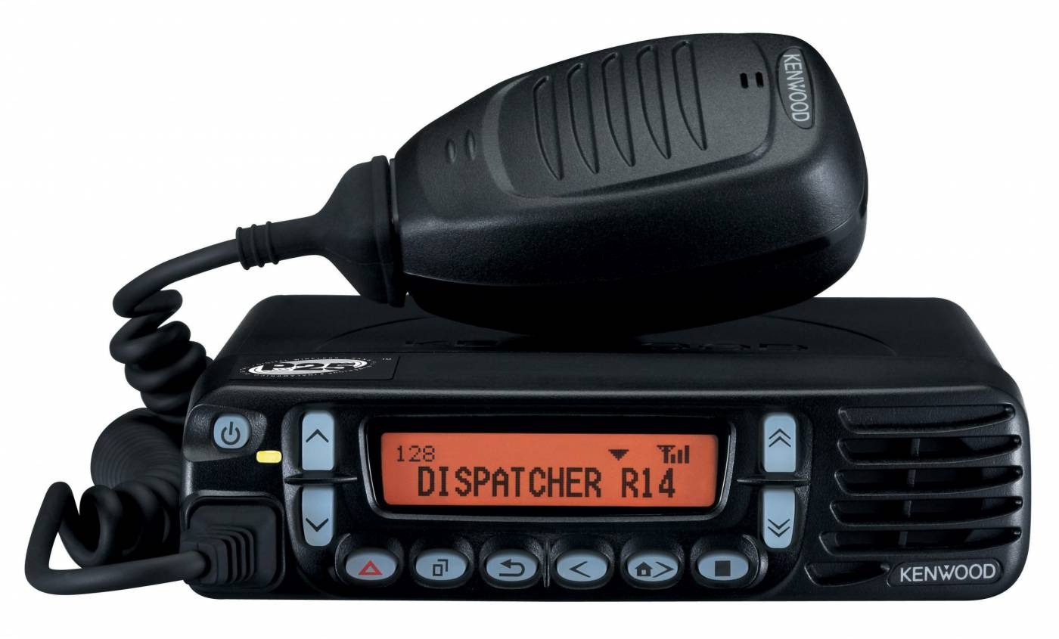
Analog Two-Way Dispatch Radio

Slide 7
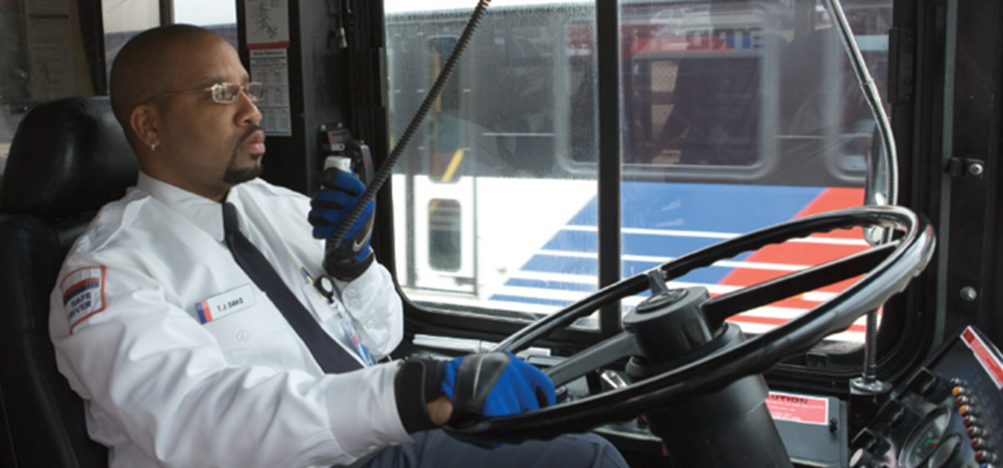
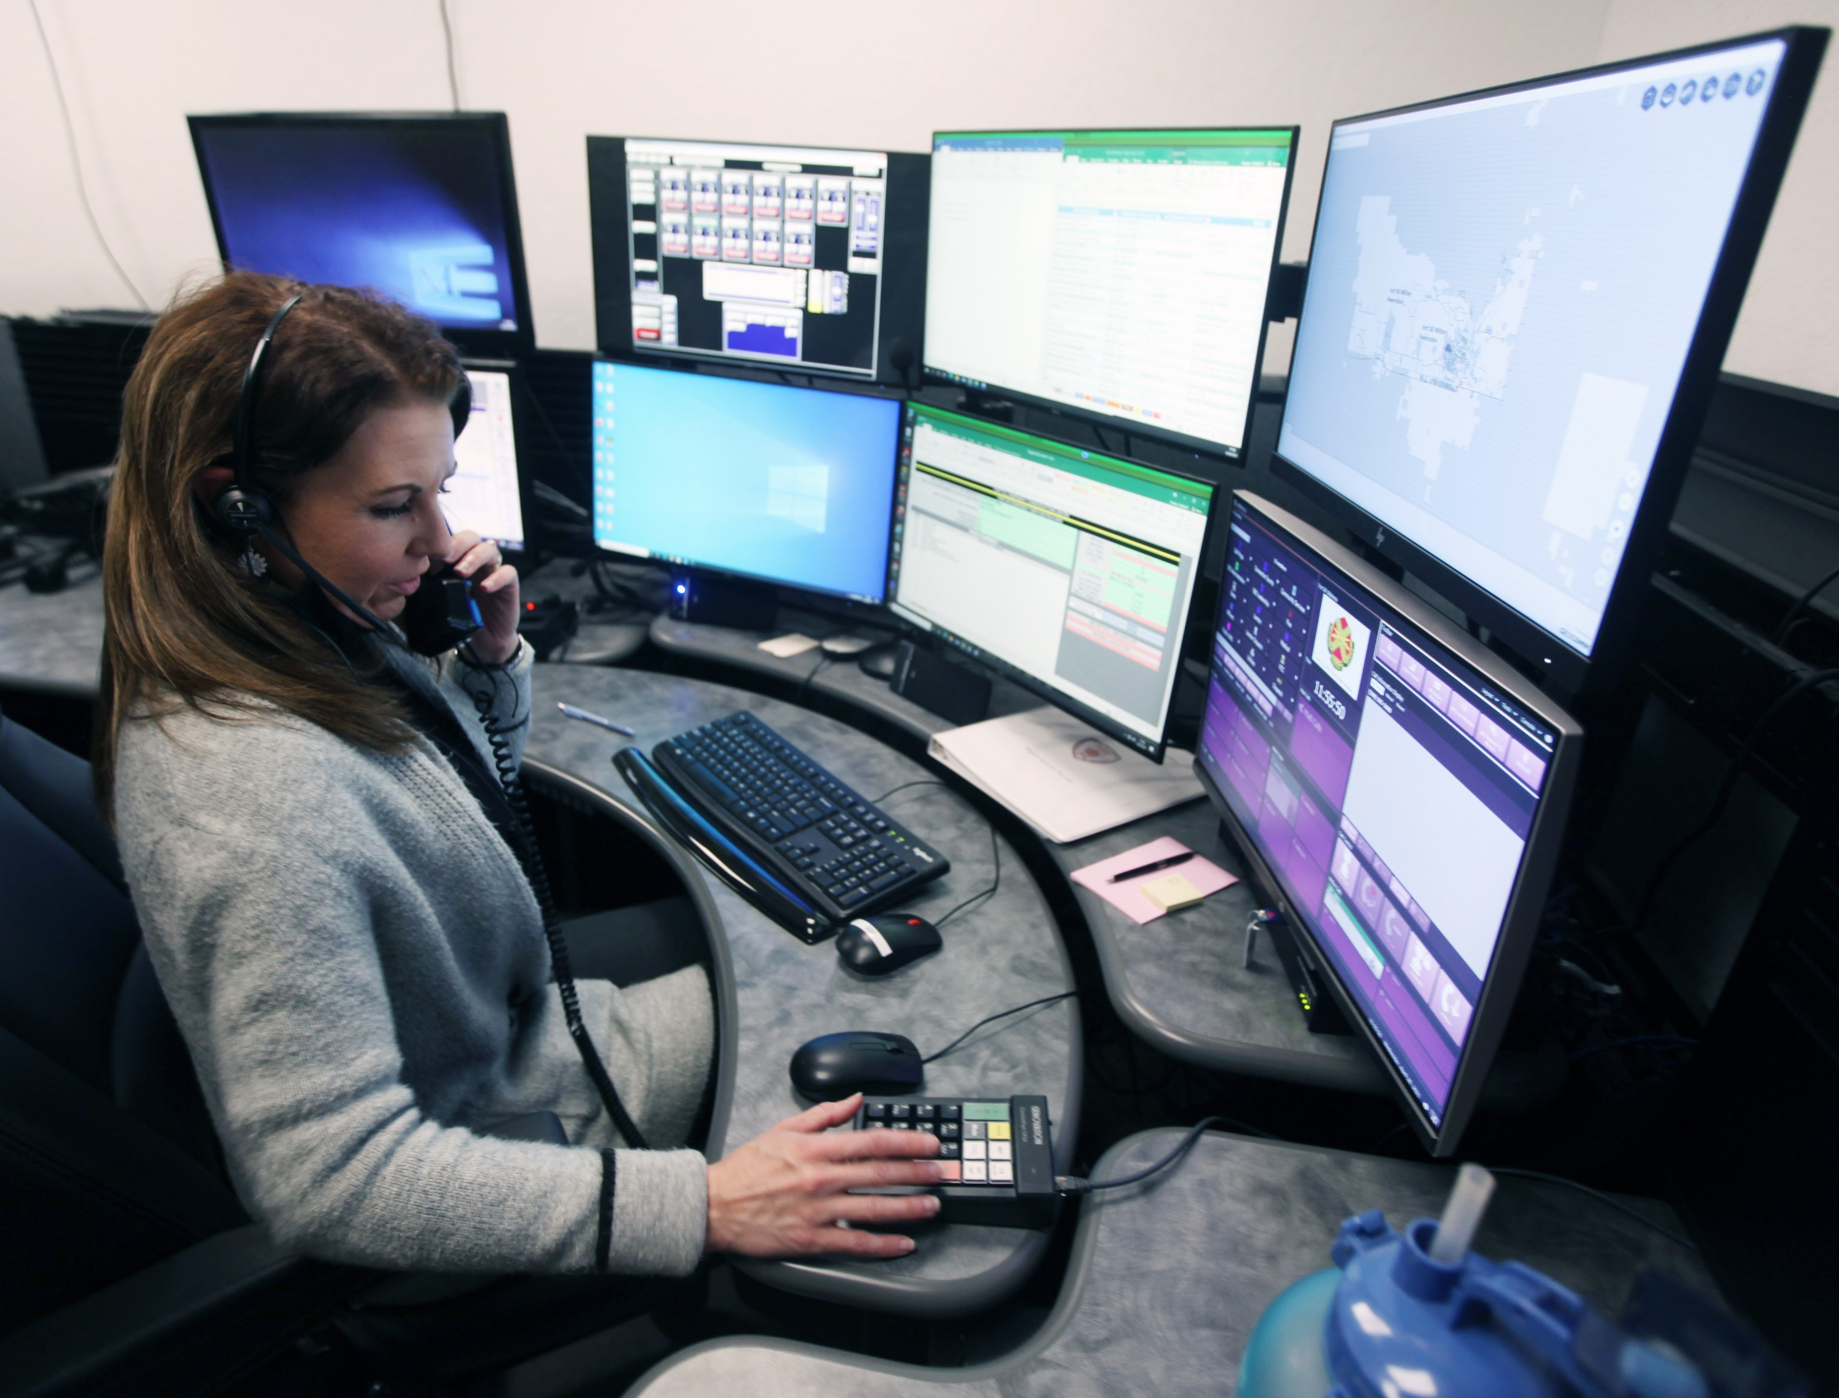
Analog Two-Way Dispatch Radio

Slide 8

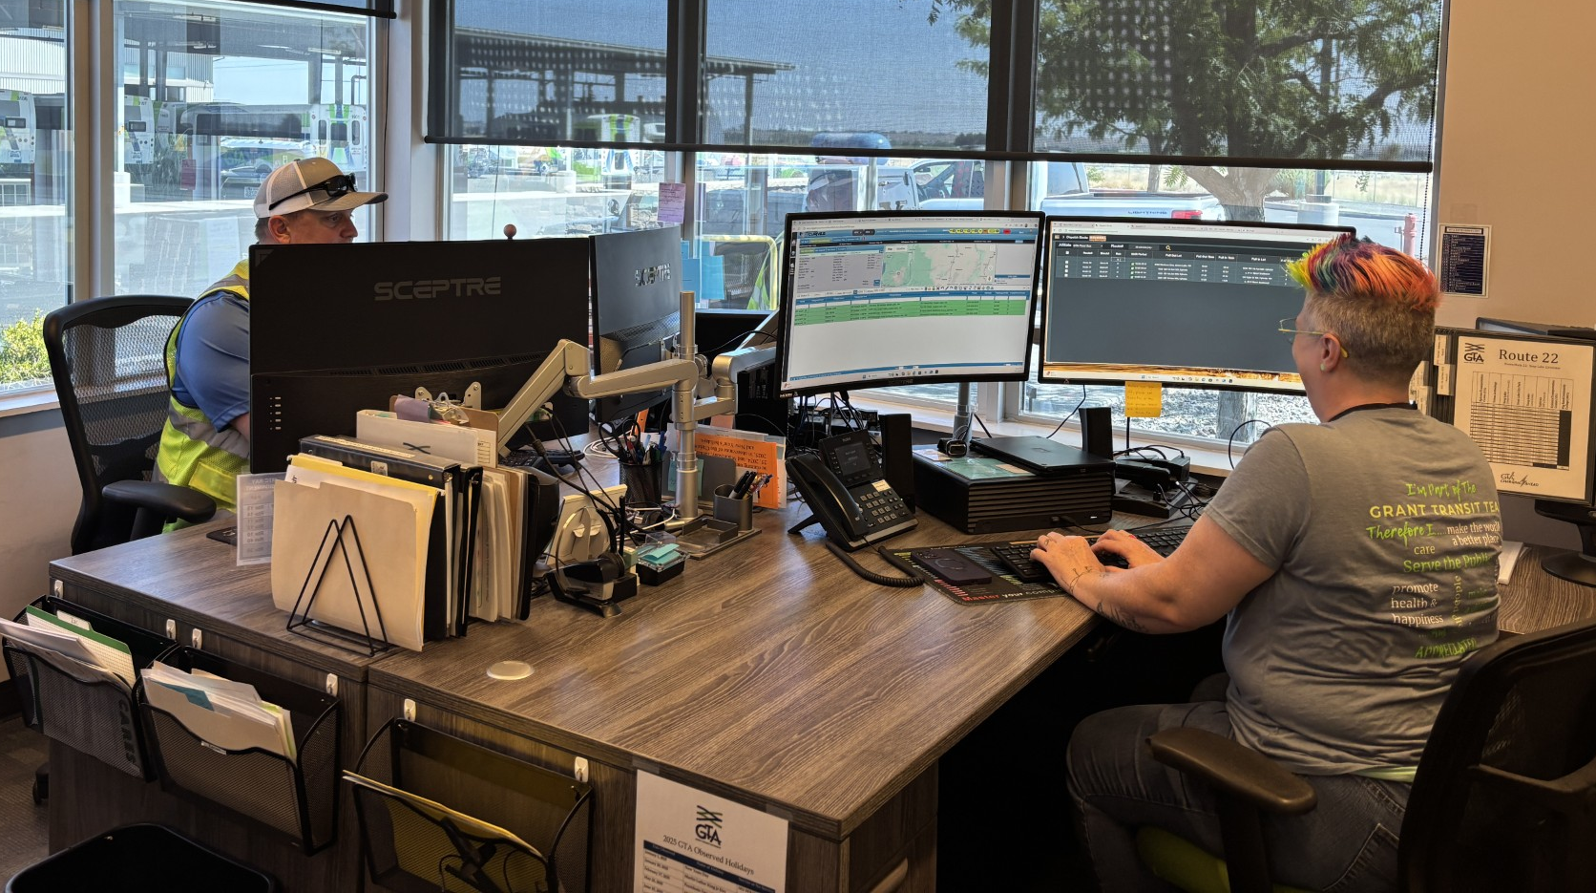
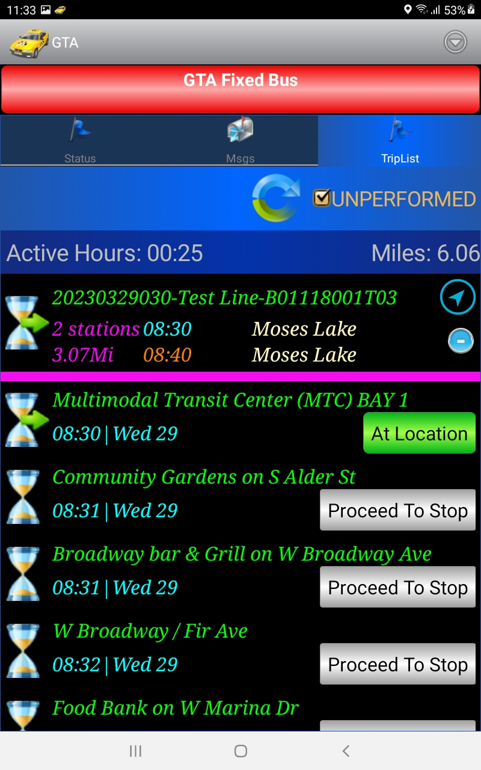
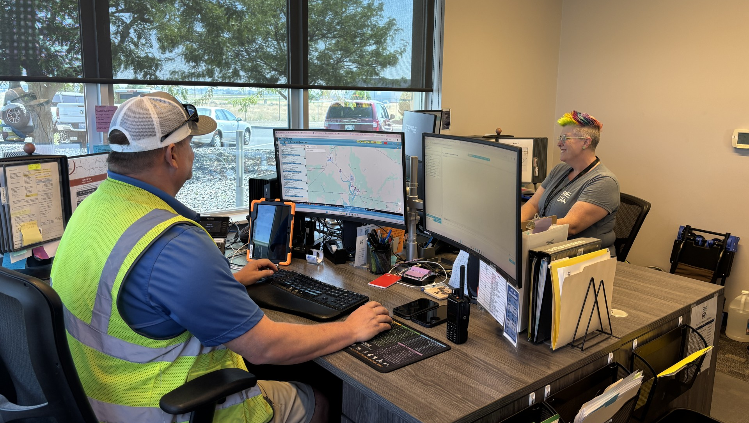
Driver & Dispatch Voyage

Slide 9
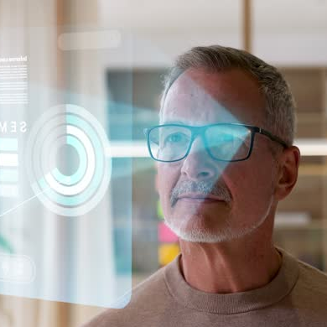
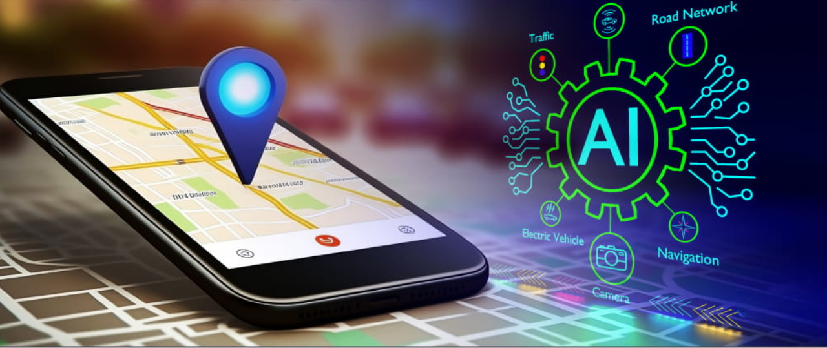




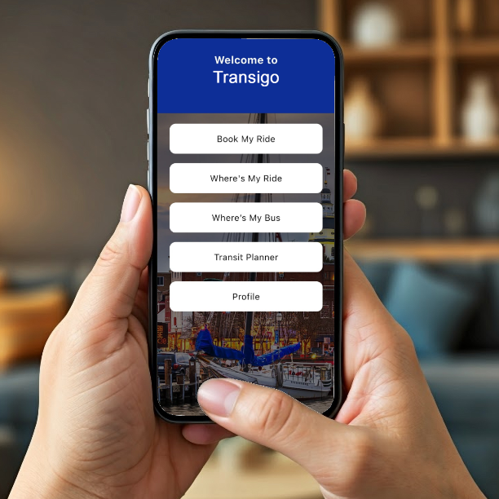

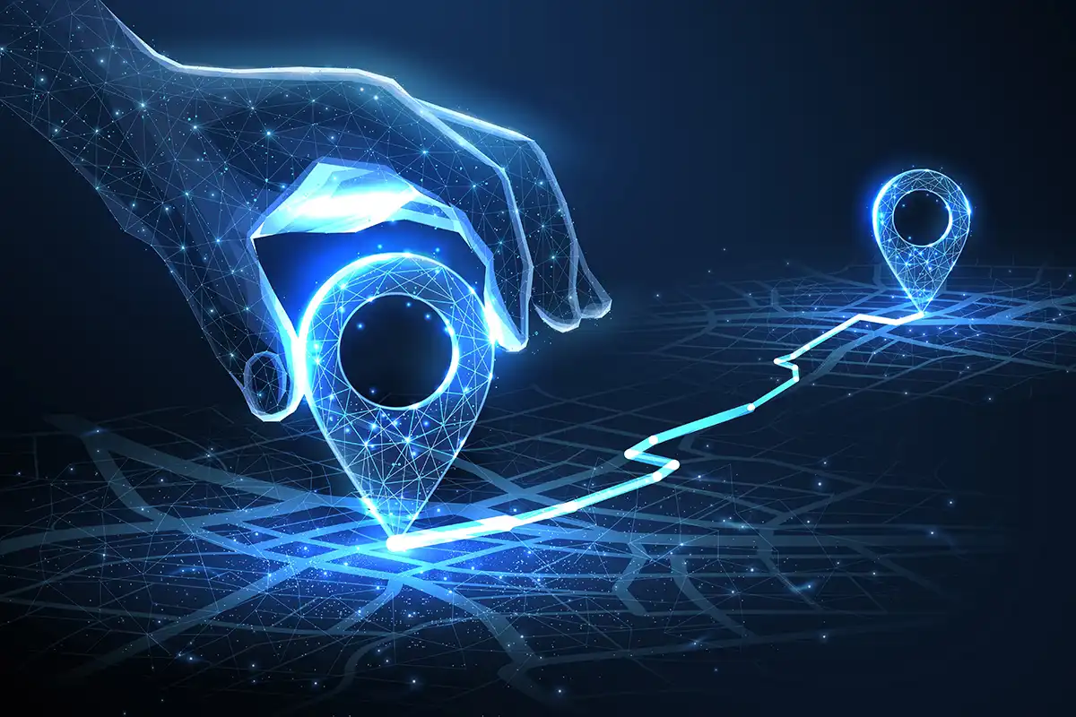
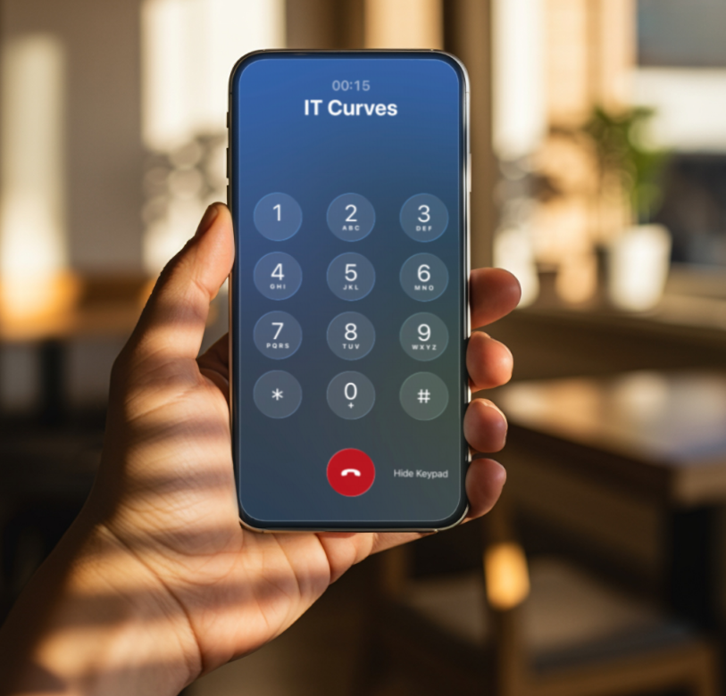




RIDER INTERACTIVITY
AI PERSONAL
ASSISTANT
MACHINE
LEARNING
Technology –Today’s Building blocks
RIDER
.INTERACTIVITY.
FIX & FLEX TRANSIT
PARATRANSIT
INTELLIGENT . TELEPHONY .
TRIP BROKER
DISPATCH
CENTER
SMART TRIP PLANNER
INTELLIGENT TELEPHONY
AI RESERVATION
RATING & SURVEY
INCIDENT TICKET

Slide 10
Technology : Tomorrow’s Building blocks
RIDER INTERACTIVITY
AI PERSONAL
ASSISTANT
MACHINE
LEARNING
INTELLIGENT TELEPHONY
AI RESERVATION
RATING & SURVEY
INCIDENT TICKET
SMART TRIP PLANNER

Slide 11
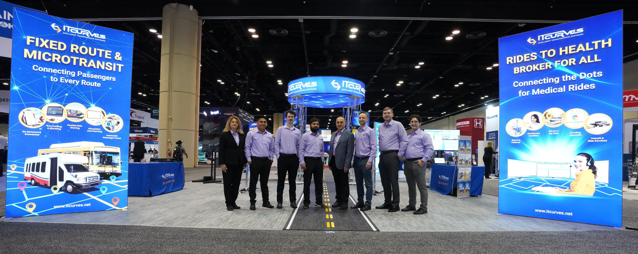
APTA and TRB participation

