Slide 1
FY2026-2027 5310 Briefing Responsibilities and Obligations
October 7th, 2025
Presented by:
Cydney Dickens, MDOT MTA OLTS
Lynn Winchell-Mendy, MDOT MTA OLTS
Designed for 5310 recipients’ new staff
or a refresher for current staff

Slide 2
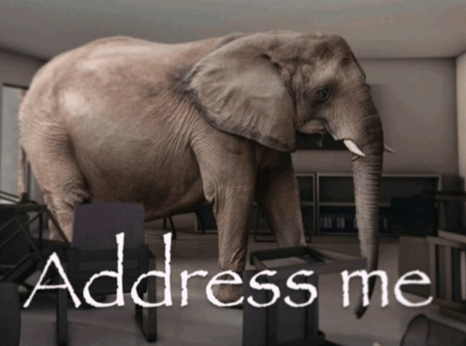
First things first:
Grant Agreements
ProjectWise
Overdue Invoices

Slide 3
Agenda for this Afternoon We will review the following:
Terminology
5310 description
Fiscal Year
5310 Manual
Funding types
Requests for Payment
Payment Process
Quarterly Reports
Title VI
ProjectWise

Slide 4
Terminology
FTA: Federal Transit Administration
MDOT: Maryland Department of Transportation
MTA: Maryland Transit Administration
OLTS: Office of Local Transit Support
Section 5310: Enhanced Mobility of Seniors & Individuals with Disabilities
MM: Mobility Management
PM: Preventive Maintenance
Match: Federal and/or Local share required for grant
FY: Fiscal year
RFP: Request for Payment
Notes:
(please note: for FY22/23 NO Local Match is required!)

Slide 5
Coordinated Public Transit-Human Services Transportation Plan
Stand up! Introduce yourself! Please share either what region/counties you serve, or a marketing outreach effort that worked well for you
Maryland’s Coordinated Public Transit–Human Services Transportation Plans are being redesigned across all five regions to reflect updated needs, strategies, and projects.
Participation matters! 5310 recipients must remain in compliance with these plans, and meeting attendance is mandatory to ensure your input is included.
The redesign process emphasizes stakeholder engagement, workshops, and focus groups are held regionally so providers’ voices guide the strategies.
Updated plans will serve as the foundation for 5310 funding decisions and project eligibility, so staying informed and engaged protects your agency’s access to resources.
The website provides regional plan updates, meeting details, and resources. Please review regularly to stay compliant.
https://marylandcoordinatedplans.com

Slide 6
Let's Discuss! Your voice matters!
Coordinated Plan Updates – Partner Spotlight: KFH Group
Joel Eisenfeld from KFH is joining us today to provide insight on the Coordinated Plans. KFH helps by updating and guiding these plans every five years, and Joel’s expertise will help frame our discussion on coordination, access to resources, and engagement opportunities for 5310 providers.
Discussion Prompts for Grantees:
What transportation gaps or challenges do you see most often in your community?
What outreach or marketing strategy has worked well for you in reaching seniors or individuals with disabilities?
How does your agency collaborate with other providers in your area?
What partnerships or community connections have been most helpful to your agency?

Slide 7
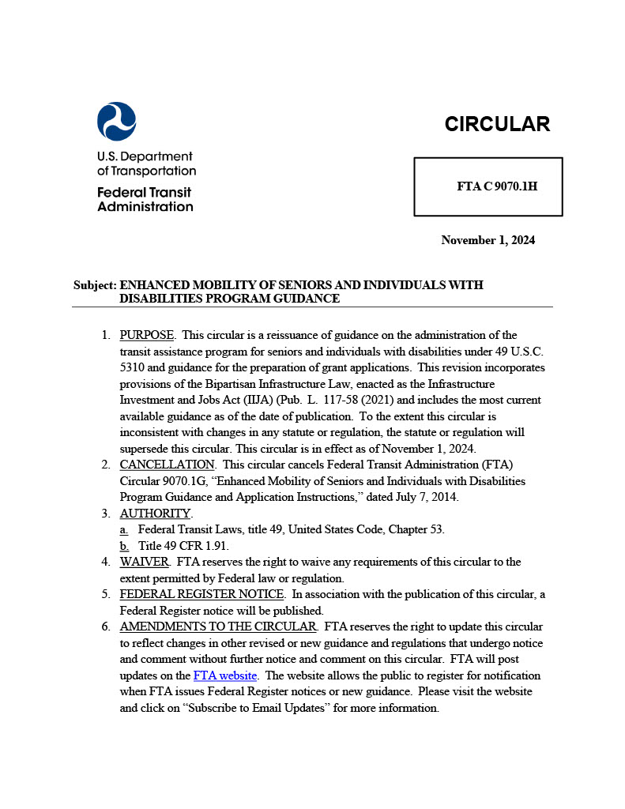
Responsibilities and Obligations
What is 5310 again?
The 5310 program exists to improve mobility for seniors and individuals with disabilities especially when public transportation is insufficient, or unavailable.
Funds can be used for capital expenses, operating expenses, and mobility management projects as long as they directly benefit the populations we’re serving.
What is the 5310 Circular :
This circular is the official guidance from the Federal Transit Administration for the Section 5310 program. It explains the rules, requirements, and expectations for how these federal funds must be used. Think of it as the playbook we all follow to stay compliant.
The newest version, 9070.1H, replaces the older 9070.1G from 2014.
https://www.transit.dot.gov/regulations-and-programs/fta-circulars/enhanced-mobility-seniors-and-individuals-disabilities

Slide 8
Responsibilities and Obligations
What is a Fiscal Year?
A 12-month period used for budgeting, reporting, and funding not always the same as the calendar year.
MDOT MTA’s Fiscal Year: July 1 – June 30
ex: FY 2026 would be July 1, 2025, through June 30, 2026
FY 2027 would be July 1, 2026, through June 30, 2027
Why It Matters:
Reporting deadlines depend on which fiscal year is being used.
Quarterly reports are tied to MDOT MTA’s fiscal year, not your agency’s.
Always double-check which fiscal year we’re referring to before preparing reports.
Notes:
The fiscal year is the year used for taxing or accounting purposes
How many organizations go by January to December?
MDOT MTA follows the fiscal year of July 1 to June 30 – that is why your grants began with a July 1 date.

Slide 9
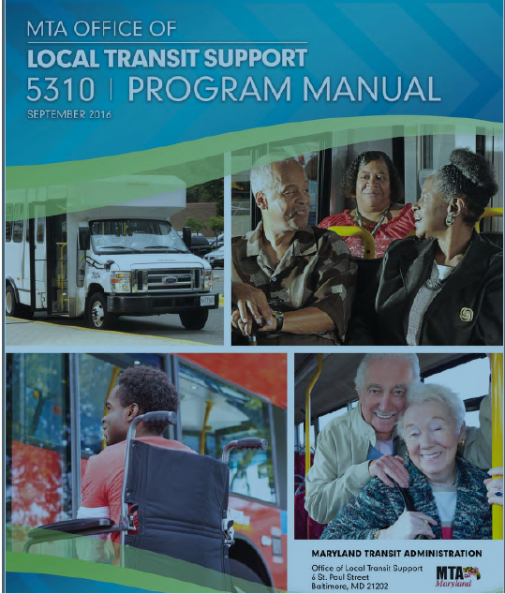
Responsibilities and Obligations
5310 Manual
Let’s take a look at the 5310 Manual which is your ‘bible’ for this grant. Well at least the table of contents.
It can be found on the TAM website under Resources/Office of Local Transit Support
https://www.taminc.org/mta-program-and-grant-information
(Recommend downloading PDF to your desktop)
Notes:
The fiscal year is the year used for taxing or accounting purposes
How many organizations go by January to December?
MDOT MTA follows the fiscal year of July 1 to June 30 – that is why your grants began with a July 1 date.

Slide 10
Difference between Capital and Operating Expenses
Capital Grant 80% Federal/20% Local Match
Expenses mostly associated with tangible items (except MM):
Equipment (Vehicles)
Equipment (non-vehicles e.g. computers)
Preventive Maintenance
Other items such as PPE
Mobility Management
Operating Grant
50% Federal/50% Local Match
Expenses used for operating the vehicle including
Driver Salaries
Dispatch Salaries
Fuel & Oil
Vehicle Insurance
Etc. (look at your budget from grant application)


Slide 11
Break Time!
Let’s take a 15-minute break, and we’ll jump into Requests for Payment when we return.

Slide 12
Request for Payment
There are two types of Request for Payment Forms – one for Capital and one for Operating
Depending on the type of grant(s) you have, the request for payment form was attached to the grant agreement
Important information that should be on your request for payment form:
Grantee Name
Federal ID Number
(Grant) Project Number
Address

Slide 13
How to Complete the Request for Payment Form
List each expense that was paid during the quarter
Use the correct Request for Payment form (Capital vs. Operating)
Enter the correct project number for the award year (example: FY26/27-C5310)
Show the total outlay and how it’s divided between Federal Share, Local Share, and any Local Overmatch
Confirm the requested reimbursement amount matches your documentation
Sign and date the form with authorized official’s name and title
Upload to ProjectWise with all required backup documentation (receipts, invoices, preventive maintenance logs, etc.)
Key Terms and Fields:
Capital Program Outlays
Financing of Net Project Cost
Federal Share
Local Share
Local Overmatch
Requested Payment
Name, Signature, Title, Date

Slide 14
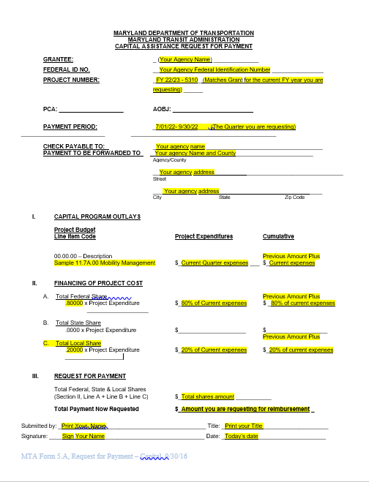
Capital Request for Payment Form

Slide 15
Request for Payment - Operating
Important information that should be on your Operating Request for Payment form:
Revenue and Expense Summary
Financing of Net Project Cost
Federal Share
Local Share
Local Overmatch
Requested Payment
Name, Signature, Title, Date

Slide 16
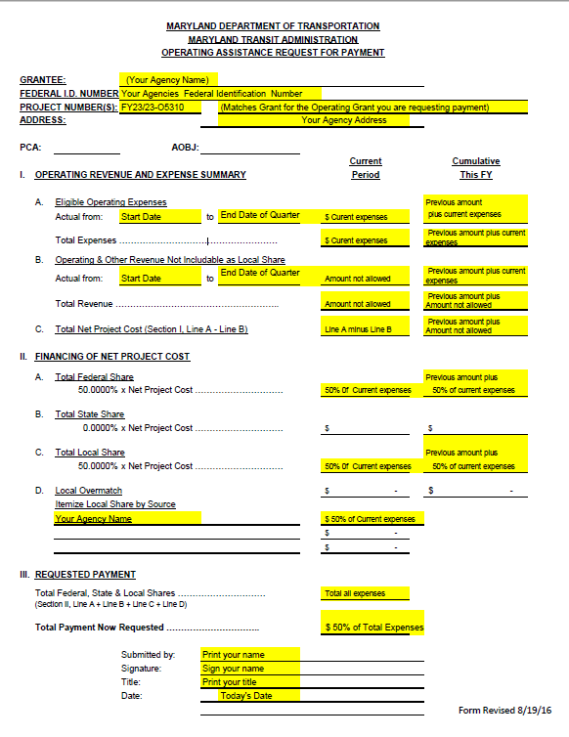
Operating Request for Payment Form

Slide 17
Required Back Up Documentation with Requests for Payment
Operating
Salary information or each person being requested reimbursement for (payroll record sufficient)
Fuel/Oil receipts
Etc. follow your application budget
Capital
Receipts for items purchased (e.g. computers, PPE, etc.)
Receipts for preventive maintenance, supplies
Note: PM is for 5310 vehicles only
If appropriate, the compliance letter from MDOT MTA
Quarterly Reports
Each quarters you will prepare your quarterly report and submit it to your program manager

Slide 18
Procurement Requirements
MDOT MTA conducts a centralized procurement for small buses.
Section 5310 subrecipients must participate, not procure vehicles locally.
Subrecipients must procure other equipment, services, and operations (e.g., computers, insurance, consultants, maintenance) following requirements in Chapter 4 of the 5310 Manual.
All procurements over certain thresholds require Program Manager concurrence:
$1,000 Capital grant-funded purchases
$5,000 Operating grant-funded purchases
$25,000+ Additional federal/state requirements apply

Slide 19
Payment Process
Submit quarterly requests for payment and back up documentation no later than 30 days after the close of the quarter.
Quarters for Fiscal Year are:
Q1 is July 1 to September 30
Q2 is October 1 to December 31
Q3 is January 1 to March 31
Q4 is April 1 to June 30
After Program Manager review and approval, your request goes through two more checks within OLTS. The approved Request for Payment is submitted to MDOT MTA Capital Programming for final review/approval then it is submitted to Finance for Payment
Typically the payment is done electronically from MDOT MTA to your agency
The entire process takes approximately 30 days after program final invoice is approval by MDOT MTA OLTS
Please remember that during the month of July there may be a delay due to the end of the year processes.

Slide 20
Quarterly Reports Must be completed if you have current 5310 vehicles regardless if you have a current operating or capital grant or not.
Section 5310 Quarterly Reports are due no later than 30 days after the end of the quarter.
These reports provide the 5310 Program Manager with information regarding the use of your 5310 vehicles for each quarter.
The Program Manager tracks the ridership for each quarter/year.
Title VI Reports are due no later than 30 days after the end of the quarter.
The 5310 Program Manager tracks the report information and stores the reports in ProjectWise should the FTA wish to review.
Should a report come in with a violation, then it is reported to the MDOT MTA Office of Compliance and agency should follow up with Program Manager
Quarterly Reports are due no later
than 30 days after the Quarter

Slide 21
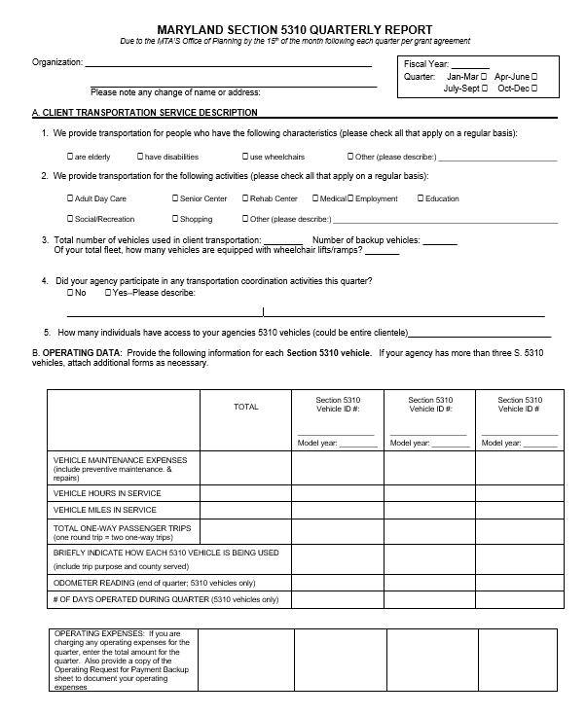
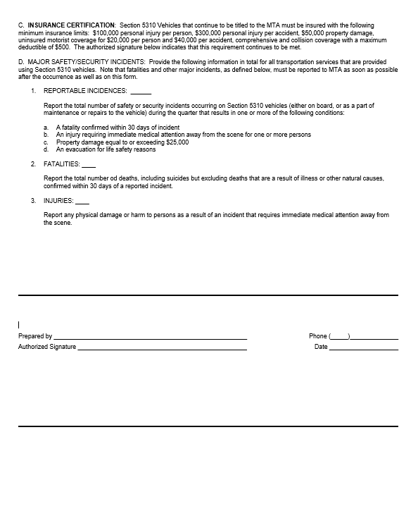
Quarterly Reports
Page One
Page Two
Quarterly Reports are due no later
than 30 days after the Quarter

Slide 22
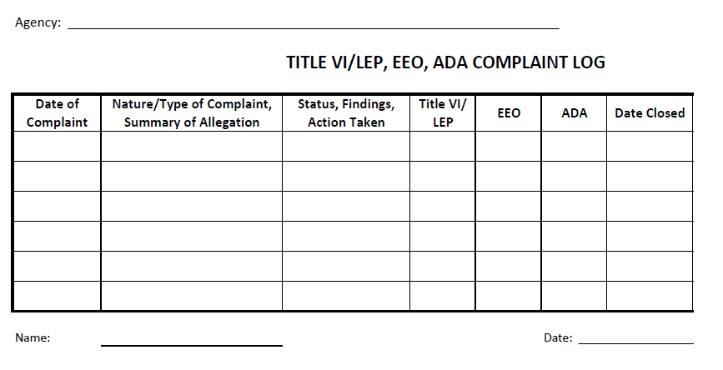
Title VI
Title VI Plans
Plans are still under review and you will be notified as the process moves forward.
Agencies new to 5310 or those agencies that did not submit one yet will need to complete a Title VI Plan - the 5310 Manager will be in touch with you.
Title VI Reports are due when you submit your quarterly report
Sample Title VI Report

Slide 23
ProjectWise
ProjectWise is a data collection tool that is used by MDOT MTA.
ProjectWise is a Windows application, like Microsoft Word or Excel.
The program needs to be installed on your computer by the person who has the local administrator privilege. If you have a computer where you have installed any window applications, you should be able to install ProjectWise. You may need your agency’s IT support staff to help.
Please contact Cydney Dickens, if you need the ProjectWise installation instruction document.
You also need to log into ProjectWise with the username and password created for you. We have created the user accounts for the Non-Profit (5310) and Senior Ride recipients. If you need the username and password, Cydney Dickens has that information.

Slide 24
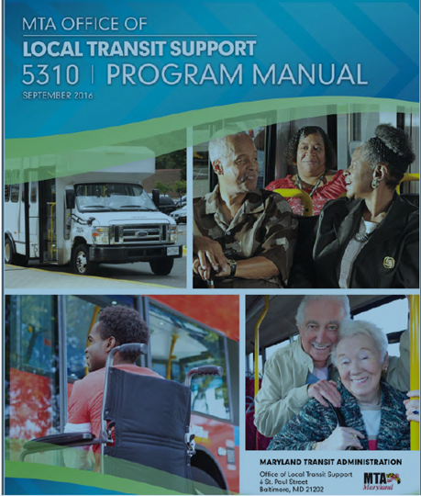
This concludes this Brief Overview of the 5310 Program

Slide 25
General Questions?

Slide 26
Need additional assistance? Cydney Dickens 5310 Program Manager MDOT MTA OLTS cdickens@mdot.Maryland.gov 410-767-8356

