Slide 1





Improving Transit Workforce Quality of Life
Transportation Association of Maryland
Best Practices and Lessons Learned from National Research
October 9, 2025

Slide 2


Introductions
Sandy Brennan
Vice President & Senior Project Manager
sbrennan@foursquareitp.com
240.205.7469
Brian Siegel
Project Manager & Senior Transportation Planner
bsiegel@foursquareitp.com
771.208.2042

Slide 3



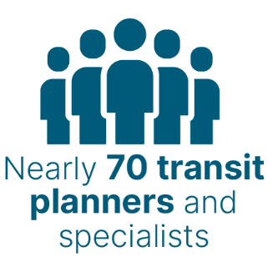





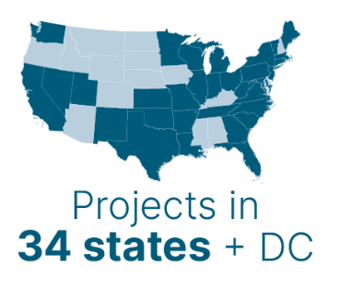





Service Area Expertise
Learn more at FoursquareITP.com
Notes:
About Foursquare ITP --- we were founded almost 20 years ago by our President and CEO L:ora Byala. We are about 75 people today, with about 70 of those folks being transit or transportation planners, analyst, coordinators. We are headquatered in DC, with offices in Philly, Boston and Atlanta. We work across the US, with an occasional candadian projects but primarily working in US.
The type of work we do ranges from transit planning and transit operations planning to active transportation so bike and pedestrian planning work, we work with DOTs, States, MPOs on more visioning transportation plans or strategic transportation plans. And we have a really strong cohort of Transportation Demand Management professionals too. SO basically covering everything that is non-SOV travel.

Slide 4
Lets get to know each other!

Slide 5
Who is in the room?

Slide 6
What comes to mind when you hear “work quality of life”?

Slide 7
What do you hope to get out of this workshop today?

Slide 8
Agenda
9:50 - 10:05 a.m.
10:05 - 10:55 a.m.
10:55 - 11:05 a.m.
11:05 - 12:00 p.m.
Mental Health and Wellness Presentation (15 min)
Mental Health, Wellness, Resiliency Small Group Exercise and Discussion (50 min)
Break (10 min)
Operator Quality of Life and Scheduling Toolkit Presentation (15 min) and Scheduling Toolkit Application Exercise (40 min)

Slide 9
Setting the stage

Slide 10
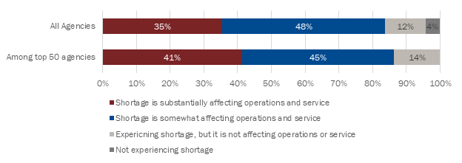
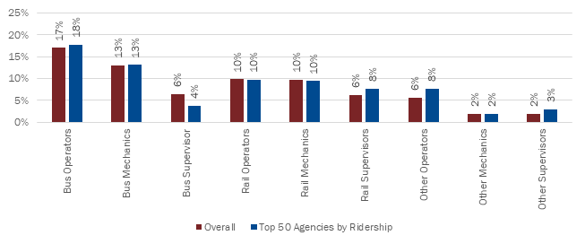
Workforce by the Numbers (APTA Transit Workforce Shortage - Oct 2022)
Severity And Impact Of Transit Workforce Shortage By Agency Size
Vacancy Rates by Role – Overall versus Top 50 Agencies
Notes:
The Transit Workforce Shortage Study built a framework for APTA, its members, and its partner organizations to better understand the workforce shortage’s causes and provides best practices for recruiting, hiring, and retaining transit operations workers
96% of agencies surveyed reported experiencing a workforce shortage, 84 percent of which said the shortage is affecting their ability to provide service.
Although the shortage is most acute at agencies serving large urbanized areas and agencies with greater ridership, most agencies across the country report the shortage has forced service reductions regardless of the size of an agency’s ridership, service area population, or fleet. Agencies reported the highest level of vacant positions among bus operators and mechanics. This trend was similar regardless of transit agency size.
Rules about drug and alcohol testing, Commercial Driver’s License (CDL) requirements, criminal background checks, and driving records extend the hiring process and exclude otherwise qualified applicants.

Slide 11
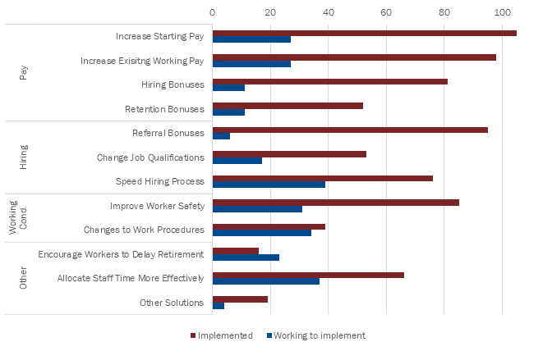
Workforce by the Numbers (APTA Transit Workforce Shortage - Oct 2022)
Solutions to Workforce Shortage by Implementation Status (Number of 190 Agencies Surveyed)
Average Rank of Factors Causing Workers to Quit Since COVID-19 (1 is greatest, 5 is least)
 | Compensation | Work Schedule | Harassment and Assault | Other Conditions | COVID-19
All Respondents | 2.2 | 2.0 | 4.2 | 3.3 | 3.2
Top 50 Agencies | 2.1 | 2.1 | 4.1 | 3.3 | 3.4
Notes:
The survey of agencies indicates that concerns about schedule and compensation were responsible for more departures than assault and harassment or concern about contracting COVID-19.
Most agencies said that schedule and compensation are leading to more departures today than before the pandemic.
What Can Be Done to Relieve the Shortage of Transit Workers?
Increasing compensation begins with increasing wages for new and current employees, but there is more that agencies can do to attract and retain workers.
Agencies should calculate the average value of those benefits so that applicants and employees are aware of their total compensation when they are making employment decisions.
Agencies need to get creative to improve worker schedules.
Explore changing their processes for rostering to improve the schedules of newer workers.
Agencies should make the application process as simple as possible—from helping applicants obtain their CDL permits, to prominently displaying a mobile-friendly employment application on their websites, to making same-day offers at hiring events.

Slide 12
Workforce by the Numbers (TCRP F29 – Mental Health, Wellness, & Resilience for Transit System Workers)
Retention Challenges
🔻 62% of agencies report difficulty retaining employees
Top reasons workers quit (2023 survey):
Work schedules
Compensation
Working conditions
On-the-job harassment/assault
COVID-19 concerns
32% of frontline workers blamed management for their leaving.
45% of current workers & 53% of former workers say agency isn’t responsive.
Barriers to Mental Health
Lack of time (36%)
Missed pay (33%)
Privacy concerns (33%)
Too tired/exhausted (32%)
Workplace Stressors
81%: verbal threats/harassment
60%: spitting
38%: projectiles thrown at buses
26%: objects thrown inside buses
Another study found 85% experience body pain from work conditions
Notes:
According to a national survey of transit agencies conducted in February 2022,
Almost 62% of responding agencies reported having difficulty retaining employees
Another survey aimed at frontline workers in January 2023 found that many factors contributed to workers quitting such as (in order of importance):
Work schedules, compensation, “other” working conditions, on-the-job harassment or assault, and concerns over contracting COVID-19 virus on the job. Issues with agency management were also cited as one of the main contributors for low retention.
The same survey from 2023 found that
32% of frontline workers blamed management for their leaving. 45% of current frontline workers did not agree that their agency was responsive to worker concerns; this percentage increased to 53% amongst former workers.
Frontline transit workers identified barriers to using mental health services offered by their agencies. The most commonly cited reasons affecting the decision to seek services through an employer were: lack of time (35.9%), concern about missed pay (33.2%), privacy concerns (32.6%), and being too tired/exhausted (31.5%)
Some of the key observations from the review of existing literature included: Frontline transit workers experience a range of difficulties in the work environment. In a survey of transit agencies, 81% reported operators experiencing verbal threats/intimidation/harassment, 60% reported spitting, 38% reported projectiles thrown at buses, and 26% reported objects thrown inside buses. Lack of access to restrooms, constrained workstations, sedentary nature of work, long work hours, and communication issues also affect the mental health of bus operators. One study found that 85% of bus operators experience pain in at least one area of their body.

Slide 13
Report 245: Mental Health, Wellness, and Resilience for Transit System Workers
Notes:
Thank you, Karen.
My name is Sandy Brennan, I was the lead investigator on TCRP Report 245: Mental Health, Wellness and Resilience of Transit System Workers. Our research team was comprised of transit planners from Foursquare ITP – my firm– and transportation researchers as well as health and psychology experts from Rutgers University.

Slide 14
Research Objectives
The research will addressed the contributing factors to a transit employee’s mental health by:
Documenting the stressors experienced by transit system workers during pre-and peri-pandemic times;
Documenting the impacts of those stressors at the individual and organizational levels;
Documenting any differences seen by race, ethnicity, gender, age, and occupation;
Identifying protective factors and actions that would help proactively develop, promote, and sustain a culture that supports the mental health, well-being, and resilience of transit workers (methods, models, and programs);
Evaluating the impacts of existing programs, policies, and practices, including labor-management relations and work organization, to address mental health issues;
Documenting the role of supervisory support in helping employees to manage exposure to stressors; and
Recommending best practices for transit systems to support the mental health of transit employees (including programs, outreach, education, and bargaining).
The objective of Report 245 was to develop a comprehensive guidebook and interactive products that would assist transit agencies and other stakeholders in exploring or implementing approaches to identify and mitigate the factors that cause negative impacts on mental health, wellness, and resilience for transit system workers.
Notes:
The objective of Report 245 was to identify key stressors that impact frontline transit worker’s mental health and wellness. And when I say frontline workers, I am talking about those who operator transit vehicles (all modes) and those who have public facing functions like maintenance workers, transit police, station personnel, etc.
In addition to looking at the root causes of stress for workers, we also asked about what resources and programs agencies had available for workers. We asked about transit agencies successes and challenges with addressing mental health among workers, and what agencies are lacking in terms of support for their employees.
This culminated in a toolkit of solutions that practitioners such as yourselves can use to help employees be more resilient in their jobs.

Slide 15




Research Stats
Review of Literature and Previous Research
Interviews of Agency and Union Staff
National Survey of Frontline Workers
Frontline Worker Focus Groups
80 References
65+ Participants
4 Large Agencies
4 Medium Agencies
2 Small Agencies
2 Sets of Union Reps
1,000+ Responses
2 Rounds 14 Participants from 10 Agencies
Notes:
Across the 18 month project, we talked to over 65 transit agency and union management personnel as well as directly surveyed frontline workers. If your agency helped disseminate that survey, my team thanks you very much!

Slide 16
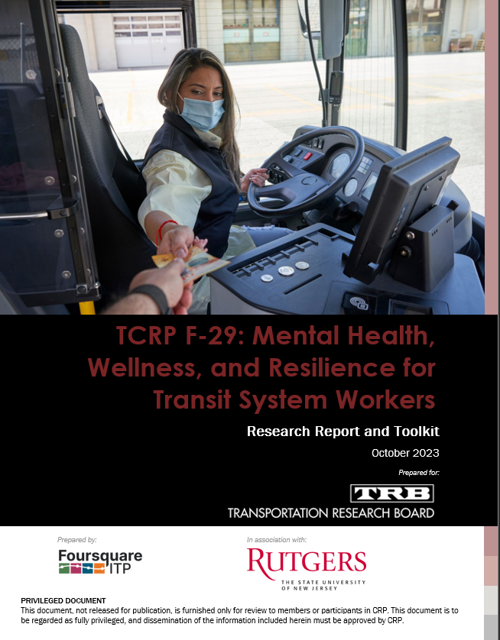
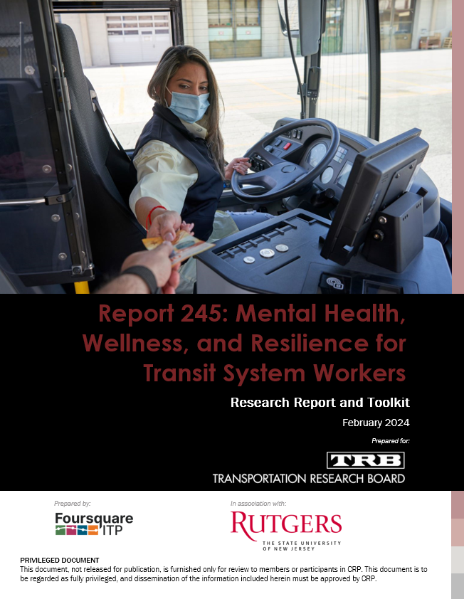
Final Product
Section 1: Research Report
Section 2: Resources & Toolkit
Notes:
Report 245 is split into two parts:
Section 1 is the research report and gets into the details of the research and findings. While Part 2 is the toolkit for practitioners. The Toolkit includes both case studies and best practices as well as a slew of practical tools for agency staff. I will get into some of those specifics later in my presentation.

Slide 17
Research Report
Section 1:
Notes:
Quickly, I will share some of the findings of our research.

Slide 18
Section 1: Research Report – Key Findings
Physical Stressors
Work Stressors
Management and Policy Stressors
External Stressors
Assaults and confrontations
PTSD
Frequency and quality of communication from managers/leadership
Child and family care
Extended periods of sitting/inactivity
Work schedules
Lack of support in the field and following incidents
Access to healthcare
Lack of exercise
Work-life balance
Inadequate training
Financial stressors (e.g., lack of affordable housing)
Lack of bathroom access
Loneliness and isolation
Trust and privacy
Toll of COVID-19
Fear of contracting COVID-19
Notes:
First we documented the stressors encounters by our frontline workers: Obvious ones like physical stresses can impact mental and physical health ---like assaults and restroom access.
Other stressors associated with the job itself can impact worker health too ---like stressful work schedules, loneliness and feelings of isolation because they primary perform their jobs in the field and solo.
Management and Policies are also a source of stress for frontline workers---lack of training, feelings of lack of support, and distrust of management were big recurring themes throughout the study.
Finally, external stressors were of course a cause for concern: access to child and family care are issues many of us face and our frontline workers do as well. Things like financial stressor, specifically with inflation, and generally the impact of COVID 19 on our lives.

Slide 19
Section 1: Research Report – Key Findings
Survey Results from frontline workers
Understaffing is a major cause of stress
Exposure to drugs and substances
Verbal and physical assaults
Elevated anxiety and depression
Mix of awareness of employer resources
Challenges utilization employer resources (lack of time, missed work/pay, privacy concerns)
Moderate satisfaction of resources
Preferences for 1-on-1 services
Notes:
When we surveyed the frontline workers directly we gained additional insights into their personal challenges. One of the biggest revelations was that Staffing issues is a major cause of stress. Nearly 88% of respondents noted that understaffing was a stressor.
Challenges with dealing with the public and exposure to drug use and assaults were also identified by more than two thirds of respondents. Veronica mentioned this morning that Safety is a big reason candidates are declining job offers or new employees are leaving. They don’t necessarily feel safe in their jobs. So as employers, we need to find ways to support them better—especially in the field.
We included standardized health questions about anxiety and depression – More than a third of frontline workers have probable anxiety or depressive disorder. That is incredibly significant so let me repeat that--More than a third of frontline workers indicated that they have probable anxiety or depressive disorder. They are suffering and we need to have programs and services to support them.
In terms of resources for mental health and wellness – workers had a mix of awareness and they had many challenges in accessing employer resources. They were only moderately satisfied with resources and programs offered by employers and there was a more clear preference for one-on-one resources.

Slide 20
Section 1: Research Report – Recommended Responses
Improve the physical safety of the workplace
Adjust benefits and policies to provide more support for good mental health and a better work-life balance
Improve and diversify communication and marketing efforts of resources
Evaluate quality and effectiveness of EAPs/UAPs
Physical barriers
Enforce existing policies
Change practices around scheduling/work assignments
Increase flexibility of time-off
Use a variety of formats for marketing
Offer a mix of times/locations for accessing services
Build awareness through constant reminders (e.g., discuss regularly)
Align services with employee needs
Involve employees in selection / feedback on services
Develop monitoring process to improve offerings
Notes:
Based on our findings, we developed some recommended responses agencies and the industry can take:
[read headlines]
Improve the physical safety of the workplace. Again versonica announced that FTA has the vehicle safety design grant, but there are also smaller steps agencies can take like enforcing existing policies that are meant to protect workers.
Adjusting benefits and policies to provide more support and a better worklife balance. Things like changing scheduling practices to increase flexibility and create more fair or desirable pieces of work for operators .
Improving and diversifying how agencies market or communicate the resources and programs you already have available to workers Just doing more awareness campaigns.
And evaluating the quality and effectiveness of EAPS and UAPs. A lot of transit agencies reported that they didn’t really have an evaluation program or a feedback loop to understand if the EAP services aligned with employee needs or were of quality.

Slide 21
Section 1: Research Report – Recommended Responses
Address privacy concerns
Employ mental health professionals
Consider 1-on-1 services
Off-site or separated services
Strengthen and enforce policies to protect frontline workers
Clearly outline and enforce policies
Passenger code of conducts
Provide more support in the field and ongoing support after incidents
Offer specialized staff trained in incident response
Ongoing support is also needed following incidents
Provide peer support and mentoring
Develop formal programs
Notes:
Privacy was a big discussion topic when we talked with the frontline workers themselves. This goes back to trust issues between frontline workers and their managers and leadership.
Stregenthening and enforncing existing policies to better protect workers is another recommendation.
Providing more in field support and support on-going after workers experience an incident. Making sure they are support both during the incident and after.
As we have heard throughout the day – peer support and mentoring programs make employees feel more engaged with the organization and they offer career pathways.

Slide 22
Section 1: Research Report – Recommended Responses
Strengthen relationships among frontline workers and between frontline workers
Provide more training to empower employees for adverse conditions
Empathy training for managers
Build trust
Provide opportunities for socializing and connecting
De-escalation training
Incident response
Increase understanding and support for frontline workers
Reduce stigmas
Collaborate to find solutions
Notes:
Last slide on recommended responses ---
Strengthening relations among and between frontloine workers to make sure they have a sense of community. They work alone a lot of times, and to make them feel connected might require more programming than you’d do for a traditional office setting.
More training to make employees feel empowered to do their jobs effectively and safely.
Empathy training for managers and more effort to build trust between leadership and employees. Holly, the MTA administrator, noted this moring she has a “Half Day with Holly” program. That is a great example of one way you can demonstrate to your employees that you care and that you understand their day to day jobs.

Slide 23
Resources & Toolkit
Section 2:
Notes:
The case studies and toolkit can be found in the second half of the report. We have created handy table at the start of section 2 so you can quickly and easily navigate the toolkit to find the resources that address your agencies specific needs and challenges.

Slide 24
Section 2: Case Studies
MARTA Using technology to connect employees with support
VTA/ATU Local 265 Increased access to mental health services, trained professionals, and other benefits
MARTA Incentives for wellness program participation
IndyGo On-site health clinic services
IndyGo Creative marketing
VTA/ATU 265 Critical Incident Support Teams
Metro Transit Red Kite Project Resiliency Training
TriMet Lactation van for nursing operators
VTA/ATU 265 Training and mentorship for retention and advancement
TWU Local 100 Union Assistance Program
MTA Operator Restroom Workgroup
Notes:
11 case studies highlighting ways agencies and unions have improved their EAP or UAP offerings, how they are expanding on those minimum requirements with enhanced mental health and wellness services, how they are creatively marketing their services, how they are offering training for resiliency and career growth. How they are supporting frontline workers in the field, post incidents and in creative ways. We have also strived to highlight how unions and agency leadership have collaborated on these efforts.
One of our case studies will be highlighted by my colleagues here today.

Slide 25
Section 2: Toolkit
Program evaluation framework
Provides guidance on using a capability maturity matrix for program evaluation.
Evaluating and Improving EAPs and UAPs
Provides a worksheet to guide the evaluation and improvement of EAPs and UAPs.
Establishing a Wellness Program
Lays out example wellness programs and steps to establish a program.
Support Mental Health in the Workplace
Offers a checklist for leadership and senior managers to ensure a supportive workplace
How to Make the Case for Increased Benefits to Support Mental Health and Wellness
Provides example messages, related statistics, and guidance on building a message.
Improving Communications and Marketing of Resources
Building Trust Between Parties
Presents recommendations for the improvement of internal marketing. Includes a worksheet with key considerations.
Offers a three-step process and worksheet for building trust among frontline workers, management, and union leadership
Notes:
The second half of Section 2 was the toolkit and we tried to create a variety of resources – checklist, tables, worksheets, frameworks, guidance, strategies and overall tips on achieving certain policy initiatives. The point of the toolkit was to offer a variety of resources that were accessible---meaning easy to read and use for any audience whether that was a union rep, supervisor, an HR representative, or a frontline worker themselves.
This included 13 different distinct items. And for time sake, I am going to just read off the items you can find in the kit.
[Just read]

Slide 26
Section 2: Toolkit
Increasing Training Offerings
Providing Support During and Post-Incidents
Modernizing Operational Policies for a Healthy Workforce
Fostering Community Among Frontline Transit Workers
Offers guidance on creating empathy trainings, leadership ride-alongs, and intervention training.
Provides guidance on creating critical response teams. Includes a drill to prepare teams for interventions.
Lays out policy suggestions and implementation guidelines for the modernization of operational policies.
Provides example activities and programs to foster community.
Developing and Implementing Mentor and Peer Programs
Self-Advocacy Tools
Provides guidance for the development of a mentorship program and lays out types of programs available.
Provides strategies and tips for understanding worker rights, dialogue with managers, partnering with HR, and peer advocacy.

Slide 27

Download the report & Toolkit
Scan to access Report 245 www.trb.org/Publications/Blurbs/183206.aspx
Notes:
Thank you for your time, you can find the report at the QR code here. I will also stick around after today’s session to chat with folks or feel free to reach out to me if you want to discuss findings/toolkit items further. And a big thank you to Karen and Ed and the panel for their guidance throughout the project. The panel was really passionate about getting this research done and wanted it to be practical tool for the industry. SO thank you Karen and Ed again.

Slide 28
Small Group Discussions
Each table will be assigned a group #
Spend 20-30 minutes discussing your questions from the perspective of your transit system (or if you do not work at a transit agency, then from the perspective your clients/partners)
Take notes! Each table will report out at the end of this exercise

Slide 29

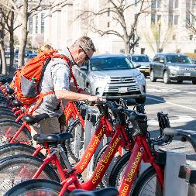


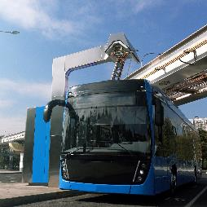
Operator Quality of Life and Scheduling Toolkit
Transportation Association of Maryland Conference
Staff Meeting Presentation
October 9, 2025
Notes:
Good morning! I’m presenting on a Scheduling Toolkit we developed as part of an APTA working group we’ve been participating for almost an year now.

Slide 30
Content
Working Group Background
APTA Scheduling Toolkit
Strategies
Notes:
I’ll start with a brief overview of the working group, I’ll describe the toolkit, and note the strategies we came up with.

Slide 31

Operator Quality of Life: APTA’s Scheduling Toolkit
DOWNLOAD HERE

Slide 32
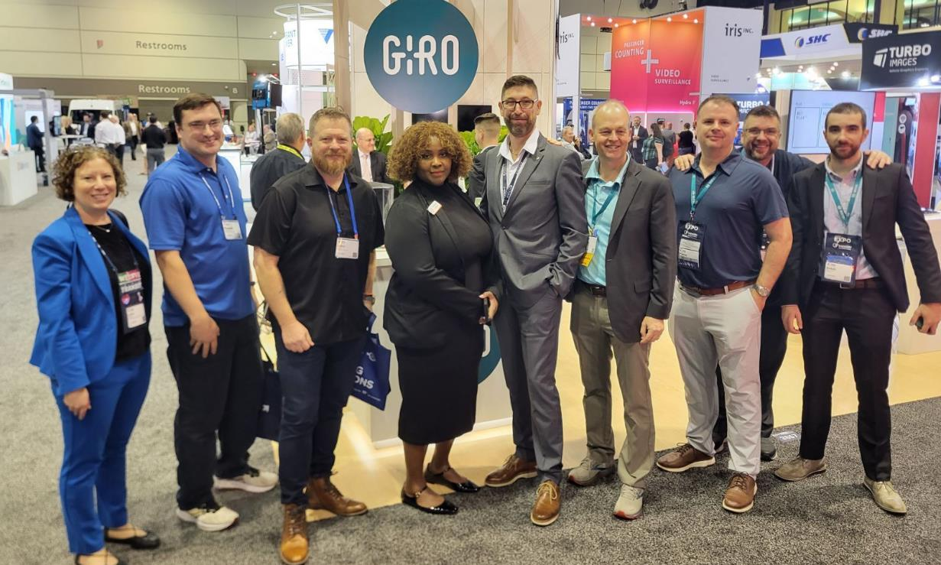
Background
APTA’s 2023 TransFORM Conference & EXPO
Months of meetings and discussions
Presentation at APTA’s first Workforce Summit in August 2024
Notes:
This is a picture taken on the floor of the APTA Expo in 2023, where consultants, technology providers, and folks from ATU and APTA got together to work to improve operators’ quality of life, focusing on how working schedules can contribute to that and ultimately better operator retention
Arjan from Giro organized our meetings, sometimes once a month, sometimes every two months to discuss recent issues and working on our session at APTA’s first Workforce Summit. . Foursquare ITP led the creation of the Scheduling Toolkit with input from this working group.
The Amalgamated Transit Union is a labor organization in the United States and Canada that represents employees in the public transit industry.

Slide 33
How to Build Better Schedules?
How can we truly improve the quality of life for operators through innovative ways of designing schedules?
How Can We Build Better Schedules as Planners and Schedulers?
How Can We Offer More Flexible Workdays or Hours?
How Can We Improve the Shift Assignment Process?
How Can We Better Communicate with the Workforce?
Notes:
The goal of the Scheduling Toolkit is to guide agencies in thinking about how to build better schedules. How can we truly improve the quality of life for operators through innovative ways of designing schedules while focusing on the service that needs to be delivered
We had some major guiding questions:
Building Better Schedules: Identifying common challenges and pain points in current scheduling practices at your agency.
Creating Flexible Workdays or Hours: Exploring options for more adaptable scheduling to meet the diverse needs of your workforce.
Improving Shift Assignment: Analyzing methods for assigning shifts that balance operational requirements with employee preferences.
Communicating with the Workforce: Emphasizing the importance of clear, consistent, and transparent communication regarding the scheduling at your agency.

Slide 34
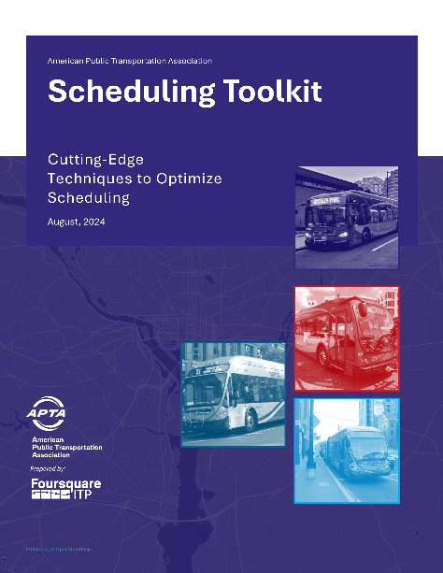
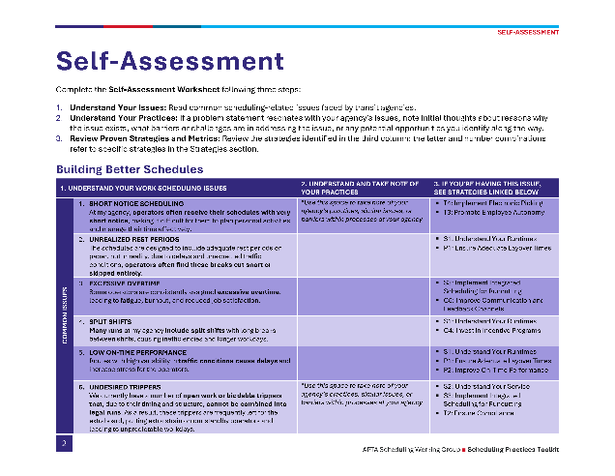
The Scheduling Toolkit
This toolkit guides agencies through an assessment of their scheduling practices and basic steps in developing strategies to enhance workforce scheduling processes and improve employee retention.
Notes:
This toolkit guides agencies through an assessment of their scheduling practices and basic steps in developing strategies to enhance workforce scheduling processes and improve employee retention.
The toolkit starts with a self-assessment sheet that outlines some common issues that relate to each one of our four guiding questions-mentioned in the previous slide:
Building Better Schedules:
Creating Flexible Workdays or Hours:
Improving Shift Assignment:
Communicating with the Workforce:

Slide 35
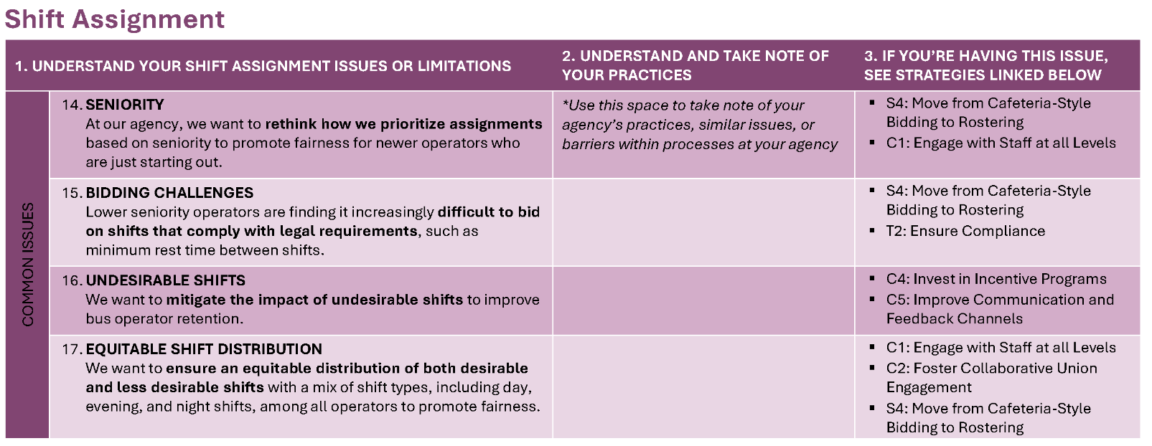
How to Use the Toolkit?
Review Proven Strategies
1
Understand Your Issues
2
Note Your Practices
3
Common Issues
Notes
Strategies
Notes:
Self-Assessment Worksheet following three steps:
Understand Your Issues: Read common scheduling-related issues faced by transit agencies.
Understand Your Practices: If a problem statement resonates with your agency's issues, note initial thoughts about reasons why the issue exists, what barriers or challenges are in addressing the issue, or any potential opportunities you identify along the way.
Review Proven Strategies and Metrics: Review the strategies identified in the third column: the letter and number combinations refer to specific strategies in the Strategies section.

Slide 36
The Strategies
SCHEDULING TECHNIQUES
S1: Understand your Runtimes
AGENCY CULTURE AND MORALE
C1: Engage with Staff at all Levels
C2: Foster Collaborative Union Engagement
PLANNING STRATEGIES
P1: Ensure Adequate Layover Times
P2: Improve On-Time Performance
TECHNOLOGY SOLUTIONS
S2: Understand your Service Curve
S3: Integrate Scheduling for Runcutting
S4: Move from Cafeteria-Style Bidding to Rostering
C3: Offer Training Opportunities
C4: Invest in Incentive Programs
C5: Improve Communication and Feedback Channels
P3: Optimize Service Frequency and Span
P4: Streamline Bus Routing
T1: Develop Scenarios
T2: Ensure Compliance
T3: Promote Employee Autonomy
T4: Implement Electronic Picking
Notes:
We have organized strategies under four comprehensive areas:
Scheduling Techniques (S): Innovative and practical methods to create more efficient and effective schedules.
Agency Culture and Morale Strategies (C): Approaches to foster a positive work environment and enhance employee satisfaction and retention.
Planning Strategies (P): Service planning approaches to ensure sustainable workforce schedule improvements.
Technology Solutions (T): Leveraging modern technology to streamline scheduling processes and improve overall efficiency.
We list 4 to 5 strategies under each topic area, with metric examples.

Slide 37
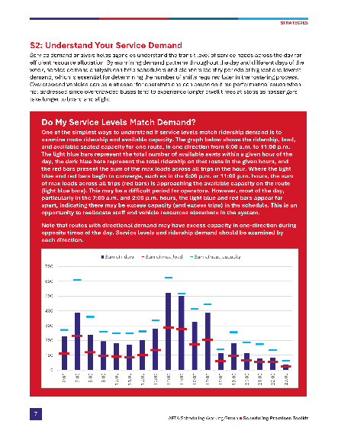
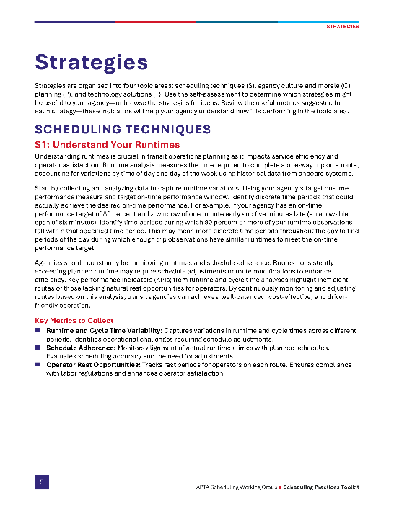
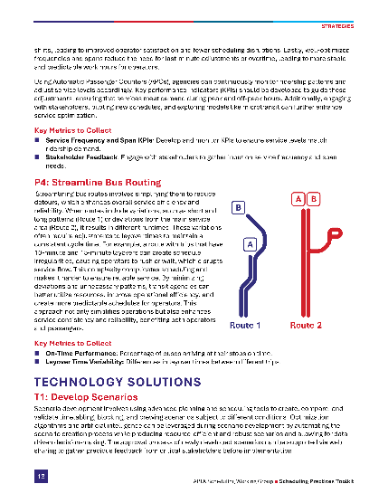
The Strategies
Description
Metrics
Notes:
This is an example of what a strategy looks like. Scheduling Techniques are labeled with the letter S and a corresponding number.
Below the description of the technique is the Key Metrics to Collect, Measure, and Analyze.

Slide 38
Individual Self Assessment
10 Minutes
1. Reflect on the 4 major categories of scheduling issues faced by transit agencies. Identify which category resonates most with your experience.
2. Use the provided space designated to take notes of your agency’s practices, related challenges, or barriers within that process.
Notes:
On your own please take 10 minutes to consider the 4 major categories of scheduling related issues faced by transit agencies. See which category and common issues resonate most with you. There’s space to take note of your agency’s practices, similar issues, or barriers within processes at your agency.
Building Better Schedules: Identifying common challenges and pain points in current scheduling practices at your agency.
Creating Flexible Workdays or Hours: Exploring options for more adaptable scheduling to meet the diverse needs of your workforce.
Improving Shift Assignment: Analyzing methods for assigning shifts that balance operational requirements with employee preferences.
Communicating with the Workforce: Emphasizing the importance of clear, consistent, and transparent communication regarding the scheduling at your agency.

Slide 39
Scheduling and Planning Techniques - Examples

Slide 40
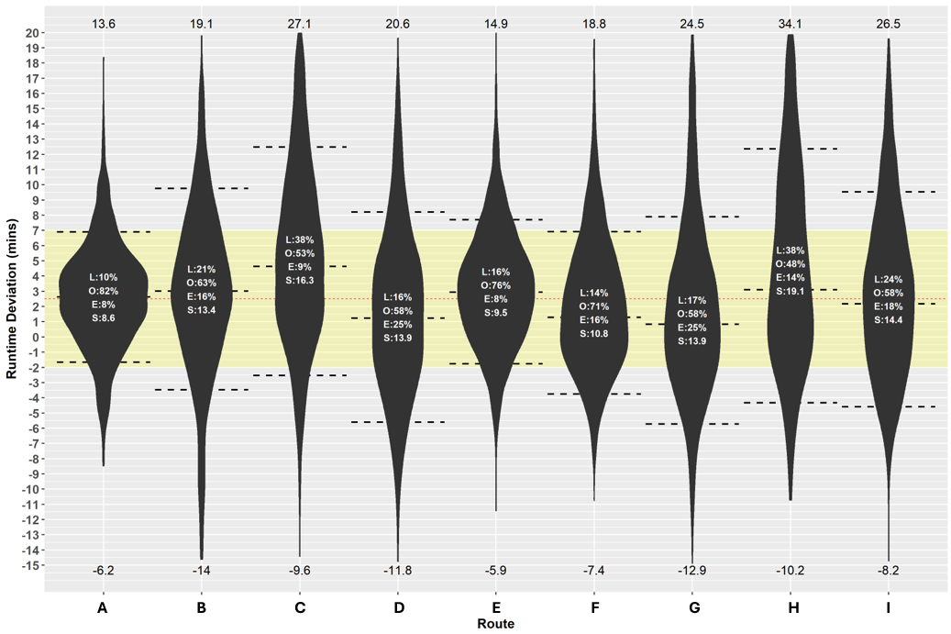
S1. Understand Your Runtimes
Analyze runtime data to identify periods of the day when the target OTP can realistically be achieved.
Adjust schedules to match actual travel conditions, improving overall service reliability.
Consistent runtimes ensure rest opportunities, contributing to better compliance with labor regulations and improved operator well-being.
Is “On-Time” Achievable?
Notes:
I want to talk through a few Strategies we can apply beginning with Scheduling Techniques
The first question agencies should ask about their runtimes is if being on time is actually achievable. The graph displays runtime observations for a series of routes in one time period. The target on-time performance for this agency is 80 percent, and the window of on-time is two minutes early and seven minutes late—the nine-minute window is shaded in light yellow across the graph. The dotted lines represent the smallest window of variation in runtimes to capture 80 percent of the observations. As you can see, only route A had 80 percent of its observed runtimes within a nine-minute window. The runtimes for the remaining routes varied so much that an 80 percent on-time performance is not possible, no matter what runtime is selected.

Slide 41
S2. Understand Your Service Demand
Analyze ridership patterns across different times of day and days of the week to match service levels with actual demand.
Overcrowding can lead to longer dwell times and operator stress.
By aligning capacity with demand, transit agencies can improve OTP, enhance passenger comfort, and reduce operator fatigue.
Notes:
One of the simplest ways to understand if service levels match ridership demand is to examine route ridership and available capacity. The graph shows the ridership, load,and available seated capacity for one route, in one direction
from 6:00 a.m. to 11:00 p.m. The light blue bars represent the total number of available seats within a given hour of the day, the dark blue bars represent the total ridership on that route in the given hours, and the red bars present the sum
of the max loads across all trips in the hour.
Where the light blue and red bars begin to converge, such as in the 6:00 p.m. or 11:00 p.m. hours, the sum of max loads across all trips (red bars) is approaching the available capacity on the route(light blue bars). This may be a difficult period for operators. However, most of the day, particularly in the 7:00 a.m. and 2:00 p.m. hours, the light blue and red bars appear far apart,
indicating there may be excess capacity (and excess trips) in the schedule. This is an opportunity to reallocate staff and vehicle resources elsewhere in the system.

Slide 42
S3. Implement Integrated Scheduling for Runcutting
Traditionally, vehicle blocking and runcutting are treated as separate processes.
Integrated scheduling simultaneously optimizes both vehicle utilization (blocking) and operator shifts (runcutting), ensuring that the efficiency of one doesn’t come at the cost of the other.
By continuously adjusting vehicle blocks during runcutting, schedulers can create more consistent and desirable shifts for operators, minimizing long gaps or fragmented workdays.
Notes:
1. Traditional Approach
Typically, agencies handle vehicle blocking (how buses/trains are assigned to routes) and runcutting (how operator shifts are built) as two separate steps.
The downside: optimizing one often creates inefficiencies in the other — for example, you might maximize vehicle use but end up with poor operator shifts.
2. Integrated Scheduling
Integrated scheduling solves this by optimizing both vehicle blocks and operator runs at the same time.
This approach balances efficiency across the system — vehicle resources and operator work rules are considered together.
3. Benefits for Operators and Agencies
Adjusting vehicle blocks dynamically during runcutting leads to more balanced shifts.
This reduces long unpaid gaps, split shifts, or fragmented workdays for operators.
The result is better quality of work life, less fatigue, and higher operator satisfaction.
Agencies also gain efficiency by aligning service needs with available workforce capacity.
4. Big Picture Impact
Ultimately, integrated scheduling means agencies don’t have to choose between operational efficiency and workforce wellbeing.
It helps retain operators, improves morale, and supports reliable service delivery.

Slide 43
Planning Strategies
P1. Ensure Adequate Runtimes
Ensuring adequate layover times is crucial for maintaining a reliable and efficient transit service while prioritizing operator well-being—layover times allow operators to rest, recover, and prepare for the next trip, which helps reduce fatigue and enhance service reliability.
P2. Improve On-Time Performance
When on-time performance is enhanced, operators face fewer instances of reduced layover time, extended hours, or unexpected delays, leading to increased job satisfaction and reduced stress.
P3: Optimize Service Frequency and Span
By aligning service frequency with actual demand and adjusting the span of service to cover both peak and off-peak hours, agencies can create more balanced and manageable shifts.
Notes:
Now I'll show a few examples of some Planning Strategies that can be applied
P1. Ensure Adequate Runtimes
Adequate layover and recovery time is critical.
It gives operators a chance to rest, reset, and stay sharp — which directly reduces fatigue.
This improves service reliability and helps maintain a healthier, safer workforce.
P2. Improve On-Time Performance
When an operator can operate closer to schedule, they don’t lose their recovery time at the end of trips.
Fewer delays mean fewer extended hours, less stress, and more consistent workdays.
This improves morale and helps retain operators.
P3. Optimize Service Frequency and Span
Matching service frequency to real rider demand ensures resources are used wisely.
Adjusting the service span to balance peak and off-peak needs creates more manageable shifts for operators.
It’s about balancing customer convenience with workforce sustainability.
Closing Thought
Together, these strategies strengthen both service reliability and operator well-being — the foundation of a sustainable transit system.

Slide 44
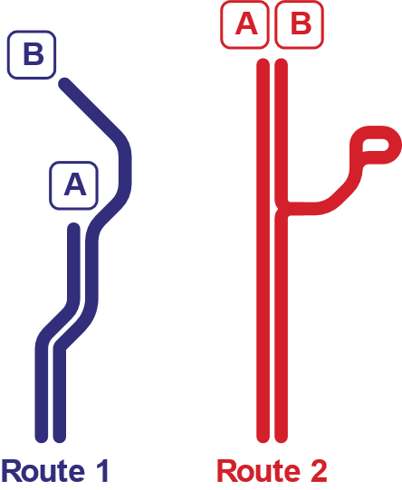
Planning Strategies (cont.)
P4. Streamline Bus Routing
This strategy involves simplifying them to reduce detours, which enhances overall service efficiency and reliability.
Route variations, such as short and long patterns (Route 1) or deviations from the main service area (Route 2), result in different runtimes.
Variations often require adjustments to layover times to maintain a consistent cycle time.
Notes:
Simplification Improves Reliability
Streamlining bus routes — cutting back on detours and unnecessary deviations — helps improve both service efficiency and schedule reliability.
Impact of Route Variations
Different versions of a route, like short-turns vs. full-length trips, can create inconsistent runtimes.
Deviations from the main service area add further complexity and make schedules harder to manage.
Scheduling Implications
These variations often force schedulers to adjust layover times to keep cycle times consistent.
Over time, this can lead to inefficiencies, irregular operator shifts, and service reliability issues.
Key Benefit
By simplifying routes, agencies reduce operational complexity, improve consistency for riders, and create more manageable shifts for operators.

Slide 45
Small Group Discussion
DOWNLOAD HERE
20 Minutes
1. Discuss your most common scheduling issues.
2. Select one issue to focus on as a group.
3. Review strategies for addressing the issue – discuss pros and cons of using the recommended strategies.
4. Report-out as a group.
Notes:
In your small groups, please take turns in your group to discuss each other’s top scheduling issues and where you landed in your most common issues.
See the strategies for addressing the issue.
What are the pros and cons of using the recommended strategies?
Then I’d like to hear a report out how on the common themes you heard in your discussions.

Slide 46
Resources
American Public Transportation Association (APTA) https://www.apta.com
Community Transportation Association of America (CTAA)
https://www.ctaa.org
Transit Workforce Center https://www.transitworkforce.org
Occupational Safety and Health Administration (OSHA) https://www.osha.gov/?
Transit Cooperative Research Program (TCRP) https://www.trb.org/TCRP/TCRP.aspx
Federal Transit Administration (FTA) https://www.transit.dot.gov
Rural Transit Assistance Program (RTAP) https://www.nationalrtap.org/

Slide 47

Special thanks to:
Sandy Brennan
Vice President & Project Manager
sbrennan@foursquareitp.com
240.205.7469
Brian Siegel
Project Manager & Senior Transportation Planner
Reinaldo Germano
bsiegel@foursquareitp.com
771.208.2042

