Slide 1

FY2025 Maryland Senior Rides
Grant Application
Briefing
Cydney Dickens
MDOT MTA
OLTS
Notes:
Welcome to the FY2024 Maryland Senior Rides Grant Application Briefing
Good morning and thank you for joining us today.
I am Nancy Huggins, Senior Rides Program Manager at Maryland Department of Transportation, Maryland Transit Administration.
This session is being recorded. Should you have any questions during the presentation, please type them into the Chat box and we will address them at the end of the presentation.

Slide 2
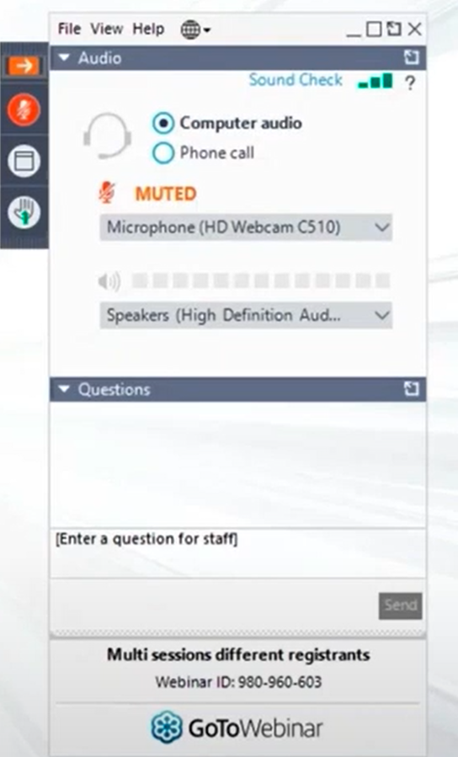
  Webinar FAQs
  “As-needed”
Select Computer or Phone Audio
The Chat window can be used for both technical issues and Q & A
All sessions will be recorded and will be available post-webinar at https://www.taminc.org/office-of-local-transit-support
Notes:
Lets review these Webinar FAQs.
This session is being recorded and will be available on the TAM website.

Slide 3
Maryland Senior Rides Program
Today we will cover the following items:
General Info – including definitions
Application Schedule
History and Program Focus
Eligibility
Funding and Local Match Requirements
Evaluation Criteria
Reporting Requirements
Application Instructions and Budgeting
Certifications and Assurances
Notes:
Today we will cover the following items:
General Info – including definitions
Application Schedule
History and Program Focus
Eligibility
Funding and Local Match Requirements
Evaluation Criteria
Reporting Requirements
Application Instructions and Budgeting
Certifications and Assurances

Slide 4
Maryland Senior Rides Program
Grant application can be found on the Transportation of Maryland
Website – https://www.taminc.org/office-of-local-transit-support
Funding for Fiscal Year 2024 anticipate $187,000
Due April 22, 2024 by 4 pm
Upload to MDOT MTA Grant Portal https://mtaolts.ecopwise.com
Operating Grant – 75%/25% match
Selection Committee
Recommendations to Secretary of Transportation
Definitions:
  Door-to-door transportation
  Low-income to moderate income
  Senior – 60 year or older
Notes:
The grant application can be found on the Transportation of Maryland Website, under Resources – Office of Local Transit Support. The application was also sent out via email to all those on a mailing list that I maintain within my files.
This is the application webinar for the Maryland Senior Rides Program for FY2024.
We anticipate the funding to remain at the same level as FY2023 which was $187,000.
Applications are due April 8, 2022 by 4 pm by uploading to the MDOT MTA Grant Portal (please note, if you are not registered already, you will need to do so in advance). Also note, if selected as a recipient and you do not have it already, you will be required to download ProjectWise and the Program Manager will work with you.)
This is an operating grant (to run services) as opposed to capital (to buy tangible goods).
The match is 75% state government and a minimum of 25% from local dollars – no in-kind match permitted.
The selection committee is made up of representatives of MDOT MTA, Dept of Aging, Dept of Disabilities, State Coordinating Committee for Human Services Transportation, and MDOT MTA’s regional coordinating bodies.
Recommendations will be sent to the Secretary of Transportation
Definitions:
“Door-to-door transportation” means providing, through pre-arranged appointment, safe escort from a departure point, into and out of a transport vehicle and to the door of the destination;
“Low-income to moderate-income” means the household income of an individual does not exceed 400% of the poverty threshold that is established by the United States Department of Commerce, Bureau of Statistics for a given year;
“Senior” means an individual age 60 or older;

Slide 5
Maryland Senior Rides Program
Introduced during the 2004 Maryland General Assembly as the Senior Rides Demonstration Program, FY2006 was the first year of the new program.
During the 2007 Session of the Maryland General Assembly, House Bill 1189 (enacted as Chapter 268, Acts 2007), passed the word ‘Demonstration’ was removed.
Therefore, the name of this annual grant is Maryland Senior Rides Program (SRP).
Notes:
A little history of the Maryland Senior Rides Program
Introduced in 2004
FY2006 was the first year of funding as the Maryland Senior Rides Demonstration Program
In 2007, dropped the “demonstration” and became Maryland Senior Rides Program or SRP

Slide 6
Maryland Senior Rides Program
Program Focus
The primary focus of this program is to encourage and facilitate the development of volunteer and/or paid transportation services for low-income to moderate-income seniors.
The following organizations are eligible to apply for SRP funding:
government agencies,
non-profit entities, and
faith-based agencies that provide transportation services and are exempt from taxation under § 501 (c)(3) of the internal revenue code.
Notes:
The primary focus is to encourage and facilitate the development of a volunteer and/or paid transportation services for low-income to moderate-income seniors.
Eligible entities include:
Local and state government agencies
Non-profit organizations
And faith based entities that provide transportation and are 501c3 organizations

Slide 7
Maryland Senior Rides Program
Eligibility
In order to be eligible for a SRP grant, the applicant must submit a proposal for a project that:
Provides door-to-door transportation for low income to moderate income seniors who have difficulty accessing or using other existing transportation services
uses primarily volunteer drivers who drive their own vehicles;
Notes:
Lets take a look at the eligibility requirements
Agency must be able to
Provides door-to-door transportation for low income to moderate income seniors who have difficulty accessing or using other existing transportation services
Uses primarily volunteer drivers who drive their own vehicles;

Slide 8
Maryland Senior Rides Program
Eligibility – continued
uses a dispatching system to respond quickly to requests from low-income to moderate-income seniors for door-to-door transportation; and
defines a geographic area for which door-to-door transportation is provided. Note: service may be provided to eligible seniors who do not reside in the geographic area as it is defined in the application, so long as service is not diminished to seniors who do reside in the target geographic area.
Notes:
Uses a dispatching system to respond quickly to requests from low-income to moderate-income seniors for door-to-door transportation; and
Define a geographic area for which door-to-door transportation is provided.
Note: service may be provided to eligible seniors who do not reside in the geographic area as it is defined in the application, so long as service is not diminished to seniors who do reside in the target geographic area.

Slide 9
Maryland Senior Rides Program
Project Funding and Local Match Requirements
Anticipate funding levels to remain the same as 2022
This is a grant for operating funds
A local match of 25% is required
No in-kind services may be used for local match
Program participants may charge reasonable fees or fares; revenue generated from user fees, fares or donations may not be used as local match.
Notes:
Funding is approved annually by the Maryland General Assembly; we anticipate funding levels to remain as last year’s funding level of $187,000.
The grant is for operating funds no capital
The local match is 25% of the total Funds Requested of the operating costs associated with providing door-to-door transportation services for low-income to moderate-income seniors – these funds must come through local sources.
No in-kind services may be used for local match – For example – you may not use volunteer services as match.
Program participants may charge reasonable fees or fares; revenue generated from user fees, fares or donations may not be used as local match.

Slide 10
Maryland Senior Rides Program
Geographical Distribution of Awards
The grants will be distributed among five geographic areas, to the extent that qualified applications are received and to the extent practicable, grants will be distributed among rural, urban, and suburban areas:
The Baltimore Metro Area
The Washington DC Metro Area
Western Maryland
Southern Maryland
The Eastern Shore
Notes:
The MDOT MTA will award grants each year, based on funding availability, the number of eligible applications received, and the quality of the proposed projects.
The Baltimore Metro Area
City of Annapolis
City of Baltimore
Anne Arundel County
Baltimore County
Carroll County
Harford County
Howard County
The Washington D.C. Metropolitan Area
Frederick County
Montgomery County
Prince George’s County
Western Maryland
Allegany County
Garrett County
Washington County
Southern Maryland
Calvert County
Charles County
St. Mary’s County
The Eastern Shore
Caroline County
Cecil County
Dorchester County
Kent County
Queen Anne’s County
Somerset County
Talbot County
Wicomico County
Worchester County

Slide 11
Maryland Senior Rides Program
Evaluation Criteria
Ability to reach the targeted population of low-income to moderate-income seniors and provide door-to-door transportation (up to 25 points)
Projected volume of ridership and basis for projection (up to 20 points)
Marketing and outreach plan to attract riders and drivers (up to 20 points); provide samples of marketing/outreach materials
Notes:
There are five criteria that the review committee will be looking at. The maximum number of points that the applications will be scored on is 100 points. When you prepare your marketing and outreach plan, we ask that you submit samples (PDFs are fine) of your marketing materials.
Up to 25 Points: Ability to reach targeted population of low-income to moderate-income seniors and to provide door-to-door transportation
Up to 20 points: Ability to project volume of ridership and provide the basis for the projection
Up to 20 points: Provide the plan to market and outreach to attract riders and drivers

Slide 12
Maryland Senior Rides Program
Evaluation Criteria – continued
Ability to sustain door-to-door transportation for low-income to moderate-income seniors should funding be reduced and/or beyond the time when grants may not be available (up to 10 points)
5. Ability to coordinate its dispatcher system with a local central dispatch system and the extent to which the program applicant encourages (up to 25 points):
  shared riding
  coordination between public & private sector transportation providers
  innovation in risk management for drivers and riders
Notes:
Up to 10 points: To demonstrate the ability to sustain the transportation should funding be reduced and/or the grant funding should not be available
Up to 25 points: To demonstrate the ability to coordinate your dispatcher system with a local central dispatch system; and explain how your agency encourages shared rides, coordination between public and private transportation and finally, your agency’s innovative approach to risk management for drivers and passengers.

Slide 13
Maryland Senior Rides Program
Risk Management
Responsibility of the local applicant to develop risk management policies and procedures to cover:
Criminal background and driving records checks
Driver and vehicle safety
Driver training
Liability coverage
Notes:
It is the responsibility of the applicant to develop a risk management policy and procedures document that addresses the following areas:
Criminal Background and Driving record checks on all drivers to protect your organization and the passengers
Driver and vehicle safety – this could include operating policies that will protect driver and passenger from safety, vehicle safety and maintenance standards, vehicle inspections, and volunteer vehicle insurance
Develop a safety training program which could include driving techniques, defensive driving, passenger assistance and sensitivity, accident or incident procedures, CPR and first aid, communications and recordkeeping procedures. Programs should be utilized with a new driver and possibly annual
Provide liability for your program beyond the personal vehicle insurance of your volunteers.

Slide 14
Maryland Senior Rides Program
Quarterly Requests for Payment and Reports
Program operating costs for reporting period
Amount/source of matching funds
Total number one-way trips, service miles, hours of service
Number of riders and drivers
Cooperative efforts
Innovations in Risk Management
Notes:
SRP recipients must submit quarterly reports as well as an annual report to the MDOT MTA. The quarterly reports must accompany quarterly requests for payment submitted to MDOT MTA.
MDOT MTA will use the quarterly reports to evaluate how efficiently and effectively the local recipients are using SRP funding. This information is collected and used in an annual report to the Governor.
These are some of the information we look for –
Costs
Matching funds
Statistics of service
Cooperative Efforts
Risk Management

Slide 15
Maryland Senior Rides Program
Application Instructions – Part I
The application will include information for the review committee.
The application package contains forms and questions that must be completed in its entirety in order to be considered.
Part I must follow the format as structured.
Register and upload application to https://mtaolts.ecopwise.com
Notes:
This information that will be circulated to the selection committee for their review, evaluation, scoring, and selection.
This package includes forms and questions, which must be completed in its entirety in order for your application to be considered.
Part I must follow the format as structured in this package so that the selection committee can fairly evaluate your application.
New this year – upload your grant application to https://mtaolts.ecopwise.com. If you have not registered before, you will need to pre-register prior to uploading your grant application.

Slide 16
Maryland Senior Rides Program
Application Instructions – Part II
Contains assurances that must be met in order for your organization’s application to be considered by the selection committee.
The form must be completed and signed exactly as printed
Attach a copy of the agency’s § 501(c) certification, if it is not a public entity.
Notes:
This section contains the assurances that must be met in order for your organization’s application to be considered by the selection committee.
The form must be completed and signed exactly as printed in this package; alterations to the text of the assurances will invalidate your application.
Also, if you are a 501c3 organization, attach a copy of the agency’s § 501(c) certification.
For those agencies on ProjectWise, submit your grant in the appropriate folder but remember to contact the program manager. For those agencies NOT on ProjectWise and to ensure submission, contact and then email your grant application to the program manager

Slide 17
Maryland Senior Rides Program
Part I: Application Forms and Questions
For your convenience, we have provided a checklist.
1 |  | Application Summary Page
2 |  | Proposed FY2022 Funding Request
3 |  | Relevant organizational experience
4 |  | Planning and implementation efforts for this project to date
5 |  | How funds awarded through this program would be used
6 |  | Operating policies and characteristics of the proposed demonstration project
7 |  | Organizational staffing and management for the proposed project
8 |  | Risk management and safety
9 |  | Projected ridership
10 |  | Marketing and outreach
11 |  | Program sustainability
12 |  | Coordination
13 |  | Implementation plan
14 |  | FY 2022 Project Budget
15 |  | Assurances
16 |  | § 501 (c) certification, if applicable
Notes:
For your convenience, we have provided a checklist. I recommend that you include it with your application.

Slide 18
Please note: using the example from the FY2021 grant application as it has not changed.
Notes:
Please NOTE: The next several pages are actually from the FY2021 grant application as the information has not changed:
This is the first page of your application – please note this one is from the 2021 application but this section is the same.

Slide 19
Please note: using the example from the FY2021 grant application as it has not changed.
Notes:
Include this as your second page (again this one is from FY 2021 but remains the same)

Slide 20
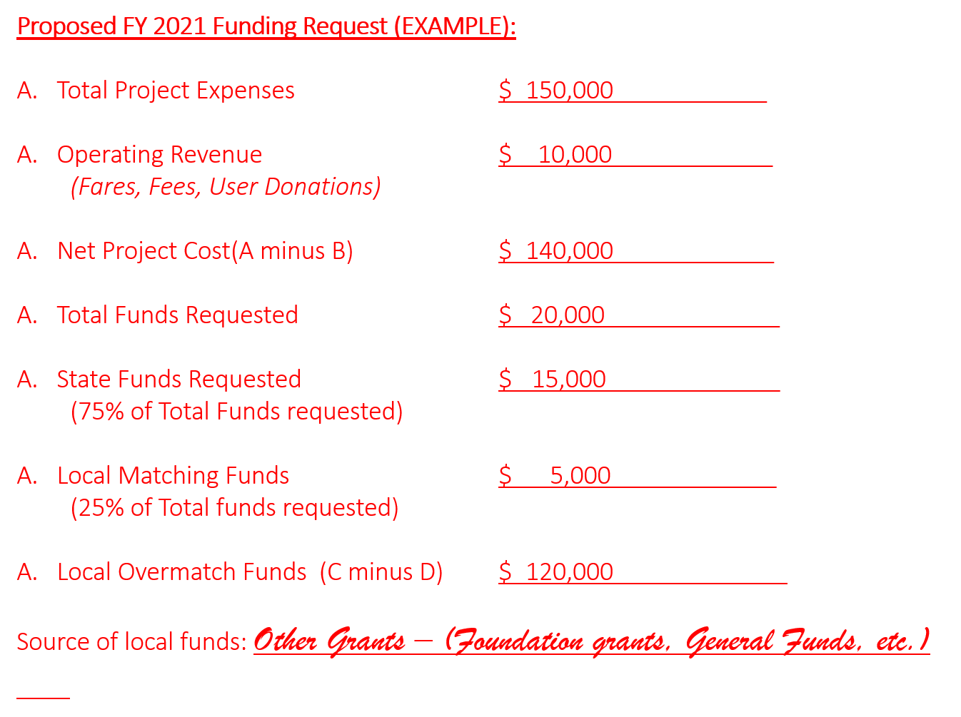
Please note: using the example from the FY2021 grant application as it has not changed.
Notes:
Here is an example from the FY2021 application of the funding request – in this request-
- Your total project expenses is: $150,000
- Your operating Revenue (which can be fares, fees or user donations) equals $10,000
- You then you take A and subtract B to get the Net Project Cost
- Then you figure out total funds you would like to request – the example show $20,000
- Then you take 75% of that total to get the total State Funds to request
- The remaining 25% will be the local share you will be subject to
Finally, you take the total Net Project Cost and subtract the total funds requested and you will get the Local Overmatch Funds.
A helpful hint: You may take a look at the local matching funds (cash) that you can afford and them work from there.
Remember, the source of all local funds can be from other grant sources, general funds, etc.
Of course, I will be happy to assist if needed.

Slide 21
Describe your relevant organizational experience, including:
Providing door-to-door transportation
Working with senior and individuals with a disability
Working with volunteers
Describe planning and implementation efforts for this project to date. If this project is currently funded by the SRP, describe your accomplishments and/or barriers from previous year’s funding that was received:
c..
Indicate how funds
awarded through this program would be used (for
example, to operate new or expanded services, etc.)
d.
Describe operating policies and characteristi
cs of the proposed
project,
including:
Target population
of low
-
income to moderate
-
Ÿ
income seniors
(explain how y
ou
reached this number; what is the percentage of the population you will serve)
Ÿ
Geographic area of service
(map of service area is encouraged as well)
Ÿ
User eligibility screening guidelines
Ÿ
Scheduling and dispatching methodology
Ÿ
Service delivery
methodology
Ÿ
User fee structure (if any)
Ÿ
Data collection/recordkeeping
Notes:
Lets take a look at the proposed program narrative:

Slide 22
e.
Describe the organizational staffing and management for the proposed
project,
including:
Lead agency
How this project fits into larger agency
Partnering agencies
Contractors
Project M
anager
Administrative and other staff
Volunteer and/or paid driver
Driver qualifications
Driver reimbursement
f.
What is the current (if any) and projected ridership to be provided to the target
population by the
project?
Current (per month)
Projected for
2021
(pe
r
month goal by the end of FY
2021
)
What is the basis for the projection?
g..
What marketing and outreach methods and strategies will be used to build
and promote the proposed project?
(
Provide samples of marketing/outreach
materials.
)
R
ecruiting drivers/vo
lunteers
M
arketing/outreach for riders
Notes:
Lets take a look at the proposed program narrative:

Slide 23
h.
Provide a brief implementation plan for the project, including major tasks and
milestones with target dates for achievement.
i.
How will the project be sustained
should funding be reduced and/or
beyond
the time when
grants may not be available?
Provide a plan should funding be reduced and/or withdrawn.
Indicate
possible
future funding sources
.
How will you monitor and evaluate the program?
j
.
How will the project be coordinated with other organizations and services in
your community? Among passengers?
How will dispatching be coordinated?
How will the service be coordinated between public and private sector
transportation providers?
Will passenger trips be shared with others? How will this be arranged?
h.
Describe how
your organization will manage risk and provide for safe delivery
of services, including
:
Driver training and safety
Vehicles used (including organizational fleet, if any)
Vehicle safety
Liability coverage
Notes:
Lets take a look at the proposed program narrative:

Slide 24
Budget Components
MAINTENANCE EXPENSES
Mechanic Salaries
Fringe Benefits
Maintenance Contracts
Materials and Supplies (parts)
Maintenance Facility Rental
Equipment Rental
Utilities
Vehicle Storage
Maintenance Training
Other
Maintenance Subtotal
OPERATING EXPENSES
Dispatcher Salaries
Fringe Benefits
Fuel and Oil
Mileage Reimbursement
Vehicle Insurance
Vehicle Depreciation
Vehicle Lease
Vehicle Storage
Operation Training
Other
Operations Subtotal
Notes:
The following slides shows samples of the components that could make up the budget – your program could use some or all of these items.
Operating Expenses
Maintenance Expenses

Slide 25
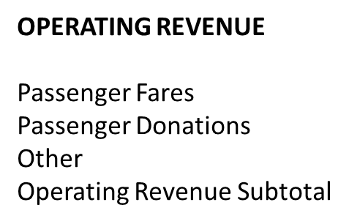
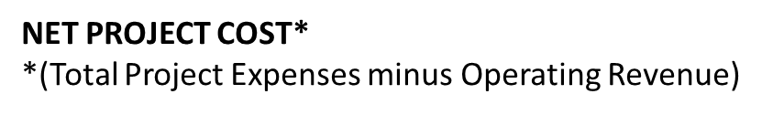
Budget Components
ADMINISTRATIVE EXPENSES
Administrator Salary
Manager Salary
Support Staff Salary
Fringe Benefits
Materials and Supplies
Telephone
Office Rental
Utilities
Advertising
Printing
Administration Training
Other
Administration Subtotal
TOTAL Project Revenue
TOTAL PROJECT EXPENSES
Notes:
Admin expenses
Then total all project expenses
Take a look at your operating revenue – this could be from passenger fares, fees, passenger donations, etc.
Total your project revenue
The Net Project Cost is your total project Expenses minus the total project Revenue
Example: My total project expenses is $150,000. My total project revenue is $10,000. Then my total Net Project Cost is $140,000.

Slide 26
Budget Components
Example
TOTAL Funds Requested
STATE Funds Requested**
**(75% of Total Funds Requested)
LOCAL/LOCAL OVERMATCH FUNDING
Donations
Agency General Funds
Other (specify)
TOTAL Local Funds**
TOTAL Local Overmatch Funds
**(Must be 25% of Total Funds Requested)
Please note: using the example from the FY2021 grant application as it has not changed.
Notes:
This slide talks about the Total Funds Requested and the State Funds Requested – the State Funds Requested is what the recipient will receive from MDOT MTA
Now, knowing the Net Project Costs, we might want to think about what we have in the way of a local cash match for the total Local Funds you have available – remember this must be 25 percent of the total Funds Requested.
Now going back to my example earlier:
So say we have $5,000 dollars that our organization can put up as the 25% cash match.
To find what the 75% for the State Funds requested, we take the 5000 and divide it by point 25 and that will give you $20,000 which will be your total Funds Requested.
Take the Total Funds Requested and multiply it by point 75 to get the State Funds Requested – in this case the State Funds Requested is $15,000.
The Local Overmatch is the total Net Project Cost minus the Total Funds Requested -- in our example, $140,000 Net Project Cost minus the $20,000 would equal $120,000 for the local overmatch funds.
Remember, all local matching funds can be from other grants, general funds, etc.
If you have a question about a match, just give me a call.

Slide 27
Part II
Certifications and Assurances
Program Assurances
II. Equal Rights Assurances
Notes:
This is an important document to be signed by an authorized official and submitted with your application.
The first Part assures that the applicant:
Has the requisite fiscal, managerial, and legal capability to carry out the SRP and to receive and disburse state funds.
Some combination of local or private funding sources has or will be committed to provide the required local share.
The applicant has and will comply with the administrative requirements that relate to the applications made to and grants received from the Maryland Department of Transportation for the SRP.
In the second part the applicant assures that:
No person, on the basis of race, color, national origin, sex or handicap shall be excluded from the participation in, or denied the benefits of, or be subject to discrimination under said project, program, or activity.
The applicant shall not discriminate against any employee or applicant for employment because of race, color, sex, national origin, and shall take affirmative action to ensure that applicants are employed, and that employees are treated during employment, without regard to their race, color, religion, sex or national origin.

Slide 28
Operations Reporting Form
For agencies awarded a Maryland Senior Rides Program grant must complete a Report Form for each quarter and a Final Report at the conclusion of the program year.
We will us the data collected to make a report to the Governor each September.
All reports and requests for payment are to be uploaded to ProjectWise
Notes:
A reporting form will be provided with your grant agreement, plus the program manager will send an electronic version.
We ask things like:
Quarterly and Annually:
Total number of seniors transported
Total number of drivers – volunteer, paid and the total together
Total number of one-way rides during period
Total number of senior-ride miles during period
Total number of senior-ride hours
If seniors are charged a fee
Annually:
What cooperative efforts done during period
What was the agency’s approach to risk management
ALL Reports and Requests for Payment are to be submitted via ProjectWise – if you receive a grant and are not on ProjectWise, you will need to work with me to install ProjectWise.

Slide 29
Questions?
Grant application can be found on the
Transportation of Maryland Website:
https://www.taminc.org/office-of-local-transit-support
Cydney Dickens
cdickens@mdot.maryland.gov
410-767-8356
Applications Due
April 22, 2024 at 4pm
https://mtaolts.ecopwise.com
Notes:
That just about wraps it up –
Any questions?
I am available to answer any questions as you prepare your application.
Thank you again for your time and best wishes for a successful application.

