Slide 1
Finding Alternative Funding for Transit Supportive Infrastructure Or...
How to Use Other People's Money to Get What Your Riders Need

Slide 2
Who We Are…
Notes:
Paul

Slide 3
What We Do…

Slide 4
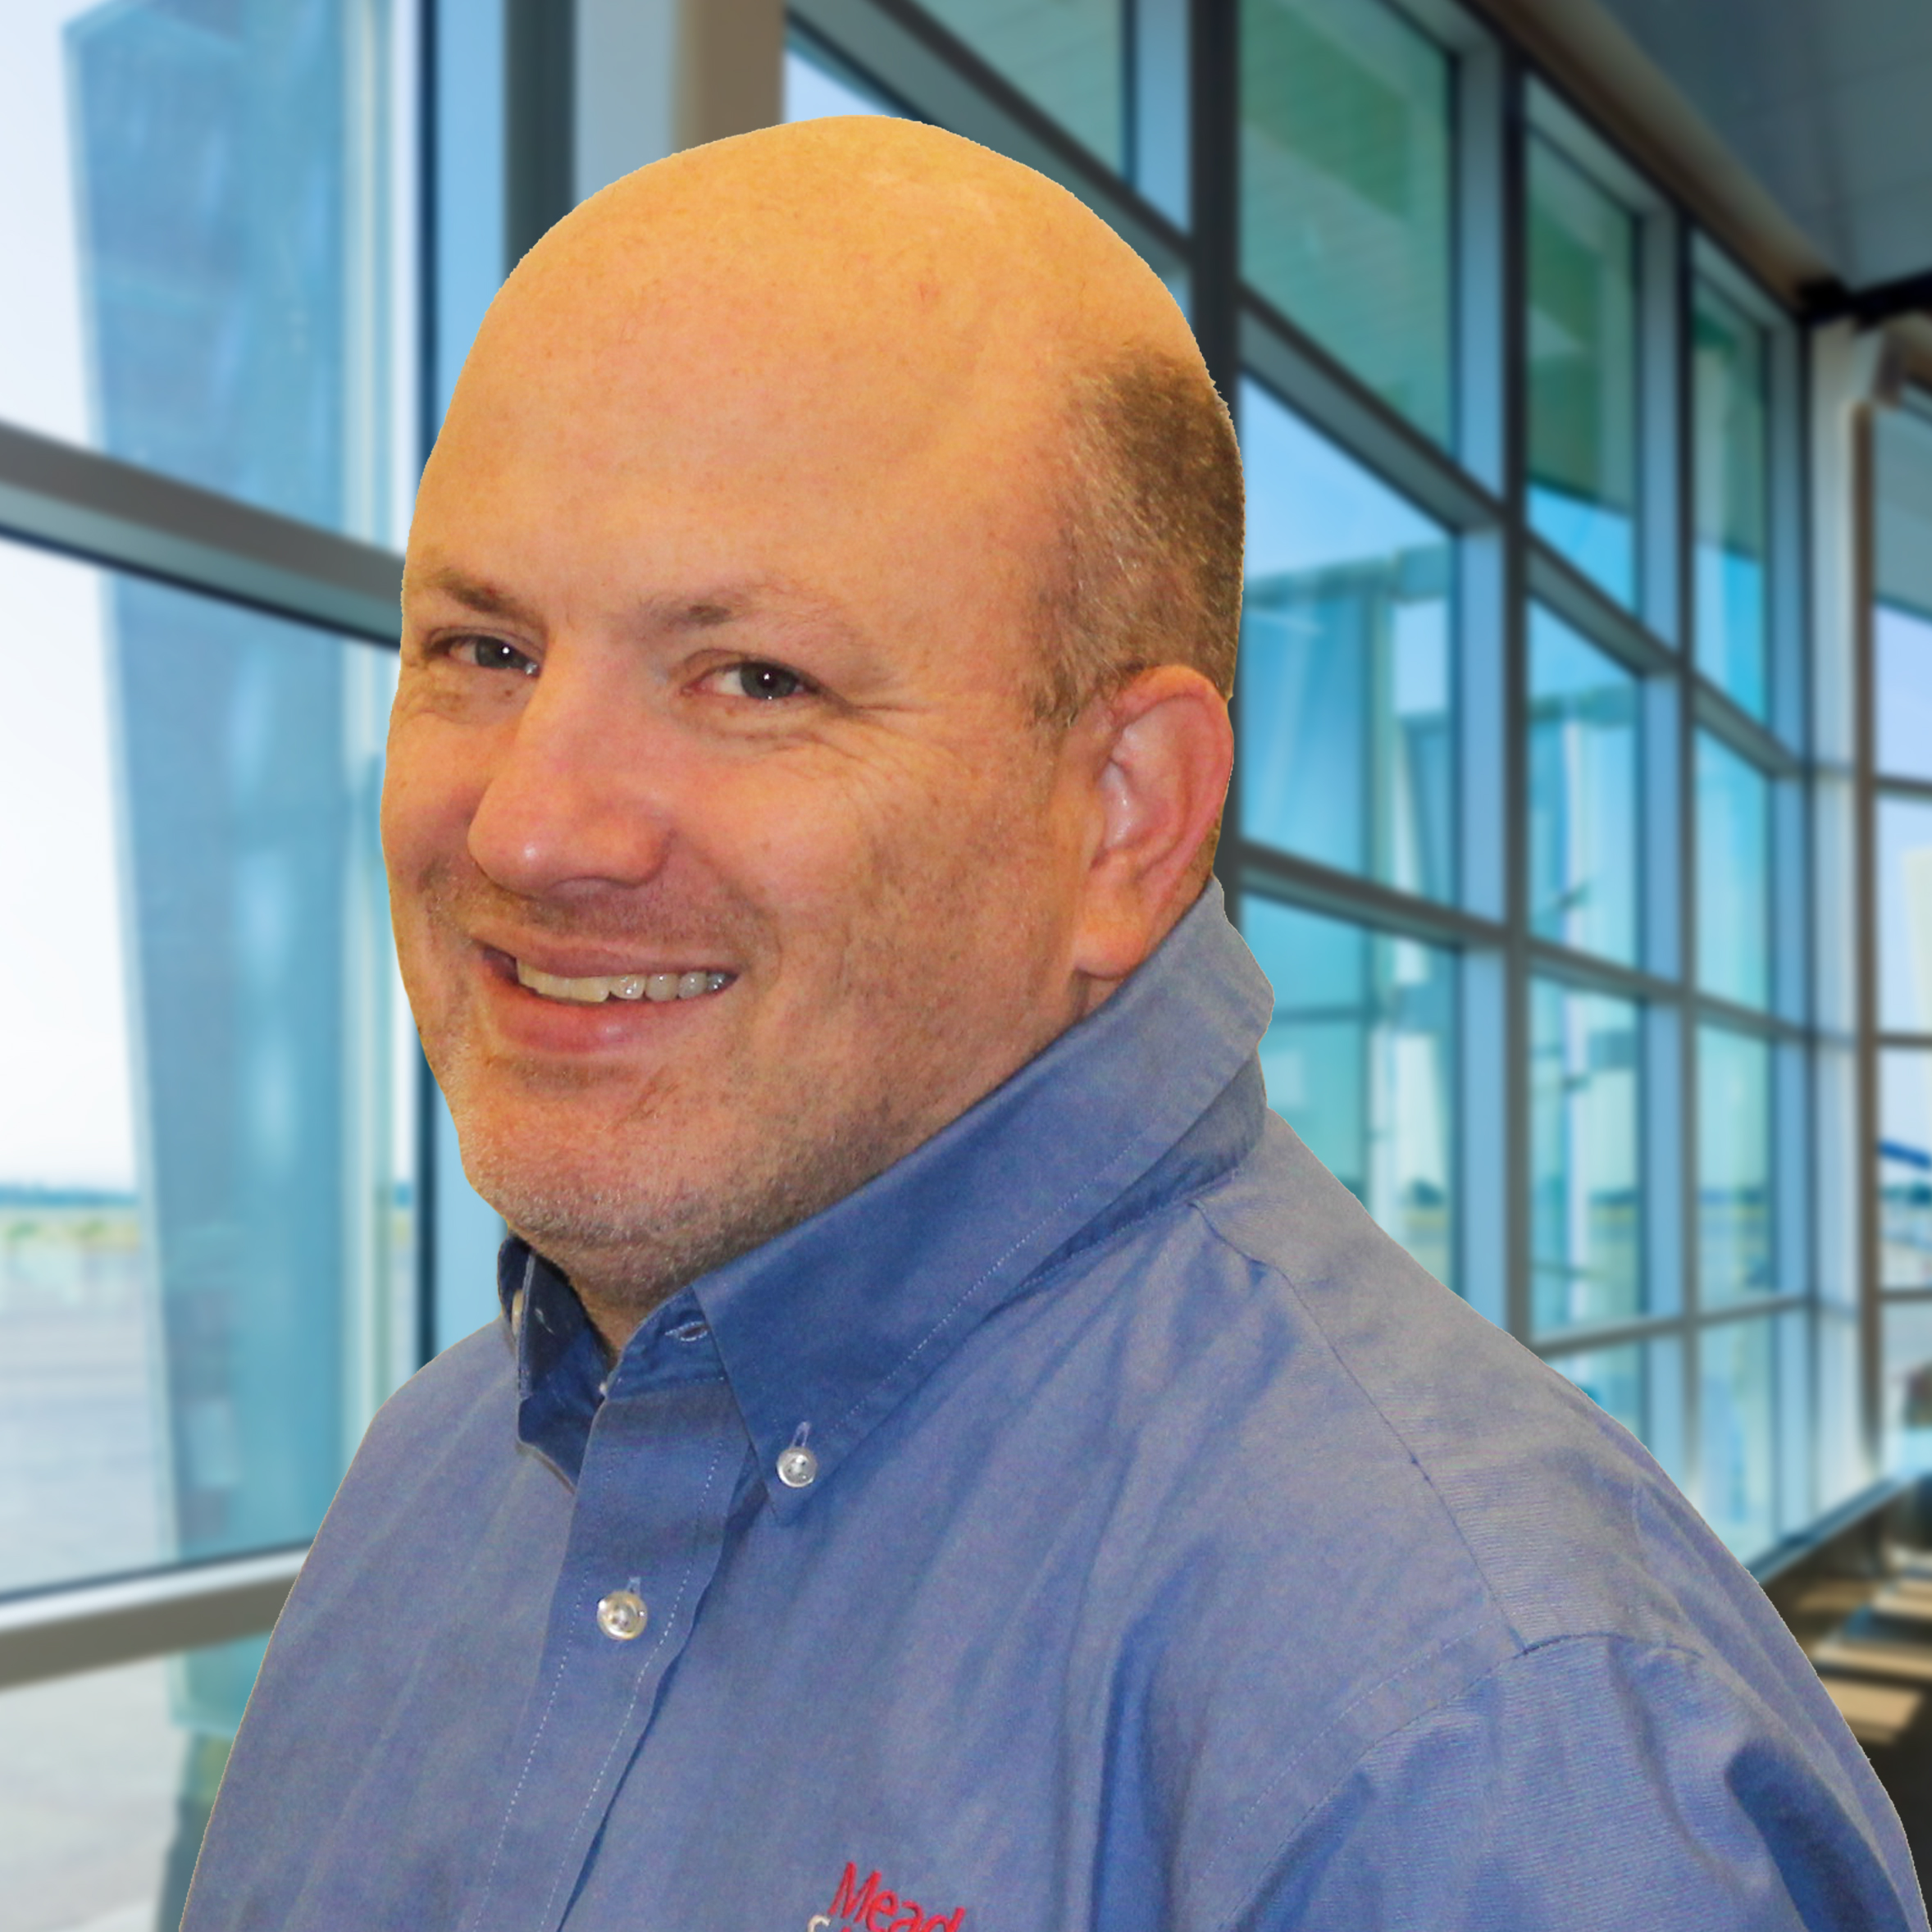
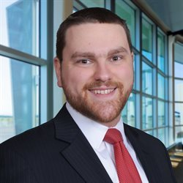
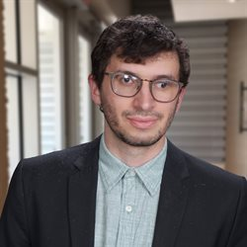
Program Team
Jamie Kendrick, AICP
Works with municipal, suburban, and rural communities on community planning & transportation projects
Former Deputy Director, Baltimore City DOT
Former Deputy Executive Director, MTA Red/Purple Line Light Rail Projects
Allysha Lorber, AICP, ASLA
Works on resiliency, sustainability, and bicycle and pedestrian projects in Maryland, DC, and Northern Virginia.
Former Chief, Capital Planning, Baltimore City DOT
Albert Guiney Engel, AICP
On-site support for MTA projects
Supporting transit procurement project in Durham, NC
Former Planner, Howard County Office of Transportation
Scott Fox, AICP
On-site support for Anne Arundel County Office of Transportation projects
Supporting transit operations analysis in Denver, CO
Former Planner, Memphis Area Transit Authority

Slide 5
What do your riders need?

Slide 6
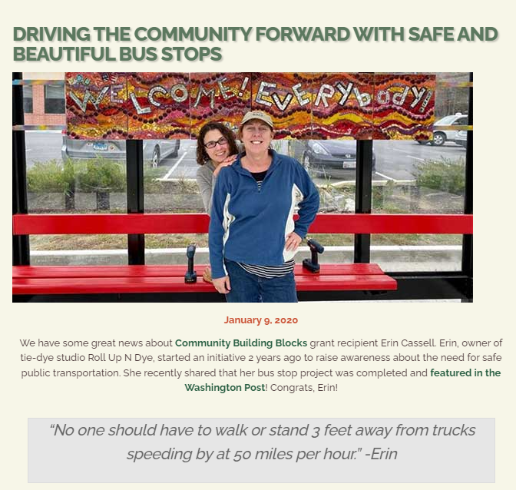
Infrastructure, Not Amenities
Safe Route to Transit
Sidewalks
Bike Paths
Protected Crosswalks
ADA Ramps
Good Place to Wait
Shelter
Bench
Lighting
Timely, Relevant Information
Maps & Schedules
Real-time signs or apps
Notes:
Every transit rider is a pedestrian at some point in their journey

Slide 7
Non-Transportation Funding Sources

Slide 8
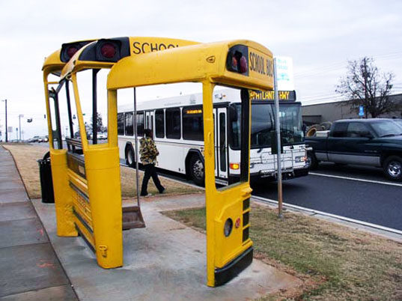
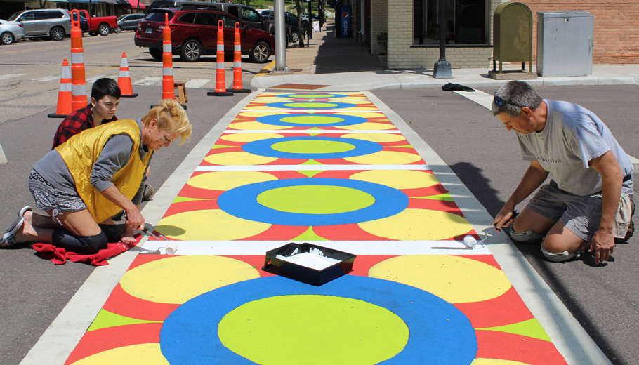
Arts-Related Grants
Public Art Across Maryland New Artworks Grant | MSAC
Great for…
Shelters, crosswalks
Building transit awareness
Making transit fun
Other partners to do the work
How much?
Planning grants up to $10,0000
Implementation grants up to $50,000
No matching funds required
Who can apply?
Units of government
Non-profits
Colleges & universities
Independent artists
Who are the partners?
Typically, the County Arts Councils have a leading role in decision-making process
When to apply…
Next round of applications due April 14, 2023.

Slide 9
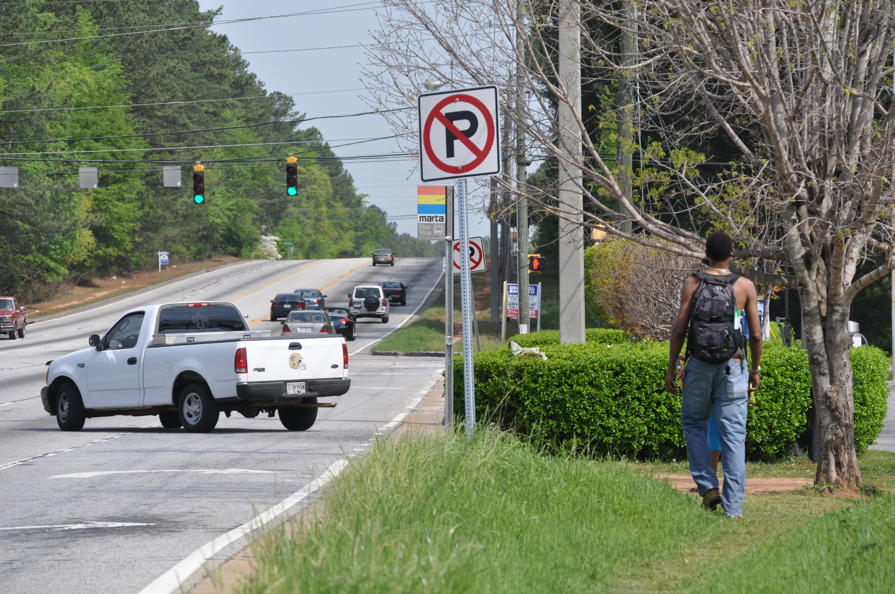
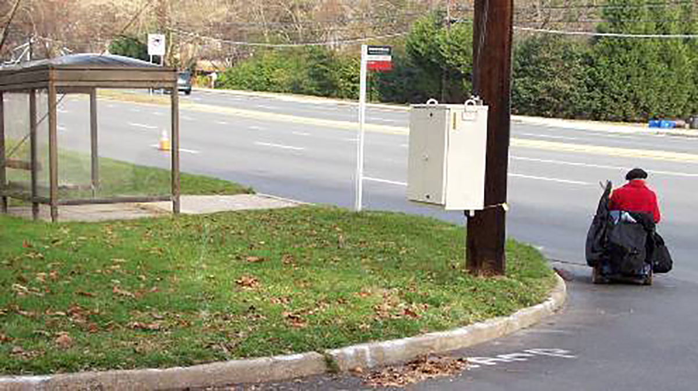
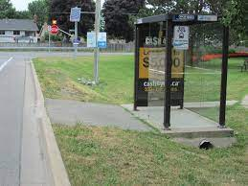
Community Development Related Grants
Community Development Block Grant Program (maryland.gov)
Great for…
Projects in low- and moderate-income communities
Sidewalks, ADA, and bus stop improvements.
How much?
Infrastructure grants from competitive program tend range from $200,000 to $1 million per project.
Larger jurisdictions receive formula funds
Who can apply?
Counties with a population of less than 200,000
Non-entitlement cities and towns of less than 50,000 population
Who are the partners?
Local housing or community services departments.
When to apply…
Statewide competitive grants typically due in mid-June.
Formula funds follow county’s annual budget process
Notes:
Town of Emmittsburg ($685,900)
Frederick County ($400,000)

Slide 10
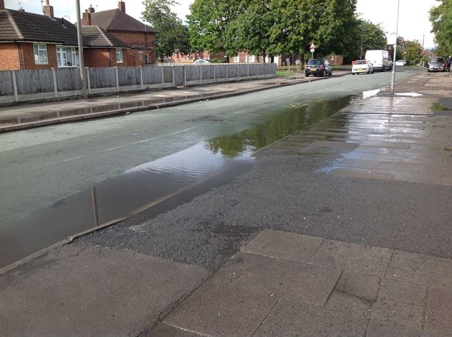
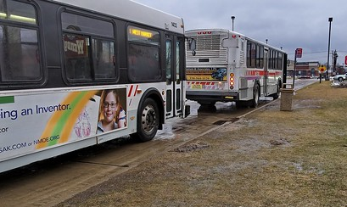
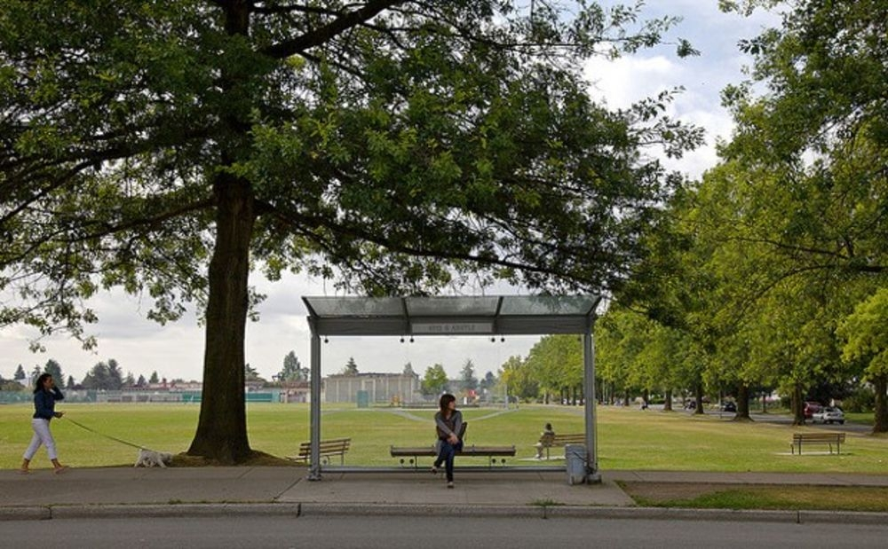
Environmental Grants
Green Streets, Green Jobs, Green Towns (G3) Grant Program
Great for…
Increasing green space near bus stops
Integration of green techniques into traditional gray infrastructure projects.
How much?
Planning grants up to $15,000
Implementation projects up to $150,000.
Who can apply?
All communities in in Chesapeake Bay
Program is open to local governments, non-profit organizations, neighborhood/community associations, and others.
Who are the partners?
Public works departments; planning, sustainability, and resiliency agencies; community-based organizations
When to apply…
Next round is due March 8, 2023
Notes:
Town of Emmittsburg ($685,900)
Frederick County ($400,000)

Slide 11
State/Regional Transportation Funding (Non-Transit)

Slide 12
Core Funding Programs
Highway User Revenues
Transfers gas tax back to local governments for road maintenance and construction.
Most counties will see a ~22% increase in HUR in FY 2024.
Counties can use funds for transit infrastructure (sidewalks, bus stops, ADA ramps)
Follows annual county budget process (operating or CIP)
SHA Capital Budget
SHA resources allocated statewide (major projects) and at District level (minor projects)
District-level projects tend to be safety, resurfacing, restriping, ADA retrofit, drainage, etc.
Annual local priority letter is the primary point of entry for projects small and large; Process tends to be managed by DPWs
Sidewalk Reconstruction program (Fund 33) is ADA oriented; and New Sidewalk (Fund 79) program focuses on sustainable communities and “urbanized” areas.
How to Win for Your Riders
Get to know your SHA District Engineer
Learn to speak their language; link to safety.
Participate in quarterly status meetings between SHA District staff and County DPW staff
Make sure that transit infrastructure needs are included in project decisions

Slide 13
Grant Programs – SHA
Transportation Alternatives Program
County and municipal governments, including locally-operated transit systems
$25 - $35 million annually statewide
Federally-funded program administered by SHA working with MPOs
Grants typically range from $100,000 to $2.5 million; 20% minimum cash match
Construction, planning, and design of infrastructure-related projects and systems that will provide safe routes for non-drivers, including children, older adults, and individuals with disabilities to access daily needs
Grants typically due in early May; letters of intent requested in March/April
Recent Awards of Interest
New sidewalk along Hammonds Ferry Road (Anne Arundel County; $450,000)
Intersection safety improvements for pedestrians in downtown Hagerstown ($550,000)
1.3 miles of new sidewalk in Boonsboro ($1.2 million)
MD 261 sidewalks in Chesapeake Beach ($160,000)
Laurel MARC Station platform and pedestrian safety improvements (MTA, $960,000)

Slide 14
Grant Programs – MDOT
Kim Lamphier Bikeways Network
Program supports projects that maximize bicycle access, fill missing links in the state’s bicycle network, and enhance last-mile connections to work, school, shopping and transit. County and municipal governments, including locally-operated transit systems
$7 - $10 million annually statewide
Non-federal funds administered by MDOT HQ
Grants typically range from $75,000 - $500,000; 20% minimum cash match
Grants typically due in late May; letters of intent requested in March/April
Recent Awards of Interest
Final design of shared use path (Town of Galena, $160,000)
Design shared-use path along Smallwood Drive between Middletown Road and St. Charles Parkway (Charles County, $160,000)
Feasibility study for shared-use path along Cherry Lane (City of Laurel, $32,000)

Slide 15
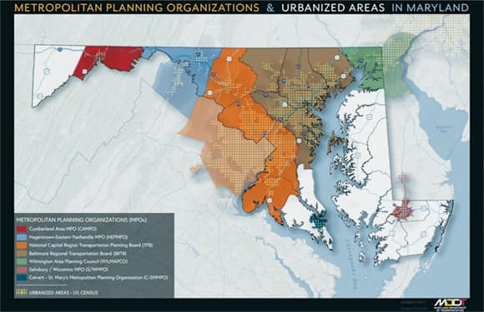
Metropolitan Planning Organizations
Unified Planning Work Program
(Focus Area/Subarea Projects)
Baltimore Regional Transportation Board
LOTS Skills Training and Support $150,000
Transportation/Land Use Connections (TLC) $300,000
Micro-transit Solutions Planning $220,000
National Capital Transportation Planning Board*
Transportation/Land Use Connections (TLC) $650,000
Transit Within Reach Program $250,000
Regional Roadway Safety Program $250,000
Smaller MPOs
Calvert-St. Mary’s MPO
Hagerstown-Eastern Panhandle MPO
Wilmington Area Planning Council (Cecil County)
Salisbury-Wicomico MPO
Cumberland Area MPO
TLC provides short-term technical assistance to local governments in to help them implement changes to the built environment that reduce traffic on roads and enable more people to easily walk, bike, and use transit.
*applications due March 3rd
Notes:
BMC did the regional transit stop assessment

Slide 16
Federal Competitive Grants

Slide 17
Common Issues/Objections to Pursuing Federal Grants
The application is way too complicated. It’s hard to decipher a 70-page Notice of Funding Opportunity.
Small chance of winning; not worth the effort.
We don’t have the staff to take on more work – writing the grant or implementing it when we win.
Administering federal funds is painful.
We don’t have the matching funds.
What has been your experience in applying for federal grants?

Slide 18
Safe Streets for All Program
The purpose of SS4A grants is to improve roadway safety by significantly reducing or eliminating roadway fatalities and serious injuries through safety action plan development and implementation focused on all users, including pedestrians, bicyclists, public transportation users, motorists, personal conveyance and micromobility users, and commercial vehicle operators.
The program provides funding to develop the tools to help strengthen a community’s approach to roadway safety and save lives and is designed to meet the needs of diverse communities that differ dramatically in size, location, and experience administering Federal funding.
$1 billion annually; competitive process; State DOT’s are not eligible, but state roads are.
437 planning grants and 37 implementation grants awarded in February 2022; next round begins in April. Two transit agencies were awarded implementation grants outright. Nearly all grants included a pedestrian element.
How to Win for Your Riders
Jurisdiction must have a comprehensive safety action plan to receive implementation funds.
Transit agency should make sure that safe access to transit is a listed strategy in the comprehensive safety action plan.
Drag your planning or public works agency to the table; partner with municipalities.
Safe Streets and Roads for All (SS4A) Grant Program | US Department of Transportation

Slide 19
2023 Safe Streets Program Wins in Maryland
Action Plan Grants
Aberdeen/Havre de Grace/Bel Air Initial Safe Streets Action Plan ($120,000)
Anne Arundel County for prioritization of bus stop improvements for pedestrian safety safety ($105k)
Baltimore City for modeling injury and health ($1 million)
City of Frederick Comprehensive Safety Action Plan ($200,000)
Frederick County “complete and green streets” updates to land development regulations and design manuals develop proactive, comprehensive street lighting policy that balances safety, light pollution, and cost ($750,000)
City of Hagerstown Comprehensive Safety Action Plan ($160,000)
Implementation Grants
Montgomery County Parks Department (M-NCPPC) received $7.5 million for “Safe Routes to Parks.” The grant will fund construction of missing sidewalk links, roadway and trail crossings, “failure to yield” enforcement campaign, etc.
Prince George’s County received $21.3 million for improvements along the High-Injury Network. Project safety countermeasures include installing new sidewalks and pedestrian refuge medians, rectangular rapid-flashing beacons for bus stop crossings, etc.
City of Salisbury received $11.8 million to construct missing sidewalk links along 21 miles of City roads, add high-visibility crosswalks, add beacons, etc.

Slide 20
FTA Competitive Grant Programs
How to Win for Your Riders
Plan ahead and know your project before funding is announced.
Show partnerships; work across county lines.
Keep MTA and FTA Regional Office in the loop
“Low/No” Bus Grants can be used for bus purchases planning, design or construction of facilities for zero emission vehicles. ZEV transition plans now required to receive funds for bus purchases. ($1.2 billion available; due April 13)
Bus and Bus Facilities Grants support state and local efforts to buy or modernize buses, improve bus facilities (including passenger facilities), and support workforce development. ($470 million available; due April 13)
Area of Persistent Poverty Program grants can be used for planning studies or financial plans to improve transit services in areas experiencing long-term economic distress. ($20 million nationally each year; applications due March 10.)
Notes:
Hagerstown, Cumberland, Salisbury, Princess Anne, Delmar, North East, Elkton

Slide 21
What’s your project?
Contact:
Jamie Kendrick
410-948-9444 or jamie.kendrick@meadhunt.com

