Slide 1
5310 Program Review
Site Visit
February 23, 2023
Presented by:
Travis Johnston, Director
MDOT MTA OLTS

Slide 2
5310 Compliance Review Site Visit
Entrance Conference
Site Visit
Exit Conference

Slide 3
Entrance Conference:
Per the FTA 5310 grant process, every three to five years MDOT MTA is required to conduct Performance Reviews for sub-recipients
OLTS Staff began the process in 2019
Due to the COVID-19 Pandemic, the process was suspended
OLTS staff is planning to begin the process again with the agencies that were scheduled in 2020
The 5310 Manager will contact you when it is time for your agency’s review

Slide 4
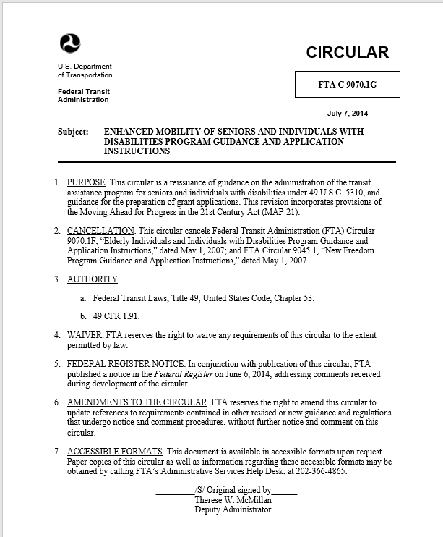
Entrance Conference:
Responsibilities and Obligations
What is 5310 again?
MDOT MTA 5310 Program
The program purpose is to improve mobility for seniors and individuals with disabilities by removing barriers to transportation service and expanding mobility options.
FTA 5310 Circular: FTA C9070.1G

Slide 5
Terminology
FTA: Federal Transit Administration
MDOT: Maryland Department of Transportation
MTA: Maryland Transit Administration
OLTS: Office of Local Transit Support
Section 5310: Enhanced Mobility of Seniors & Individuals with Disabilities
MM: Mobility Management
PM: Preventive Maintenance
Match: Federal and/or Local share required for grant
FY: Fiscal year
RFP: Request for Payment
Notes:
(please note: for FY22/23 NO Local Match is required!)

Slide 6
Site Visit: Items to be Reviewed
We will review the following:
Project Status
Financial Consideration
Grant Compliance Documentation
Reporting Compliance
Procurement
Asset Condition and Use

Slide 7
Site Visit: Project Status
We will review the following:
Objectives/Milestones, Completion Dates
Concerns, Actions for Completion

Slide 8
Site Visit: Financial Consideration
We will review the Following:
Invoicing on time?
Provides required documentation on a consistent basis?
Project on target to spend all funds by end of grant cycle?

Slide 9
Site Visit: Grant Compliance
Documentation
We will review the following:
Recent signed Certifications and Assurances
Written cell phone policy with enforcement
ADA Policy/Plan (notifications, logs, action)
ADA Assurance on file
Written ADA Plan
Plan included policy statement
Plan included definitions
Plan includes location(s), days/hours of operation
Plan includes unrestricting transportation of clients with disabilities
Plan included unrestricting transport of travel aid/service animals
Plan included trip denials/complaint log
Plan included formal complaint process

Slide 10
Site Visit: Grant Compliance Documentation
We will review the following:
If EEO program is required; confirms policy is on file
  EEO policy
  EEO plan
Provide and describes written Title VI Plan
Title VI Plan has current LEP Policy/Plan
Confirm that Title VI information is publicly posted
Describe FTA funded vehicles by size and driver CDL/requirements
Provides CDL/requirements plan if a vehicle over 15-passenger seating
Provides current copy of D&A Drug Free Workplace program/policy
D&A program/policy includes awareness plan
Provides a described written Disposition Policy
Subrecipient provides copy of current insurance certificate
Provide a described driver safety and accident procedures

Slide 11
Site Visit: Reporting Compliance
We will review the following:
Quarterly ridership reports for past 4 quarters
Provides current asset/vehicle list

Slide 12
Site Visit: Procurement
We will review the following:
Provide and describe current purchasing/procurement policy and guidelines
Provide and describe current procurement file(s)

Slide 13
Site Visit: Asset Conditions and Use
We will review the following:
Provide asset list
All MTA/FTA funded vehicles should be on site for inspection day of review
  Subrecipient explains any and all service uses of vehicle(s)
  Subrecipient explains driver vehicle and operation training SOP
  Subrecipient provides copy of driver manual/SOP/forms/training cards/log
  Subrecipient describes pre and post trip inspection process
  Subrecipient provides written SOP
  Subrecipient shows at least one pre/post trip form from each of the past 6 months for each vehicle
  Subrecipient describes how passenger trips are captured on daily log sheets and how information is processes to Quarterly/Annual/internal reports.
  Subrecipient provides written procedures
  Subrecipient provides at least one daily log sheet for each of the past 6 months for each vehicle
Provides and describes written PM plan
Provides and describes PM records for the past 12 months for each vehicle listed on asset inventory

Slide 14
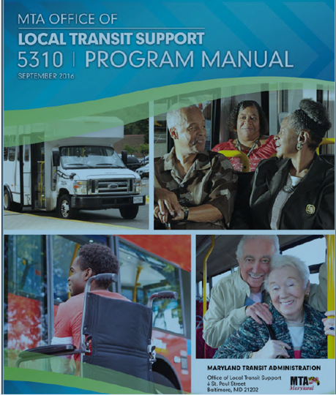
This concludes this Brief Overview of the 5310 Compliance Review Site Vist

Slide 15
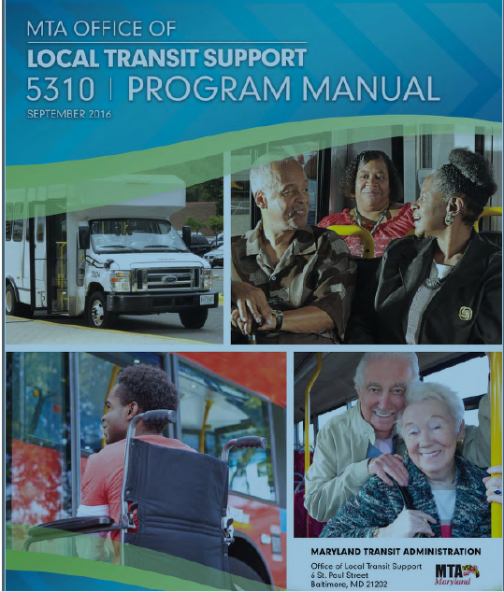
Exit Conference:
Responsibilities and Obligations
5310 Manual
Let’s take a look at the 5310 Manual which is your ‘bible’ for this grant.
It can be found on the TAM website under Resources/Office of Local Transit Support
Recommend downloading PDF to your desktop
Notes:
The fiscal year is the year used for taxing or accounting purposes
How many organizations go by January to December?
MDOT MTA follows the fiscal year of July 1 to June 30 – that is why your grants began with a July 1 date.

Slide 16
General Questions???
? ? ?

Slide 17
Need additional assistance?
Nancy Huggins, 5310 Program Manager, MDOT MTA OLTS nhuggins@mdot.Maryland.gov

