Slide 1
LOTS Comprehensive Review
Site Visit
February 23, 2023
Presented by:
Tanya Nichols, Deputy Director
MDOT MTA OLTS

Slide 2
Lots Compliance Review Site Visit
Entrance Conference
Site Visit
Exit Conference

Slide 3
Entrance Conference:
Per the FTA grant process, every three to five years MDOT MTA is required to conduct Comprehensive Reviews for sub-recipients
Due to the COVID-19 Pandemic, the process was suspended
OLTS staff has begun the process again with the agencies that were scheduled in 2022 and in 2023
The OLTS team will contact you when it is time for your agency’s review

Slide 4
Terminology
FTA: Federal Transit Administration
MDOT: Maryland Department of Transportation
MTA: Maryland Transit Administration
OLTS: Office of Local Transit Support
Section 5307: Large Urban/Small Urban Funds
Section 5311: Rural Formula Funds
Section 5339: Bus and Bus Facilities
MM: Mobility Management
PM: Preventive Maintenance
Match: Federal and/or Local share required for grant
FY: Fiscal year
RFP: Request for Payment
Notes:
(please note: for FY22/23 NO Local Match is required!)

Slide 5
Site Visit: Items to be Reviewed
We will review the following:
Legal Authority and Annual Certifications
Grant Administration and Project Management
Financial Management
Procurement
Planning and Public Participation
Service Requirements/Restrictions
Asset Management, Safety, And Security
Personal Issues – Human Resources

Slide 6
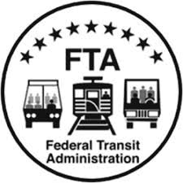
Legal Authority and Annual Certifications
The Locally Operated Transit Systems (LOTS) must certify that they comply with a number of requirements in order to receive federal funds. The certifications that you should have available for inspection during the site visit.
Pending legislation or litigations.
Lobbying.
Section 5333 (b) Warranty.
Federal Certifications and Assurances

Slide 7
Grant Administration and Project Management
Grantees must be able to grant activities and FTA/MTA-funded projects in accordance with the grant application, grant agreement, and all applicable laws and regulations using sound management practices. All grantees are required to report operating and financial data to MTA when they request payment. Grantees that use their own workforce on a capitol project, with the force account work costing $1,000,000 or more, must have a force account plan justification (excluding preventive maintenance)
Governing boarding?
Who is responsible for grant administration?
Describe your grant administration process.
Is your workforce used in the execution of capitol grant projects?
Do you lease any MTA/FTA-funded assets?
Monitoring subrecipients/third-party?

Slide 8
Financial Management
Grantees must demonstrate the ability to 1) match and manage FTA grant funds, 2) cover operating deficits through long-term stable and reliable sources of revenue, 3) maintain and operate federally funded facilities and equipment, and 4) conduct and annual independent organization-wide audit
Sources of local funding
Current financial status of the agency
Do you charge indirect cost
Do you use volunteer services or in-kind contributions
Farebox and other cash handling procedures
Sources of non-fare operating revenue
Who prepares the budget

Slide 9

Procurement
General Procurement Policy
  Procurements outside MTA bus contracts?
  Small, Medium, Large Procurements (Follow specific Requirements in LOTS manual)
  Competitive over 25k
Buy America
Debarment and Suspension
Lobbying
DBE

Slide 10
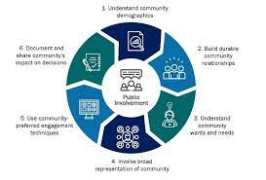
Planning and Public Participation
The grantee must participate in the transportation planning process in compliance with FTA requirements, Metropolitan statewide Planning Final Rule, and Management Systems Interim Final Rule, as revised
Program of Projects
Title VI
Public Comment:
  Fare/Service Changes

Slide 11
Service Requirements/Restrictions
Elderly and Persons with Disabilities/Medicare Half-Fare
ADA – complaint processes, website
Charter Bus Protections
School Bus Protections

Slide 12
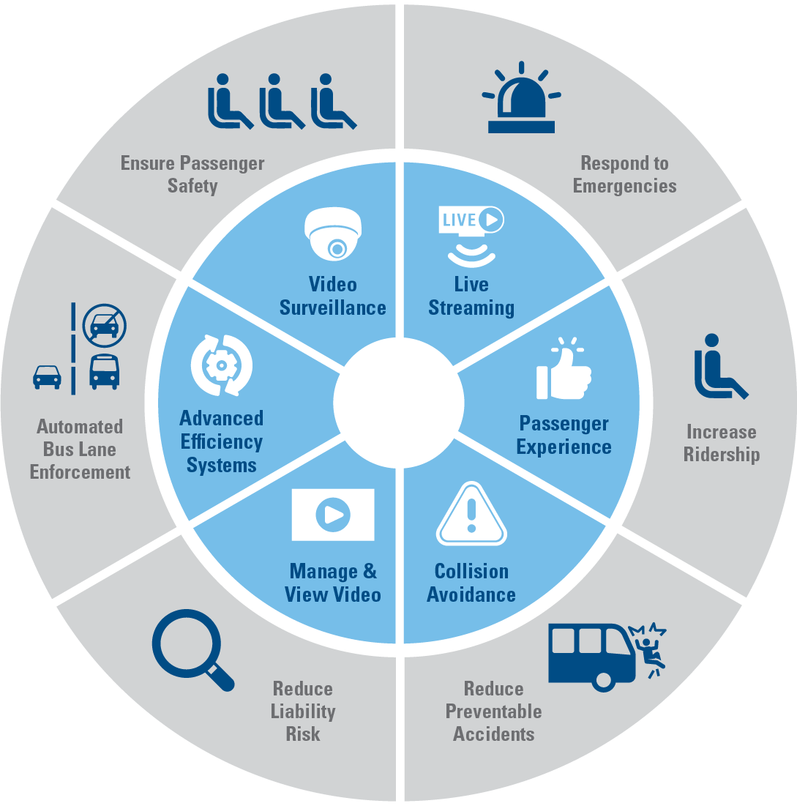
Asset Management, Safety, and Security
The Grantee must maintain control over real property , facilities, and equipment and ensure that they are used in transit service
Grantees must keep federally funded equipment and facilities in good operating order and maintain ADA accessibility features.
Grantees must operate services in safe and secure manor. Under the Safety Authority Provisions of the Federal Transit laws, the Secretary has the authority to investigate operations of the grantee for any conditions that appear to create a serious hazard of death or injury, especially of the transit service
Vehicle and Facility Management (TAMP)
Maintenance Plan
Safety and Security (PTASP)

Slide 13

Personnel Issues – Human Resources
Equal Employment Opportunity (EEO)
Drug-Free Workplace
FTA Drug and Alcohol Testing Program
  50% drug testing/10% Alcohol testing of safety sensitive employees over ALL service hours and days.
  MIS reports submitted.
  DAMIS annual report.

Slide 14
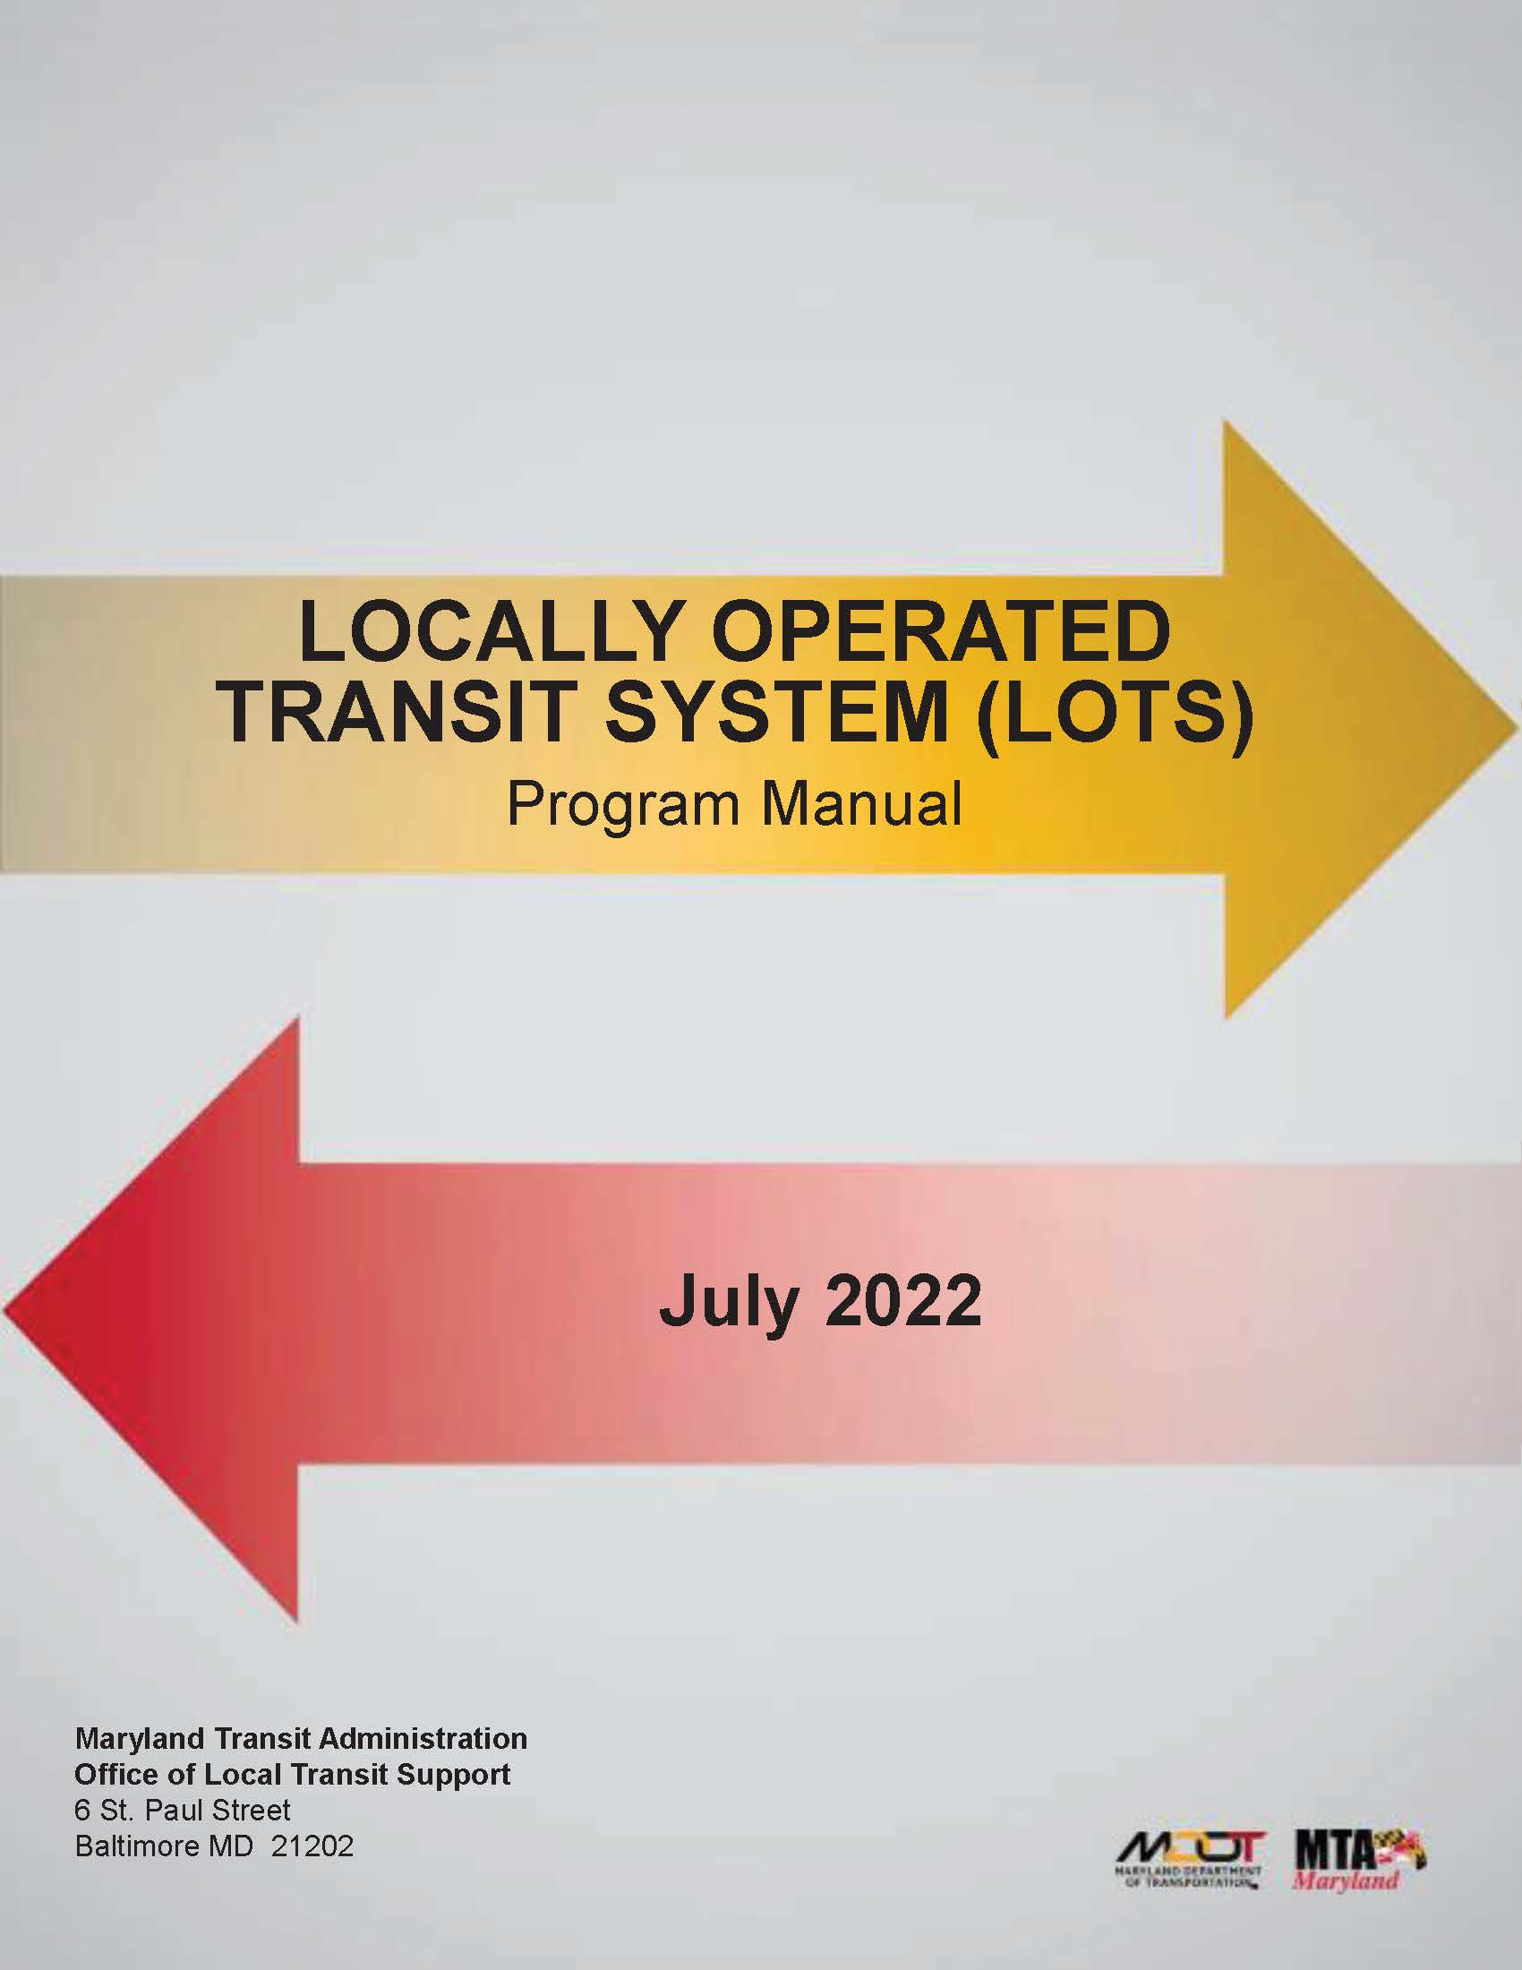
This concludes this Brief Overview of the LOTS Compliance Review Site Visit

Slide 15
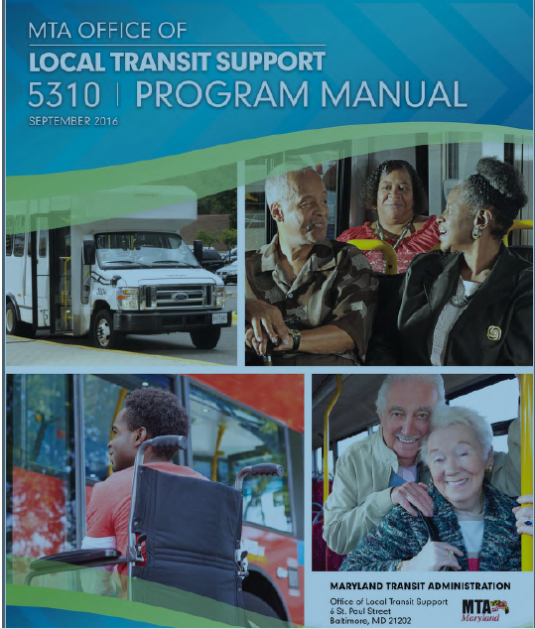
Exit Conference:
Responsibilities and Obligations
LOTS Manual
Let’s take a look at the LOTS Manual which is your ‘bible’ for this grant.
It can be found on the TAM website under Resources/Office of Local Transit Support
Recommend downloading PDF to your desktop
Notes:
The fiscal year is the year used for taxing or accounting purposes
How many organizations go by January to December?
MDOT MTA follows the fiscal year of July 1 to June 30 – that is why your grants began with a July 1 date.

Slide 16
General Questions???
? ? ?

Slide 17
Need additional assistance?
Regional Planner:
Eastern Region:
Jason Kepple: jkepple@mdot.maryland.gov
Western Region:
Kirby Wilhelm: kwilhelm1@mdot.maryland.gov
Southern Region:
Bruce Hojnacki: bhojnacki@mdot.maryland.gov
Northern Region:
Chris Taylor: ctaylor7@mdot.maryland.gov
Central Region:
Luke Benson: lbenson@mdot.maryland.gov

