Slide 1
TAM Winter Series
Comprehensive/Program Reviews
February 23, 2023
Presented by:
Travis Johnston, Director
Tanya Nichols, Deputy Director
MDOT MTA OLTS

Slide 2
Introduction:
Office Of Local Transit Support
Director: Travis Johnston
Deputy Director: Tanya Nichols
Regional Planners:
Jason Kepple - Eastern
Bruce Hojnacki - Southern
Kirby Wilhelm - Western
Luke Benson - Central
Chris Taylor - Northern
5310 Program Manager
Nancy Huggins
Budget, Finance, and Accounting
Jen Vickery
Program Manager (NTD, D&A)
Glenn Hoge
Administrative Coordinator
Bryan Glazer

Slide 3
What is a Comprehensive/Program Review:
LOTS compliance reviews are conducted by the MTA or the MTA’s consultant on all Section 5311/5307/5339 recipients. LOTS reviews ensure that local grantees are following the Federal and State rules and are conducted every three-five years.
Per the FTA 5310 grant process, every three to five years MDOT MTA is required to conduct Performance Reviews for sub-recipients

Slide 4
Terminology
FTA: Federal Transit Administration
MDOT: Maryland Department of Transportation
MTA: Maryland Transit Administration
OLTS: Office of Local Transit Support
Section 5307: Large Urban/Small Urban Funds
Section 5311: Rural Formula Funds
Section 5339: Bus and Bus Facilities
Section 5310: Enhanced Mobility of Seniors & Individuals with Disabilities
MM: Mobility Management
PM: Preventive Maintenance
Match: Federal and/or Local share required for grant
FY: Fiscal year
RFP: Request for Payment
Notes:
(please note: for FY22/23 NO Local Match is required!)

Slide 5
Resources:
Maryland State Management Plans for the Section 5311 and Section 5339 programs - available through MTA as well as through the TAM website - http://taminc.org/Office-of-Local-Transit-Support
The “Super Circular,” 2 CFR Part 200, “Uniform Administrative Requirements, Cost Principles, and Audit Requirements for Federal Awards,”- http://www.ecfr.gov/cgibin/text-idx?tpl=/ecfrbrowse/Title02/2cfr200_main_02.tpl
Uniform System of Accounts - https://www.transit.dot.gov/ntd/uniform-systemaccounts-usoa
FTA Circular C 5010.1D, “Grant Management Requirements,” last updated Aug. 2012 (Note: this circular is currently being updated to incorporate changes established under the “Super Circular”) - https://www.transit.dot.gov/regulations-and-guidance/ftacirculars/grant-management-requirements
Comprehensive Financial Management Guidelines for Rural and Small Urban Public Transportation Providers, prepared for the North Carolina DOT, American Association of State Highway and Transportation Officials (AASHTO) Multi-State Technical Assistance Project (MTAP), and U.S. DOT/FTA (September 1992). Downloadable through the State Library of North Carolina Digital Collections - http://digital.ncdcr.gov/cdm/ref/collection/p16062coll9/id/119548

Slide 6
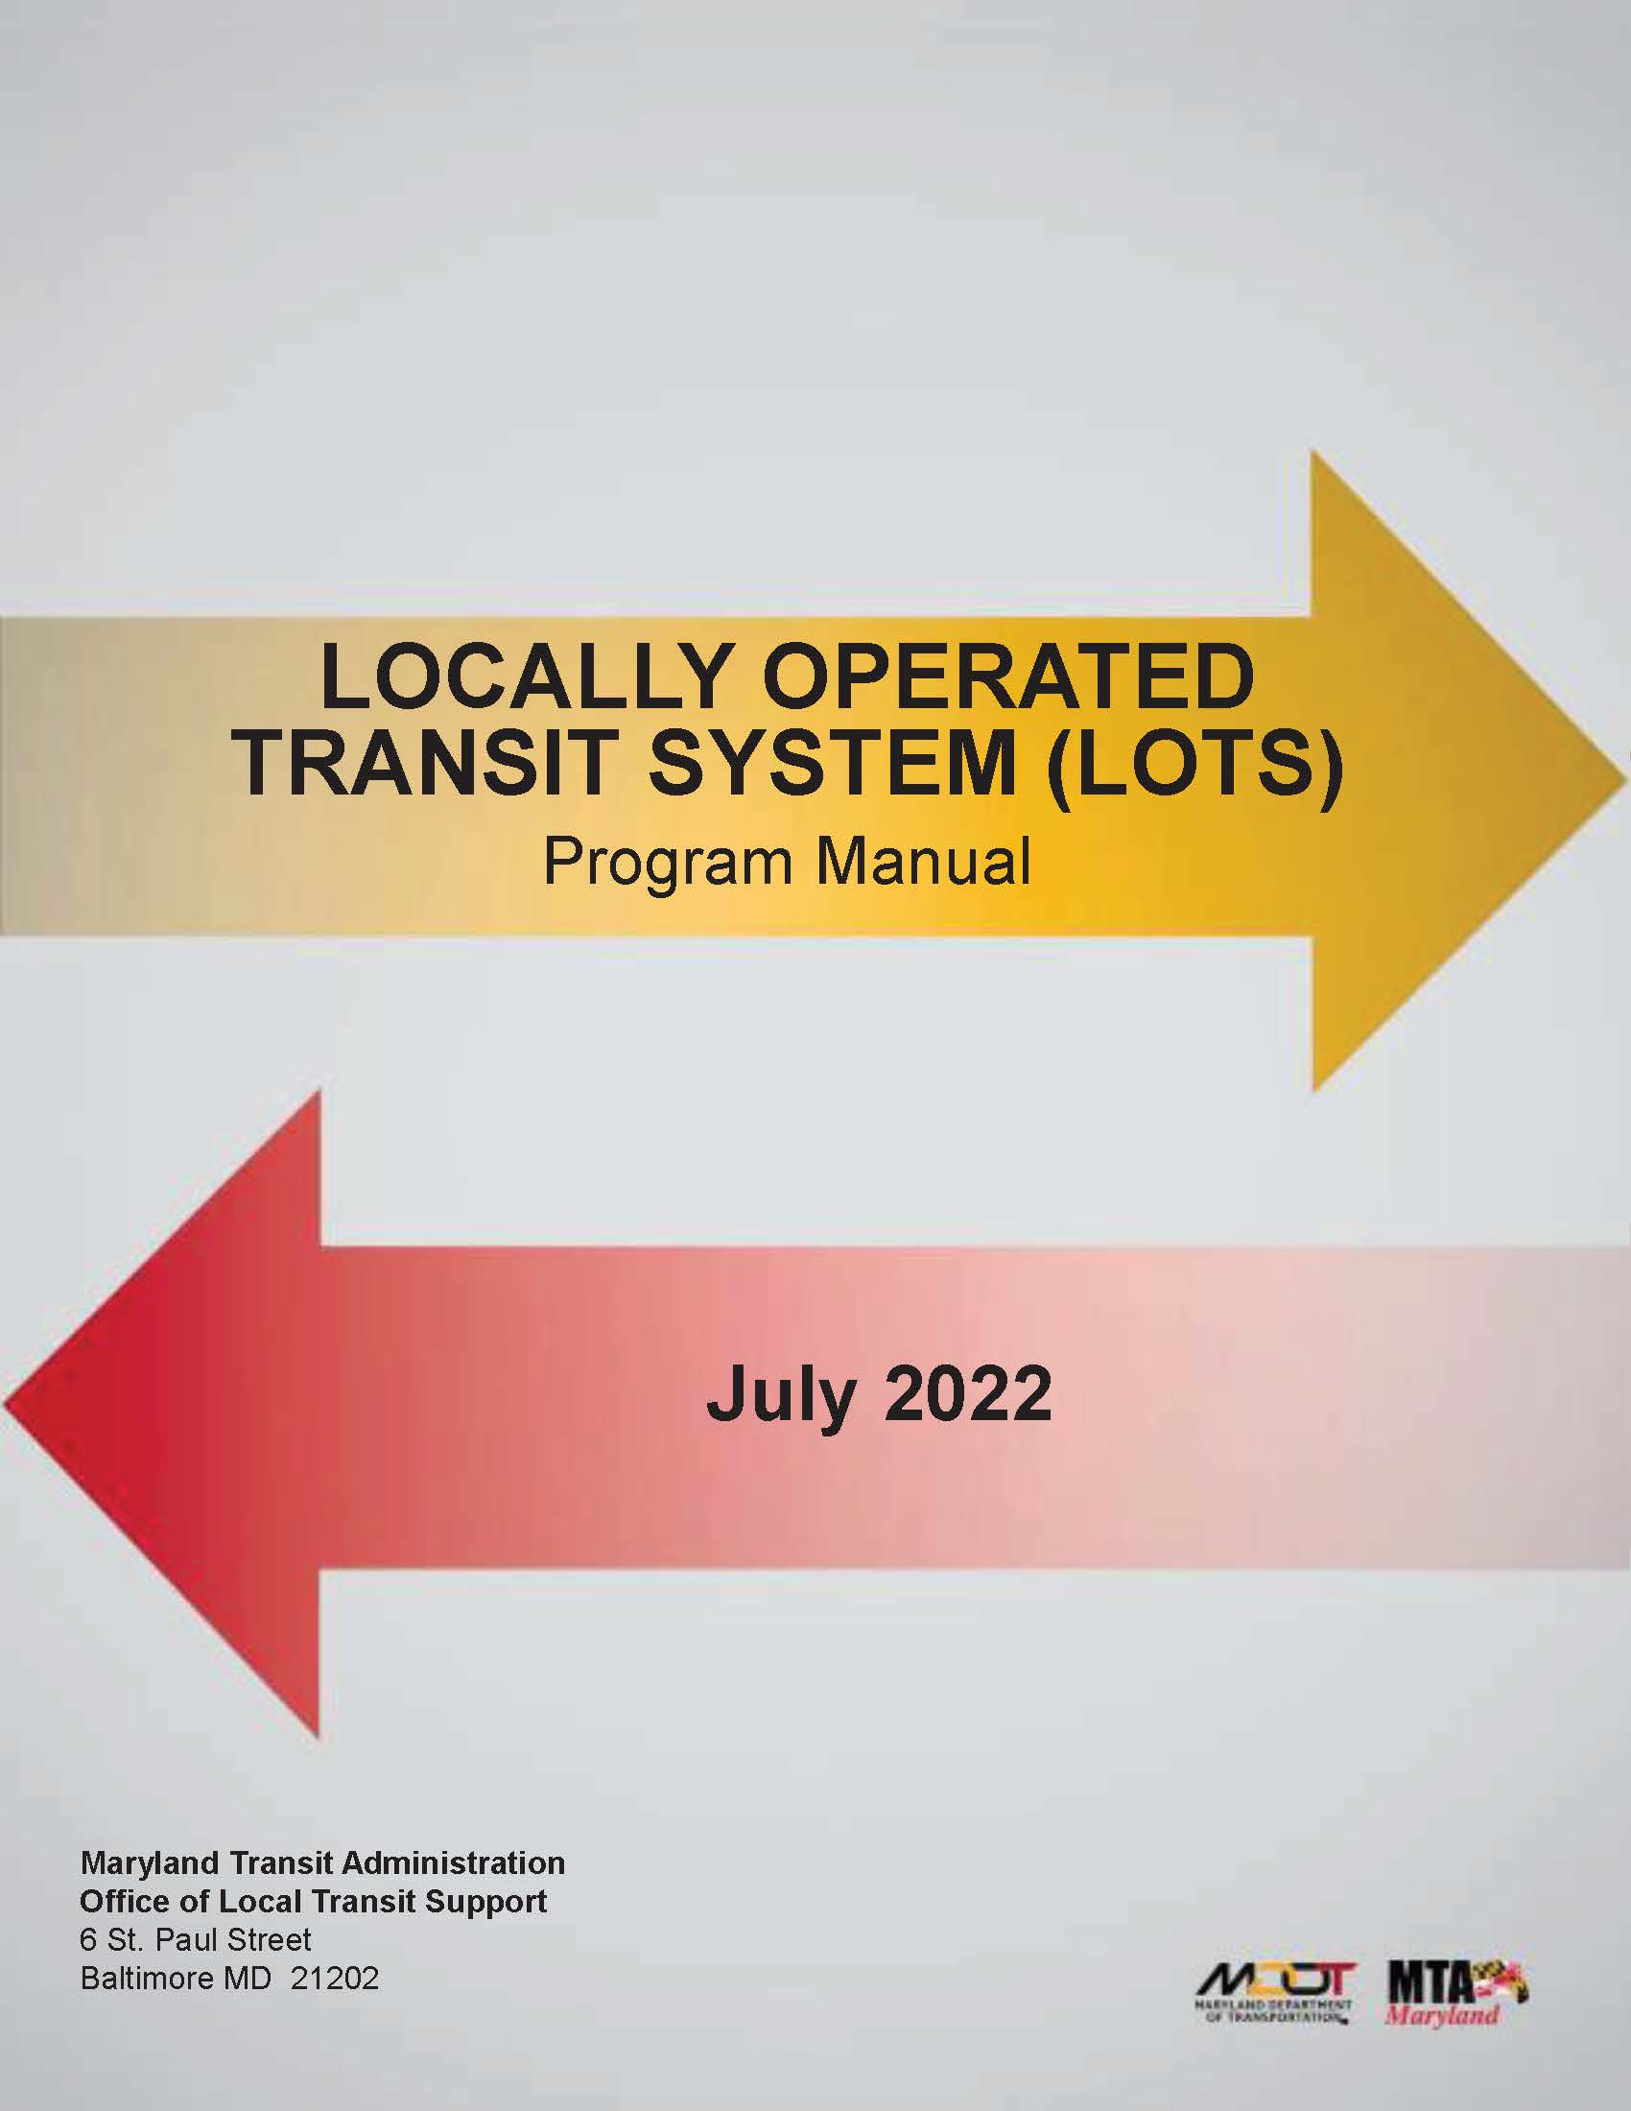
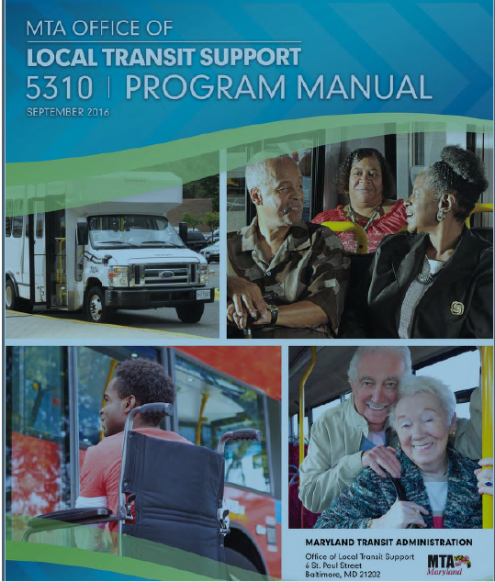
LOTS MANUAL
LOTS Manual
Let’s take a look at the LOTS Manual which is your ‘bible’ for your grant(s).
It can be found on the TAM website under Resources/Office of Local Transit Support
Recommend downloading PDF to your desktop
Notes:
The fiscal year is the year used for taxing or accounting purposes
How many organizations go by January to December?
MDOT MTA follows the fiscal year of July 1 to June 30 – that is why your grants began with a July 1 date.

Slide 7
5310 Manual
5310 Manual
Let’s take a look at the 5310 Manual which is your ‘bible’ for this grant.
It can be found on the TAM website under Resources/Office of Local Transit Support
Recommend downloading PDF to your desktop
Notes:
The fiscal year is the year used for taxing or accounting purposes
How many organizations go by January to December?
MDOT MTA follows the fiscal year of July 1 to June 30 – that is why your grants began with a July 1 date.

Slide 8
General Questions???
? ? ?

Slide 9
Need additional assistance?
Contact Information:
Regional Planner:
Eastern Region:
Jason Kepple: jkepple@mdot.maryland.gov
Western Region:
Kirby Wilhelm: kwilhelm1@mdot.maryland.gov
Southern Region:
Bruce Hojnacki: bhojnacki@mdot.maryland.gov
Northern Region:
Chris Taylor: ctaylor7@mdot.maryland.gov
Central Region:
Luke Benson: lbenson@mdot.maryland.gov
5310 Program Manager
Nancy Huggins: Nhuggins@mdot.maryland.gov

