Slide 1
Customer Service Dealing with Difficult Personalities Working through Conflict

Slide 2
Training Discussion
6 key skills to Customer Service
Explore Difficult Personalities
The communication rule
Working through Conflict

Slide 3
Customer service is dependent on:
1. Customer-friendly policies set by
the organization's executives.
2. Training offered to the staff.
3. Attitude of the staff about their
own organization (created by the
the way the organization treats
them).

Slide 4
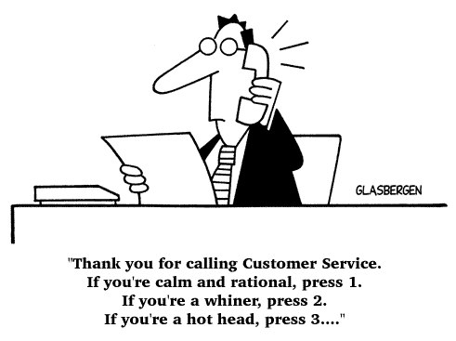
Activity: What is Customer Service and who are your customers?
What is customer service?
Who are your customers?
What services do you provide?
Notes:
Ask tables:
What is customer service – if we have multiple answers – ee’s will have the same
Knowledge about what can and can not be provided (explain Why)
Who are customers - ?
We think of many different things when it comes to customer service – call centers, department stores, Apple, just to name a few. The reality of the situation is that most of us are in fact in the business of customer service, though we may not see it that way. A customer can be anyone – someone you speak to on the phone, someone you interact with face-to-face, a client, a consumer – anyone!
Ask participants if they can take a minute to think of who their customers are and share with the group. Furthermore, ask the group if there is in fact a better term or alternative term to use other than customer service. It may help to take a moment to think about the services that each participant, and their organizations provide.

Slide 5
Customer Service Skill #1: The Ability to Listen
Utilize active listening skills.
Learn and use the customer’s name.
Make meaning out of what you’re hearing.
Limit distractions.
Do not interrupt.
Avoid making assumptions and jumping to conclusions.

Slide 6
Customer Service Skill #2: Assuming Ownership
Accept responsibility and accountability for the issues at hand.
Do not put blame on others.
Offer solutions, not excuses.
Don’t pass off the customer to someone else.
Determine what you can do to help.
Don’t make promises you can’t deliver on.
Notes:
.

Slide 7
Customer Service Skill #3: Understand Your Customers
Ensure that you understand your job and your responsibilities.
Know your products and services.
Recognize the types of customers you could interact with.
Anticipate how you can ensure a positive experience for customers.
Learn what you can do to improve the experience for your customers.

Slide 8
Customer Service Skill #4: Know When to Apologize
Know how to express regret so that when something goes wrong, you can apologize.
The customer may not always be right but should feel that they get what is needed or explained why it can not happen.
Confront problems as soon as they happen.
Make it simple for customers to complain.

Slide 9
Customer Service Skill #5: Use Language That Works
Avoid the use of company or industry jargon.
Explain any terminology that may be unfamiliar.
Use language that is helpful, useful and positive in nature.
NEGATIVE PHRASES
I don’t know.
I can’t do that for you.
You should…
Hold on.
No.
POSITIVE PHRASES
That is a great question. Let me find out for you.
Here is what I can do.
All you need to do is…
Let me find get back to you in X minutes – would that be okay? Are you able to hold?
We have… or I can….
--www.telephonedoctor.com

Slide 10
Customer Service Skill #6: Be Action Oriented
Meet regular goals in a timely fashion.
Manage your time wisely to make decisions that matter.
Work well both individually and as part of a team.
Demonstrate professionalism and courtesy in yourself and your products.
Have confidence in your ability to do your job and serve the customer.

Slide 11
Personalities

Slide 12
Hostile Aggressive Trio
Sherman Tanks
Abusive
Abrupt
Snipers
Covert Assault
Innuendo
Exploders
Adult Tantrums
Attacking

Slide 13
Coping Methods: Hostile Aggressive Trio
Sherman Tanks
Give them a little time
Snipers
Call them out
Exploders
Give them time to run down
Get their attention
State your own thoughts assertively
DO NOT ARGUE
Offer the sniper an alternative to direct interaction
Remove them from the audience
Get their attention by saying or shouting a neutral phrase

Slide 14
“And One More Thing” - Complainers
Passive, helpless
Blaming – fault external
Nothing is ever right
Easier to blame than change
Triangulate

Slide 15
Coping Method: Complainers
Listen attentively to their complaints even if you feel guilty or impatient.
Acknowledge what they're saying by paraphrasing.
Avoid joining them even if, at the moment, you accept their allegations as true.
State and acknowledge facts without comment.
Try to move to a problem-solving.
If all else fails, ask the Complainer: "How do you want this discussion to end?"

Slide 16
Negativist
No People
Reject ideas and new suggestions quickly
Inflexible
Resistant to change

Slide 17
Coping Method: Negativist
Watch for your own “sympathetic depression.”
Make optimistic, but realistic statements.
Stay away from solution steps for as long as possible.
Don’t sugar-coat.
Be prepared to take action on your own.
“Use” their negativism to point out potential problems that may need contingency planning.

Slide 18
Customer Service Reminders
Customer service is not a department.
Make it a constant goal to continuously improve your customer service.
Under promise and over deliver.
Smile – the customer can tell!
Make your customer service experiences memorable.
Know your customers and let your customers know you.
Go the extra mile.
Give customers the benefit of the doubt.
Want to know what your customers think? Ask them!
Be yourself, not a script.
Action afterwards matters.

Slide 19
Communication

Slide 20
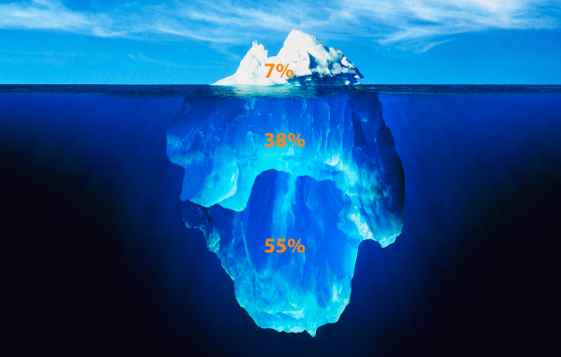
7 - 38 - 55 Rule of Communication
Notes:
7-38-55 rule of negotiation and communication

Slide 21
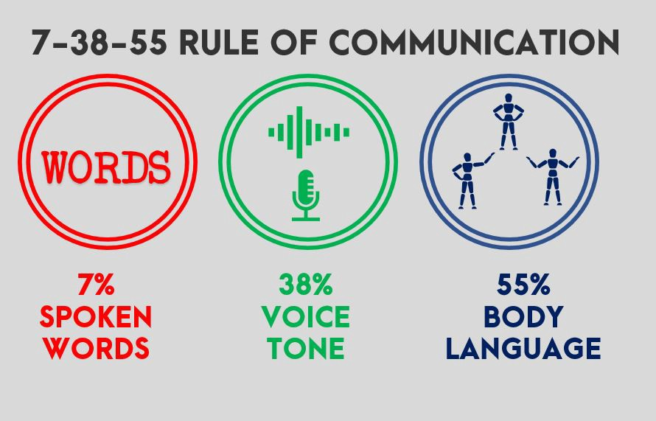
It’s Not Only What You Say, It’s How You Say it
How you frame and deliver your message means more than the words you choose.

Slide 22
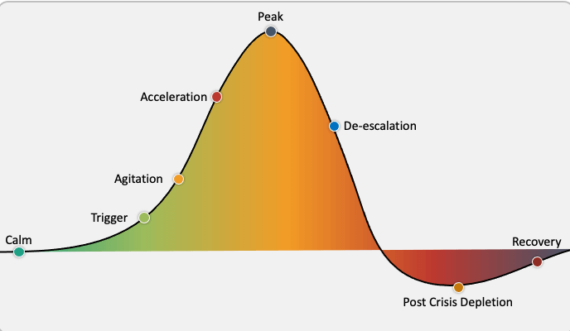
Understanding Key Terms:
Conflict:
A serious disagreement or argument, typically a protracted one.
Escalation:
To increase the intensity or seriousness of something
De-Escalation:
To decrease the size, scope, or intensity. To reduce, lessen in magnitude.
Source: Confident Counselors
Notes:
A phase of physical exhaustion and/or confusion. Not all students go through this phase, especially if the crisis episode was short and low to moderate. Some students return to their specific level of baseline.
It’s important to be able to verbalize definitions clearly and set the understanding of what is happening with an individual or individuals and the overall goal to effectively manage that situation.
“De-escalation provides the best results when implemented EARLY in the escalation phase, ideally, we try to practice prevention and avoid triggers. The higher the intensity, the more challenging to de-escalate.”
https://www.google.com/url?sa=i&url=https%3A%2F%2Fconfidentcounselors.com%2F2018%2F01%2F11%2Fde-escalation-strategies%2F&psig=AOvVaw2uoRz0O0YSWEujDmQYZEc5&ust=1610746871428000&source=images&cd=vfe&ved=0CA0QjhxqFwoTCNj8leuxnO4CFQAAAAAdAAAAABAU

Slide 23
Emotional Charge: Aggression
Why do people escalate?
What’s happening when a person shows signs of escalation?
What are visual signs?
Rapid Breathing
Wide Eyes
Rapidly Shifting Mood
Restlessness
Response to feeling threatened, scared, or hurt
Displaced anger
Anger is a feeling or response to a perceived negative situation
Contributors can be: frustration and fear
Notes:
“Why do people escalate?”
What could be contributing to aggression/anger?
Do you feel yourself ‘escalating a bit or getting anxious’ thinking about situations and answering these questions? One key is to realize how you are impacted by these situations as well.

Slide 24
Reaction:
Louder, defensive
Emotions increase (e.g., yelling, crying, agitation)
Pacing, not settled
Response:
Hi Sam. My name is Kelly and I’m here to help.
Tell me more so I can better understand what we can do to help you right now.
I can’t understand what you need when you are shouting, but I do want to hear you out.
That sounds like…or I imagine that is very difficult…

Slide 25
Understanding De-escalation
Communication Is Key
Stay calm
Listen
Manage your response
Set limits
Handle challenging questions
Prevent a physical confrontation
Communication Barriers
Pre-judging
Not listening
Criticizing
Name calling
Engaging in power struggles
Ordering
Threatening
Minimizing
Arguing
Notes:
Communication is key and de-escalation techniques should be viewed from the individual, team and organizational level. It goes beyond the individual level.
Supporting one another through effective communication practices is critical. Remember effective communication starts with Listening for verbal cues, looking for visual and nonverbal cues, as well as what's in writing (texts, slac, emails).
This applies to both internal and external customers.

Slide 26
De-escalation Techniques
Do:
Ensure safety first: Evaluate exits, potential hazards, points of entry
Avoid the hold button, when possible
Offer options/choices and follow up
Repeat information for clarity and understanding
Show value to the person through listening and empathize
Seek support from others where needed
Don’t:
Engage in a power struggle
Become rigid in your process or protocols
Raise your voice, cuss, intimidate or
give ultimatums
Tell the person you know how they
feel
Make promises you can’t keep
Take the situation personal
Notes:
If you have time, have a different person read each of the D0’s and Don’ts outload.
Interesting note – did their tone or body language change as they read them?
Special note: if you are in person with de-escalation:
Ensure a safe (personal space) distance is maintained
Adopt an open body posture

Slide 27
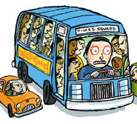
Transportation
Vicarious Trauma: when we experience overwhelming volumes of information—especially information that holds an emotional charge—our bodies, minds, and spirit adapt to help us cope. At times, the way we cope may help in the moment but may have negative long-term results.

Slide 28
Violence Equation
Economic Stress
Mental Illness
Threat Potential
Desire for Revenge
Notes:
Workplace violence can strike anywhere, and no one is immune, despite the list of high-risk professions.
Workplace violence is now recognized as a specific category of violent crime that calls for distinct responses from employers, law enforcement, and the community. This recognition is relatively recent.
Sensational multiple homicides represent a very small number of workplace violence incidents. The majority of incidents that employees/ managers have to deal with on a daily basis are lesser cases of assaults, domestic violence, stalking, threats, harassment (to include sexual harassment), and physical and/or emotional abuse that make no headlines. Many of these incidents, in fact, are not even reported to company officials, let alone to police.

Slide 29
Self Care for Individuals
Daily
Weekly
Monthly
Sleep and rest
Eat well
Get activity
Take breaks (not with technology)
Set boundaries
Connect with friends
Hobbies
Celebrate successes and accomplishments
Take time off
Seek feedback
Prioritize and set goals
Set budget/live within finances

Slide 30
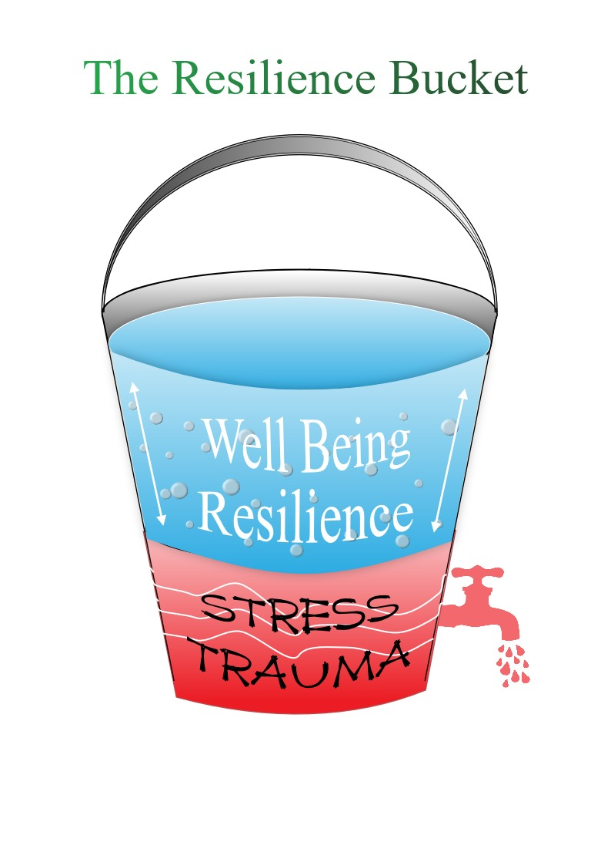
Resilience
re·sil·ience /rəˈzilyəns/
the capacity to recover quickly from difficulties; toughness.

Slide 31
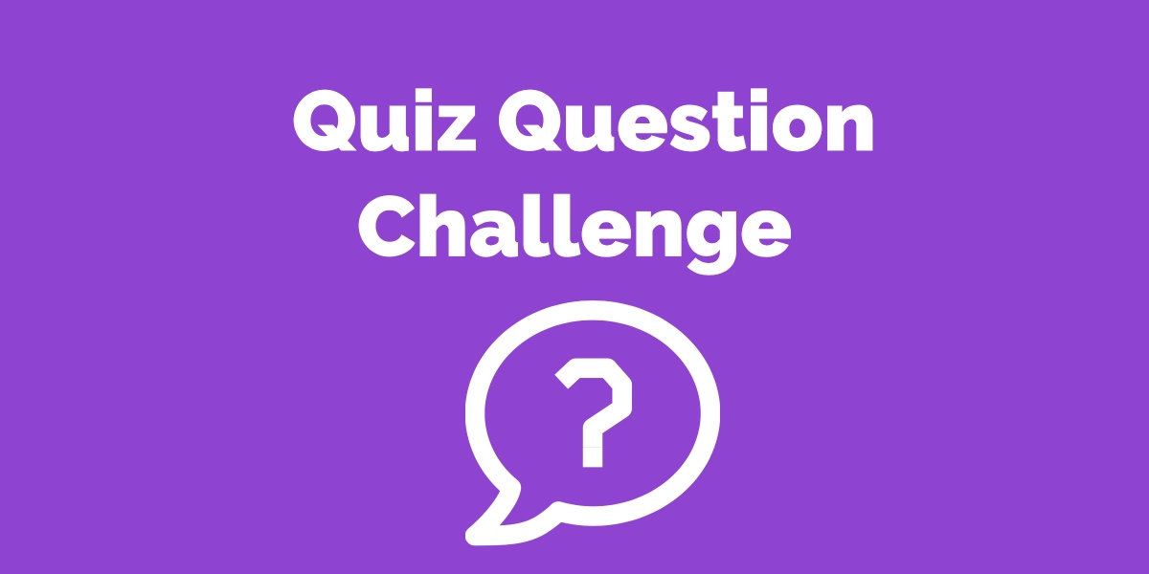
What do we know?
1) Name 2 of the 3 things customer service is dependent on:
Customer-friendly policies set by the organization's executives.
Training offered to the staff.
Attitude of the staff about their own organization
(generated by the way their organization treats them).

Slide 32
Name three of the six Customer Service skills:
The Ability to Listen
Assuming Ownership
Understand your Customers
Know when to Apologize
Use Language that Works
Be Action Oriented

Slide 33
3) Name a difficult personality and method
to handle:
Hostile Aggressive Trio:
Sherman Tank, Sniper, Exploder
2. Complainer
3. Negativist

Slide 34
4) Which gives you more power:
Reacting or Responding?
Responding:

Slide 35
5) What is the 7-38-55 Rule of Communication?

Slide 36
6) Name an item you can do for daily self-care.
Sleep & rest, eat well, activity, take breaks, set boundaries
7) Name an item you can do for weekly self-care.
Connect with friends, hobbies, celebrate successes and
accomplishments
8) Name an item you can do for monthly self-care.
Take time off, seek feedback, prioritize & set goals, and
set budget/live within finances

Slide 37
9) These are the correct components of a violence equation:
True or False?
Economic Stress
Mental Illness
Threat Potential
Owning Gun
Economic Stress
Mental Illness
Threat Potential
Desire for Revenge

Slide 38
10) How does employee resiliency affect your
workplace?
Resiliency is the capacity to recover and bounce
back quickly from life challenges, and difficulties.

